Slide 1
Computational Psycholinguistics Lecture 1: Introduction, basic probability theory, incremental parsing
Florian Jaeger & Roger Levy
LSA 2011 Summer Institute
Boulder, CO
8 July 2011

Slide 2
What this class will and will not do
We can’t give a comprehensive overview in 8 classes
We will try to convey:
How to profitably combine ideas from computational linguistics, psycholinguistics, theoretical linguistics, statistics, and cognitive science
How these ideas together have led to a productive new view of how language works given incrementality, uncertainty, and noise in the communicative channel
We will point out potential research topics when possible
We won’t cover work on acquisition (but we do touch on related topics)

Slide 3
Brief instructor self-intros
T. Florian Jaeger
Roger Levy

Slide 4
Summary of the course: Lecture 1
Crash course in probability theory
Crash course in natural language syntax and parsing
Basic incremental parsing models: Jurafsky 1996

Slide 5
Summary of the course: Lecture 2
Surprisal theory (Hale, 2001; Levy, 2008)
Technical foundations: Incremental Earley parsing
Applications in syntactic comprehension:
Garden-pathing
Expectation-based facilitation in unambiguous contexts
Facilitative ambiguity
Digging-in effects and approximate surprisal

Slide 6
Summary of the course: Lecture 3
Zipf’s Principle of Least Effort [Zipf, 1935, 1949]
Introduction to information theory [Shannon, 1948]
Shannon information
Entropy (uncertainty)
Noisy channel
Noisy Channel theorem
Language use, language change and language evolution [Bates and MacWhinney, 1982; Jaeger and Tily, 2011; Nowak et al., 2000, 2001, 2002; Plotkin and Nowak, 2000]
Entropy and the mental lexicon [Ferrer i Cancho, XXX; Manin, 2006; Piantadosi et al., 2011; Plotkin and Novak, 2000]
Notes:
Update references for Ferrer. The entropy of English [Shannon, 1951; Cover and King, 1978; Brown et al., 1992]

Slide 7
Summary of the course: Lecture 4
Constant Entropy Rate: Evidence and Critique [Genzel and Charniak, 2002, 2003; Keller, 2004; Moscoso del Prado Martin, 2011; Piantadosi & Gibson, 2008; Qian and Jaeger, 2009, 2010, 2011, submitted]
Entropy and alternations (choice points in production)
Linking computational level considerations about efficient communication to mechanisms:
information, probabilities, and activation [Moscoso del Prado Martin et al. 2006]
an activation-based interpretation of constant entropy

Slide 8
Summary of the course: Lecture 5
Input uncertainty in language processing
The Bayesian Reader model of word recognition
Noisy-channel sentence comprehension
Local-coherence effects
Hallucinated garden paths
(Modeling eye movement control in reading)

Slide 9
Summary of the course: Lecture 6
Moving beyond entropy and information density: a model of the ideal speaker
Contextual confusability [Lindblom, 1990]
Informativity [van Son and Pols, 2003]
Resource-bounded production
Linking computational level considerations about efficient communication to mechanisms:
the ‘audience design’ debate in psycholinguistics [Arnold, 2008; Bard and Aylett, 2005; Ferreira, 2008]

Slide 10
Summary of the course: Lecture 7
Adaptation – What’s known?
Phonetic perception [Bradlow and Bent, 2003, 2008; Kraljic and Samuel, 2005, 2006a,b, 2007, 2008; Norris et al., 2003; Vroomen et al., 2004, 2007]
Syntactic processing [Fine et al., 2010; Fine and Jaeger, 2011; Farmer et al., 2011]
Lack of invariance revisited
Adaptation as rational behavior: Phonetic perception as Bayesian belief update [Kleinschmidt and Jaeger, 2011; XXX-VISION]
Linking computation to mechanisms:
What type of learning mechanisms are involved in adaptation? [Fine and Jaeger, submitted; Kaschak and Glenberg, 2004; Snider and Jaeger, submitted]
Where will this lead us? Acquisition and adaptation
Notes:
The last bullet refers to a full blown model of adaptation

Slide 11
Summary of the course: Lecture 8
We’re keeping this lecture open for spillover & choice of additional topics as student interest indicates

Slide 12
Today
Crash course in probability theory
Crash course in natural language syntax and parsing
Pruning models: Jurafsky 1996

Slide 13
Probability theory: what? why?
Probability theory is the calculus of reasoning under uncertainty
This makes it well-suited to modeling the process of language comprehension
Language comprehension involves uncertainty about:
What has already been said
What has not yet been said
The girl saw the boy with the telescope.
(who has the telescope?)
I like my tea with lemon and...
(sugar? mint? spices?)

Slide 14



Crash course in probability theory
Event space Ω
A function P from subsets of Ω to real numbers such that:
Non-negativity:
Properness:
Disjoint union:
An improper function P for which is called deficient

Slide 15


Probability: an example
Rolling a die has event space Ω={1,2,3,4,5,6}
If it is a fair die, we require of the function P:
Disjoint union means that this requirement completely specifies the probability distribution P
For example, the event that a roll of the die comes out even is E={2,4,6}. For a fair die, its probability is
Using disjoint union to calculate event probabilities is known as the counting method
Notes:
Show probability of two dice roll coming out with total four.

Slide 16

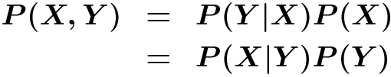
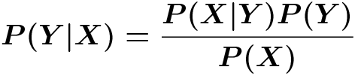
Joint and conditional probability
P(X,Y) is called a joint probability
e.g., probability of a pair of dice coming out <4,6>
Two events are independent if the probability of the joint event is the product of the individual event probabilities:
P(Y|X) is called a conditional probability
By definition,
This gives rise to Bayes’ Theorem:
Notes:
Show probability of two dice summing to no more than six, given that first die roll was no more than three

Slide 17



Marginalization
We’ll use terms marginalization and marginal probability
Example: Joint probabilities for Old English word order
The marginal probability P(X=x) is
In our example:

Slide 18
Bayesian inference
We already saw Bayes’ rule as a consequence of the laws of conditional probability
Its importance is its use for inference and learning
The posterior distribution summarizes all the information relevant to decision-making about X on the basis of Y
Observations (“data”)
Likelihood of data given a particular hidden structure
Prior probability of hidden structure
Hidden structure
Posterior distribution
(marginal likelihood of data)

Slide 19
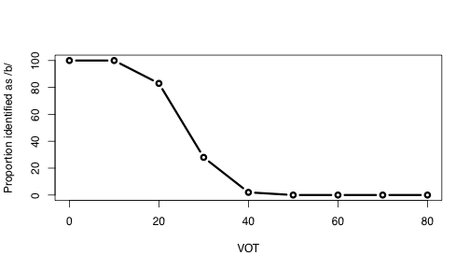
Phoneme identification as Bayesian inference
Voice onset time (VOT) a key cue in distinguishing voicing in English stops (Liberman et al., 1957)
What would an optimal listener do?

Slide 20
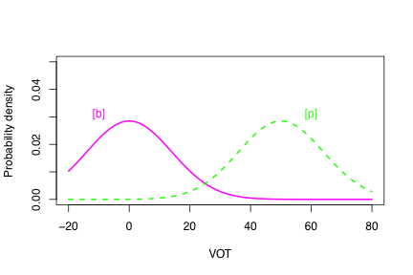
Phoneme identification as Bayesian inference
The empirical distributions of [b] and [p] VOTs looks something* like this
The optimal listener would compute the relative probabilities of [b] and [p] and respond on that basis

Slide 21

Phoneme identification as Bayesian inference
To complete Bayesian inference for an input Y, we need to specify the likelihood functions
For likelihood, we’ll use the normal distribution:
And we’ll set the priors equal: P(X=b)=P(X=p)=0.5
Likelihood
Prior
Marginal likelihood
mean
variance

Slide 22
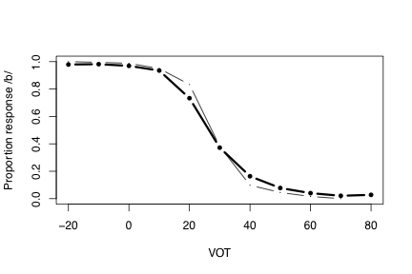
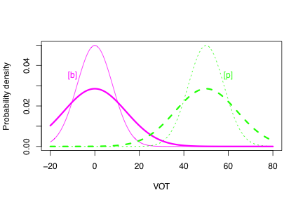
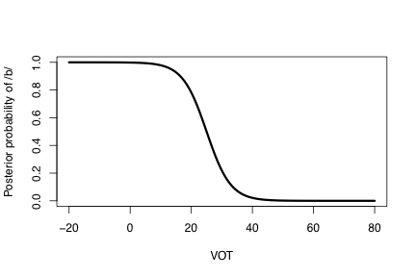

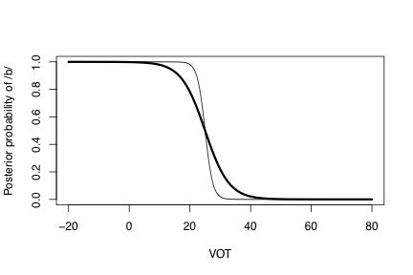
Phoneme identification as Bayesian inference
If the variances for /b/ and /p/ are equal, then we get
Variance should matter!
Clayards et al. (2008)

Slide 23
Estimating probabilistic models
With a fair die, we can calculate event probabilities using the counting method
But usually, we can’t deduce the probabilities of the subevents involved
Instead, we have to estimate them (=statistics!)
Usually, this involves assuming a probabilistic model with some free parameters,* and choosing the values of the free parameters to match empirically obtained data
*(these are parametric estimation methods)

Slide 24

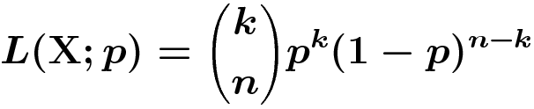

Maximum likelihood
Simpler example: a coin flip
fair? unfair?
Take a dataset of 20 coin flips, 12 heads and 8 tails
Estimate the probability p that the next result is heads
Method of maximum likelihood: choose parameter values (i.e., p) that maximize the likelihood* of the data
Here, maximum-likelihood estimate (MLE) is the relative-frequency estimate (RFE)
*likelihood: the data’s probability, viewed as a function of your free parameters

Slide 25
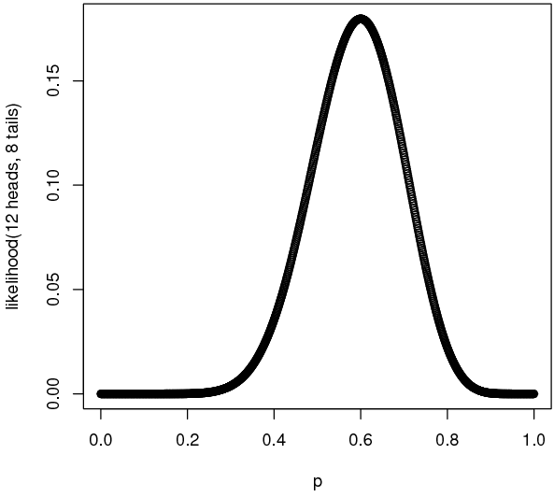

Slide 26
Issues in model estimation
Maximum-likelihood estimation has several problems:
Can’t incorporate a belief that coin is “likely” to be fair
MLEs can be biased
Try to estimate the number of words in a language from a finite sample
MLEs will always underestimate the number of words
There are other estimation techniques with different strengths and weaknesses
In particular, there are Bayesian techniques that we’ll discuss later in the course (Lecture 7)
*unfortunately, we rarely have “lots” of data

Slide 27
Today
Crash course in probability theory
Crash course in natural language syntax and parsing
Pruning models: Jurafsky 1996

Slide 28
We’ll start with some puzzles
The women discussed the dogs on the beach.
What does on the beach modify?
The women kept the dogs on the beach.
What does on the beach modify?
The complex houses married children and their families.
The warehouse fires a dozen employees each year.
Ford et al., 1982→ dogs (90%); discussed (10%)
Ford et al., 1982→ kept (95%); dogs (5%)

Slide 29
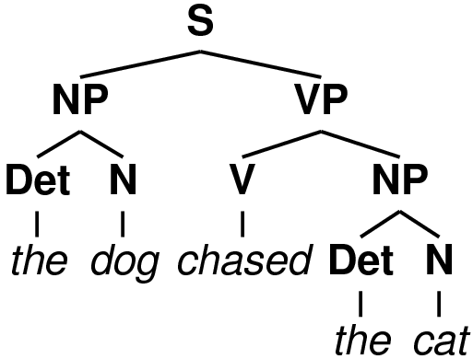
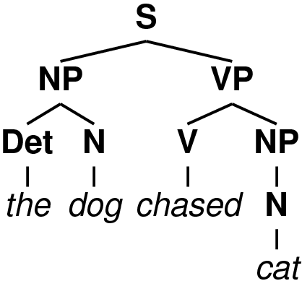
Crash course in grammars and parsing
A grammar is a structured set of production rules
Most commonly used for syntactic description, but also useful for (sematics, phonology, …)
E.g., context-free grammars:
A grammar is said to license a derivation if all the derivation’s rules are present in the grammar
S → NP VP
NP → Det N
VP → V NP
Det → the
N → dog
N → cat
V → chased
✗
OK

Slide 30
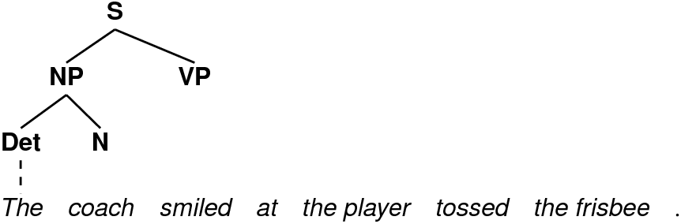
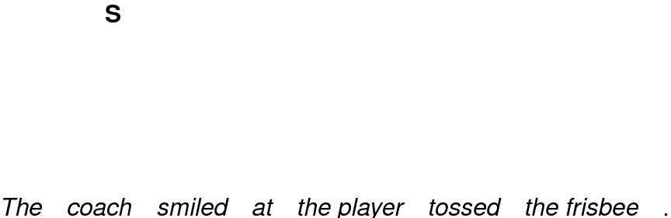
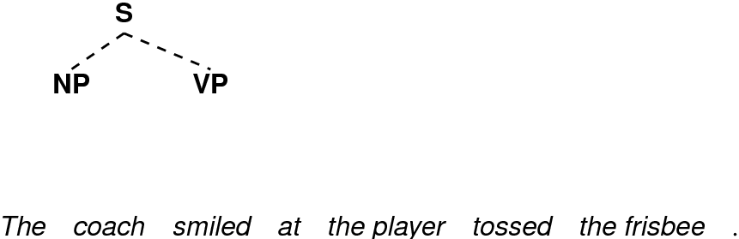
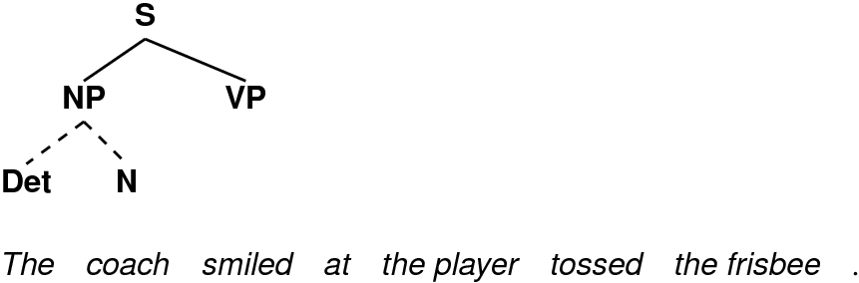
Top-down parsing
Fundamental operation:
Permits structure building inconsistent with perceived input, or corresponding to as-yet-unseen input
S → NP VP
NP → Det N
Det → The
…

Slide 31
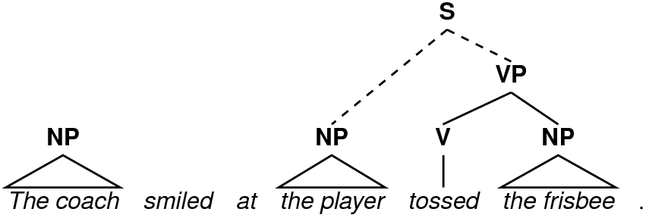
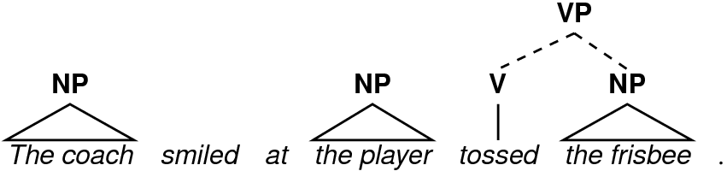
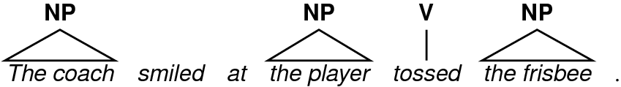
Bottom-up parsing
Fundamental operation: check whether a sequence of categories matches a rule’s right-hand side
Permits structure building inconsistent with global context
VP → V NP
PP → P NP
S → NP VP
…

Slide 32
Ambiguity
There is usually more than one structural analysis for a (partial) sentence
Corresponds to choices (non-determinism) in parsing
VP can expand to V NP PP…
…or VP can expand to V NP and then NP can expand to NP PP
Ambiguity can be local (eventually resolved)…
…with a puppy on his lap.
…or it can be global (unresolved):
…with binoculars.
The girl saw the boy with…

Slide 33
Serial vs. Parallel processing
A serial processing model is one where, when faced with a choice, chooses one alternative and discards the rest
A parallel model is one where at least two alternatives are chosen and maintained
A full parallel model is one where all alternatives are maintained
A limited parallel model is one where some but not necessarily all alternatives are maintained
A joke about the man with an umbrella that I heard…
*ambiguity goes as the Catalan numbers (Church and Patel 1982)

Slide 34
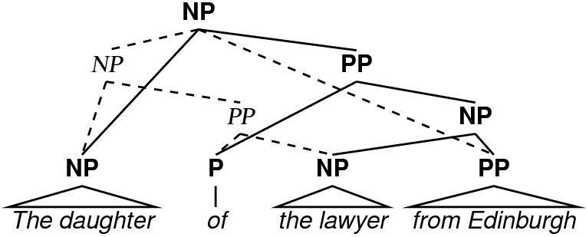
Dynamic programming
There is an exponential number of parse trees for a given sentence (Church & Patil 1982)
So sentence comprehension can’t entail an exhaustive enumeration of possible structural representations
But parsing can be made tractable by dynamic programming
Notes:
The daughter of the lawyer from Edinburgh…

Slide 35
Dynamic programming (2)
Dynamic programming = storage of partial results
There are two ways to make an NP out of…
…but the resulting NP can be stored just once in the parsing process
Result: parsing time polynomial (cubic for CFGs) in sentence length
Still problematic for modeling human sentence proc.
Notes:
omit “still problematic” bullet?

Slide 36
Hybrid bottom-up and top-down
Many methods used in practice are combinations of top-down and bottom-up regimens
Left-corner parsing: incremental bottom-up parsing with top-down filtering
Earley parsing: strictly incremental top-down parsing with top-down filtering and dynamic programming*
*solves problems of left-recursion that occur in top-down parsing

Slide 37
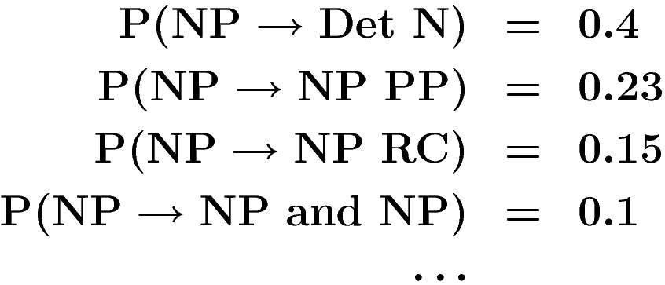
Probabilistic grammars
A (generative) probabilistic grammar is one that associates probabilities with rule productions.
e.g., a probabilistic context-free grammar (PCFG) has rule productions with probabilities like
Interpret P(NP→Det N) as P(Det N | NP)
Among other things, PCFGs can be used to achieve disambiguation among parse structures

Slide 38
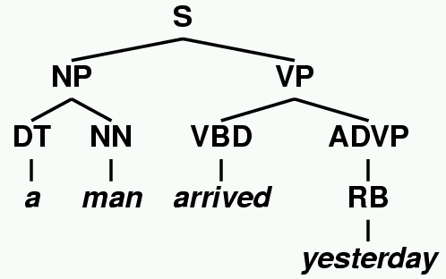
a man arrived yesterday
0.3 S → S CC S 0.15 VP → VBD ADVP
0.7 S → NP VP 0.4 ADVP → RB
0.35 NP → DT NN ...
0.7
0.35
0.15
0.3
0.03
0.02
0.4
0.07
Total probability: 0.7*0.35*0.15*0.3*0.03*0.02*0.4*0.07= 1.85×10⁻⁷
Notes:
say “these are Penn treebank labels!”

Slide 39
Probabilistic grammars (2)
A derivation having zero probability corresponds to it being unlicensed in a non-probabilistic setting
But “canonical” or “frequent” structures can be distinguished from “marginal” or “rare” structures via the derivation rule probabilities
From a computational perspective, this allows probabilistic grammars to increase coverage (number + type of rules) while maintaining ambiguity management

Slide 40
Inference about sentence structure
With a probabilistic grammar, ambiguity resolution means inferring the probability distribution over structural analyses given input
Bayes Rule again
The girl saw the boy with…

Slide 41
Today
Crash course in probability theory
Crash course in natural language syntax and parsing
Pruning models: Jurafsky 1996

Slide 42
Pruning approaches
Jurafsky 1996: a probabilistic approach to lexical access and syntactic disambiguation
Main argument: sentence comprehension is probabilistic, construction-based, and parallel
Probabilistic parsing model explains
human disambiguation preferences
garden-path sentences
The probabilistic parsing model has two components:
constituent probabilities – a probabilistic CFG model
valence probabilities

Slide 43
Jurafsky 1996
Every word is immediately completely integrated into the parse of the sentence (i.e., full incrementality)
Alternative parses are ranked in a probabilistic model
Parsing is limited-parallel: when an alternative parse has unacceptably low probability, it is pruned
“Unacceptably low” is determined by beam search (described a few slides later)

Slide 44
Jurafsky 1996: valency model
Whereas the constituency model makes use of only phrasal, not lexical information, the valency model tracks lexical subcategorization, e.g.:
P( <NP PP> | discuss ) = 0.24
P( <NP> | discuss ) = 0.76
(in today’s NLP, these are called monolexical probabilities)
In some cases, Jurafsky bins across categories:*
P( <NP XP[+pred]> | keep) = 0.81
P( <NP> | keep ) = 0.19
where XP[+pred] can vary across AdjP, VP, PP, Particle…
*valence probs are RFEs from Connine et al. (1984) and Penn Treebank
Notes:
this is the issue connecting with marginalization!!!
Note that valence probs come either from

Slide 45

Jurafsky 1996: syntactic model
The syntactic component of Jurafsky’s model is just probabilistic context-free grammars (PCFGs)
0.7
0.35
0.15
0.3
0.03
0.02
0.4
0.07
Total probability: 0.7*0.35*0.15*0.3*0.03*0.02*0.4*0.07= 1.85×10⁻⁷

Slide 46
Modeling offline preferences
Ford et al. 1982 found effect of lexical selection in PP attachment preferences (offline, forced-choice):
The women discussed the dogs on the beach
NP-attachment (the dogs that were on the beach) -- 90%
VP-attachment (discussed while on the beach) – 10%
The women kept the dogs on the beach
NP-attachment – 5%
VP-attachment – 95%
Broadly confirmed in online attachment study by Taraban and McClelland 1988

Slide 47
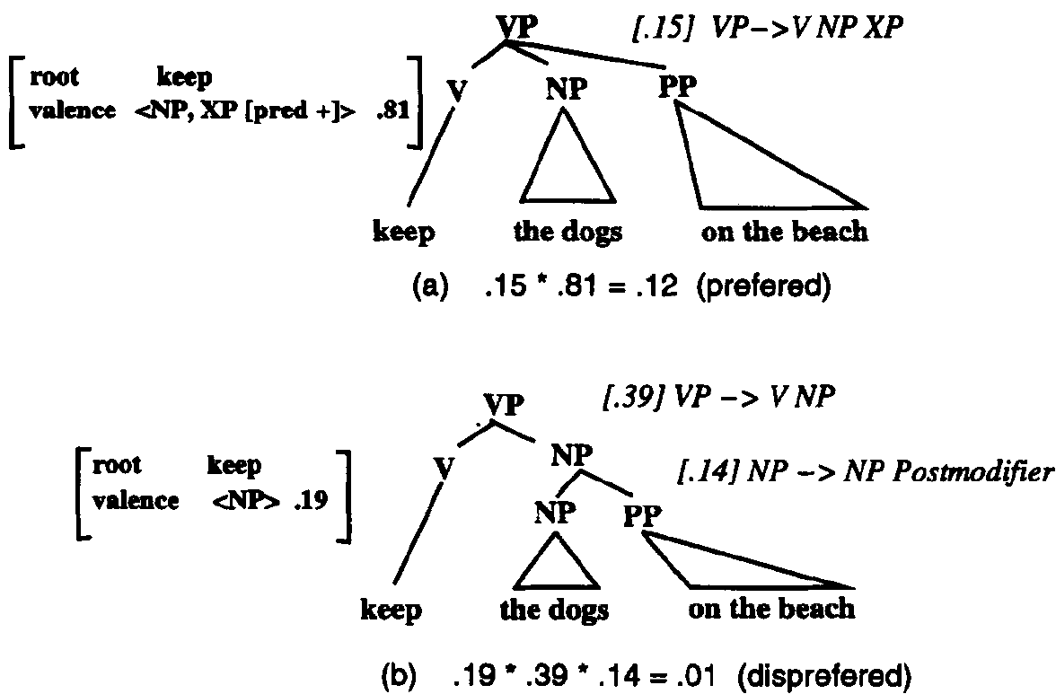
Modeling offline preferences (2)
Jurafsky ranks parses as the product of constituent and valence probabilities:

Slide 48
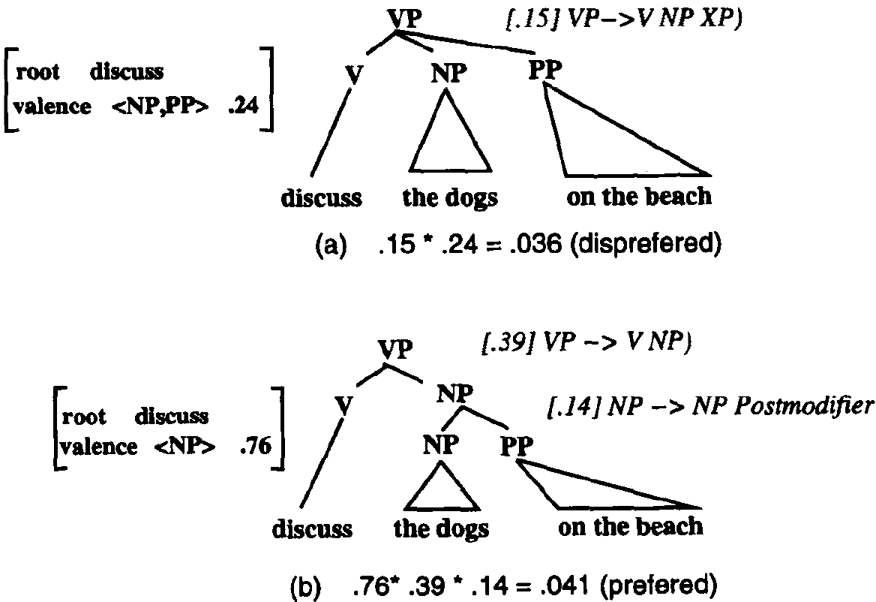
Modeling offline preferences (3)

Slide 49
Result
Ranking with respect to parse probability matches offline preferences
Note that only monotonicity, not degree of preference is matched

Slide 50
Modeling online parsing
Does this sentence make sense?
The complex houses married and single students and their families.
How about this one?
The warehouse fires a dozen employees each year.
And this one?
The warehouse fires destroyed all the buildings.
fires can be either a noun or a verb. So can houses:
[_{NP} The complex] [_{VP} houses married and single students…].
These are garden path sentences
Originally taken as some of the strongest evidence for serial processing by the human parser
Frazier and Rayner 1987

Slide 51
Limited parallel parsing
Full-serial: keep only one incremental interpretation
Full-parallel: keep all incremental interpretations
Limited parallel: keep some but not all interpretations
In a limited parallel model, garden-path effects can arise from the discarding of a needed interpretation
[S [NP The complex] [VP houses…] …]
discarded
[S [NP The complex houses …] …]
kept

Slide 52
Modeling online parsing: garden paths
Pruning strategy for limited ranked-parallel processing
Each incremental analysis is ranked
Analyses falling below a threshold are discarded
In this framework, a model must characterize
The incremental analyses
The threshold for pruning
Jurafsky 1996: partial context-free parses as analyses
Probability ratio as pruning threshold
Ratio defined as P(I) : P(I_{best})
(Gibson 1991: complexity ratio for pruning threshold)

Slide 53
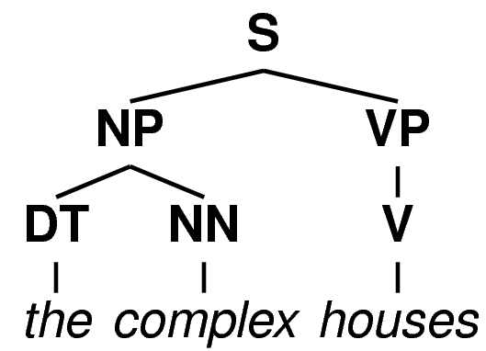

Garden path models 1: N/V ambiguity
Each analysis is a partial PCFG tree
Tree prefix probability used for ranking of analysis
Partial rule probs marginalize over rule completions
these nodes are actually
still undergoing expansion
Notes:
add in example of marginalization, and show its equivalence to a grammar transform

Slide 54
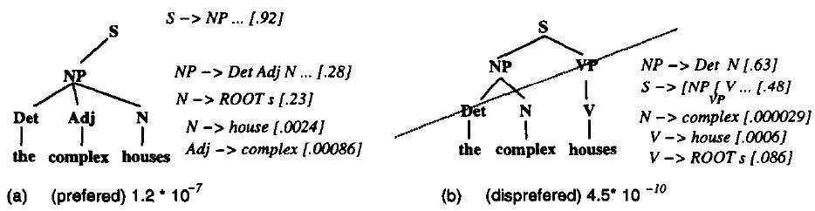
N/V ambiguity (2)
Partial CF tree analysis of the complex houses…
Analysis of houses as noun has much lower probability than analysis as verb (> 250:1)
Hypothesis: the low-ranking alternative is discarded

Slide 55
N/V ambiguity (3)
Note that top-down vs. bottom-up questions are immediately implicated, in theory
Jurafsky includes the cost of generating the initial NP under the S
of course, it’s a small cost as P(S -> NP …) = 0.92
If parsing were bottom-up, that cost would not have been explicitly calculated yet

Slide 56
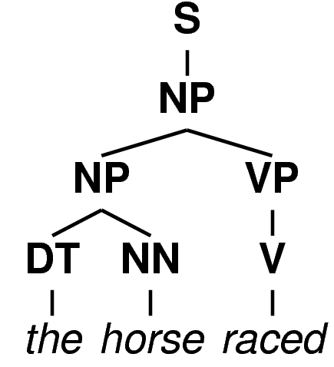
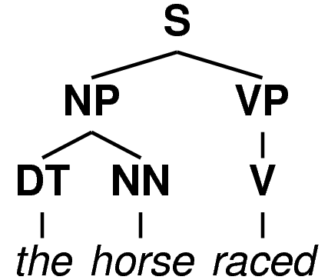
Garden path models 2
The most famous garden-paths: reduced relative clauses (RRCs) versus main clauses (MCs)
From the valence + simple-constituency perspective, MC and RRC analyses differ in two places:
The horse raced past the barn fell.
(that was)
p=0.14
p≈1
best intransitive:
p=0.92
transitive valence: p=0.08
Notes:
we’ll come back to RRCs twice: once in competition models, once in surprisal

Slide 57
Garden path models 2, cont.
82 : 1 probability ratio means that lower-probability analysis is discarded
In contrast, some RRCs do not induce garden paths:
Here, the probability ratio turns out to be much closer (≈4 : 1) because found is preferentially transitive
Conclusion within pruning theory: beam threshold is between 4 : 1 and 82 : 1
(granularity issue: when exactly does probability cost of valence get paid???)
The bird found in the room died.

Slide 58
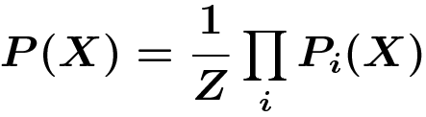
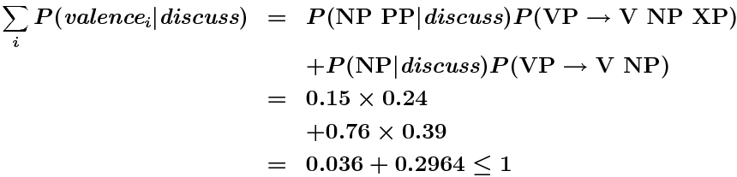
Notes on the probabilistic model
Jurafsky 1996 is a product-of-experts (PoE) model
Expert 1: the constituency model
Expert 2: the valence model
PoEs are flexible and easy to define, but hard to learn
The Jurafsky 1996 model is actually deficient (loses probability mass), due to relative frequency estimation

Slide 59

Notes on the probabilistic model (2)
Jurafsky 1996 predated most work on lexicalized parsers (Collins 1999, Charniak 1997)
In a generative lexicalized parser, valence and constituency are often combined through decomposition & Markov assumptions, e.g.,
The use of decomposition makes it easy to learn non-deficient models
sometimes approximated as

Slide 60
Jurafsky 1996 & pruning: main points
Syntactic comprehension is probabilistic
Offline preferences explained by syntactic + valence probabilities
Online garden-path results explained by same model, when beam search/pruning is assumed

Slide 61
General issues
What is the granularity of incremental analysis?
In [_{NP} the complex houses], complex could be an adjective (=the houses are complex)
complex could also be a noun (=the houses of the complex)
Should these be distinguished, or combined?
When does valence probability cost get paid?
What is the criterion for abandoning an analysis?
Should the number of maintained analyses affect processing difficulty as well?

Slide 62
For Wednesday: surprisal
Read Hale, 2001, and the “surprisal” section of the Levy manuscript
The proposal is very simple:
Think about the following issues:
How does surprisal differ from the Jurafsky 1996 model?
What is garden-path disambiguation under surprisal?
What kinds of probabilistic grammars are required for surprisal?
What kind of information belongs in “Context”?

