Slide 1
Laboratory-acquired infection – prevention and management
Alessandro Gerada

Slide 2
Introduction
Straight-forward information is surprisingly difficult to find
Used to be a typical essay question in FRCPath Part 2 – now likely to morph into short answer questions
Large language models have made this sort of question easier to prepare for
Questions usually involve an incident e.g., spill or handling of cultures on open bench
There can be subtlety in how risk is described – err on side of caution

Slide 3
Immediate actions
Always start by stressing immediate actions to terminate any further exposures

Slide 4
Information gathering
Focus on aerosol-generating high-risk activities
Robust documentation throughout – can get out of hand if collecting information retrospectively
Involve the right teams – H&S, occupational health, laboratory management, UKHSA, etc
Incident teams and meetings particularly if large exposure
Modern one-room laboratory design has complicated management

Slide 5
Incident reporting and learning
Important to highlight ability of lab to review and change practice
Laboratory non-conformity, DATIX, incident report, RIDDOR (HSE)
Most cases arise due to communication breakdown between clinicians and lab

Slide 6
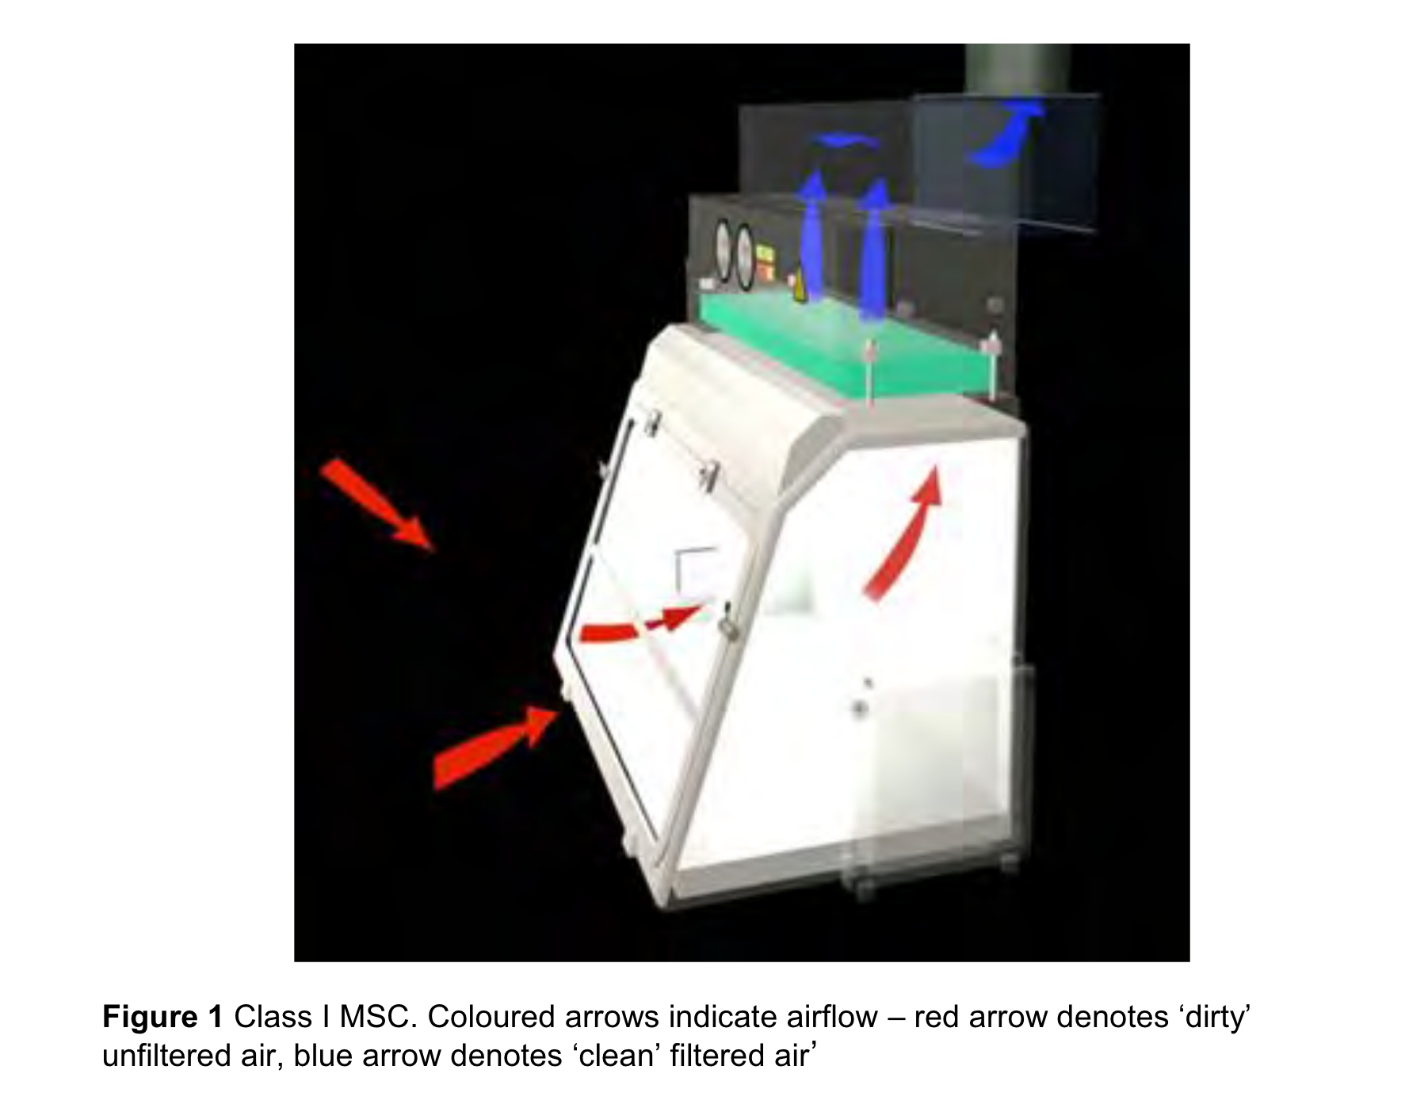
Biosafety cabinets
Class 1 cabinet – focused on protecting user
(Advisory Committe on Dangerous Pathogens 2019)

Slide 7
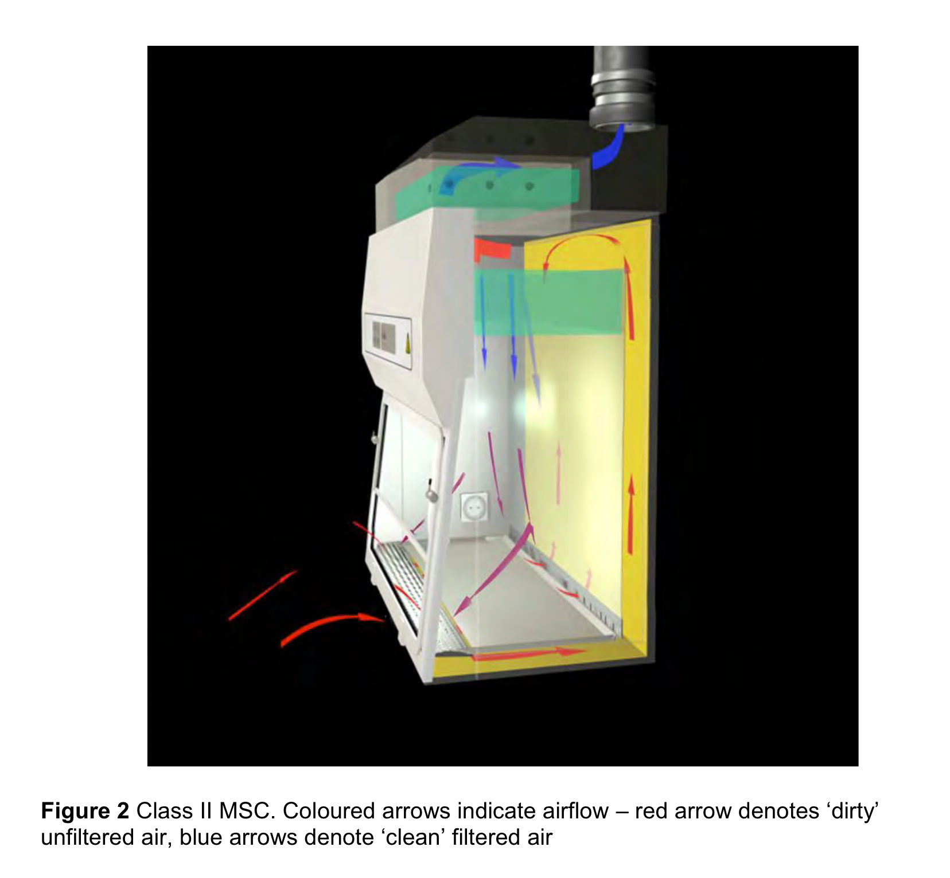

Slide 8
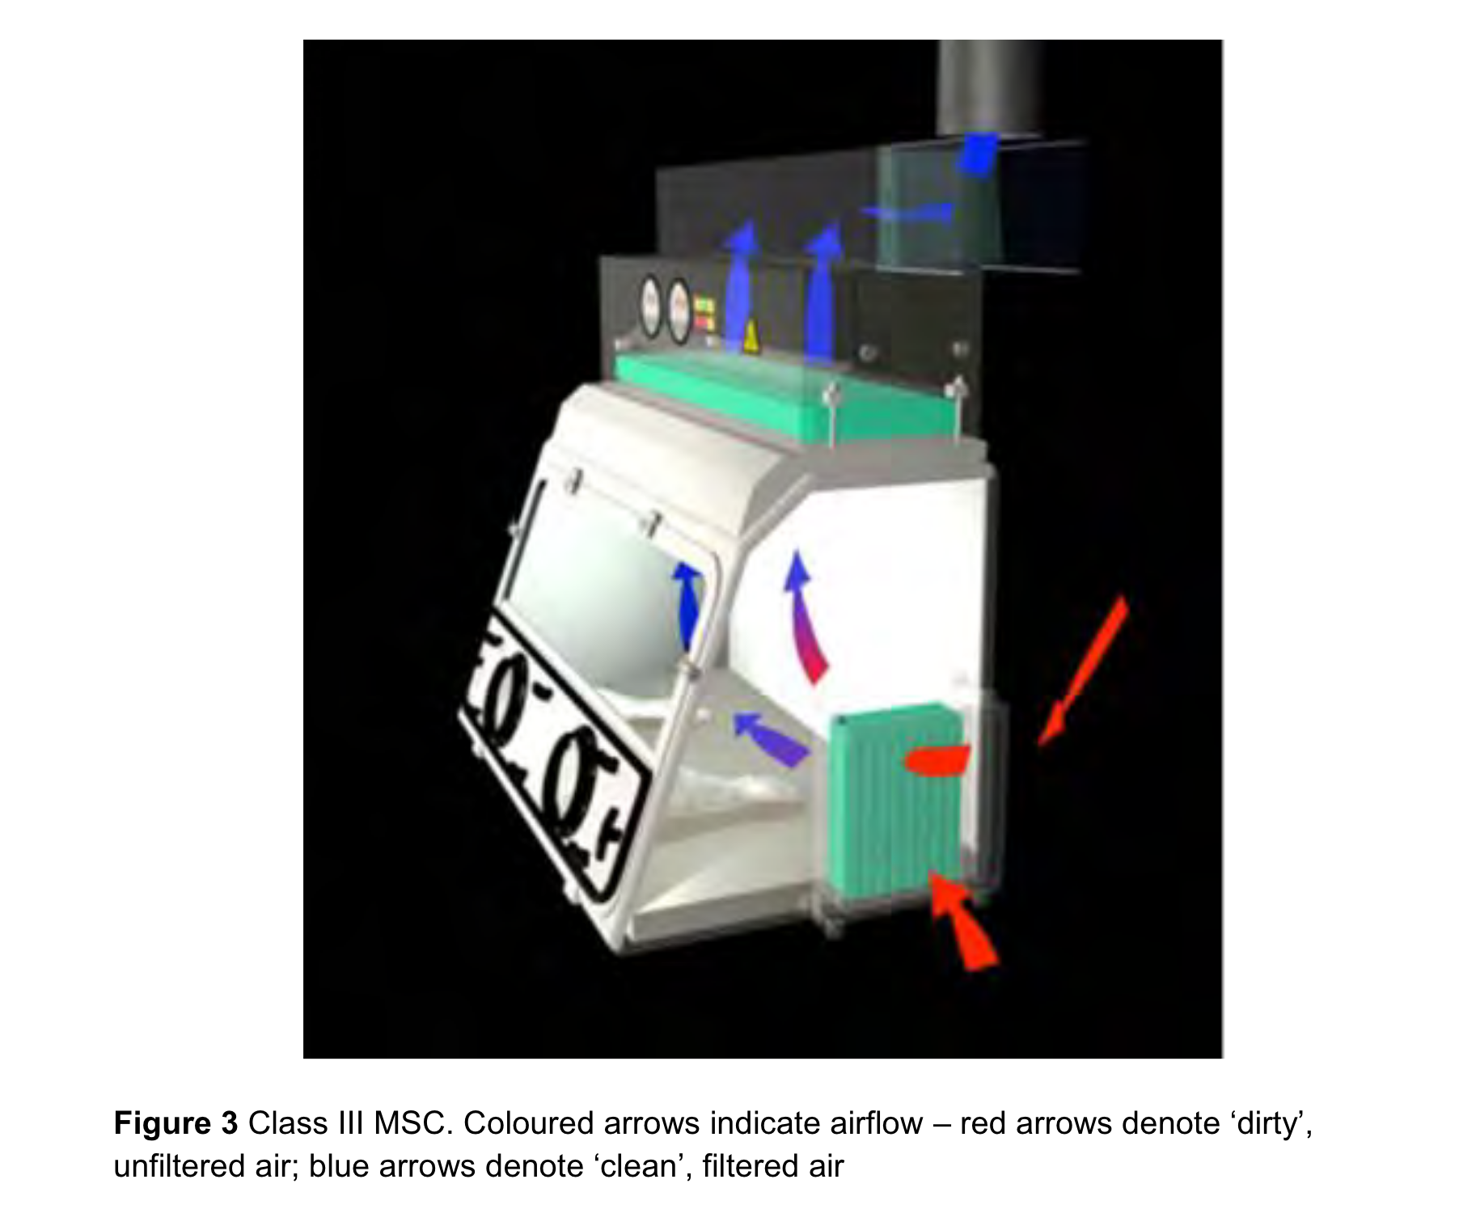

Slide 9
MALDI-TOF
Procedure itself is relatively safe, but plate set up and disposal involve handling of cultures
Sepsityper can lead to earlier detection and reduce risk

Slide 10
Pathogen specific details
Pathogen | Cont. level | Prophylaxis | Follow up
Brucella | 3 | Doxycycline | Serology
Francisella | 3 | Doxycycline | Fever watch
B. pseudomallei, B. mallei | 3 | Co-T, Doxycycline, Co-amoxiclav | Serology (only for B. pseudomallei)
M. tuberculosis | 3 | NA | Symptoms, CXR, Quantiferon
N. meningitidis | 2 | Ciprofloxacin, rifampicin
Enteric pathogens (Salmonellae, Shigella, toxigenic E. coli) | 3*
B. anthracis | 3 | Ciprofloxacin, doxycycline
Dimorphic fungi (Blasomyces, Coccidioides, Histoplasma) | 3 | Itraconazole | Serology

Slide 11
Comments
Where serology indicated, baseline test should be collected and stored
Viruses and protozoa are relatively rare causes

Slide 12
Further reading and references
Advisory Committe on Dangerous Pathogens. 2019. “Management and Operation of Microbiological Containment Laboratories,” March.
“Brucella Reference Unit (BRU).” 2020. GOV.UK. November 12, 2020. https://www.gov.uk/government/collections/brucella-reference-unit-bru.
Health and Safety Executive. 2021. “The Approved List of Biological Agents.”
Peacock, Sharon J., Herbert P. Schweizer, David A. B. Dance, Theresa L. Smith, Jay E. Gee, Vanaporn Wuthiekanun, David DeShazer, Ivo Steinmetz, Patrick Tan, and Bart J. Currie. 2008. “Management of Accidental Laboratory Exposure to Burkholderia Pseudomallei and B. Mallei.” Emerg Infect Dis 14 (7): e2. https://doi.org/10.3201/eid1407.071501.
Singh, Kamaljit. 2009. “Laboratory‐Acquired Infections.” CLIN INFECT DIS 49 (1): 142–47. https://doi.org/10.1086/599104.
Stevens, David A., Karl V. Clemons, Hillel B. Levine, Demosthenes Pappagianis, Ellen Jo Baron, John R. Hamilton, Stanley C. Deresinski, and Nancy Johnson. 2009. “Expert Opinion: What To Do When There Is Coccidioides Exposure in a Laboratory.” CLIN INFECT DIS 49 (6): 919–23. https://doi.org/10.1086/605441.
Traxler, Rita M., Mark W. Lehman, Elizabeth A. Bosserman, Marta A. Guerra, and Theresa L. Smith. 2013. “A Literature Review of Laboratory-Acquired Brucellosis.” J Clin Microbiol 51 (9): 3055–62. https://doi.org/10.1128/JCM.00135-13.

