Slide 1
What’s Monte Carlo Tree Search About?
Dr Peter L Green
Senior Lecturer
School of Engineering

Slide 2
Minimax
‘Minimise opponent’s maximum reward’
Player moves

Slide 3
Minimax
‘Minimise opponent’s maximum reward’
Player moves
Opponent moves

Slide 4
Minimax
‘Minimise opponent’s maximum reward’
Player moves
Opponent moves
1
6
10
5
2
3
1
2
7
Opponent rewards

Slide 5
Minimax
‘Minimise opponent’s maximum reward’
Player moves
10
5
7
Opponent moves
1
6
10
5
2
3
1
2
7
max(opponent rewards)

Slide 6
Minimax
‘Minimise opponent’s maximum reward’
Player moves
10
5
7
Opponent moves
1
6
10
5
2
3
1
2
7
min(max(opponent rewards))

Slide 7
Minimax
‘Minimise opponent’s maximum reward’
Player moves
5
Opponent moves
5
2
3
Pruning…

Slide 8
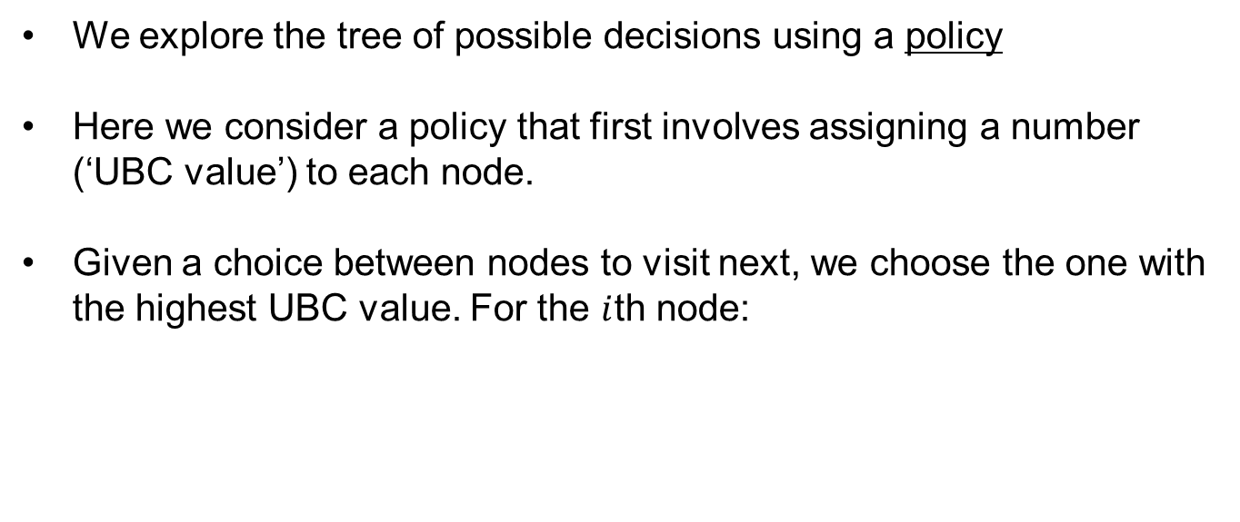
Monte Carlo Tree Search
We explore the tree of possible decisions using a policy
Here we consider a policy that first involves assigning a number (‘UBC value’) to each node.
Given a choice between nodes to visit next, we choose the one with the highest UBC value. For the $i$th node:

Slide 9

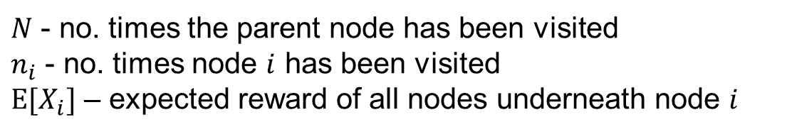
Monte Carlo Tree Search
We explore the tree of possible decisions using a policy
Here we consider a policy that first involves assigning a number (‘UBC value’) to each node.
Given a choice between nodes to visit next, we choose the one with the highest UBC value. For the $i$th node:
$$E\left[X_{i}\right]+2\sqrt{\frac{ln⁡(N)}{n_{i}}}$$
$N$ - no. times the parent node has been visited
$n_{i}$ - no. times node $i$ has been visited
$E[X_{i}]$ – expected reward of all nodes underneath node $i$

Slide 10

Monte Carlo Tree Search
We explore the tree of possible decisions using a policy
Here we consider a policy that first involves assigning a number (‘UBC value’) to each node.
Given a choice between nodes to visit next, we choose the one with the highest UBC value. For the $i$th node:
$$E\left[X_{i}\right]+2\sqrt{\frac{ln⁡(N)}{n_{i}}}$$
$N$ - no. times the parent node has been visited
$n_{i}$ - no. times node $i$ has been visited
$E[X_{i}]$ – expected reward of all nodes underneath node $i$
We visit nodes that will lead to high expected rewards

Slide 11

Monte Carlo Tree Search
We explore the tree of possible decisions using a policy
Here we consider a policy that first involves assigning a number (‘UBC value’) to each node.
Given a choice between nodes to visit next, we choose the one with the highest UBC value. For the $i$th node:
$$E\left[X_{i}\right]+2\sqrt{\frac{ln⁡(N)}{n_{i}}}$$
$N$ - no. times the parent node has been visited
$n_{i}$ - no. times node $i$ has been visited
$E[X_{i}]$ – expected reward of all nodes underneath node $i$
We avoid nodes that have already been visited a lot.
We have to choose nodes that have never been visited.

Slide 12

Monte Carlo Tree Search
We explore the tree of possible decisions using a policy
Here we consider a policy that first involves assigning a number (‘UBC value’) to each node.
Given a choice between nodes to visit next, we choose the one with the highest UBC value. For the $i$th node:
$$E\left[X_{i}\right]+2\sqrt{\frac{ln⁡(N)}{n_{i}}}$$
$N$ - no. times the parent node has been visited
$n_{i}$ - no. times node $i$ has been visited
$E[X_{i}]$ – expected reward of all nodes underneath node $i$
We visit nodes if the parent has been visited a lot relative to node $i$

Slide 13
Monte Carlo Tree Search
We explore the tree of possible decisions using a policy
Here we consider a policy that first involves assigning a number (‘UBC value’) to each node.
Given a choice between nodes to visit next, we choose the one with the highest UBC value. For the $i$th node:
$$E\left[X_{i}\right]+2\sqrt{\frac{ln⁡(N)}{n_{i}}}$$
$N$ - no. times the parent node has been visited
$n_{i}$ - no. times node $i$ has been visited
$E[X_{i}]$ – expected reward of all nodes underneath node $i$
If multiple nodes have the same UBC, we choose them randomly (uniformly).

Slide 14
Monte Carlo Tree Search
We explore the tree of possible decisions using a policy
Here we consider a policy that first involves assigning a number (‘UBC value’) to each node.
Given a choice between nodes to visit next, we choose the one with the highest UBC value. For the $i$th node:
$$E\left[X_{i}\right]+2\sqrt{\frac{ln⁡(N)}{n_{i}}}$$
$N$ - no. times the parent node has been visited
$n_{i}$ - no. times node $i$ has been visited
$E[X_{i}]$ – expected reward of all nodes underneath node $i$
We’ll now look at an example, where we only have 1 player (to keep things simple).

Slide 15
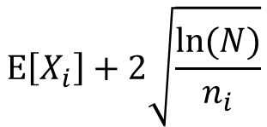
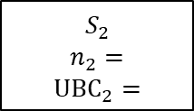

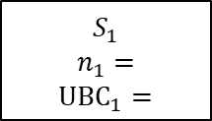




$$E\left[X_{i}\right]+2\sqrt{\frac{ln⁡(N)}{n_{i}}}$$
$$S_{0}$$
$$n_{0}=$$
$$S_{1}$$
$$n_{1}=$$
$$UBC_{1}=$$
$$S_{2}$$
$$n_{2}=$$
$$UBC_{2}=$$
$$S_{3}$$
$$R_{3}=?$$
$$S_{4}$$
$$R_{4}=?$$
$$S_{5}$$
$$R_{5}=?$$
$$S_{6}$$
$$R_{6}=?$$

Slide 16
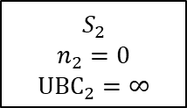
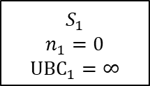

$$E\left[X_{i}\right]+2\sqrt{\frac{ln⁡(N)}{n_{i}}}$$
$$S_{0}$$
$$n_{0}=0$$
$$S_{1}$$
$$n_{1}=0$$
$$UBC_{1}=∞$$
$$S_{2}$$
$$n_{2}=0$$
$$UBC_{2}=∞$$
$$S_{3}$$
$$R_{3}=?$$
$$S_{4}$$
$$R_{4}=?$$
$$S_{5}$$
$$R_{5}=?$$
$$S_{6}$$
$$R_{6}=?$$

Slide 17
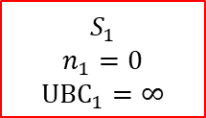
$$E\left[X_{i}\right]+2\sqrt{\frac{ln⁡(N)}{n_{i}}}$$
$$S_{0}$$
$$n_{0}=0$$
$$S_{1}$$
$$n_{1}=0$$
$$UBC_{1}=∞$$
$$S_{2}$$
$$n_{2}=0$$
$$UBC_{2}=∞$$
$$S_{3}$$
$$R_{3}=?$$
$$S_{4}$$
$$R_{4}=?$$
$$S_{5}$$
$$R_{5}=?$$
$$S_{6}$$
$$R_{6}=?$$
Iteration 1
Nodes 1 and 2 have the same UBC value so we pick one randomly (node 1 in this case).

Slide 18

$$E\left[X_{i}\right]+2\sqrt{\frac{ln⁡(N)}{n_{i}}}$$
$$S_{0}$$
$$n_{0}=0$$
$$S_{1}$$
$$n_{1}=0$$
$$UBC_{1}=∞$$
$$S_{2}$$
$$n_{2}=0$$
$$UBC_{2}=∞$$
$$S_{3}$$
$$R_{3}=?$$
$$S_{4}$$
$$R_{4}=15$$
$$S_{5}$$
$$R_{5}=?$$
$$S_{6}$$
$$R_{6}=?$$
Iteration 1
We continue in the same fashion until we reach a ‘leaf’ (node 4 in this case), where we evaluate the reward. This part of the algorithm is often called ‘simulation’ or ‘rollout’.

Slide 19
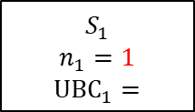


$$E\left[X_{i}\right]+2\sqrt{\frac{ln⁡(N)}{n_{i}}}$$
$$S_{0}$$
$$n_{0}=1$$
$$S_{1}$$
$$n_{1}=1$$
$$UBC_{1}=$$
$$S_{2}$$
$$n_{2}=0$$
$$UBC_{2}=∞$$
$$S_{3}$$
$$R_{3}=?$$
$$S_{4}$$
$$R_{4}=15$$
$$S_{5}$$
$$R_{5}=?$$
$$S_{6}$$
$$R_{6}=?$$
Iteration 1
We then update the information in the nodes that we visited during the simulation phase… This is called ‘back propagation’ (not to be confused with neural networks!)

Slide 20
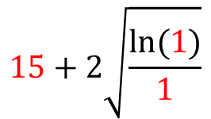
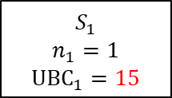

$$15+2\sqrt{\frac{ln⁡(1)}{1}}$$
$$S_{0}$$
$$n_{0}=1$$
$$S_{1}$$
$$n_{1}=1$$
$$UBC_{1}=15$$
$$S_{2}$$
$$n_{2}=0$$
$$UBC_{2}=∞$$
$$S_{3}$$
$$R_{3}=?$$
$$S_{4}$$
$$R_{4}=15$$
$$S_{5}$$
$$R_{5}=?$$
$$S_{6}$$
$$R_{6}=?$$
Iteration 1
We then update the information in the nodes that we visited during the simulation phase… This is called ‘back propagation’ (not to be confused with neural networks!)

Slide 21

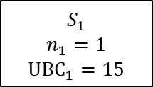
$$E\left[X_{i}\right]+2\sqrt{\frac{ln⁡(N)}{n_{i}}}$$
$$S_{0}$$
$$n_{0}=1$$
$$S_{1}$$
$$n_{1}=1$$
$$UBC_{1}=15$$
$$S_{2}$$
$$n_{2}=0$$
$$UBC_{2}=∞$$
$$S_{3}$$
$$R_{3}=?$$
$$S_{4}$$
$$R_{4}=15$$
$$S_{5}$$
$$R_{5}=?$$
$$S_{6}$$
$$R_{6}=?$$
Iteration 2
Node 2 has the higher UBC.

Slide 22

$$E\left[X_{i}\right]+2\sqrt{\frac{ln⁡(N)}{n_{i}}}$$
$$S_{0}$$
$$n_{0}=1$$
$$S_{1}$$
$$n_{1}=1$$
$$UBC_{1}=15$$
$$S_{2}$$
$$n_{2}=0$$
$$UBC_{2}=∞$$
$$S_{3}$$
$$R_{3}=?$$
$$S_{4}$$
$$R_{4}=15$$
$$S_{5}$$
$$R_{5}=?$$
$$S_{6}$$
$$R_{6}=8$$
Iteration 2
Simulation finishes at node 6.

Slide 23



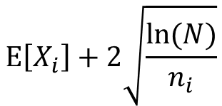
$$E\left[X_{i}\right]+2\sqrt{\frac{ln⁡(N)}{n_{i}}}$$
$$S_{0}$$
$$n_{0}=2$$
$$S_{1}$$
$$n_{1}=1$$
$$UBC_{1}=15$$
$$S_{2}$$
$$n_{2}=1$$
$$UBC_{2}=∞$$
$$S_{3}$$
$$R_{3}=?$$
$$S_{4}$$
$$R_{4}=15$$
$$S_{5}$$
$$R_{5}=?$$
$$S_{6}$$
$$R_{6}=8$$
Iteration 2
Back propagation…

Slide 24

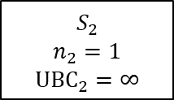
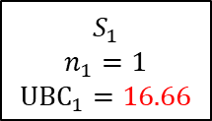
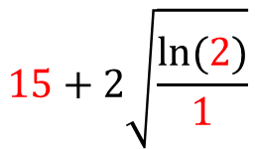
$$15+2\sqrt{\frac{ln⁡(2)}{1}}$$
$$S_{0}$$
$$n_{0}=2$$
$$S_{1}$$
$$n_{1}=1$$
$$UBC_{1}=16.66$$
$$S_{2}$$
$$n_{2}=1$$
$$UBC_{2}=∞$$
$$S_{3}$$
$$R_{3}=?$$
$$S_{4}$$
$$R_{4}=15$$
$$S_{5}$$
$$R_{5}=?$$
$$S_{6}$$
$$R_{6}=8$$
Iteration 2
Back propagation…

Slide 25
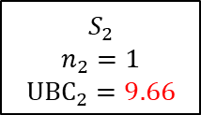
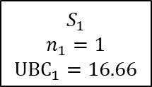
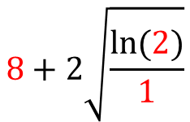
$$8+2\sqrt{\frac{ln⁡(2)}{1}}$$
$$S_{0}$$
$$n_{0}=2$$
$$S_{1}$$
$$n_{1}=1$$
$$UBC_{1}=16.66$$
$$S_{2}$$
$$n_{2}=1$$
$$UBC_{2}=9.66$$
$$S_{3}$$
$$R_{3}=?$$
$$S_{4}$$
$$R_{4}=15$$
$$S_{5}$$
$$R_{5}=?$$
$$S_{6}$$
$$R_{6}=8$$
Iteration 2
Back propagation…

Slide 26
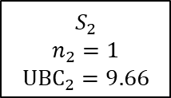
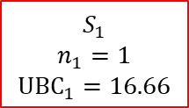

$$E\left[X_{i}\right]+2\sqrt{\frac{ln⁡(N)}{n_{i}}}$$
$$S_{0}$$
$$n_{0}=2$$
$$S_{1}$$
$$n_{1}=1$$
$$UBC_{1}=16.66$$
$$S_{2}$$
$$n_{2}=1$$
$$UBC_{2}=9.66$$
$$S_{3}$$
$$R_{3}=0$$
$$S_{4}$$
$$R_{4}=15$$
$$S_{5}$$
$$R_{5}=?$$
$$S_{6}$$
$$R_{6}=8$$
Iteration 3
Simulation…

Slide 27

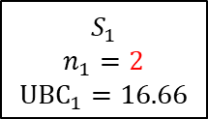

$$E\left[X_{i}\right]+2\sqrt{\frac{ln⁡(N)}{n_{i}}}$$
$$S_{0}$$
$$n_{0}=3$$
$$S_{1}$$
$$n_{1}=2$$
$$UBC_{1}=16.66$$
$$S_{2}$$
$$n_{2}=1$$
$$UBC_{2}=9.66$$
$$S_{3}$$
$$R_{3}=0$$
$$S_{4}$$
$$R_{4}=15$$
$$S_{5}$$
$$R_{5}=?$$
$$S_{6}$$
$$R_{6}=8$$
Iteration 3
Back propagation…

Slide 28

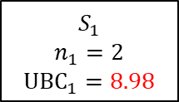
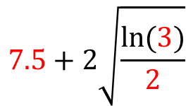
$$7.5+2\sqrt{\frac{ln⁡(3)}{2}}$$
$$S_{0}$$
$$n_{0}=3$$
$$S_{1}$$
$$n_{1}=2$$
$$UBC_{1}=8.98$$
$$S_{2}$$
$$n_{2}=1$$
$$UBC_{2}=9.66$$
$$S_{3}$$
$$R_{3}=0$$
$$S_{4}$$
$$R_{4}=15$$
$$S_{5}$$
$$R_{5}=?$$
$$S_{6}$$
$$R_{6}=8$$
Iteration 3
Back propagation…

Slide 29
Thank you for your attention. ANY QUESTIONS?
Dr Peter L Green
p.l.green@liverpool.ac.uk

