Slide 1
Ring Polymer Surface Hopping: Incorporating Nuclear Quantum Effects into Nonadiabatic Molecular Dynamics Simulations
Report：Ye infeng(zongzi)

Slide 2
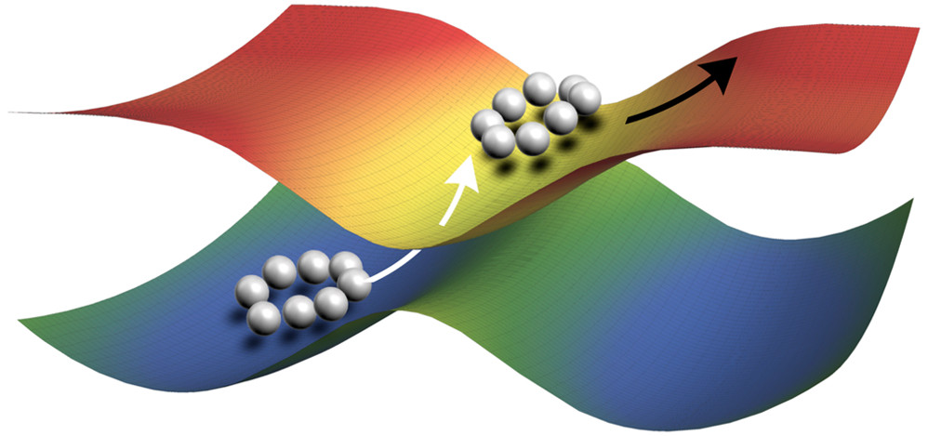
Published in: Farnaz A. Shakib; Pengfei Huo; J. Phys. Chem. Lett. 2017, 8, 3073-3080.
DOI: 10.1021/acs.jpclett.7b01343

Slide 3
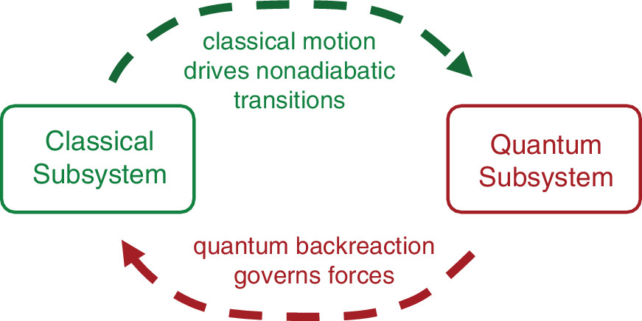
What is the original about it?

Slide 4
What is nonadiabatic dynamics
Let us begin from adiabatic dynamics
1.Molecular Mechanics
2. Semi-classical/mixed classical-quantum
3. Quantum reaction dynamics

Slide 5
The basis theory of Quantum Chemistry:
Self-consistent field theory
Born-Oppenheimer approximation (adiabatic approximation)

Slide 6
Born-Oppenheimer approximation:
Nucleus motion on the potential energy surface (PES)

Slide 7
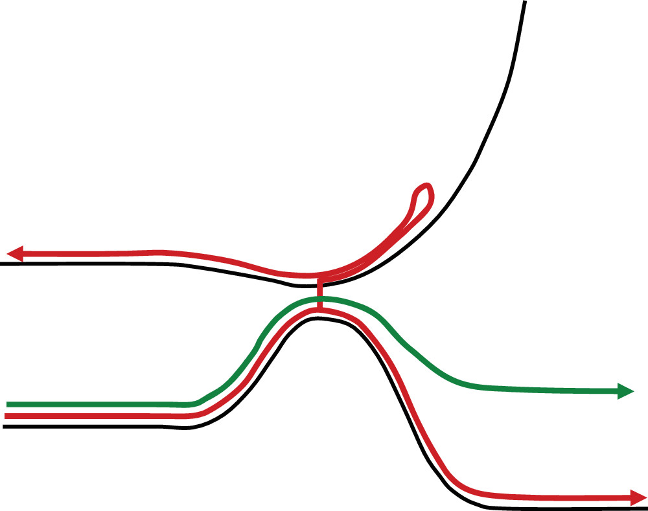
particula:
Electron run slower than nucleus
B-O broken
Nucleus motion on the differenct potential energy surface
Schematic comparison of motion governed by two potential energy surfaces (black curves).
Green: self consistent field methods (e.g., time dependent Hartree, Ehrenfest).
Red: bifurcating paths with entanglement (e.g., multi configuration time dependent Hartree, surface hopping).
Mean-field(Ehrenfest)
Mixed classical-quantum
Surface hopping

Slide 8
Classical subsystem
self-consistency
Quantum subsystem
Quantum treatment
Equilibrium

