Slide 1
Solving the Max Cut Problem
Sakibul Alam, Alex Gardner, Vincent Gonzales

Slide 2

Max Cut Overview
Introducing the General Max Cut Problem
Generic Branch and Cut Algorithm
Implementation and Pseudocode
Computational Performance
Future Improvements and Concluding Remarks

Slide 3
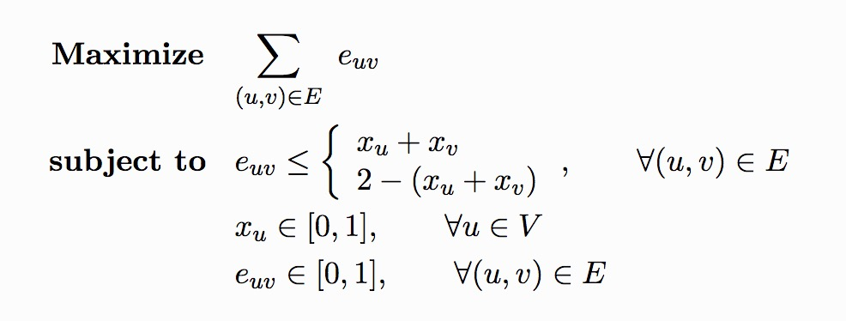

What is the Max Cut Problem?
Undirected graph G = (V,E)
Goal: Partition nodes into two sets by removing edges from the graph such that the cost of the edges removed is maximized

Slide 4
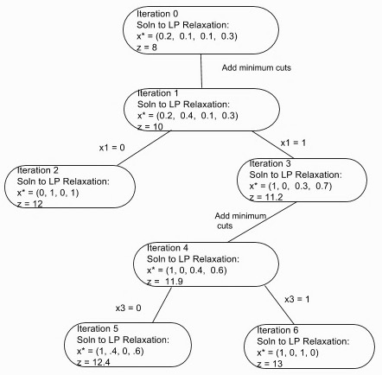
Solving Max Cut via Branch and Cut
Solve LP solution
Add cutting planes
Re-Optimize to see if integer
Check if integer and branch accordingly
Stop when we can no longer get better

Slide 5
Implementing a Branch and Cut Algorithm
Implemented in Python
DFS-like queue of models to keep track of branching
While queue is non-empty, process models
Add all valid and necessary odd cycle cut constraints and optimize
Check if solution is integer and better than current best

Slide 6

Branch and Cut Pseudocode
Initialize and Solve Initial Model (LP Relaxation)
If initial model solution is integer:
Return model
Else:
queue.add(model);
cur_best ← lower_bound_algo(model)
While queue not empty:
model ← queue.pop(0)
model ← add_odd_cuts(model)
Solve model
If model solution is integer:
If model.obj > cur_best:
cur_best ← model.obj
ElseIf model.obj ≤ cur_best:
continue
Else:
m1, m2 ← branch_and_bound(model)
queue.add(m1)
queue.add(m2)
Return model

Slide 7
Adding Cut Constraints to the Model
c₁
flag ← True
While flag:
added_list ← [ ]
pg ← build_pseudograph(model)
For node in model.vars:
constraint, violated_flag ← build_constraint(pg, node)
added_list.add(violated_flag)
If violated_flag and constraint not in model.constrs:
model.addConstr(constraint)
model.optimize()
If model integer or sum(added_list) == 0:
flag ← False
Return model
c₂
c₃
c₁
c₁
c₂
c₃
c₂
c₃

Slide 8

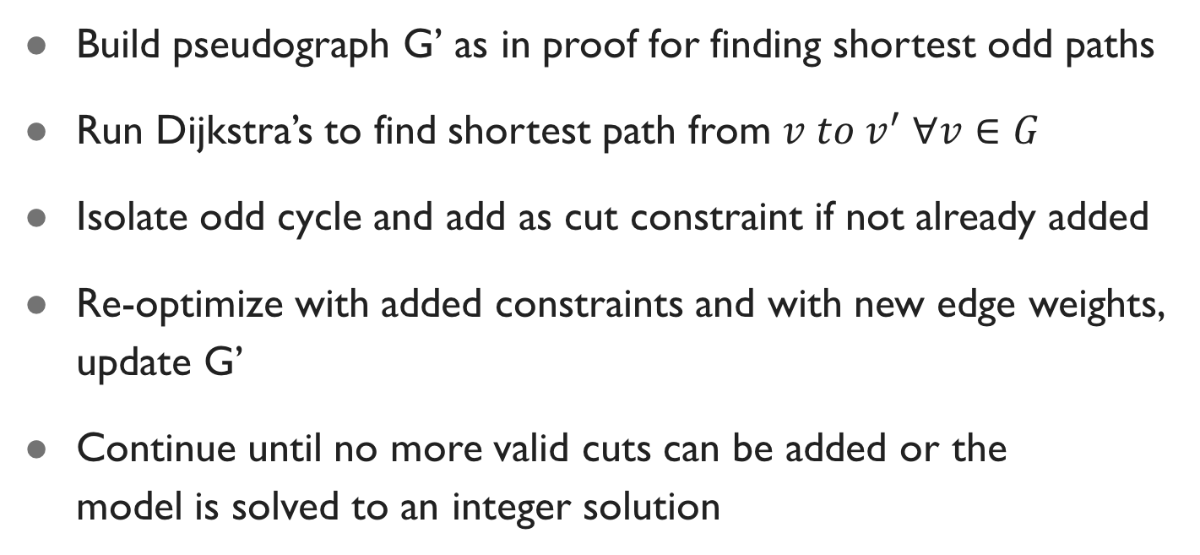
Building the Cut Constraints
Build pseudograph G’ as in proof for finding shortest odd paths
Run Dijkstra’s to find shortest path from $v to v^{′} ∀v∈G$
Isolate odd cycle and add as cut constraint if not already added
Re-optimize with added constraints and with new edge weights, update G’
Continue until no more valid cuts can be added or the model is solved to an integer solution

Slide 9
Computational Results – TSP Graphs
Test Case | Att48 | Gr21 | Ulysses22 | Hk48
Number of Nodes | 48 | 21 | 22 | 48
Number of Edges | 1128 | 210 | 231 | 1128
Optimal Max Cut | 798828 | 49892 | 117119 | 771712
Run Time* (s) | 40.633 | 1.534 | 0.899 | 41.673
Iteration Count | 1 | 5 | 1 | 1
* Computations Run on: Late-2013 Macbook Pro – 2.6GHz Intel i5, 8GB 1600 MHz DDR3 RAM

Slide 10
Computational Results – Planar Graphs
Test Case | a280 | bier127 | ch130 | ch150 | d198 | d493 | d657 | d1291
Number of Nodes | 280 | 127 | 130 | 150 | 198 | 493 | 657 | 1291
Number of Edges | 788 | 368 | 377 | 432 | 571 | 1467 | 1958 | 3845
Optimal Max Cut | 12330 | 375761 | 22567 | 22549 | 79438 | 129744 | 199616 | 547939
Run Time* (s) | 250.909 | 17.329 | 18.603 | 34.314 | 63.855 | 2609.894 (~43 mins) | 5949.041 (~1.65 hrs) | 80958.156 (~22.5 hrs)
Iteration Count | 1 | 1 | 1 | 1 | 1 | 1 | 1 | 1
* Computations Run on: Late-2013 Macbook Pro – 2.6GHz Intel i5, 8GB 1600 MHz DDR3 RAM

Slide 11

Algorithmic Shortcomings and Potential Improvements
Slower than expected for planar graphs
Run Dijkstra’s Algorithms tens of thousands of times
Queue Implementation - BFS vs DFS
Duplicate cut generation and check
Better lower bound algorithm
Implementations of Dijkstra’s on sparse graphs that run quicker

Slide 12
Max Cut Recap
Questions?
Max Cut Problem Overview
Branch and Cut Algorithm
Our Implementation and Pseudocode
Computational Results
Potential Improvements

