Slide 1
Solving the Max Cut Problem
Sakibul Alam, Alex Gardner, Vincent Gonzales

Slide 2
Max Cut Overview
General Max Cut Problem
Branch and Cut Algorithm
Our Implementation
Computational Results
Concluding Remarks
Cut Icon

Slide 3
What is the Max Cut Problem?
Undirected graph G = (V,E)
Goal: Partition nodes into two sets by removing edges from the graph such that the cost of the edges removed is maximized
Linear Program Formulation Here
Pic of Scissors

Slide 4
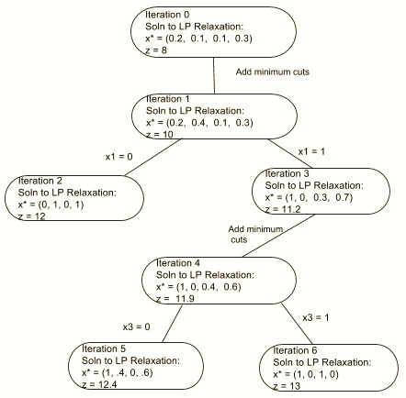
Solving Max Cut via Branch and Cut
Solve LP solution
Add cutting planes
Re-Optimize to see if integer
Check if integer and branch accordingly
Stop when we can no longer get better

Slide 5
Stopping Condition - When to Stop Branching
Branch reaches an integer feasible solution
Branch solution in non-integer but worse than current best solution
Branch solution is infeasible
Tree Shadow Icon

Slide 6
Implementing a Branch and Cut Algorithm
Implemented in Python
DFS-like queue of models to keep track of branching
While queue is non-empty, process models
Add all valid and necessary odd cycle cut constraints and optimize
Check if solution is integer and better than current best

Slide 7
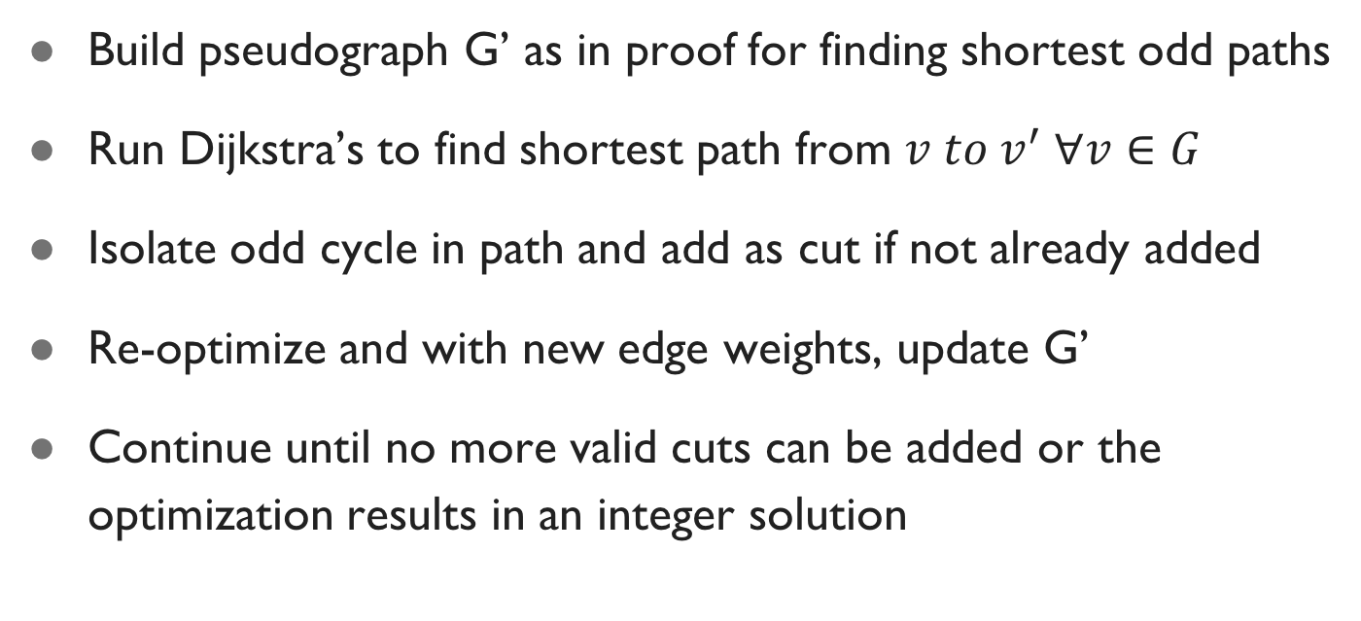
Adding Cut Constraints to Limit Branching
Build pseudograph G’ as in proof for finding shortest odd paths
Run Dijkstra’s to find shortest path from $v to v^{′} ∀v∈G$
Isolate odd cycle in path and add as cut if not already added
Re-optimize and with new edge weights, update G’
Continue until no more valid cuts can be added or the optimization results in an integer solution
Edward Scissorhands

Slide 8
Computational Results – TSP Graphs
Test Case | Att48 | Gr21 | Ulysses22 | Hk48
Number of Nodes | 48 | 21 | 22 | 48
Number of Edges | 1128 | 210 | 231 | 1128
Optimal Max Cut | 798828 | 49892 | 117119 | 771712
Run Time* (s) | 221.669 | 2.136 | 1.809 | 70.585
Iteration Count | 14 | 5 | 1 | 1
* Computations Run on: Late-2013 Macbook Pro – 2.6GHz Intel i5, 8GB 1600 MHz DDR3 RAM

Slide 9
Computational Results – Planar Graphs
Test Case | a280 | bier127 | ch130 | ch150 | d198 | d493 | d657 | d1291
Number of Nodes | 280 | 127 | 130 | 150 | 198 | 493 | 657 | 1291
Number of Edges | 788 | 368 | 377 | 432 | 571 | 1467 | 1958 | 3845
Optimal Max Cut | 12330 | 375761 | 22567 | 22549 | 79438 | 129744 | 199616 | 547939
Run Time* (s) | 310.749 | 19.546 | 21.108 | 39.427 | 79.278 | 3327.402 (~55 mins) | 8155.256 (~2.25 hrs) | 80958.156 (~22.5 hrs)
Iteration Count | 1 | 1 | 1 | 1 | 1 | 1 | 1 | 1
* Computations Run on: Late-2013 Macbook Pro – 2.6GHz Intel i5, 8GB 1600 MHz DDR3 RAM

Slide 10
Algorithmic Shortcomings and Potential Improvements
Slower than expected for planar graphs
Run Dijkstra’s Algorithms tens of thousands of times
Other shortcomings
Solutions
Timer Icon

Slide 11
Max Cut Recap
Questions?
Max Cut Problem Overview
Branch and Cut Algorithm
Our Implementation
Computational Results
Potential Improvements

