Slide 1

user Behavior analysis
Nikhil Aggarwal
Ridhima puri

Slide 2
Agenda
Motivation
Introduction to Data Set
Data Cleaning
Visualization
Modelling Techniques

Slide 3


Motivation
Mobile Apps have become one of the ways to survive the cut throat competition and has following benefits:
Visible to customers all the time and increase engagement
Direct marketing channel and build brand
Provide value to customers and build customer loyalty
Companies provide free products/services via mobile apps to transition their customers to a paid membership.
Requires heavy marketing and a huge amount of budget in the form of offers and promotions.
Very important for a company to know their target market and direct their major marketing efforts towards the users who will not subscribe to the paid memberships

Slide 4
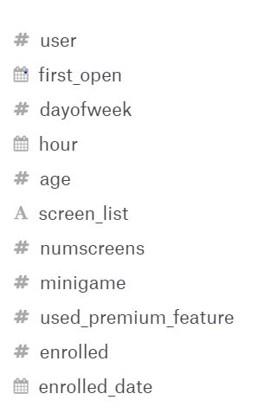
Introduction to Data set
We are using data posted at Kaggle under the name “Fintech_App_Behaviour_Analysis”.
The data has 2 files. First is the app data consisting of 50K rows and 12 columns.
Second is the top screens data consisting of 58 rows and 2 columns.
The data gives an overview of time and date of app installation, the features used by the users and the usage of the app.

Slide 5
Data cleaning
No missing data found but Screen list variable was a challenge
It consisted of the information about the various screens visited by a user while using the app.
The number of screens visited could be different for every user and this variable consisted of all the comma separated values.
List of top screens in the app in a separate csv file.
Our final approach was to use the top screens data and generate additional columns in our main data set which consisted of 0 as a default value (indicating not visited).
For every screen visited by a user the column with that name was marked as 1 i.e. user visited this screen.

Slide 6
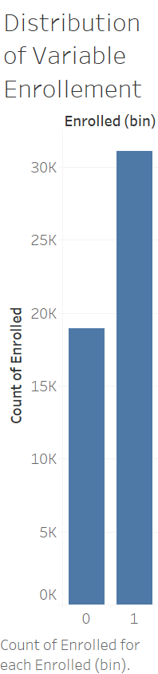
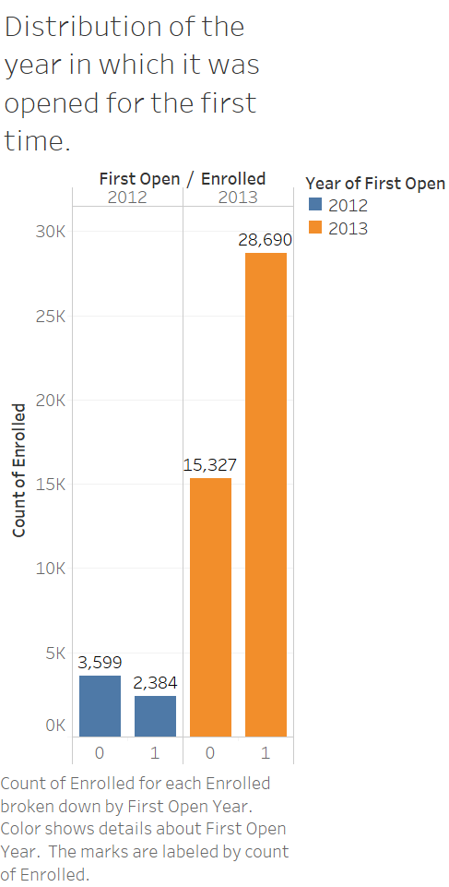
Data Visualization
We have greater number of enrolled users than not enrolled.
The number of users coming and using the app and the number of users enrolling for the app are higher in 2013 as compared to 2012.

Slide 7
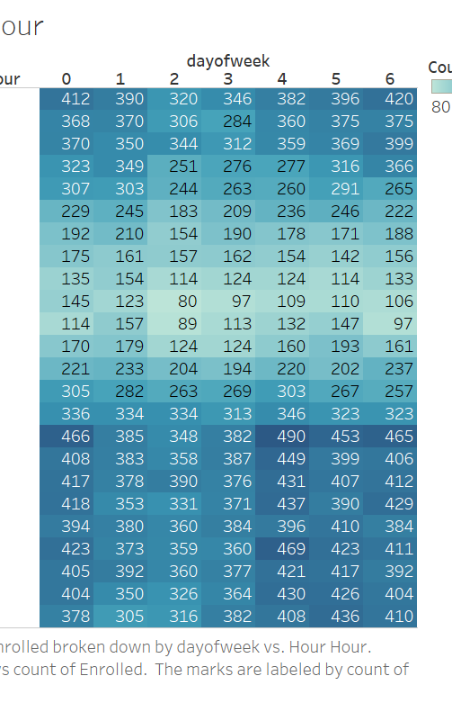
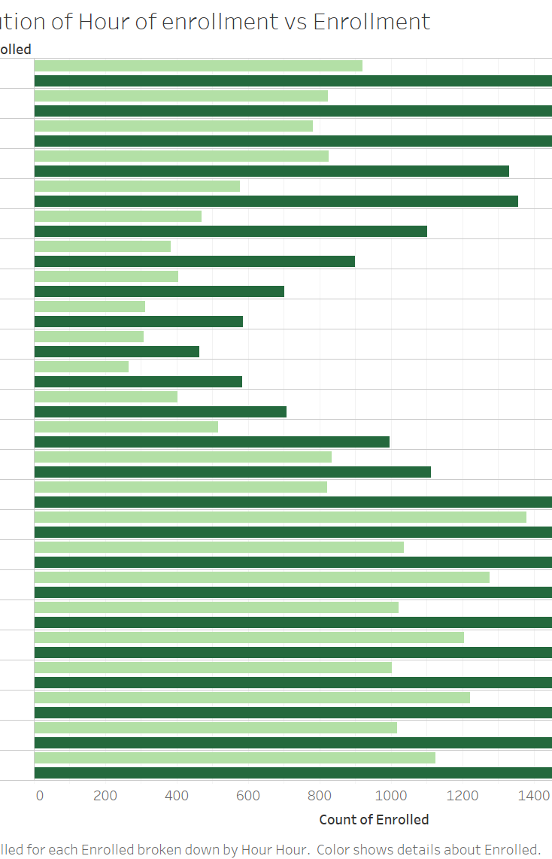
Effect of Hour and Day of week
More users were active during the off-working hours and thus the late evening and the night time had greater people enrolling for the app.
Similarly weekends had more enrollment than weekdays.

Slide 8
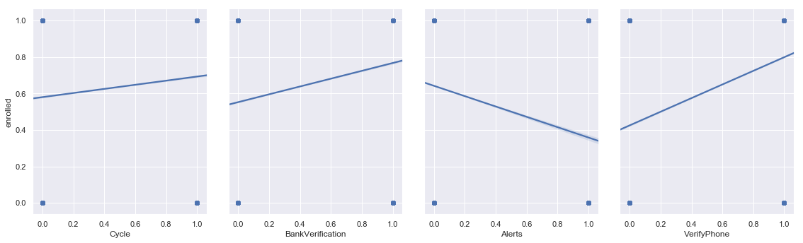
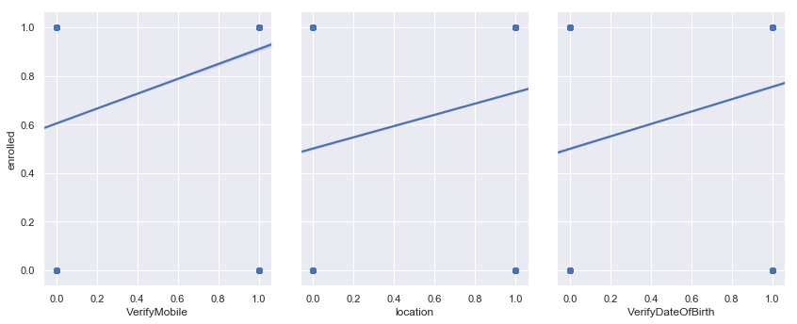
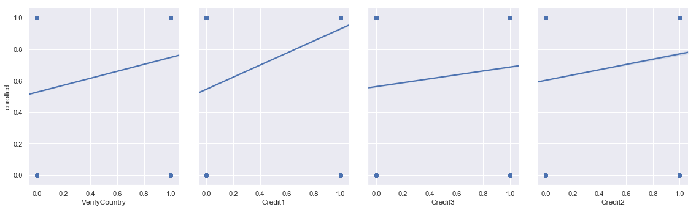
Impact of Screen visited
From the data visualization we concluded that if we need to launch offers and promotions it should be on all the credit screens, verifications screens and the games screen
These screens have maximum entry of users and are increasing the chances of enrollment

Slide 9
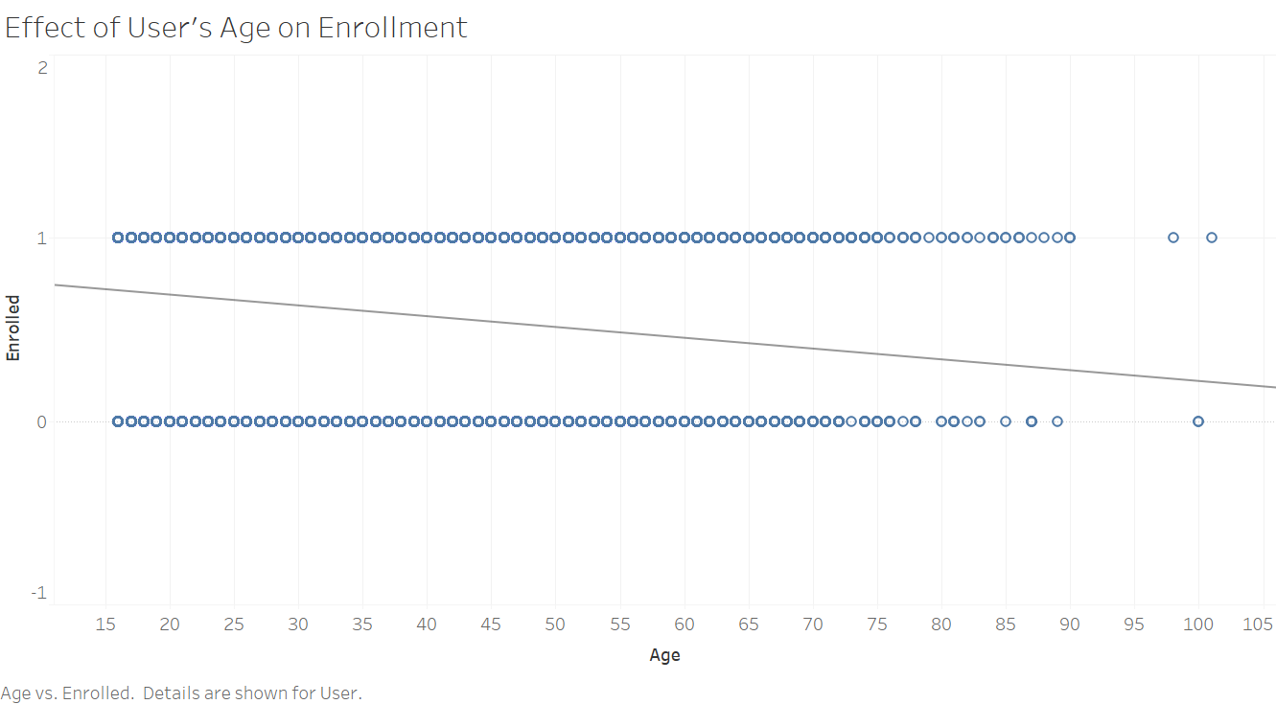
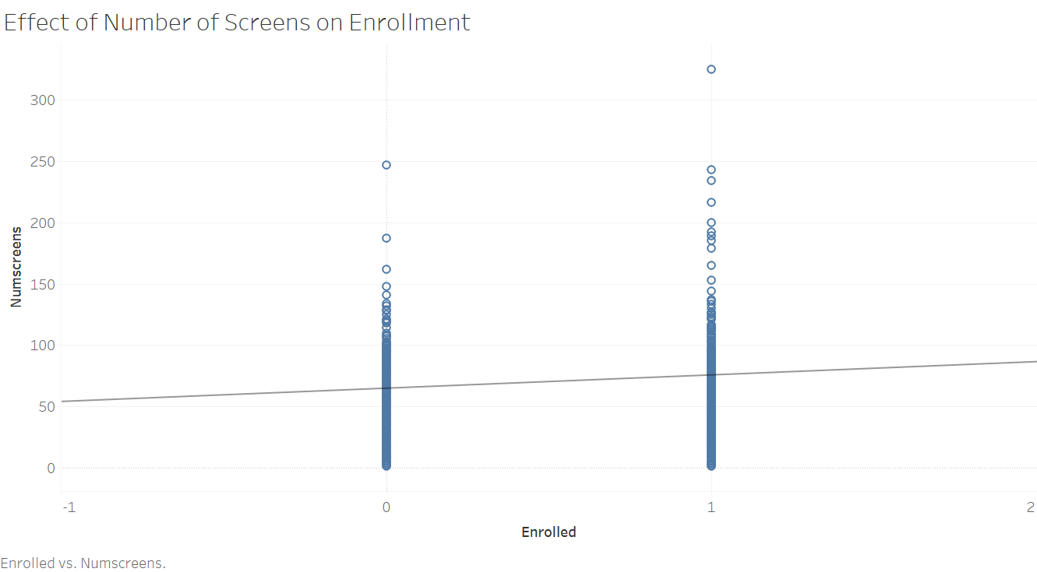
Age and number of screen visited

Slide 10
Model Selection and parameter tuning
K fold Cross Validation
Principal Component Analysis
Grid Search(Hyper Parameter Tuning)
Feature Scaling

Slide 11
Models and their accuracies
ACCURACY | Train Data | Test Data
Logistic Regression | 70.15% | 70.60%
KNN | 71.30% | 71.44%
Decision Trees | 69.085% | 69.36%
Random Forest | 69.81% | 70.07%
XGBoost | 73.01% | 73.05%
Artificial Neural Networks | 70.30% | 70.50%

Slide 12
Summary and usages
XGBoost gives the best predictive power to classify the people who would not enroll for the app with an accuracy if 73.05%.
Other business uses of studying user behavior:
We can study the screens used the most by any user and use this information for advertisements.
We can put a greater marketing effort for the users who have lower chance of conversion.
By studying the features used the most, we can lure the consumers to buy subscription by enhancing such features.

