Slide 1
IC 272 MINI PROJECT
BATCH 5
Nidhi
Ruchika
Parth
Shrikha
Gahan
Pranjal

Slide 2





Data Attributes

Slide 3
Exploratory Data Analysis
This dataset contains data of several patients in the US refilling different medications from pharmacies . Each row in a data is a patient who refills a particular medicine.

Slide 4
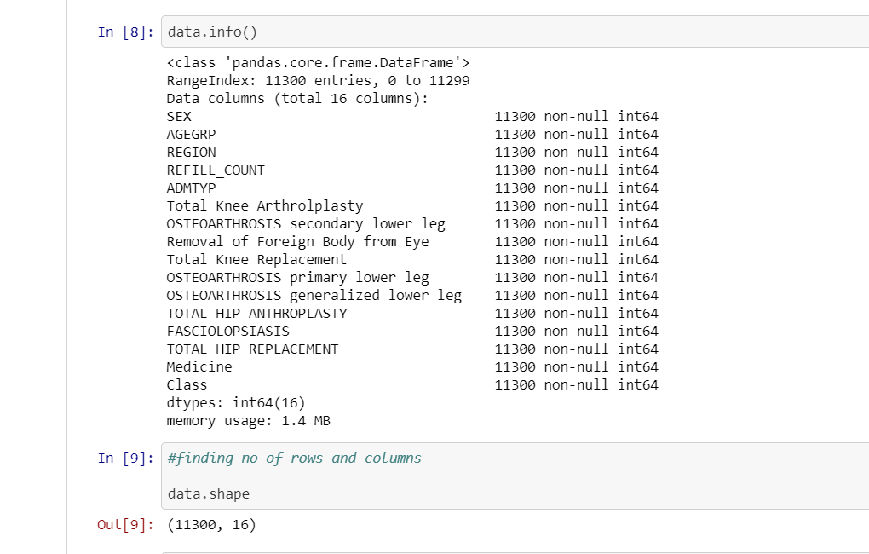

Slide 5
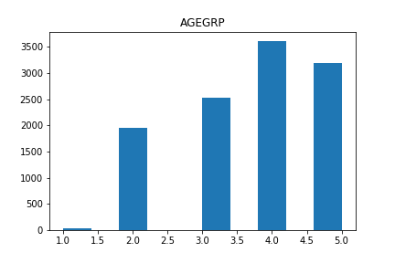
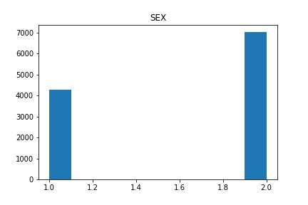
HISTOGRAMS
1: MALE
2: FEMALE

Slide 6
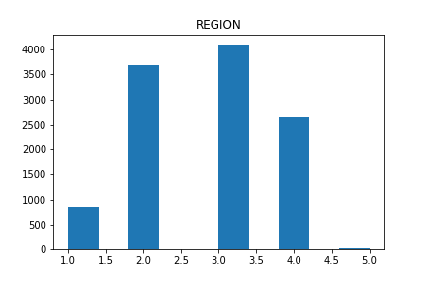
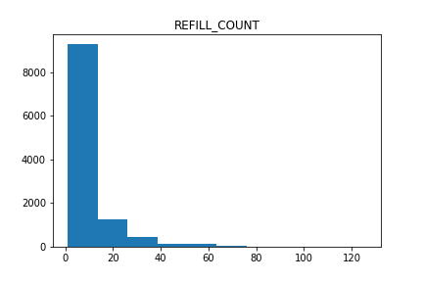

Slide 7
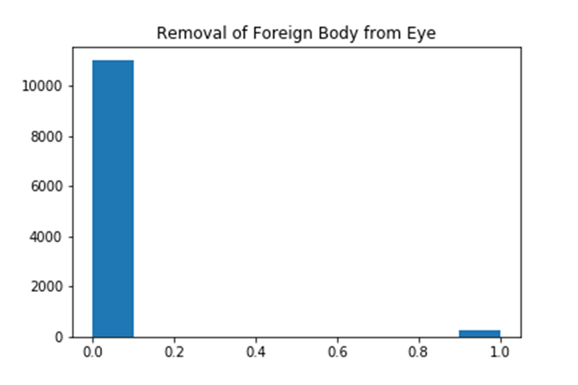
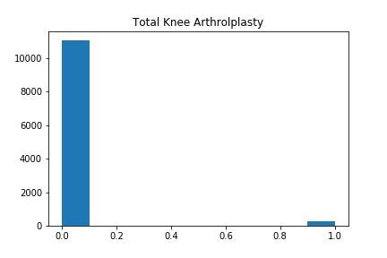
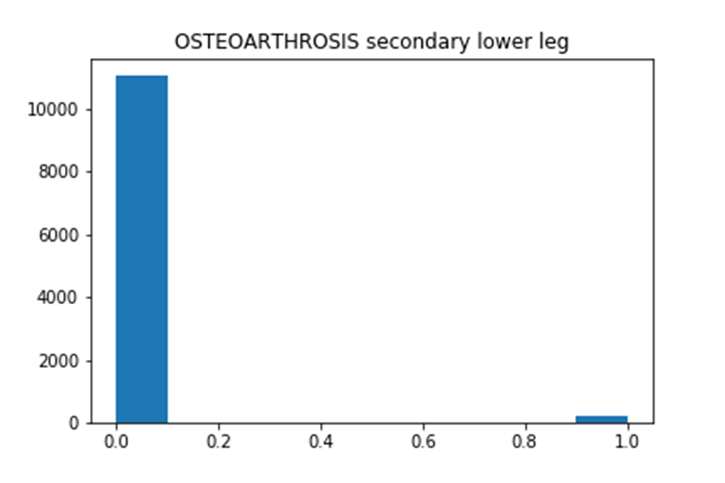
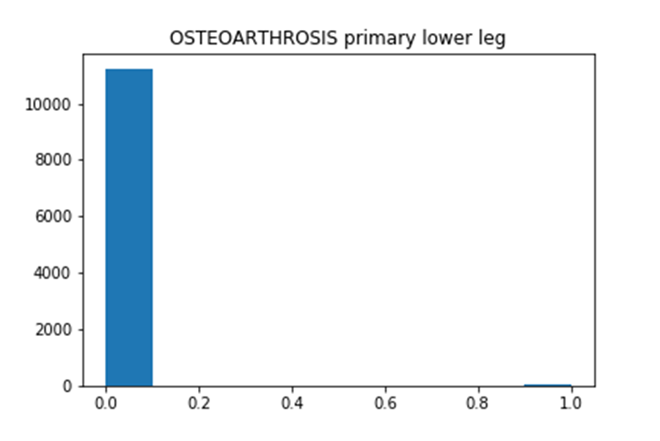

Slide 8
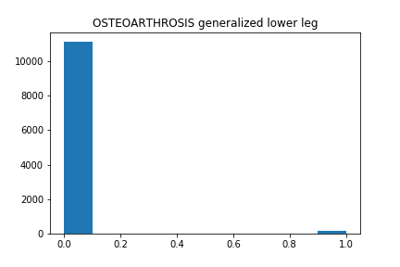
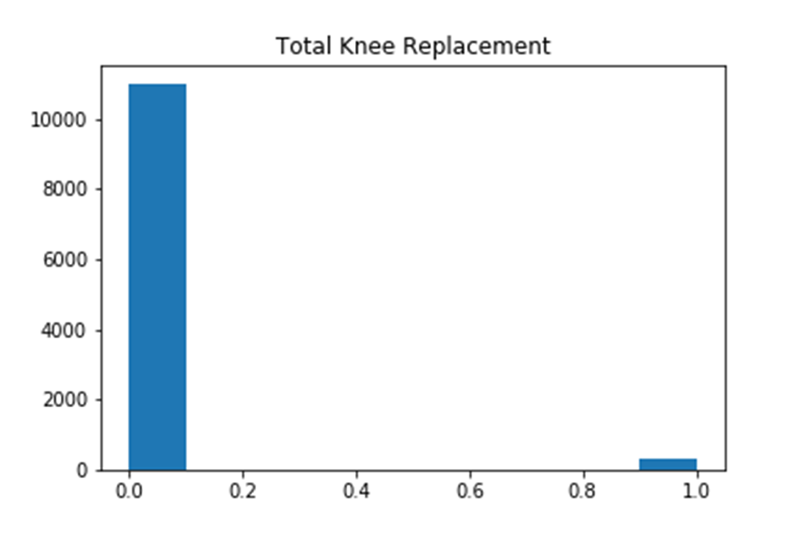

Slide 9
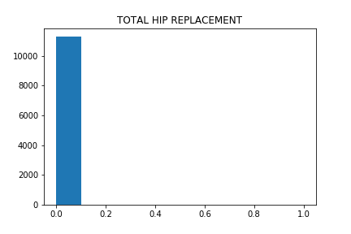
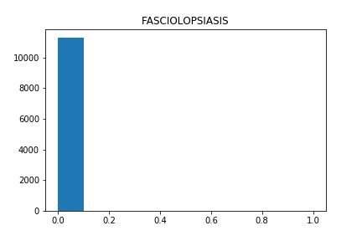
Not a single person has gone through these medications:

Slide 10
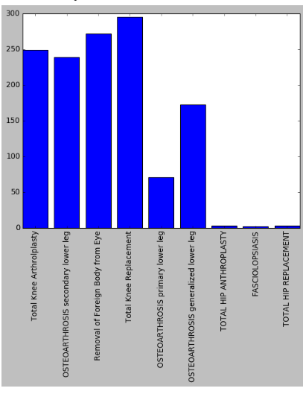
Frequency Of Different Operations

Slide 11
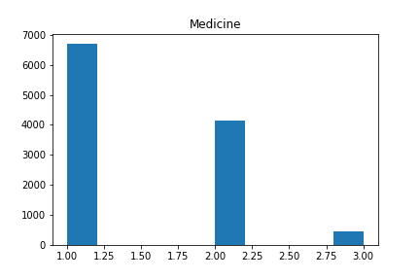
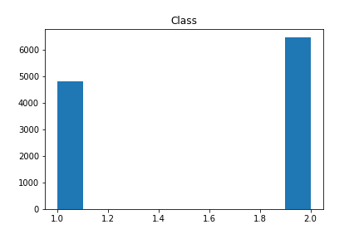

Slide 12
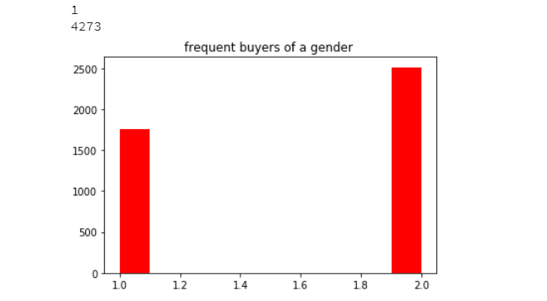
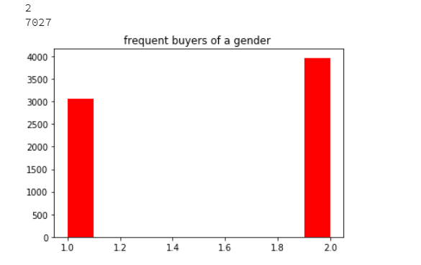
Classification of class w.r.t gender.
MALE
FEMALE

Slide 13
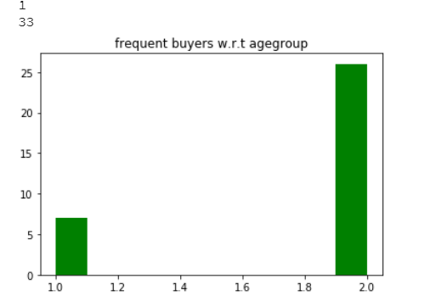
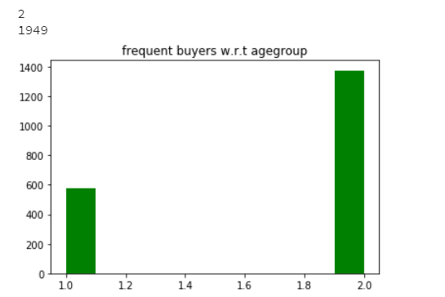
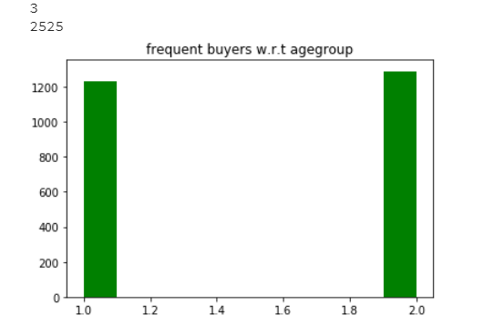
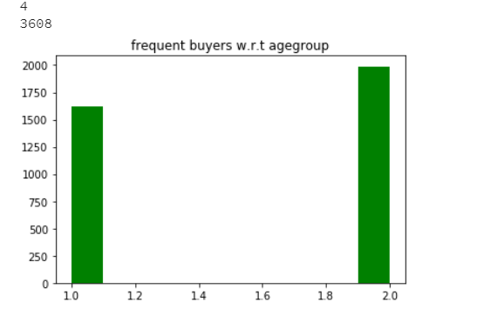
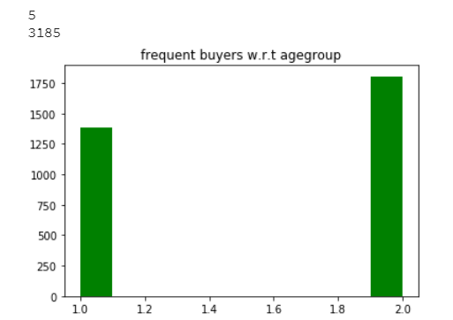
Classification of class w.r.t. Age Group

Slide 14
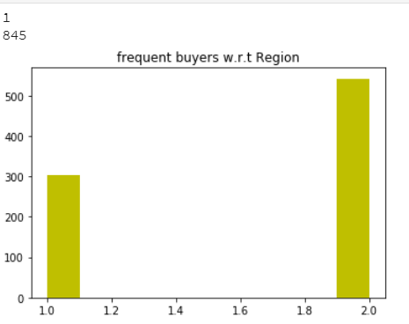
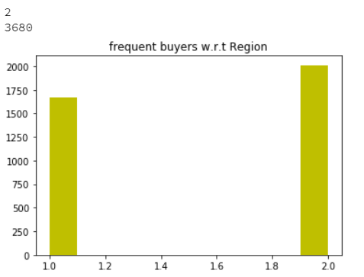
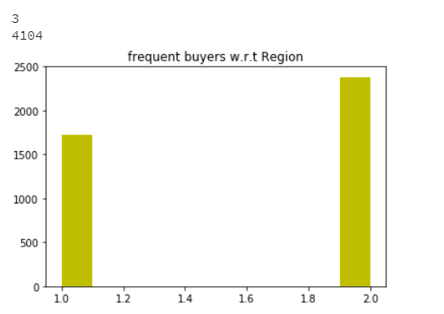
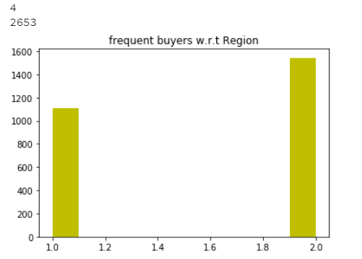
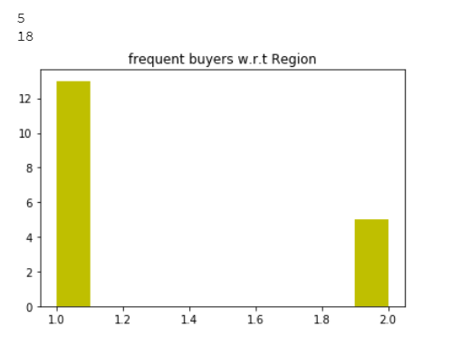
Classification of class w.r.t. regions

Slide 15
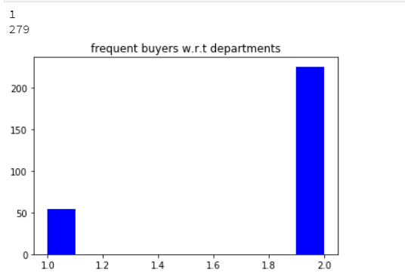
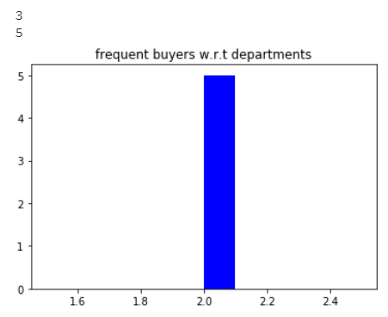
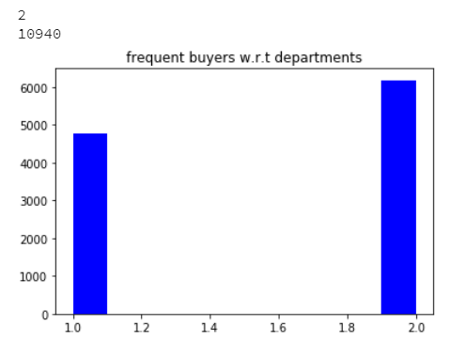
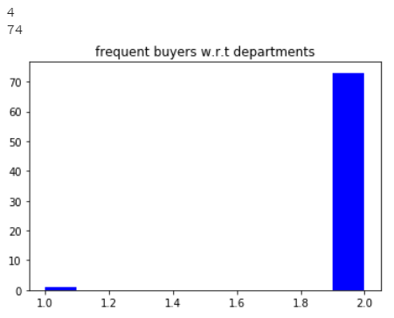
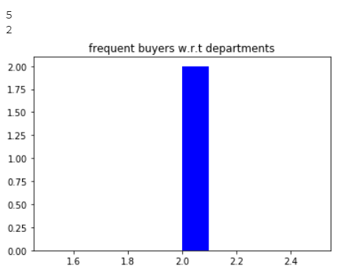
Classification of class w.r.t. Departments(ADMTYP)

Slide 16
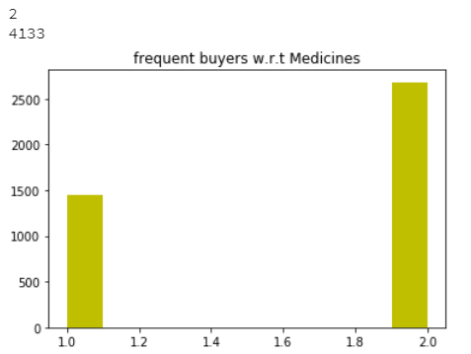
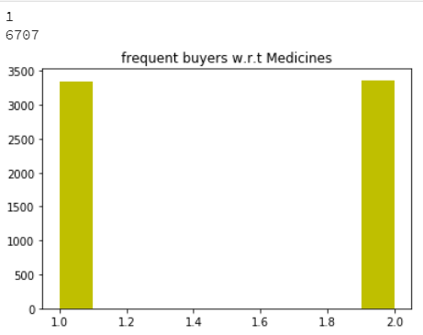
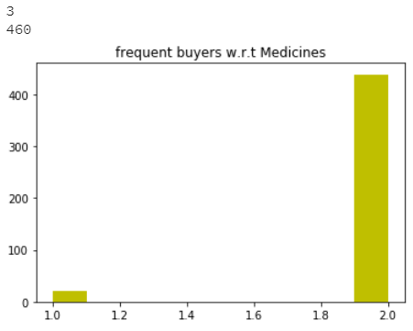
Classification of class w.r.t. MEDICINES

Slide 17
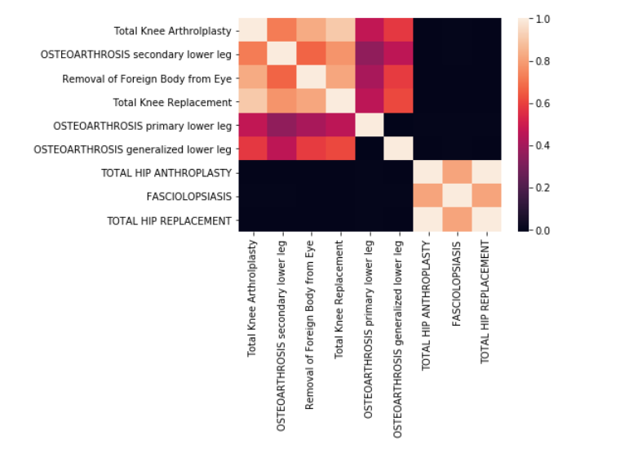
Heat map of different operations and their correlations

Slide 18
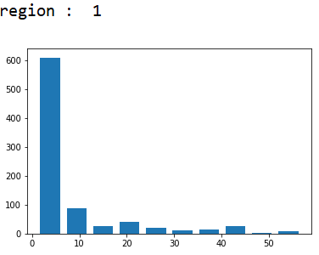
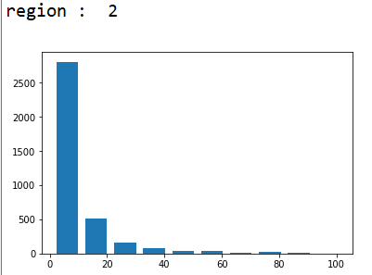
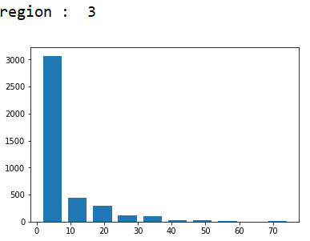
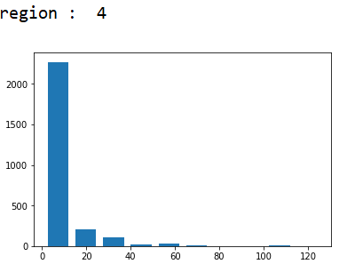
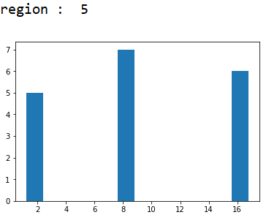
Refill Counts from different regions:

Slide 19
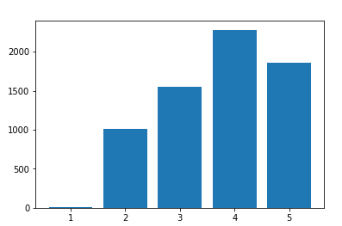
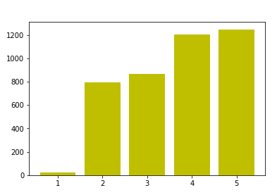
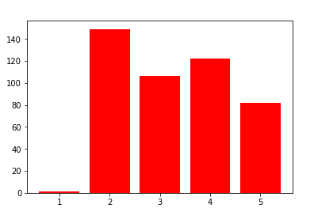
Use of medicines by different age groups
Medicine 1
Medicine 2
Medicine 3

Slide 20
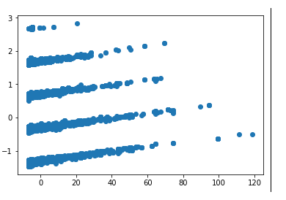
SCATTER PLOT OF DATA AFTER PCA (n_components=2)

Slide 21
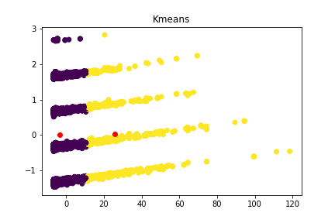
K MEANS CLUSTERING ( clusters=2)
PURITY SCORE : 0.688

Slide 22
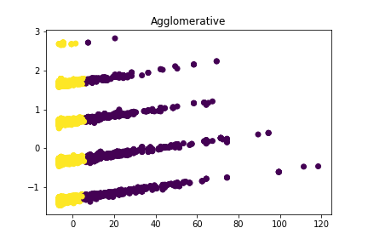
AGGLOMERATIVE CLUSTERING ( clusters=2)
PURITY SCORE: 0.753

Slide 23
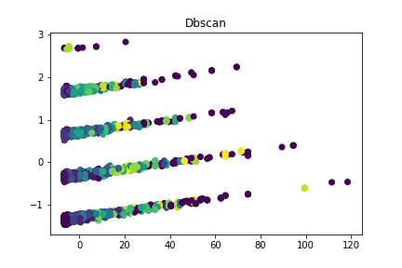
DBSCAN CLUSTERING
PURITY SCORE : 0.9

Slide 24
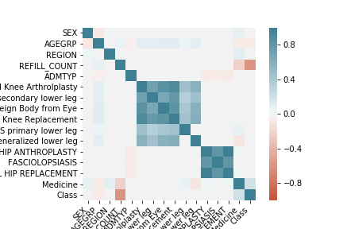

Covarience Plots

Slide 25

Scatter plots of all attributes taken two at a time

Slide 26

Nearest Neighbour Classification

Slide 27


K-nearest Neighbour Classification

Slide 28

Bayes-Classification Unimodal

Slide 29


Bayes-Classification Multimodal

Slide 30


After applying PCA (Reduced Dimension = 1)

Slide 31


After applying PCA (Reduced Dimension = 2,3)

Slide 32


After applying PCA (Reduced Dimension = 4)

Slide 33
SEX -0.022927833175784083 AGEGRP -0.06690921600992919 REGION -0.0011192859220723185 REFILL_COUNT -0.6028187901342353 ADMTYP 0.0006670893930201674 Total Knee Arthrolplasty 0.01477762489235768 OSTEOARTHROSIS secondary lower leg 0.0010702471039462386 Removal of Foreign Body from Eye 0.009252896762120016 Total Knee Replacement 0.010917066256215063 OSTEOARTHROSIS primary lower leg 0.020970880800436686 OSTEOARTHROSIS generalized lower leg -0.0033060213707193534 TOTAL HIP ANTHROPLASTY 0.003060044835251118 FASCIOLOPSIASIS 0.01146663394858448 TOTAL HIP REPLACEMENT 0.003060044835251118 Medicine 0.20589254192569523
Feature subset Selection
Pearson Correlations with target attribute

Slide 34
Max. correlated with Refill count

Slide 35


DBSCAN
Class
Class
Refill_count
Refill_count

Slide 36


Next max. correlation with medicine
K-Nearest Neighbour

Slide 37


Bayes Classification

Slide 38


DBSCAN
Class
Class
medicine
medicine

