Slide 1
Hangman Game

Slide 2
Team 5
Deepa Dhingra
Meera Mali
Pratheeksha Devegowda
Renu Batheja
Somya Aggarwal

Slide 3
No! Click to go on.
YOU LOST!
X
h
a
n
g
m
a
n
Q
W
E
R
T
Y
U
I
O
P
A
S
D
F
G
H
J
K
L
Z
X
C
V
B
N
M
New Word.

Slide 4
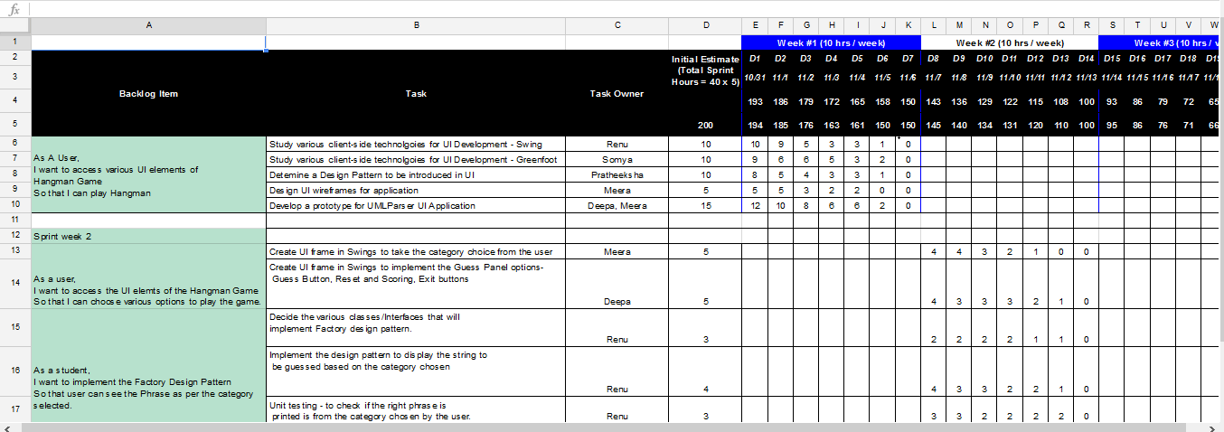
Scrum Board

Slide 5
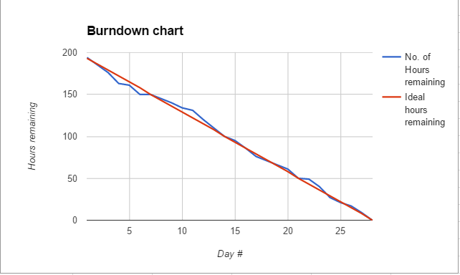
Burn down Chart

Slide 6
Class Diagram

Slide 7
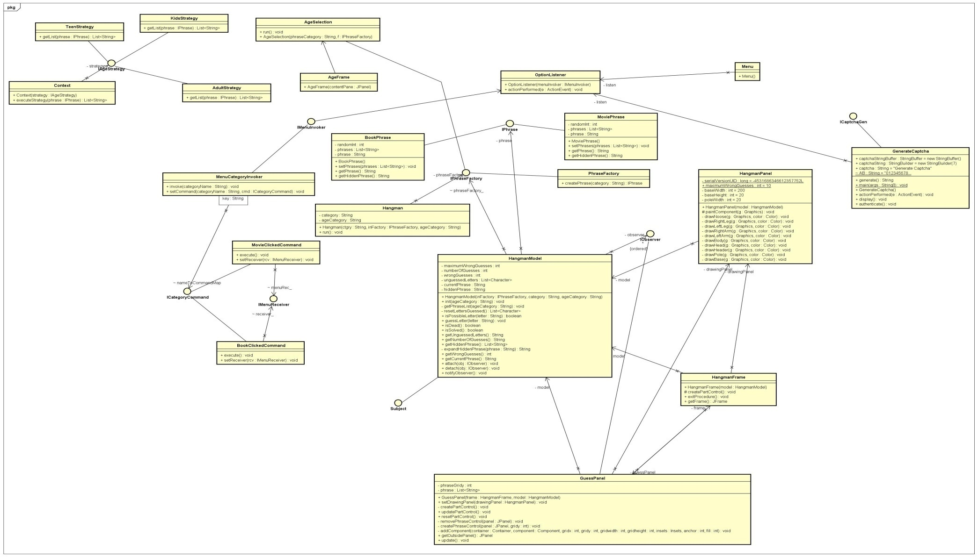

Slide 8
UI Wireframes

Slide 9
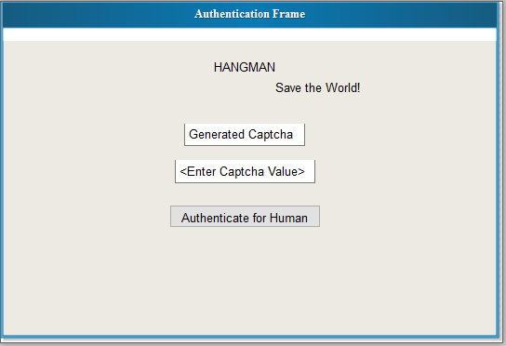
Captcha Screen

Slide 10
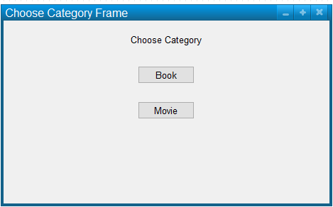
Phrase Category

Slide 11
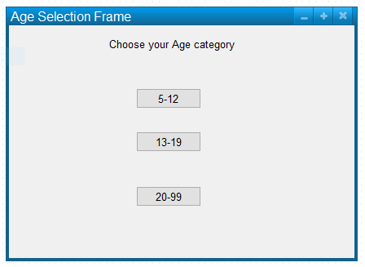
Age Category

Slide 12
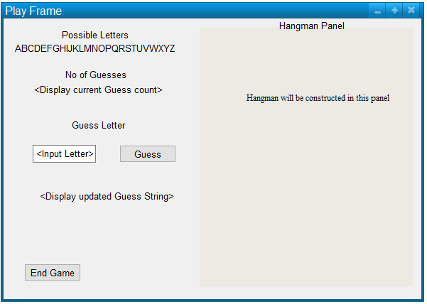
Guess Panel

Slide 13
Use Case Overview Diagram

Slide 14
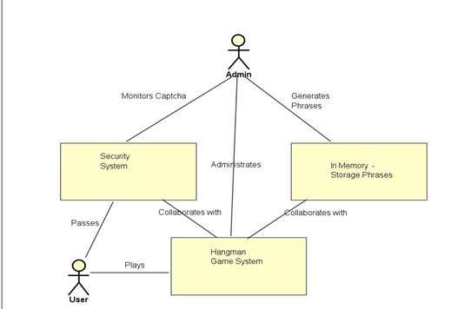

Slide 15
Use Case Specifications
And
Sequence Diagrams

Slide 16
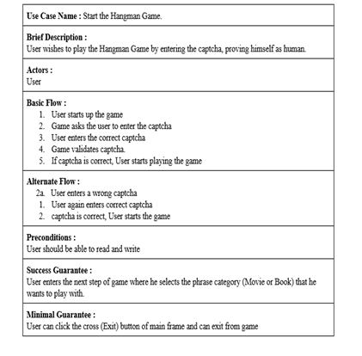
Start Hangman Game

Slide 17
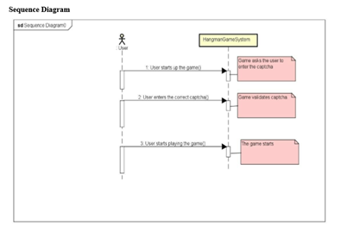

Slide 18
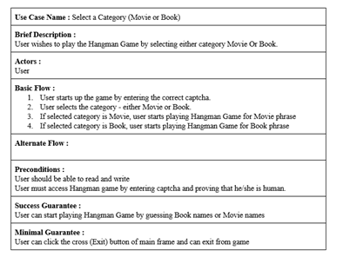
Select Category

Slide 19
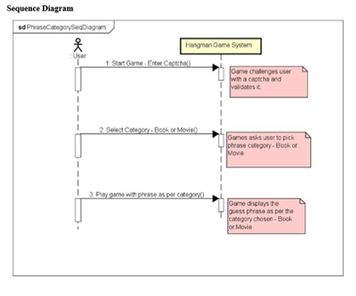

Slide 20
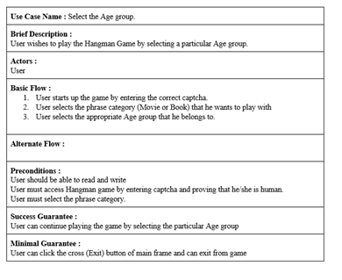
Select Age Group

Slide 21
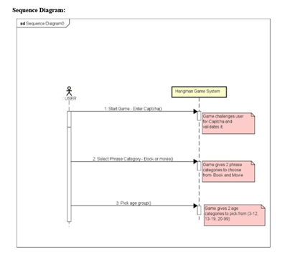

Slide 22
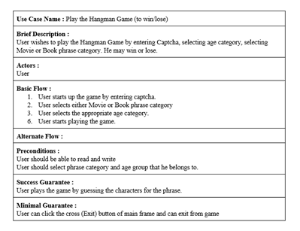
Play Hangman Game – Win/Loose

Slide 23
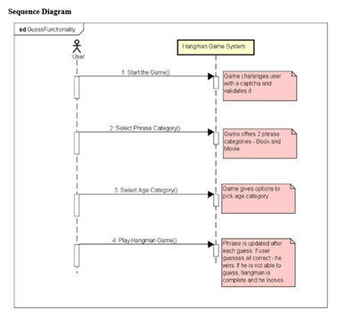

Slide 24
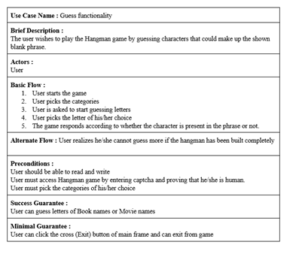
Guess Functionality

Slide 25
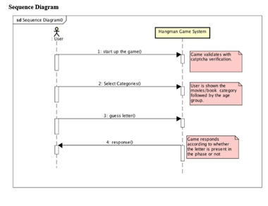

Slide 26
Activity Diagram

Slide 27
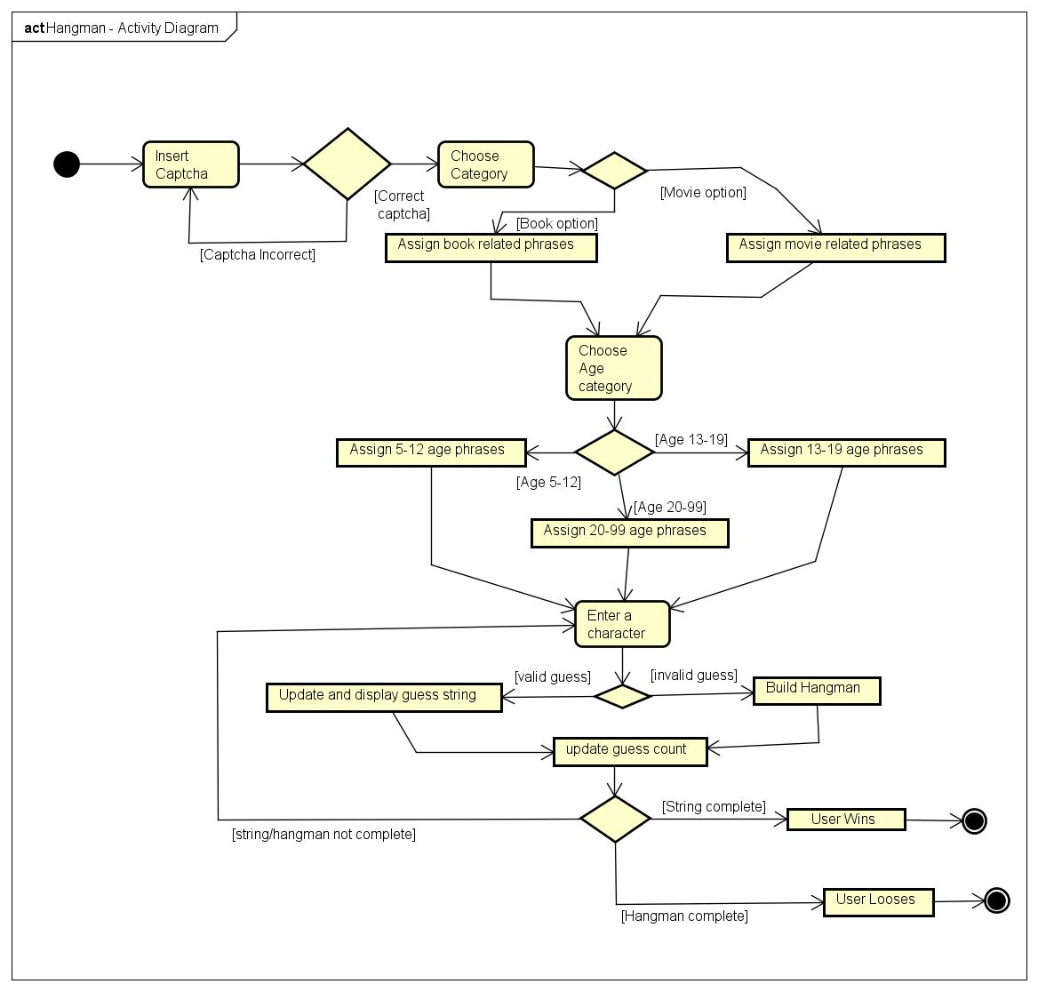

Slide 28
Design Patterns
Proxy Pattern
Observer Pattern
Strategy Pattern
Factory Pattern
Abstract Factory
Command Pattern

Slide 29
Proxy Pattern
Captcha generation and validation
User passes captcha to play the game
Participating classes:
Generate Captcha
ICaptchaGen
Menu

Slide 30
Abstract Factory & Factory Method Patterns
Factory creation based on the category chosen (Book/Movie)
Abstract factory can be used to enhance more features.
Participating classes:
IPhraseFactory
IPhrase
Phrase

Slide 31
Command Pattern
Based on Menu Item invoked (Book/Movie) command is sent
Participating classes:
IMenuInvoker
IMenuReceiver
ICategoryCommand
MenuCategoryInvoker
BookClickedCommand
MovieClickedCommand
Menu

Slide 32
Strategy Pattern
Based on Age category picked, appropriate strategy is used to generate phrases
Participating classes:
IAgeStrategy
KidsStrategy
TeenStrategy
AdultStrategy
Context
AgeFrame
AgeSelection

Slide 33
Observer Pattern
Hangman panel observes a wrong guess in guess panel and builds up the hangman drawing.
Participating classes:
IObserver
OptionListener
GuessPanel
HangmanPanel

