Slide 1
Cricket Matches Analysis

Slide 2
Problem Statement
The notebooks explores the basic use of Pandas and will cover the basic commands of Exploratory Data Analysis(EDA) which includes cleaning, munging, combining, reshaping, slicing, dicing, and transforming data for analysis purpose
Exploratory Data Analysis Understand the data by EDA and derive simple models with Pandas as baseline. EDA ia a critical and first step in analyzing the data and we do this for below reasons :Finding patterns in Data
Determining relationships in Data
Checking of assumptions
Preliminary selection of appropriate models
Detection of mistakes

Slide 3
Coolum's in Dataset and Description
Column Name | Description
id | Identity Column
season | Year in which Match
city | City where match has been played
date | Date on which Match has been played
team1 | First Team
team2 | Second Team
toss_winner | Team who won the Toss
toss_decision | What does team has decide whether to bat or field first
result | normal, no result or tie
dl_applied | 0 for False and 1 for True
winner | Team won
win_by_runs | Margin of runs in victory
win_by_wickets | By How many wickets team has won
player_of_match | Player who has performed best in that Match
venue | Name of stadium
umpire1 | Name of Umpire1
umpire2 | Name of Umpire2
umpire3 | Name of Umpire3

Slide 4
Sample data
id | season | city | date | team1 | team2 | toss_winner | toss_decision | result | dl_applied | winner | win_by_runs | win_by_wickets | player_of_match | venue | umpire1 | umpire2 | umpire3
1 | 2017 | Hyderabad | 2017-04-05 | Sunrisers Hyderabad | Royal Challengers Bangalore | Royal Challengers Bangalore | field | normal | 0 | Sunrisers Hyderabad | 35 | 0 | Yuvraj Singh | Rajiv Gandhi International Stadium, Uppal | AY Dandekar | NJ Llong | NaN

Slide 5


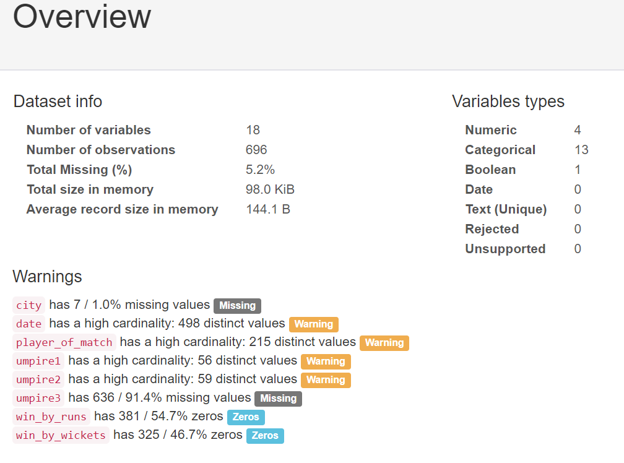
Pre-profiling

Slide 6
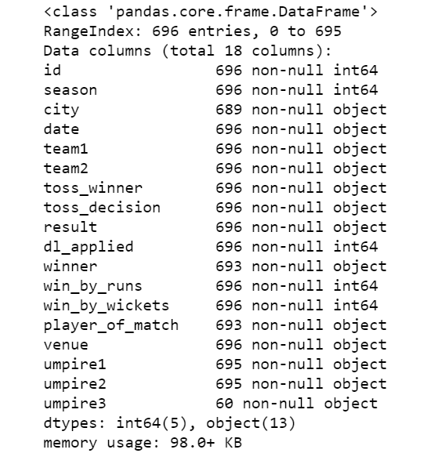
Insight of Dataset

Slide 7

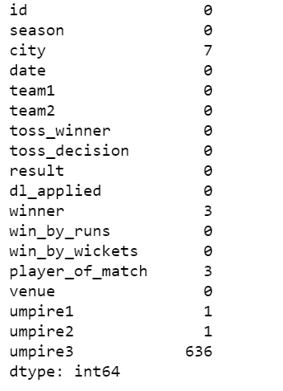
Null values in Dataset

Slide 8
Preprocessing Data
Dealing with missing values:-
Dropping missing entries of umpire3.
Replacing missing values of winner with N/A values as these matches were having no result.
Changing city to Abu Dhabi as they are from Dubai Venue.
Replacing values of winner with N/A values as those matches were tie.
Added a new column loser to the dataset.

Slide 9
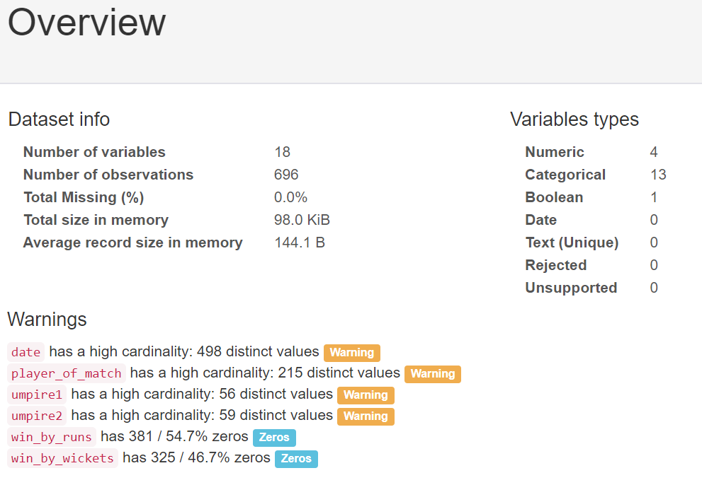
Post profiling

Slide 10
Assumption and predicates

Slide 11
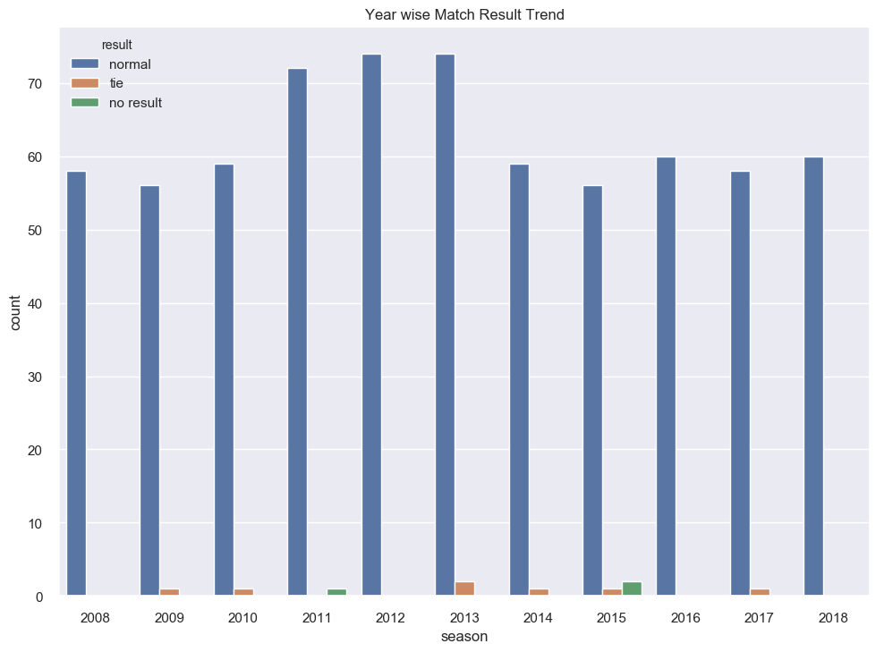
result trend on yearly basis
You can see maximum matches has been played in 2013.
Number of matches which have been tie and no result are very low

Slide 12
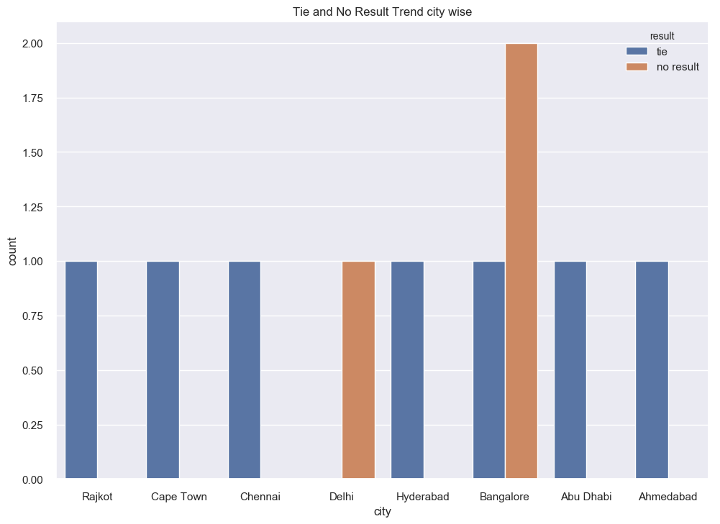
tie and no results trend on cities basis
Bangalore has maximum number of no results

Slide 13
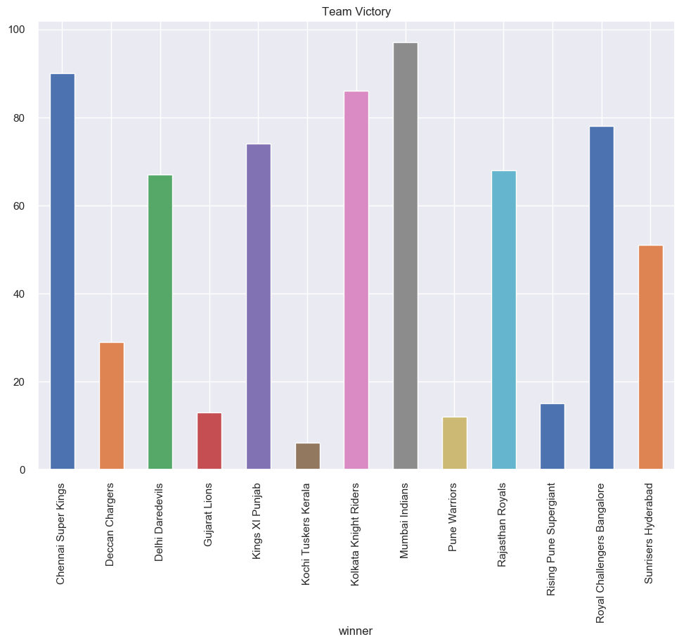
overall trend of Match Played by winner
Mumbai Indians has secured maximum victory.
Kochi Tuskers Kerela has minimum victory

Slide 14
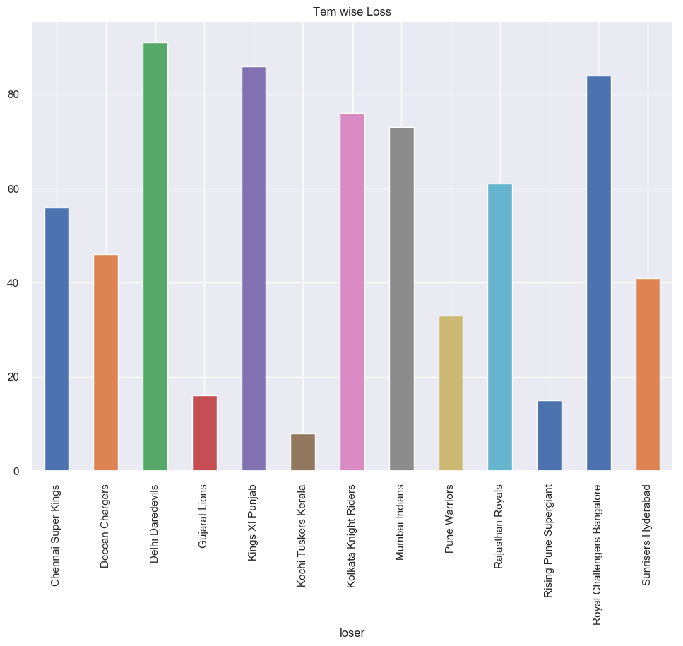
overall trend of Match Played by loser
Delhi Daredevils has maximum number of losses.
Kochi Tuskers Kerela has minimum number of losses.

Slide 15
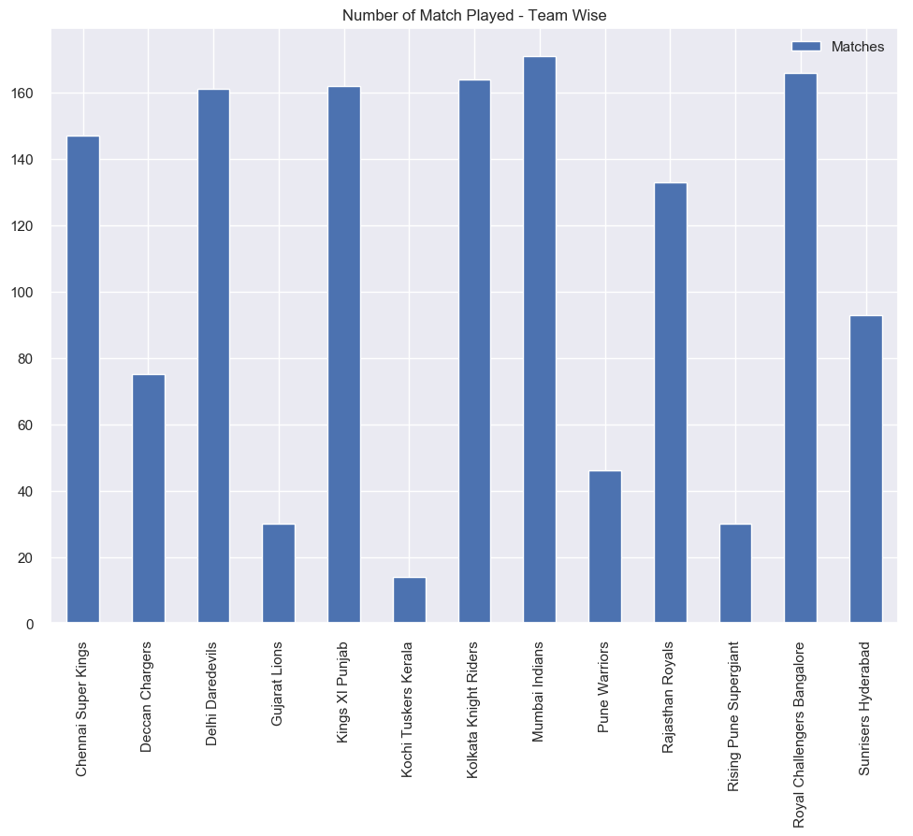
overall trend of Matches basis on performance
Mumbai Indians has played maximum number of matches.
Kochi Tuskers Kerela has played minimum number of matches.
Overall Mumbai Indians has best performance.
Overall Pune Warriors has lowest performance.

Slide 16
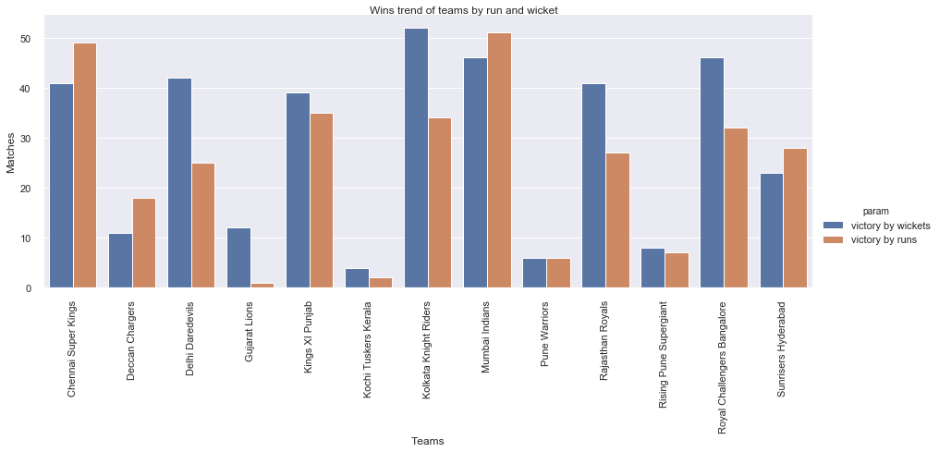
trend of wins by run and wickets of differen teams
Overall Maximum victories Mumbai Indians have.
Maximum victoreis by runs also Mumbai Indians have.
Maximum victories by wicktes Kolkata Knight Riders have.

Slide 17
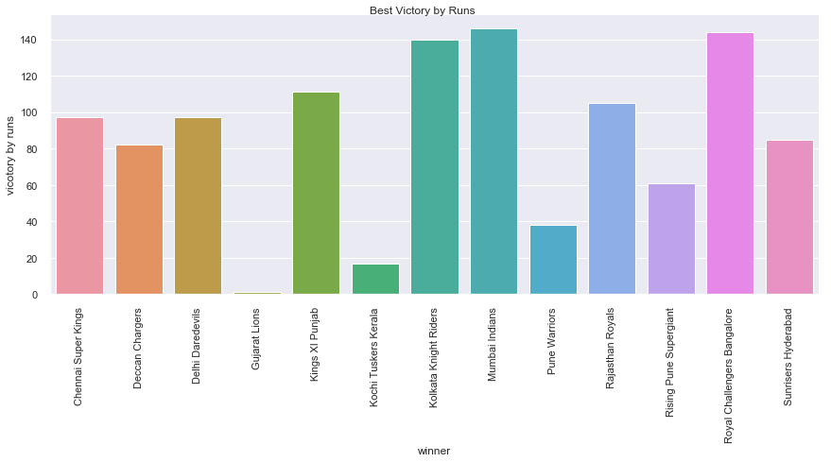
victory by runs
Mumbai Indians has the maximum run difference victory.
With more than 125 runs Mumbai Indians, Royal Challengers Bangalore, Kolkata Knight Riders emerged victorious

Slide 18
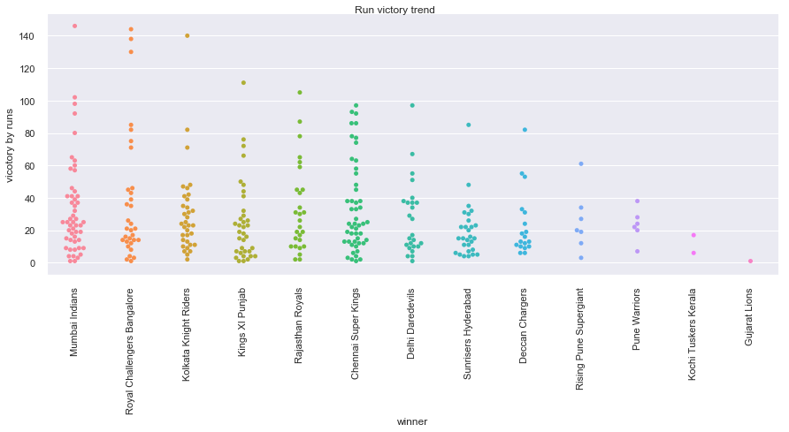
range of margin of runs in which teams has finished the match
Maximum teams has won matches by the margin of runs in range of 0 to 20.
There are 7 outliers i.e. 7 matches which has been finished by more than a difference of 100 runs.
Maximum outliers or biggest victories which is more than 100 runs has been made by Royal Challengers Bangalore

Slide 19
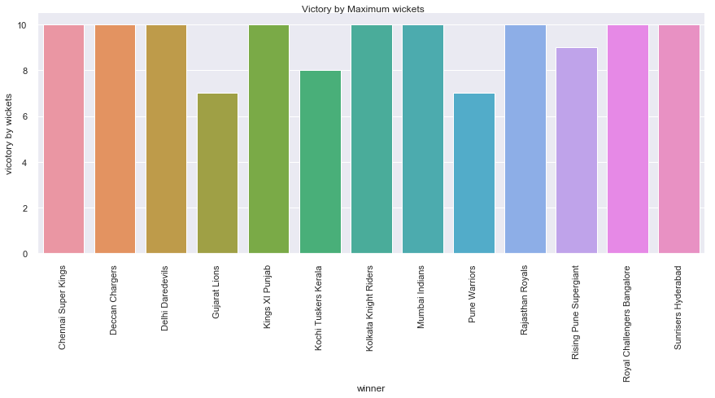
team has won the match with maximum wickets
Almost all teams has managed to win one match with 10 wickets.
All teams did manage to win at least 1 match with the margin of 7 wickets.

Slide 20
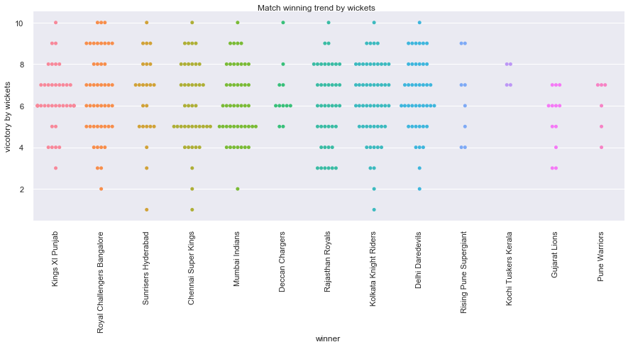
range of winning matches by wickets
Most of the matches has been won with in range of 6 to 8 wickets.
Kochi Tusker Kerela won only 4 matches by wicket but all of them were in the range of 7 to 8 wickets.

Slide 21
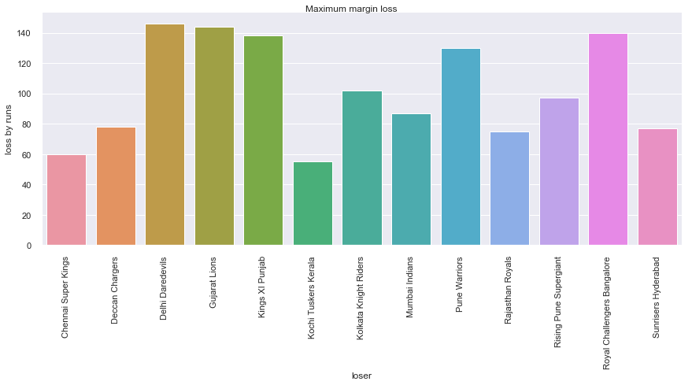
Team lost with the maximum margin of runs
Delhi Daredevils lost its match with margin of more than 140 runs.
Teams which lost with margin of more than 120 runs are Delhi Daredevils, Gujrat Lions, Kings XI Punjab, Royal Challengers Bangalore and Pune Warriors.
Kochi Tuskers Kerela lost with minimum margin.

Slide 22
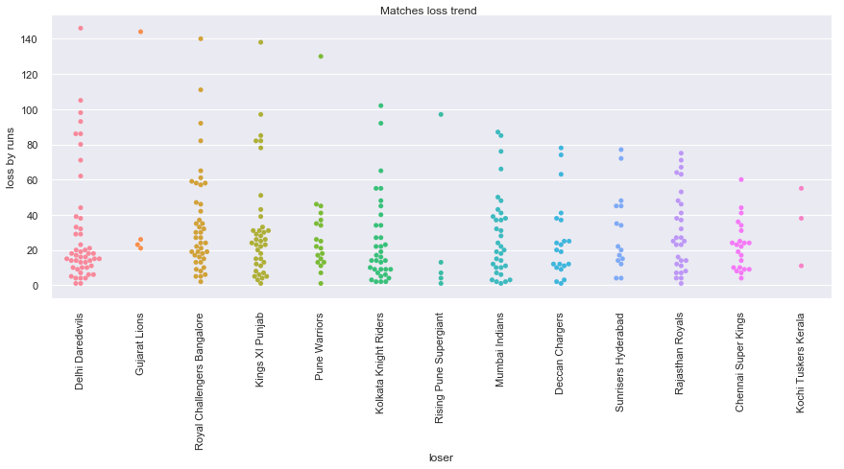
range where most of teams loss their matches
Range in which most of teams lost is 0 to 20 runs.
Rising Pune Supergiant lost all of its matches with the lesser margin than 20 runs.
Gujarat Lions lost all of its matches with more than margin then average range margins.

Slide 23
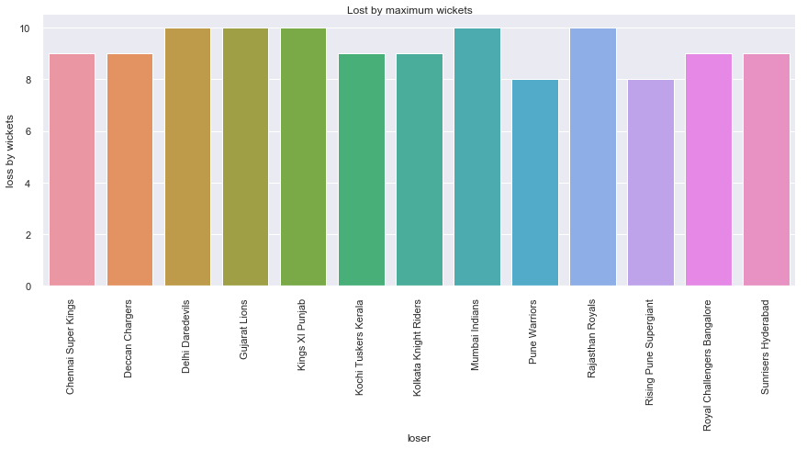
team lost with maximum wickets
Delhi Daredevils, Gujarat Lions, Kings XI Punjab, Rajasthan Royals and Mumbai Indians lost matches with 10 wickets.
Minimum maximum lost by wickets is 8 wickets by Pune Warriors and Rising Pune Supergiant.

Slide 24
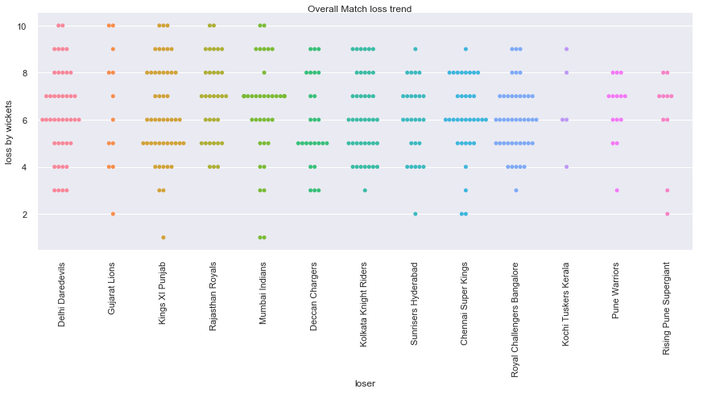
average loss range of matches by teams
Maximum Teams lost with in range of 6 to 8 wickets.
Maximum team lost with 6 wickets.
Kings XI Punjab lost maximum 3 times with 10 wickets.

Slide 25
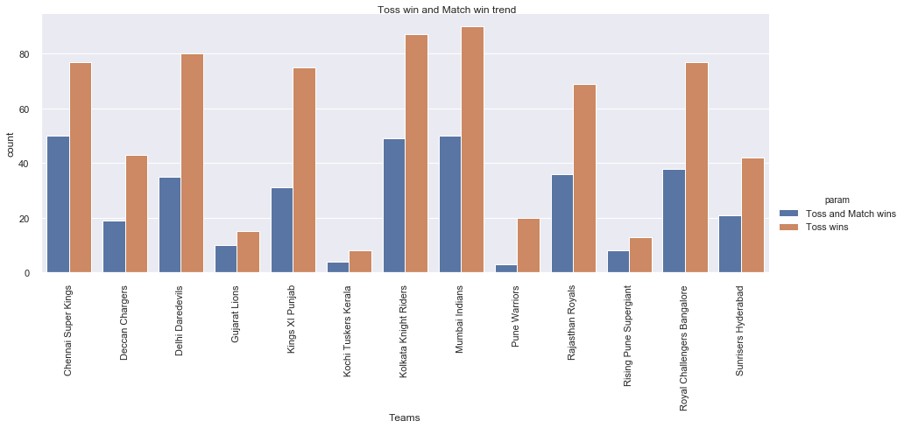
teams managed to win the toss and match both
Mumbai Indians won toss maximum times.
Chennai Super Kings won matches maximum times when they won the toss.

Slide 26
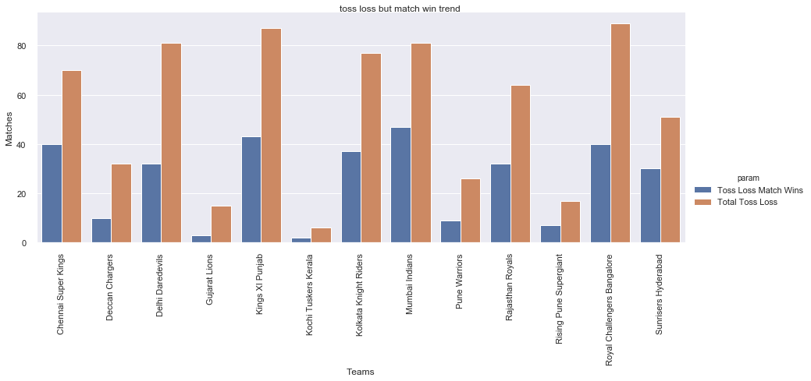
team lost the toss but won the match most
Overall Royal Challenger Bangalore lost maximum toss.
Mumbai Indians managed to emarged as victorious maximum times even after losing the toss

Slide 27
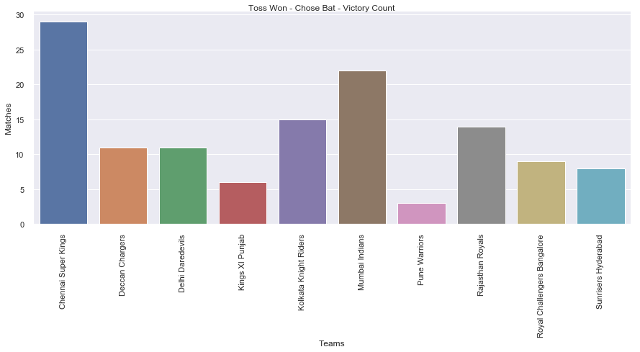
team won the toss and chose to bat first and won the match
Chennai Super Kings won maximum matches when the won the toss and chose to bat.
We can say that Chennai Super Kings is best Defender.

Slide 28
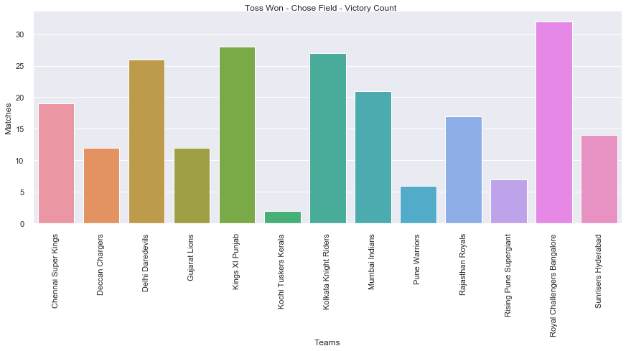
team won the toss and chose to field first and won the match
Royal Challengers Bangalore won maximum times when they won the toss and chose to field.
We can say that Royal Challenger Bangalore is best Chaser.

Slide 29
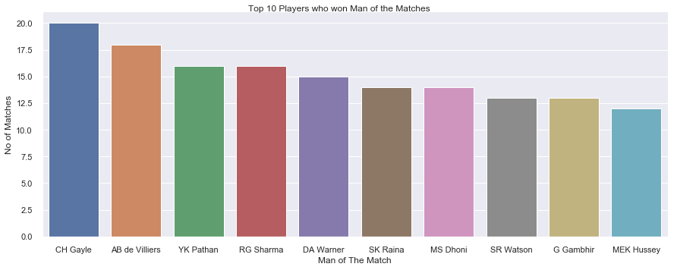
best 10 players in IPL
CH Gayle performed best during IPL. He won 20 times Man of the Match award

Slide 30
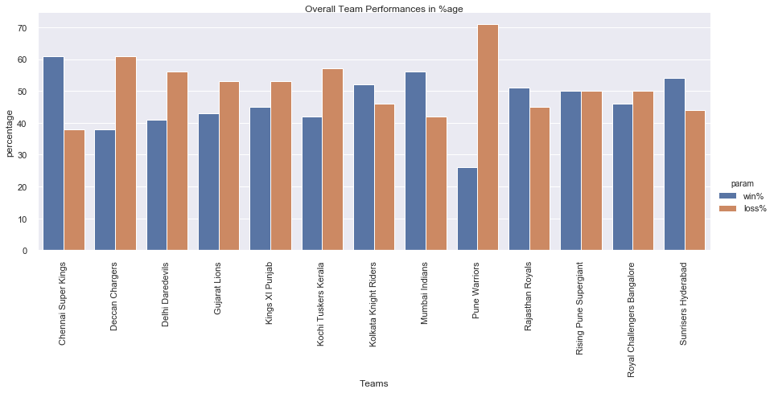
percentage of victory and loss team wise
In win percentage Chennai Super Kings secured Maximum victories.
In loss percentage Pune Warriors have maximum loss.

Slide 31
Conclusions
Mumbai Indians has won maximum number of matches.
Delhi Daredevlis has lost maximum number of matches.
Mumbai Indians played maximum number of matches.
Mumbai Indians is the best defender as they have won maximum matches by run.
Kolkata Knight Riders is the best Chaser as they have won maximum matches by wickets.
Mumbai Indians won maximum number of matches when they won the toss where as Chennai Super Kings won maximum percentage of matches when won the toss.
Chennai Super Kings won maximum number of matches while they won the toss then chose to bat. whereas Royal Challenger Bangalore was able to won maximum matches when they won the toss and chose to field.
Overall Chennai Super Kings has maximum winning percentage and Pune warriors has maximum loss percentage.
CH Gayle won maximum number of Man of The Match Titles.

Slide 32
Action Items
In ILP Chennai Super Kings is best to get tender. Next close teams are Mumbai Indians, Sunrises Hyderabad and Kolkata Knight Riders.
In ILP Rising Pune Supergiant has 50-50 winning and loss chances.
Delhi Daredevils, Royal Challenger Bangalore, Pune Warriors and Kochi Tuskers Kerala needs to train more as they have more losing percentage then winning percentage.
We have almost 30 players with more than 5 times Man of the Match award and CH Gayle won maximum times ie 20. so getting him in team will benefit the team.

Slide 33
Thanks

