Slide 1
HADOOP 2.6 INSTALLING ON UBUNTU 14.04 (SINGLE-NODE CLUSTER)

Slide 2
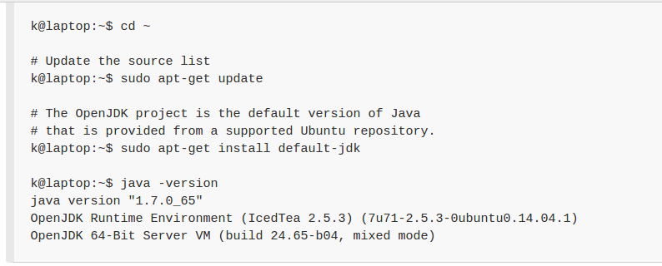
Install JAVA

Slide 3
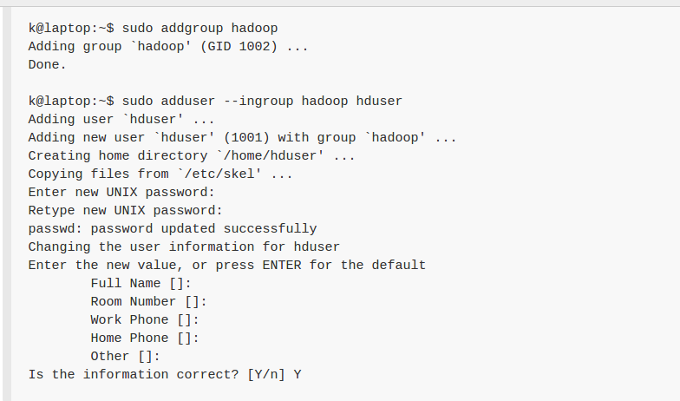
Adding a dedicated Hadoop user

Slide 4
Install SSH
The ssh is pre-enabled on Linux, but in order to start sshd daemon, we need to install ssh first. Use this command to do that :
      sudo apt-get install ssh

Slide 5
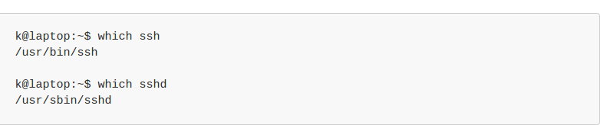
Check SSH

Slide 6
Create and Setup SSH Certificates
Hadoop requires SSH access to manage its nodes, i.e. remote machines plus our local machine. For our single-node setup of Hadoop, we therefore need to configure SSH access to localhost.
Hadoop uses SSH (to access its nodes) which would normally require the user to enter a password. However, this requirement can be eliminated by creating and setting up SSH certificates using the following commands. If asked for a filename just leave it blank and press the enter key to continue.

Slide 7
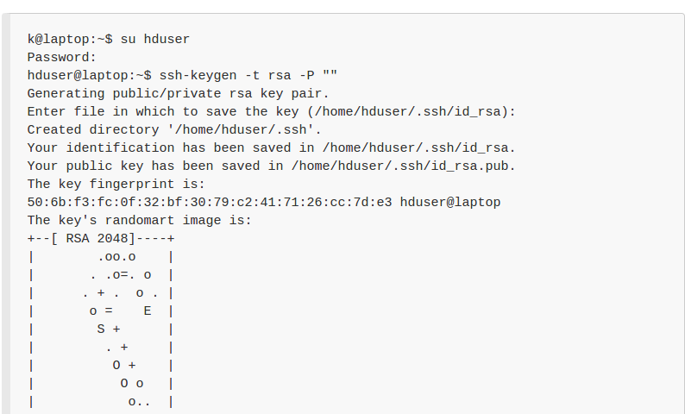
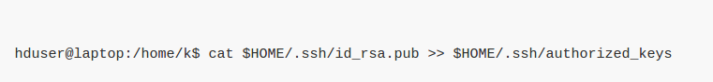

Slide 8
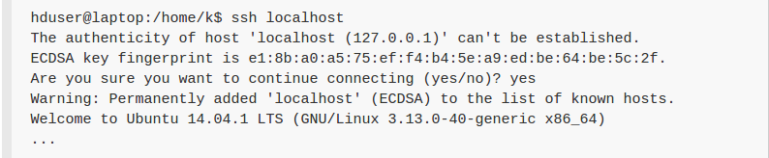
Check SSH Connection

Slide 9
Install Hadoop
Run these commands in terminal:
Wget http://mirrors.sonic.net/apache/hadoop/common/hadoop-2.6.0/hadoop-2.6.0.tar.gz
tar xvzf hadoop-2.6.0.tar.gz

Slide 10
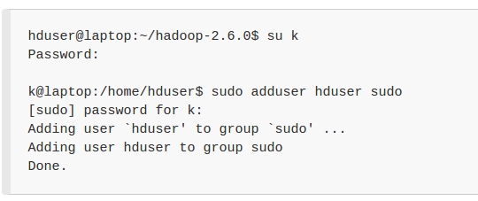
Add hadoop user to sudo group

Slide 11
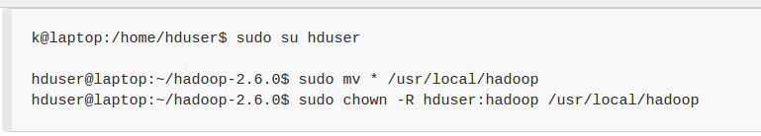
Move hadoop installation

Slide 12
Setup Configuration Files
The following files will have to be modified to complete the Hadoop setup:
~/.bashrc
/usr/local/hadoop/etc/hadoop/hadoop-env.sh
/usr/local/hadoop/etc/hadoop/core-site.xml
/usr/local/hadoop/etc/hadoop/mapred-site.xml.template
/usr/local/hadoop/etc/hadoop/hdfs-site.xml

Slide 13
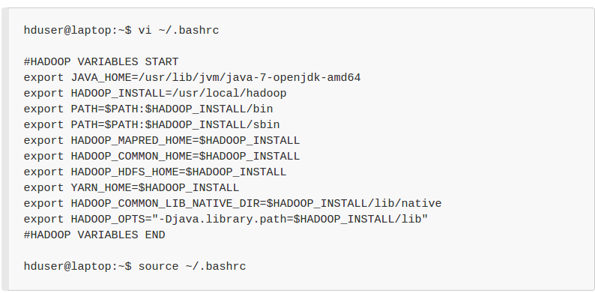
Append at the end of ~/.bashrc

Slide 14
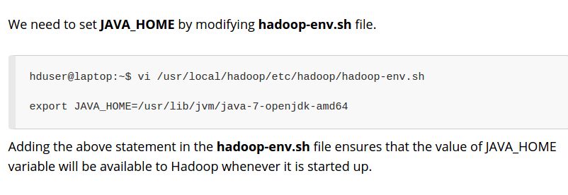
Edit
/usr/local/hadoop/etc/hadoop/hadoop-env.sh

Slide 15
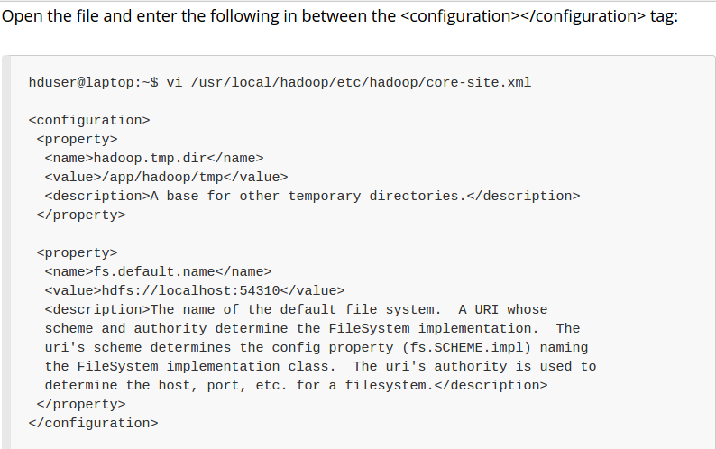
Edit
/usr/local/hadoop/etc/hadoop/core-site.xml:

Slide 16
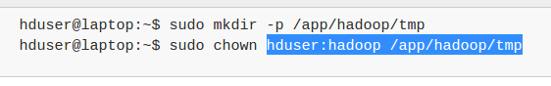
The /usr/local/hadoop/etc/hadoop/core-site.xml file contains configuration properties that Hadoop uses when starting up.
This file can be used to override the default settings that Hadoop starts with.

Slide 17
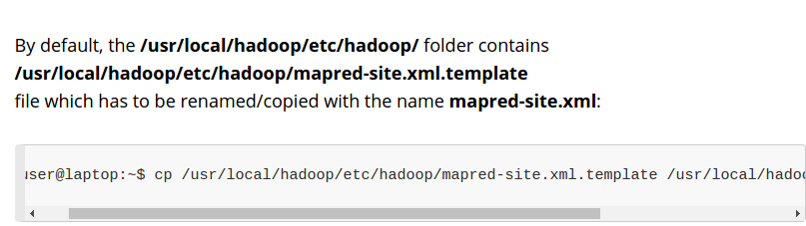
Edit
/usr/local/hadoop/etc/hadoop/mapred-site.xml

Slide 18
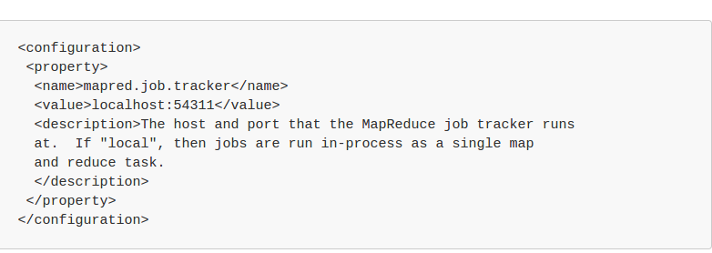
The mapred-site.xml file is used to specify which framework is being used for MapReduce.
We need to enter the following content in between the <configuration></configuration> tag:

Slide 19
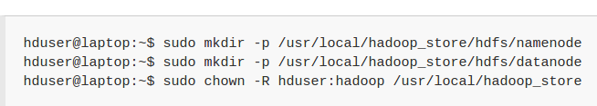
Edit
/usr/local/hadoop/etc/hadoop/hdfs-site.xml
Before editing this file, we need to create two directories which will contain the namenode and the datanode for this Hadoop installation.
This can be done using the following commands:

Slide 20
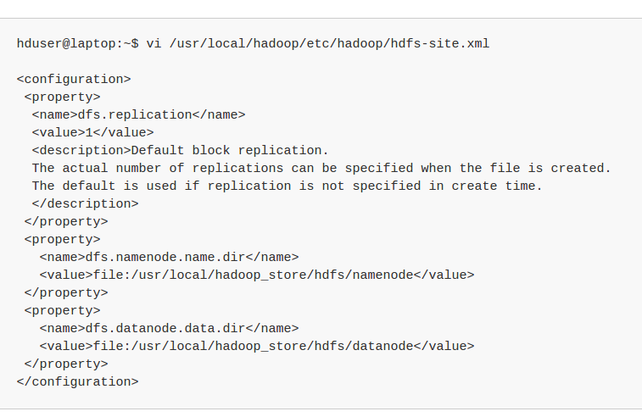
Open the file and enter the following content in between the <configuration></configuration> tag:

Slide 21
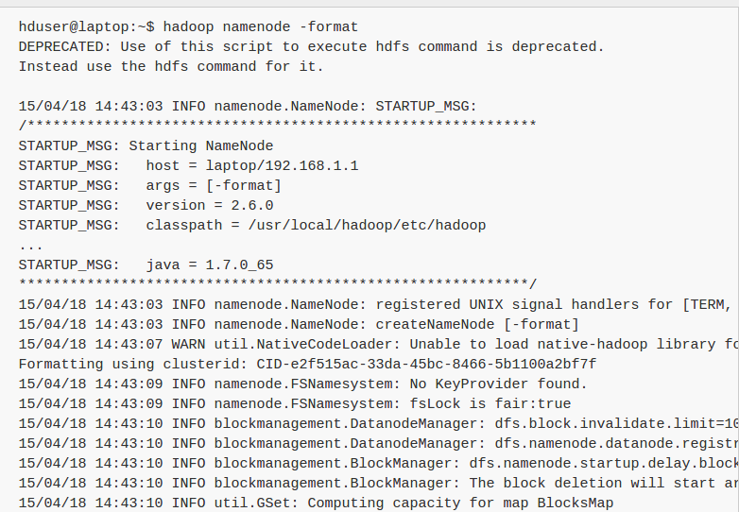
Format the New Hadoop Filesystem

Slide 22
Starting Hadoop
Change your directory to: “cd /usr/local/hadoop/sbin”
Start hadoop services command : “./start-all.sh”
Check all the nodes command: “jps”
Stopping hadoop : “./stop-all.sh”

Slide 23
Check on Github:https://github.com/agggaurav/HadoopInstallation
To use complete installation from github kindly make few changes:
Clone and extract to Desktop.
Change the path from home directory to Desktop.
Check my Java version.
Check my .bashrc file.
Change hadoop user name to “hadoop”

