Slide 1

Software Project 2 Final Presentation Mundus
Team 7: Professor: Matthias Book
Agnar Pétursson
Daníel Þór Guðmundsson
Emil Þór Emilsson

Slide 2
Vision
House chores are boring!
But what if it wasn‘t a chore, but somekind of a game?
Mundus is a digital platform that gamifies mundane house chores.

Slide 3


Functionality
Parents create quests and rewards for the children
Children gain ingame money and experience for completing quests
Use money to buy rewards
Use experience to level up

Slide 4
LIVE DEMO

Slide 5
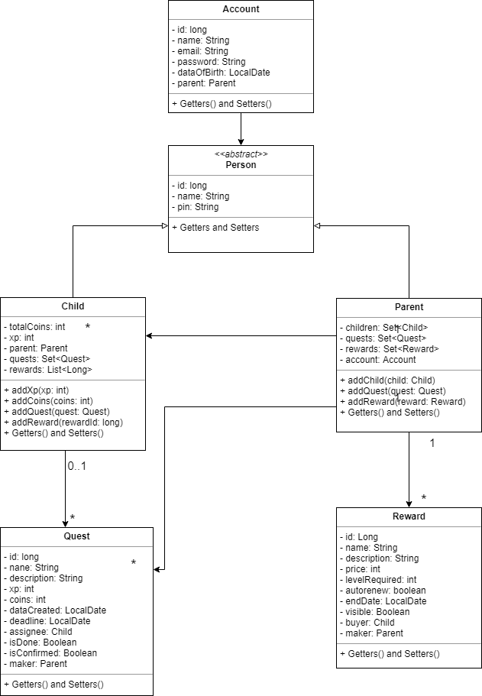
Server Architecture
Database
JPA Repository
PostgreSQL
Server Side Rendering
Server does all the work and passes on information to the client
Hosted at Heroku

Slide 6
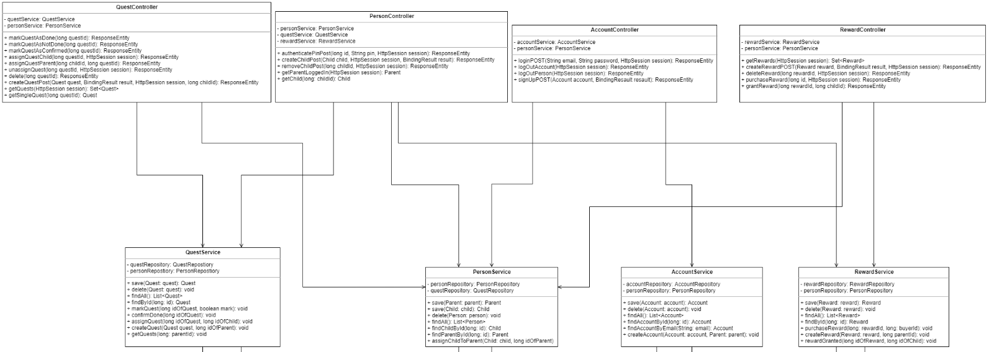

Slide 7
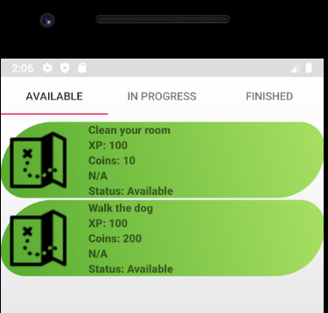
Client Architecture
View
Heavy use of fragments
Recyclerview and adapters
Mostly constraint layout
Only portrait mode (by choice!)
Separate activites for child and parent

Slide 8
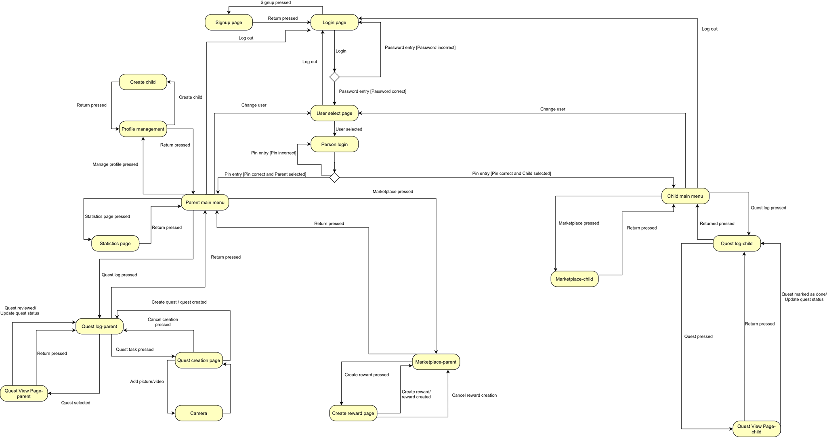

Slide 9

Client Architecture
Logic
Minimum API 22 (but developed with respect to 28)
Double login system
Client sends the server a request and the server returns the login status
Always fetch the newest information
If the client wants some more information on a e.g. quest, the quest is fetched from the server instead of using a cached quest on the client side
Notifications
Google Firebase

Slide 10
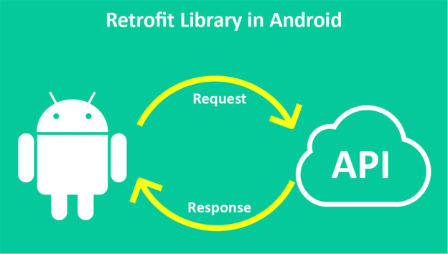
Client Architecture
Networking
Retrofit
A really simple and effective third part library for networking
All API calls really simple
Cookies to store login status are saved for 30 days

Slide 11




Process
Agile with (almost) weakly sprints
Use Trello to plan and distribute work
More disciplined as the project progressed
Version control
Heavy usage of git
Each team member with his own branch
Separate branch for larger features
Work flow
Focus on most of the functionaility first
More focus on UI in later stages of the project
Remote meatings (even before the pandemic)
Regular remote meetings through Discord/Zoom

Slide 12
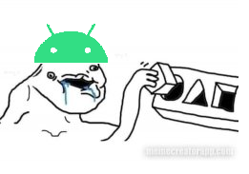

Challenges
Android sucks
Poorly documented and overengineered
Ever changing „best“ practises hard to follow
Tutorials on the web outdate pretty fast
Lack of system design
No experience with Android made it difficult to plan ahead
Lead to some inefficient design problems and over stuffed classes
„Figure it out as we go“ mindset
Camera functionality and image upload
Cookies

Slide 13
What went well
Team work
Each member of the team contributed to the final product
Team members showed initiative and interest in the project
Remote meetings
Networking went way better than we expected
Start with functionality, end with the view
Git version control and merging

Slide 14
What we would do different
Rewrite the server
Put more emphasis on design before coding
Design principles
More disciplined work flow
Split dense classes into smaller classes
Use some frontend framwork e.g. React, Flutter etc.
Use some of the Android specific functionality
Saved states
Rotate screen

Slide 15
Questions?

