Slide 1
LeetCamp Week 2
Srishti Kumar
Nikhil Naru

Slide 2
UMPIRE Method (Codepath)
Understand
Do a dry run through given example with interviewer
Come up with edge cases
Match
Have I already seen a version of this problem before?
3. Pseudocode (Plan)
4. Implement (will be very easy if you pseudocode first!)
5. Reflect (Test & Verify)
Test your edge cases
6. Evaluate performance (Big-O Notation)
Notes:
Just read each line, be efficient

Slide 3
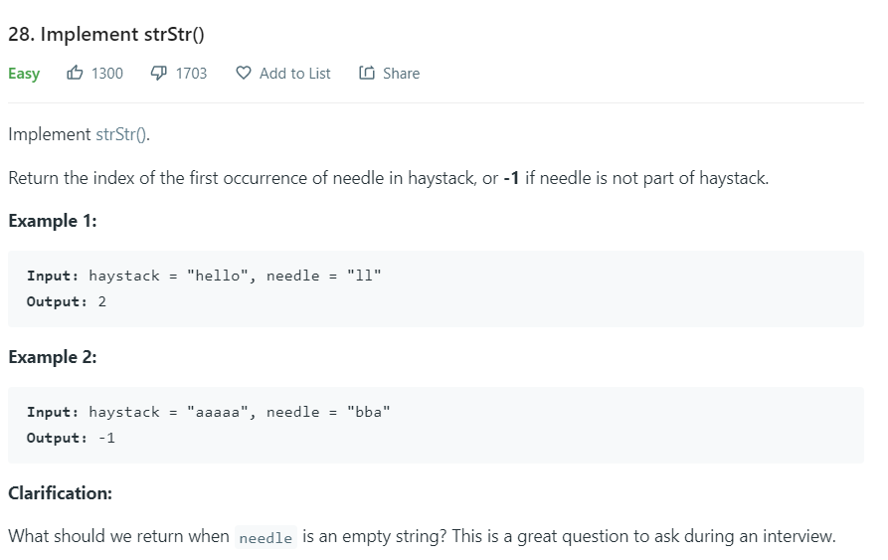
Question 1 - strStr()

Slide 4
Implement strStr()
Brute force
Try all positions in string (2 for-loops)
O(N(N-L)) = O(N^2) = Quadratic Time
2-pointer approach
Better version of brute force
Best time complexity = O(N) = Linear
Worst time complexity = O(N(N-L)) = O(N^2) = Quadratic Time
Rabin-Karp Algorithm (not discussed here - look it up if curious!)

Slide 5
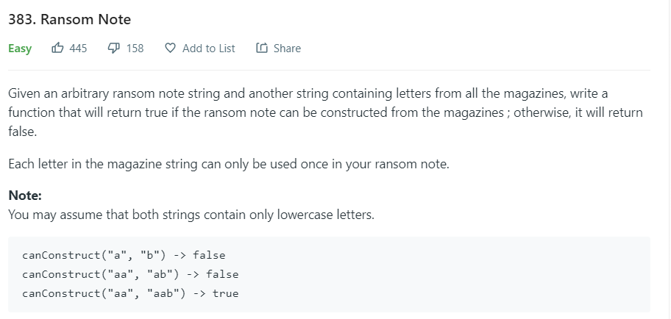
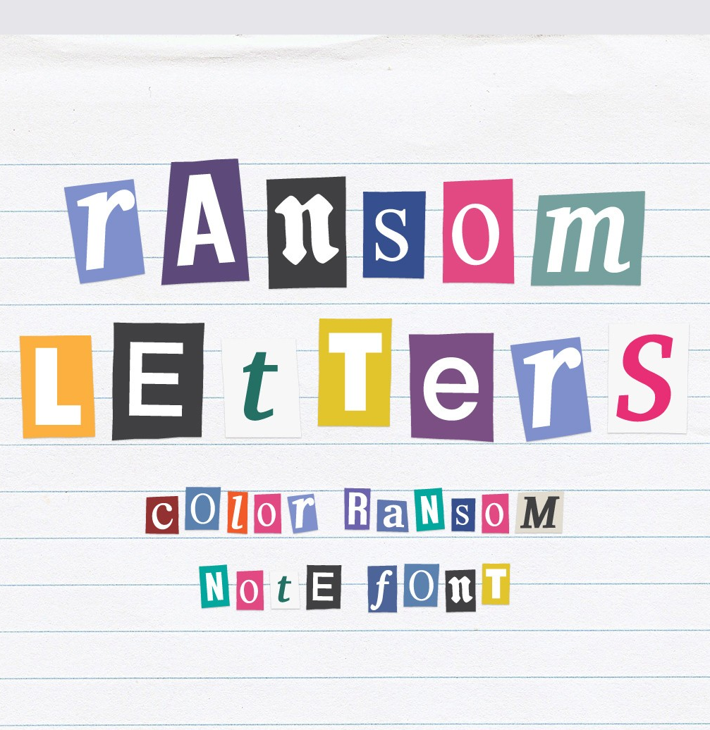
Question 2 - Ransom Note

Slide 6
Question 2 - Ransom Note
Idea:
Magazine letter count must be >= ransom note letter count
Create a frequency map (map letter -> count)
What’s the time complexity?

Slide 7
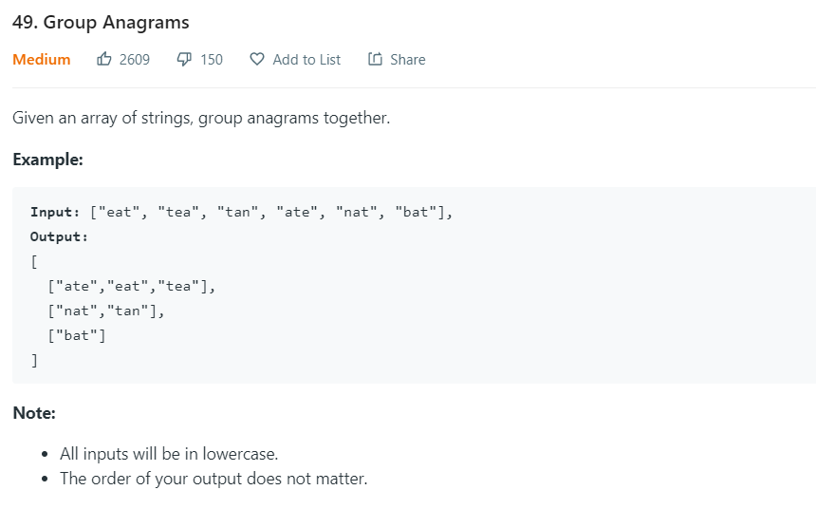
Group Anagrams

Slide 8
Challenge - Group Anagrams
What do anagrams have in common?
Same number of individual letters (eg: “eat”, “ate”, “eta” each have 1 of each letter)
Can we sort the words?
Use a hashmap approach?

Slide 9
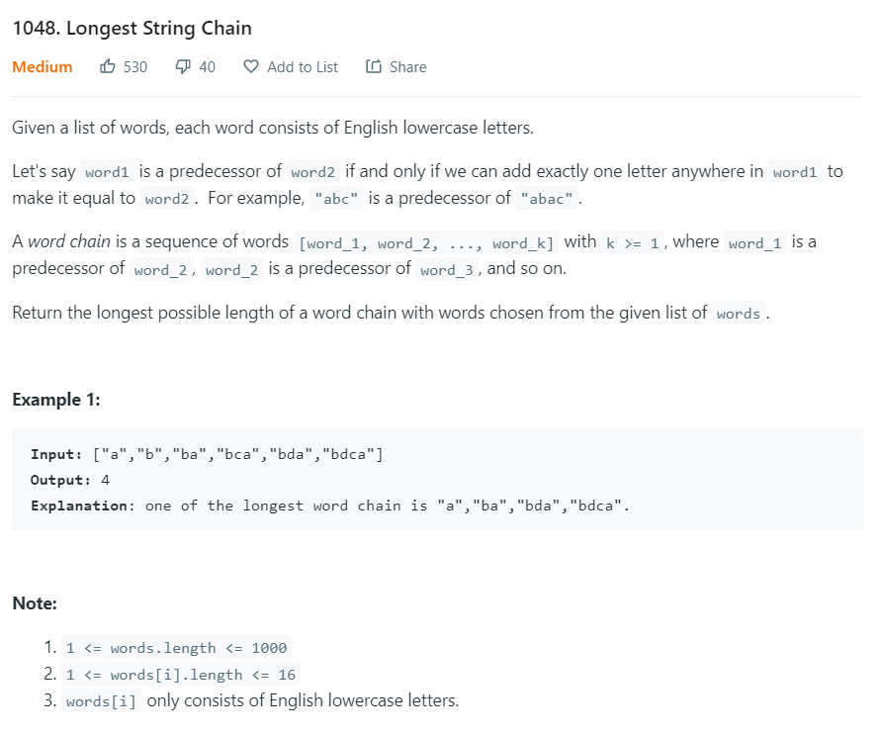
Extra Challenge (2 Sigma Interview Question)
https://leetcode.com/problems/longest-string-chain/

