Slide 1
TraceOps
Evidence-backed investigations
for delayed orders
Team ALPHA
Open Agent Hackathon 2026
The Agent That Can Explain Why
01
Notes:
Team ALPHA. Proposed Track 02: The Agent That Can Explain Why. All product examples use fictional data. Local implementation, not yet a submitted entry.

Slide 2
The operations investigation problem
A support lead needs to explain a delayed order.
The order system shows the delay.
The warehouse shows available stock.
A support ticket may reveal a different blocker.
TraceOps connects these records and makes each finding inspectable.
02
Notes:
Target-user hypothesis, not a validated market study. No customer interviews or measured time savings are claimed.

Slide 3
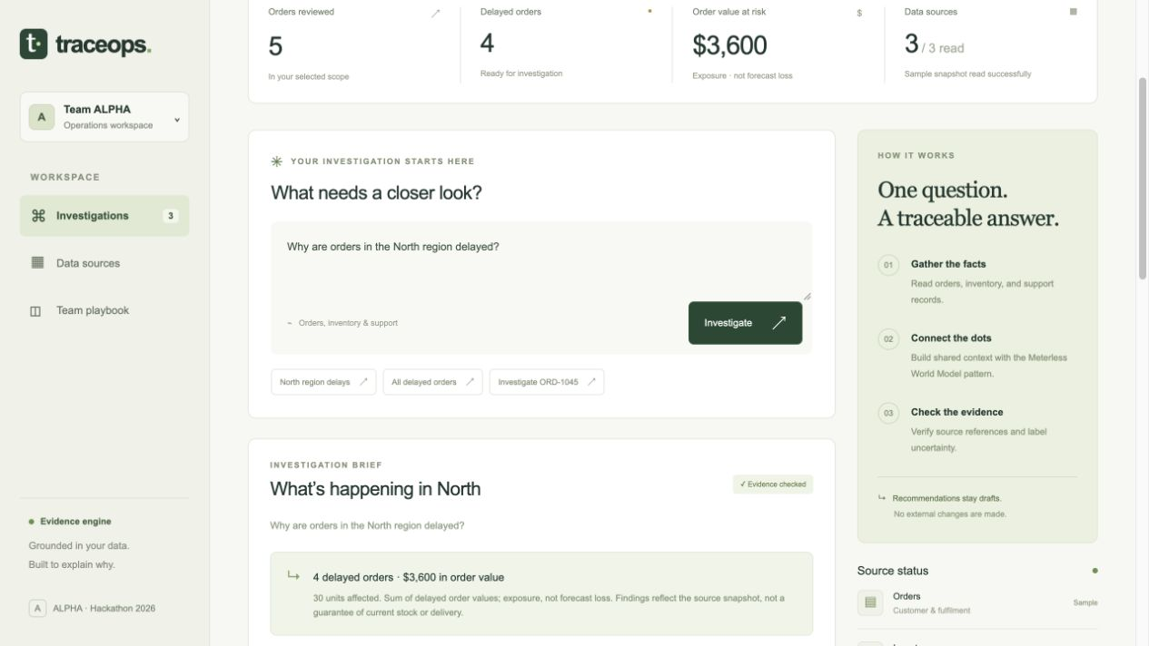
The investigation workspace
Fictional data, deterministic analysis and explicit mode labels
03
Notes:
Product screenshot captured from the running local sample application on October 26, 2026. No live provider calls are represented.

Slide 4
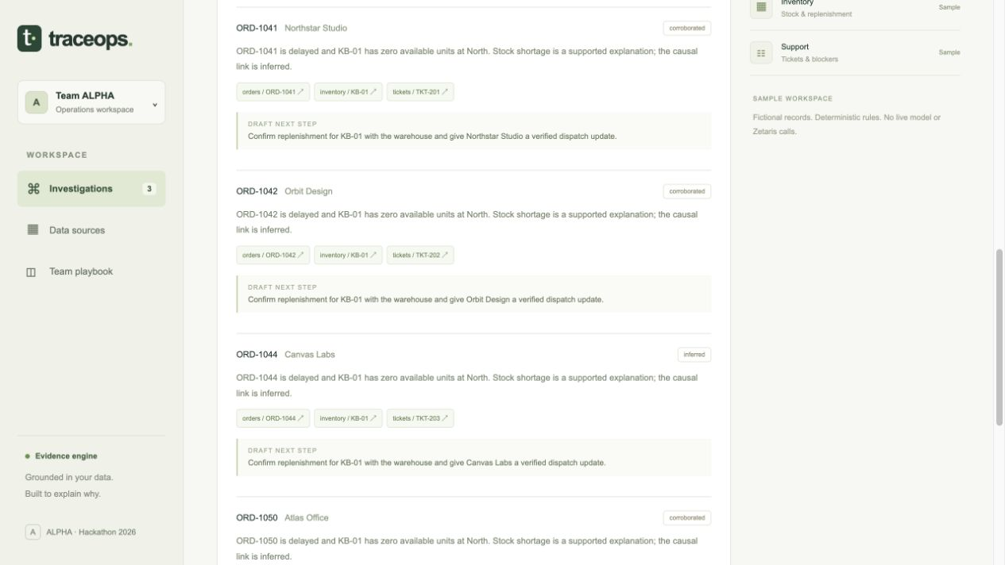
Four delayed orders, with traceable evidence
$3,600
Order value exposure in the
North-region sample
4 delayed orders
30 units affected
Stock shortage remains a supported inference. A record link shows exactly why.
04
Notes:
Source: data/orders.csv, data/inventory.csv, data/tickets.csv. North: ORD-1041 $960, ORD-1042 $600, ORD-1044 $1200, ORD-1050 $840. Total $3600 and 30 units. These are demonstration values, not measured business impact. Screenshot: running local app.

Slide 5
Agent workflow and technical stack
01 Planner scopes the question
02 Collector reads a bounded source snapshot
03 World Model ingests and builds shared context
04 Investigator produces supported findings
05 Verifier checks citations and order provenance
Python standard library, SQLite, HTML, CSS and JavaScript
Persistent history, Markdown brief and JSONL trace
05
Notes:
Implementation: traceops/agent.py, traceops/connectors.py and traceops/world.py. The stages are cooperating software components. Sample reasoning is deterministic. Live model mode performs narrative generation through an injected generator.

Slide 6
Sponsor technologies in the active path
Zetaris
Meterless World Model
Connector reads three virtual tables through the documented SQL proxy.
Live tenant verification is pending.
Our implementation stores stable observations, pins run snapshots and supplies shared context with provenance.
Minimum service subset runs locally.
Optional NVIDIA model adapter is prepared. Live inference remains unverified.
06
Notes:
Sources: https://github.com/zetaris/getting-started/tree/main/scripts and hackathon Resources, Meterless README / WORLD MODEL Agent Engine, viewed Oct 26 2026. Meterless documents are reference architectures, not a hosted SDK. Live connectivity remains unverified at deck creation.

Slide 7
Reliability and next steps
Current evidence
Next validation
Sample workflow and source drill-down work.
Tests cover persistence, missing data, conflicting blockers and explicit failures.
Run against the team’s Zetaris instance.
Exercise the chosen model.
Validate with operations users.
Add authenticated deployment.
Team ALPHA aims to submit two hours before the official deadline.
07
Notes:
Verification: tests/test_traceops.py and docs/verification.md. No customer ROI, production deployment, live Zetaris connectivity or live NVIDIA usage is claimed. Final event rules require source repository, 1–4 minute demo video and slide deck. https://hackathon.genai.works/event/open-agent-hackathon-2026

