Slide 1
License Plates Detection and Text extraction

Slide 2
The System Architecture

Slide 3
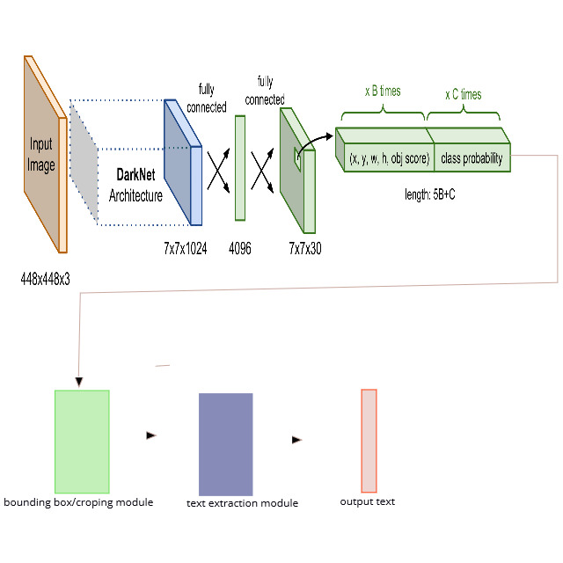

Slide 4
YOLOV3 (You Only Look Once v3)
A network for object detection. The object detection task consists in determining the location on the image where certain objects are present, as well as classifying those objects in one step.
YOLOv3 has few incremental improvements on YOLOv2.
Feature Extractor: darknet53 architecture with 53 convolutional layers.
Keras implementation

Slide 5
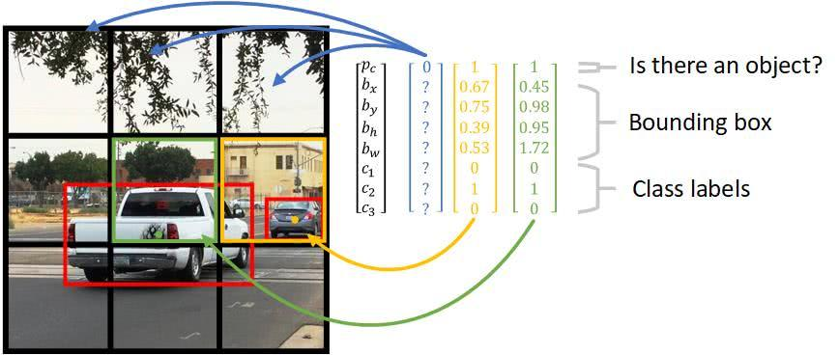
YOLO

Slide 6

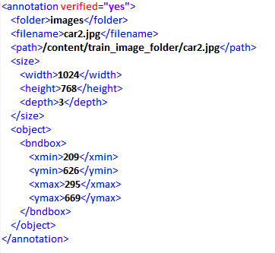
Data preparation

Slide 7
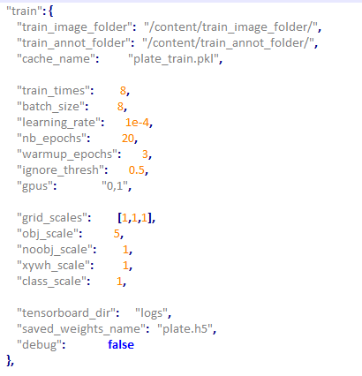
Training

Slide 8
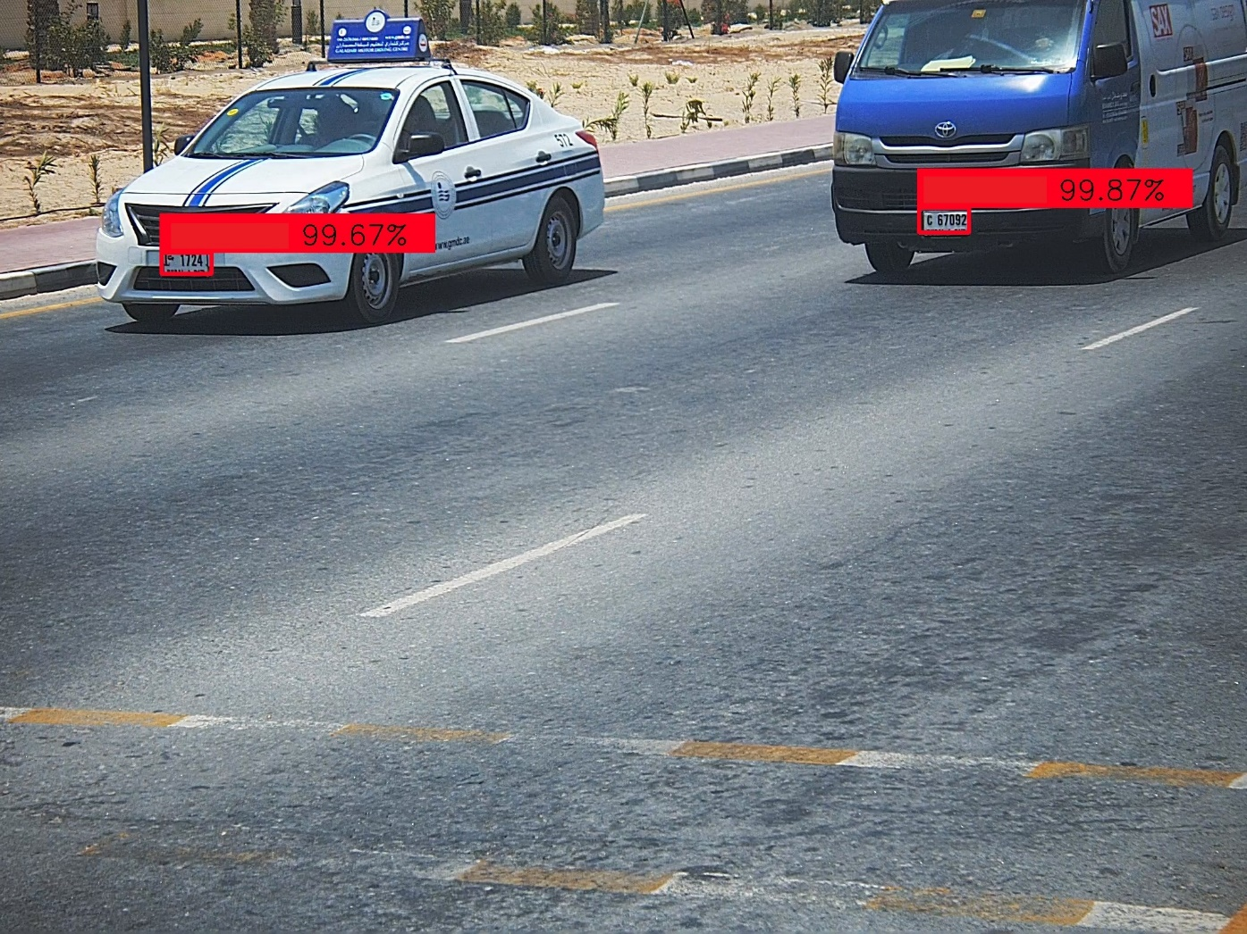
Detection results

Slide 9
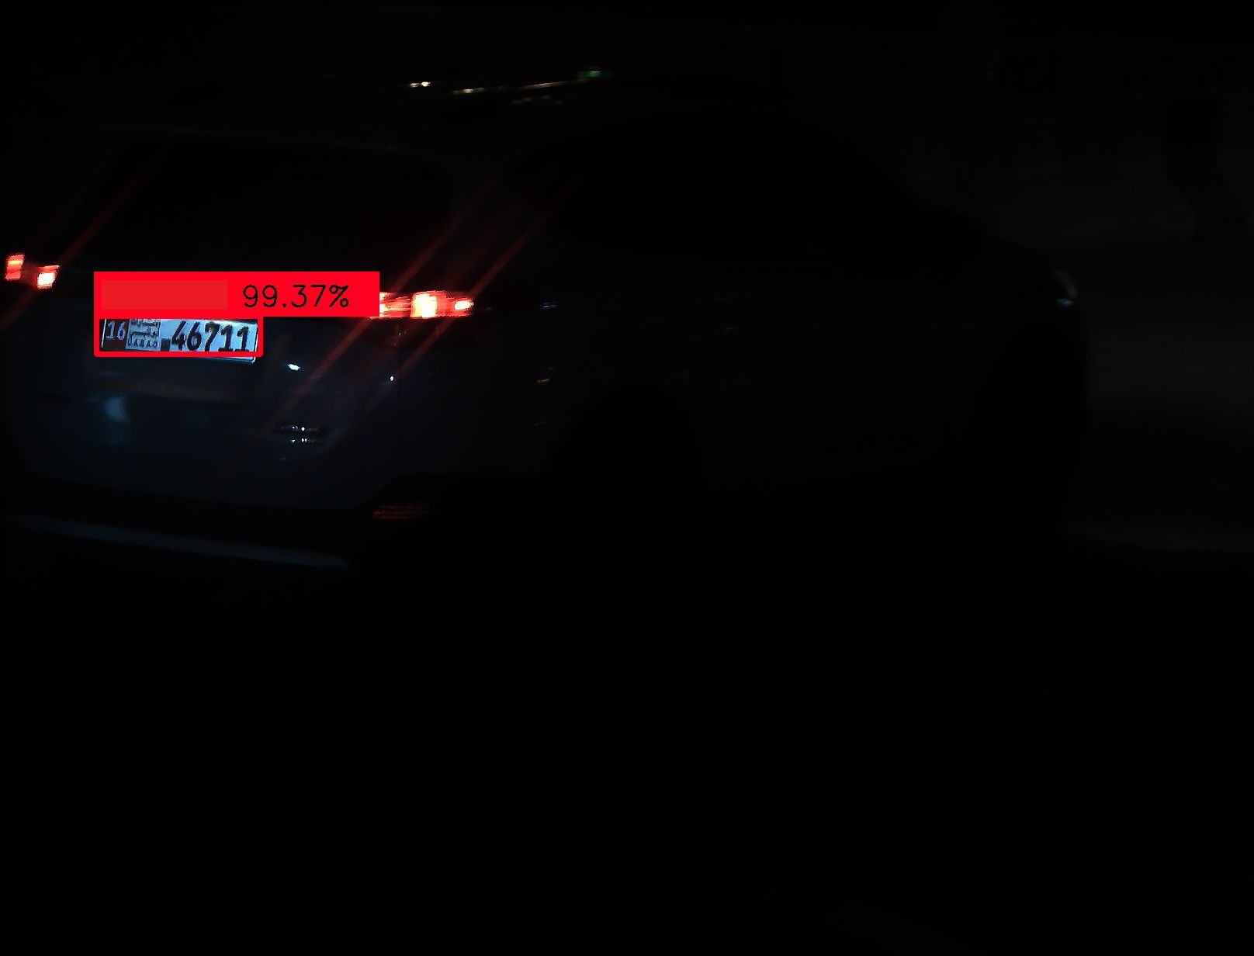
Detection results

Slide 10
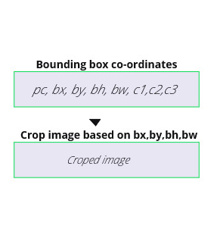
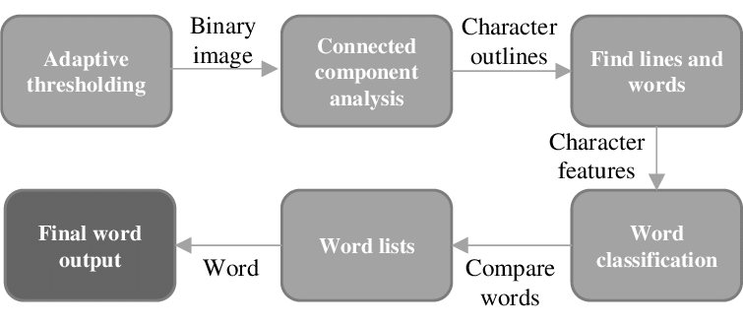
Extraction

Slide 11
RESULT

Slide 12
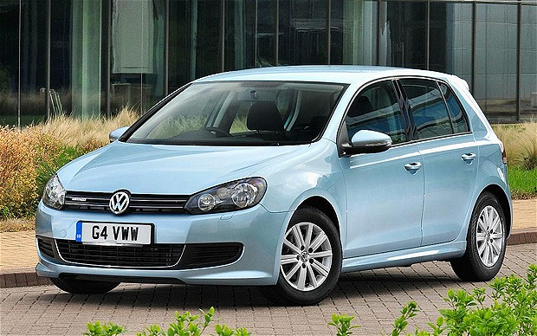

Slide 13
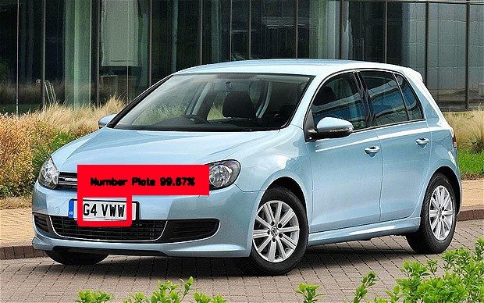

Slide 14
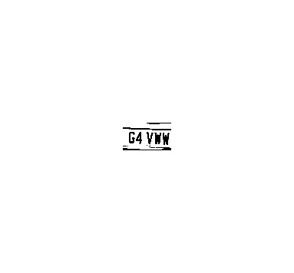
Preprocessed Image

Slide 15
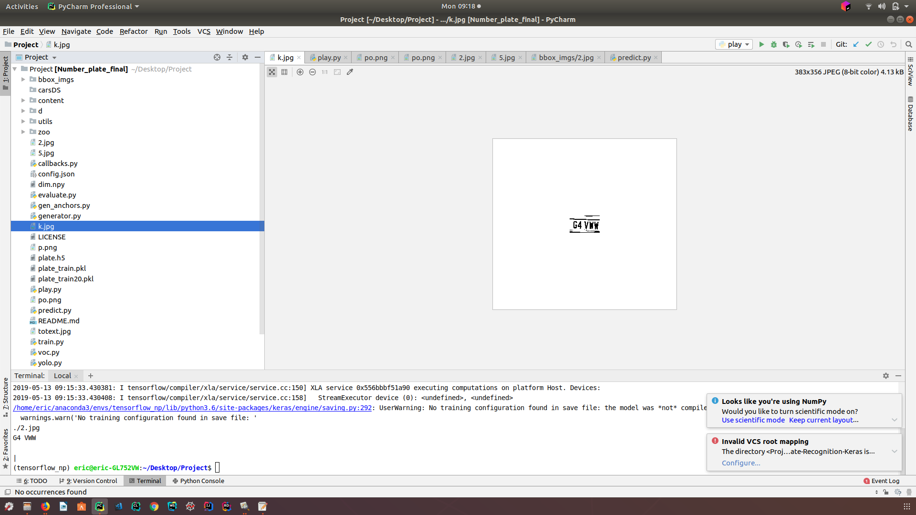

Slide 16
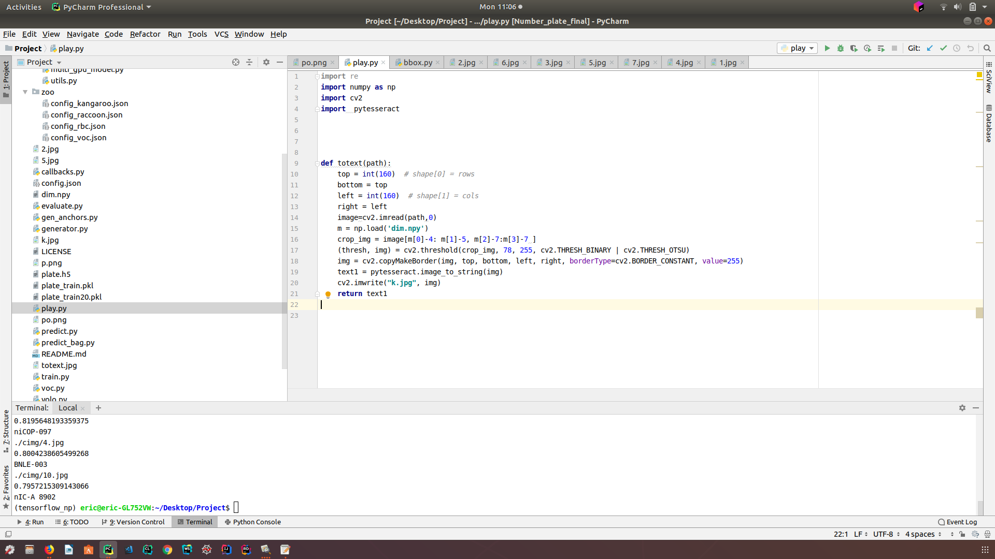

Slide 17
Thanks for listening

