Slide 1
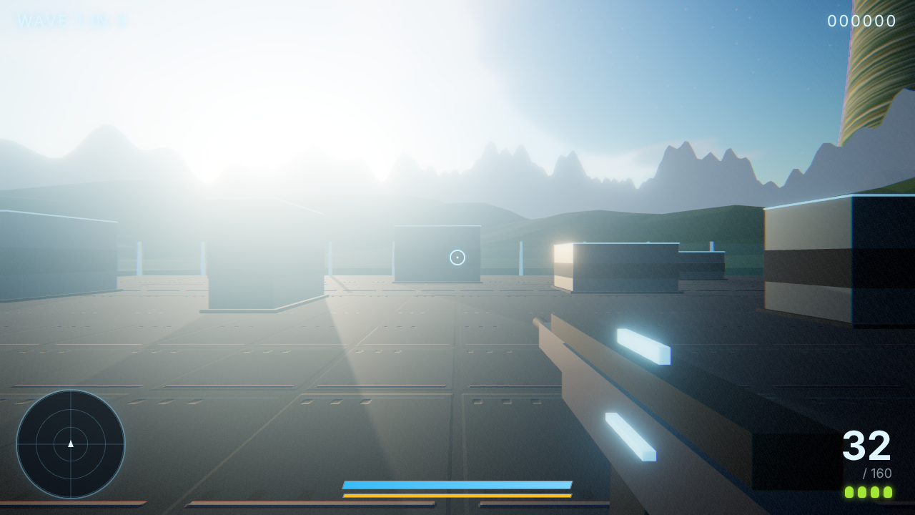
RINGFALL
A browser-native arena shooter.
One ring, one dawn, two kinds of thing that want you dead.
TypeScript + three.js, zero assets.
2026-10-21
One session, four acts, one reel
Notes:
Ringfall, built in one hackathon session on 2026-10-21. The one-line description is from the README.

Slide 2
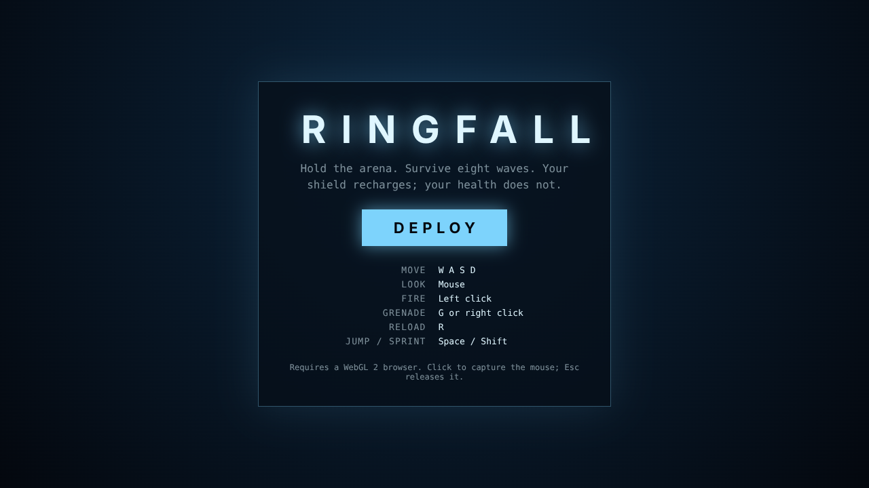
The brief
1
A WebGL arena shooter, running in a browser, no assets
2
Four hours, 14:08 to 18:30 UTC: three building, one coaching
3
To crefft engineering standards: gates on every commit
14:27 the first title screen
191
35
292 + 2
33 + 13
commits on main at 18:18
pull requests merged
unit + smoke tests pass
cloud sessions + local subagents
Notes:
Numbers are from the journal's 18:10 freeze entry, taken from GitHub at 18:18: 191 commits on main, 35 pull requests merged, 292 unit tests and two Playwright smoke tests passing on main, thirteen cloud sessions dispatched between 17:10 and 17:12 and thirty-three by 18:20, plus thirteen local subagents.

Slide 3
Four acts
1
2
3
4
Act one
Act two
Act three
Act four
A working game in forty minutes: pure core, tests first, plain renderer, draft PR at 14:30
The renderer rewrite, and three unrelated bugs hiding in one black frame
The game plays itself: bot, headless harness, deterministic recorder, offline score
The coach: four local streams, then thirty-three cloud sessions, one issue each
The correction between acts one and two: the first thirty seconds are the product
Notes:
From the journal's 'The story, not the straight line'. The second act began with a correction and the fourth with a change of role.

Slide 4
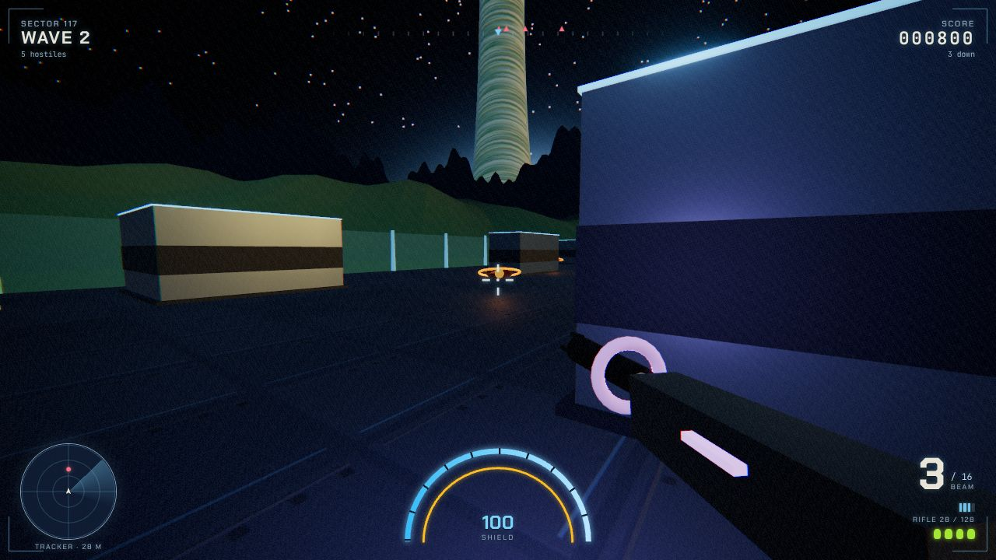
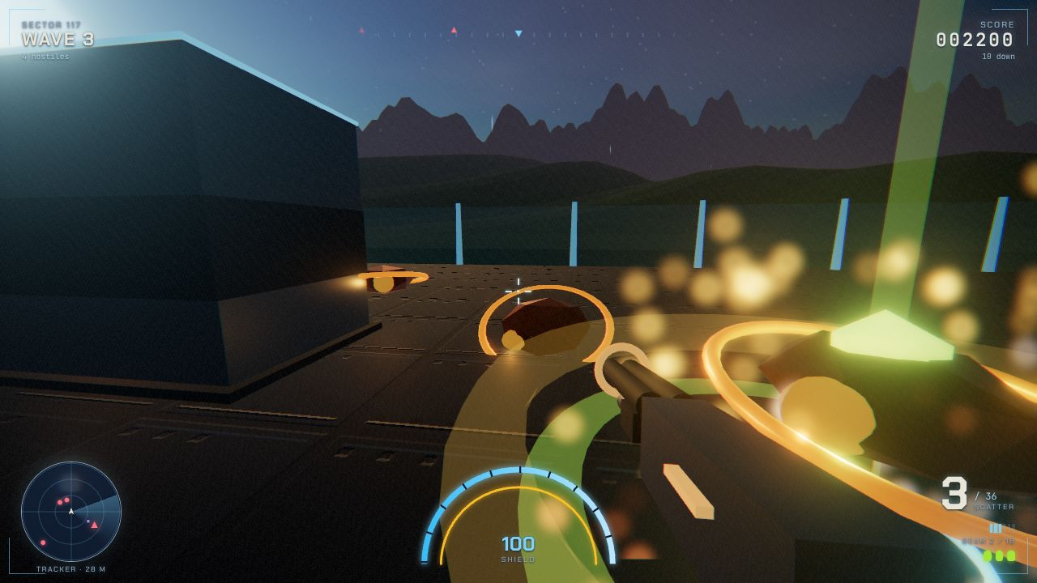
What a player sees
Wave 2 at night, beam in hand, ring overhead
Dawn on the ring: sun, bloom on the trims, mountains at the rim
Wave 3, the scatter gun and a pickup column
Notes:
Three frames from the deterministic run at seed 7. Left: the post stack working at 15:14. Right: the beam at night and the scatter gun with a pickup column, both captured at 16:56.

Slide 5
The game plays itself
1
The bot: state in, keyboard and mouse out, no more than a person sees
BALANCE AFTER WEAPONS, 16:22
2
The balance gate: twenty seeded games per profile, win rate and clear times
Profile
Win rate
Waves
Accuracy
Steady
15%
5.35
39%
3
The recorder: one sim step per captured frame, so the film runs at speed
Reckless
0%
4.20
42%
One seed drives balance in Node, smoke tests in Chromium, and the demo film
Before weapons: 0% win rate on both profiles, no run reached wave eight
Notes:
Balance after weapons, from the journal: twenty seeds per profile, 480 s cap, after stream B1 landed six weapons at 16:22. Weapons, not tuning, moved the bot from never reaching wave eight to winning three runs in twenty.

Slide 6
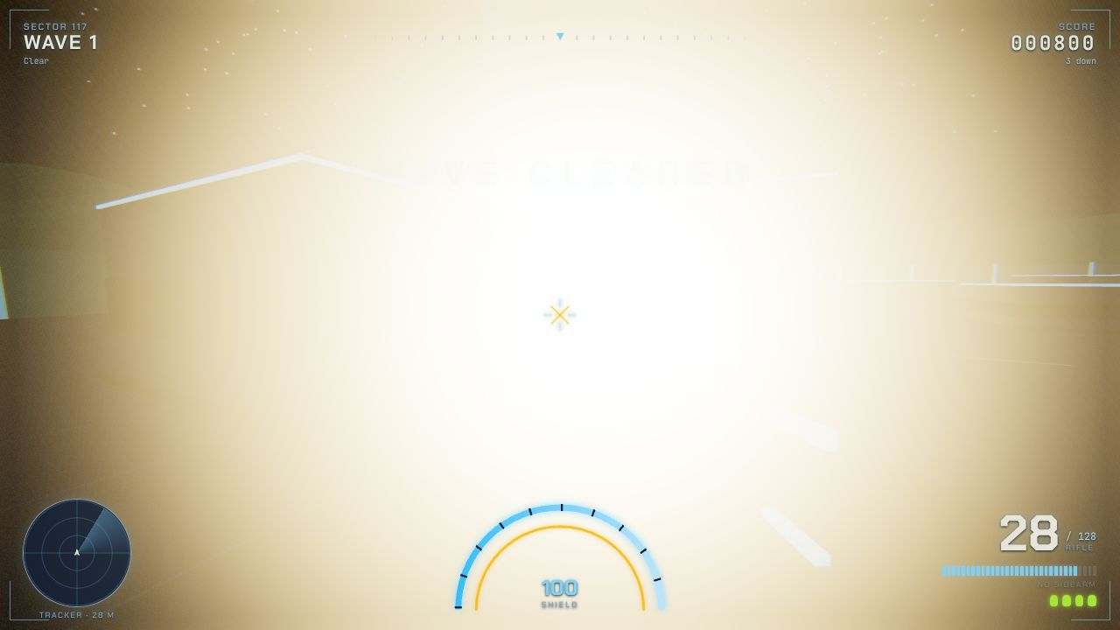
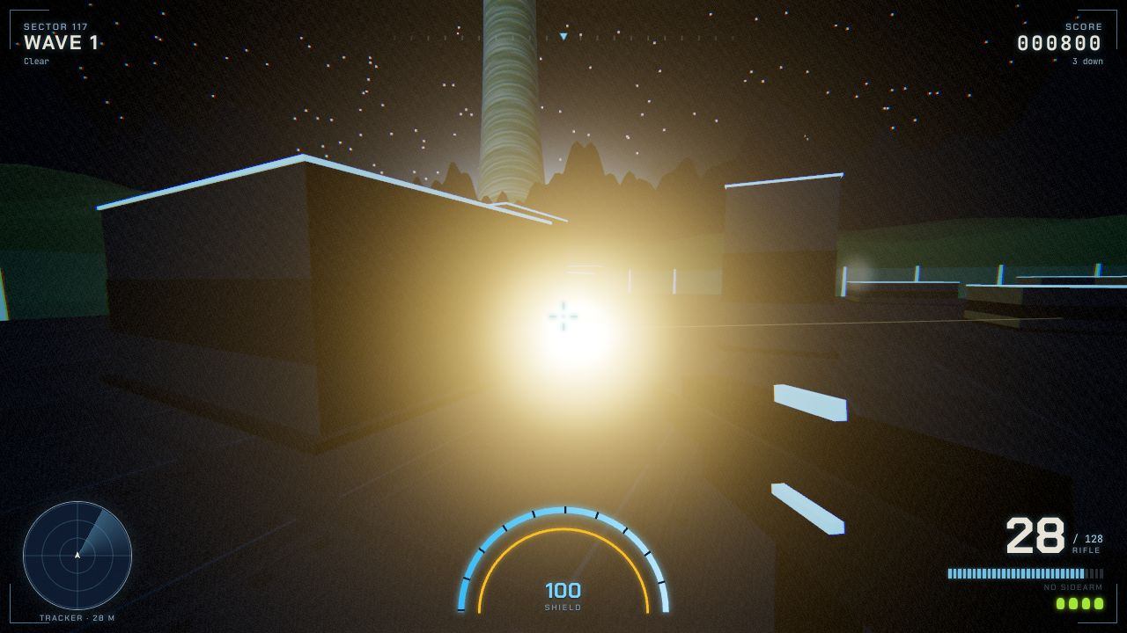
The whiteout
Before, 16:52 mean brightness 204 of 255
After, 17:00 mean brightness 61 of 255
Cause sprite size = size x 300 / depth, so forty sparks at 375 px each, additive
Fix sprites capped at 64 px, faded within 2 m of the eye, blasts scaled by distance
Notes:
16:45 entry. The user said the flare on kills was far too much. Two rounds of light tuning missed because nobody had measured a frame. A headless replay and a read of the particle shader found the size law.

Slide 7
Coach, not player
4
33
1
local streams
cloud sessions, one issue each
merge order, gate-first
A environment and the lighting hook
B1 simulation, input and HUD for weapons
B2 weapon viewmodels, pickups, sounds
C the reel script and its cards
Briefed with the files it owns
The capture hook at seed 7
The gates to run and the PR template
Reports back with the measured numbers
#32 core purity as a lint rule
#30 luminance gate, #12 balance gate
Then the renderer pull requests
Then core, main merged into each
>
>
Notes:
16:05 onwards. Four local streams with disjoint file ownership, then thirteen cloud sessions between 17:10 and 17:12, one issue each. Merge order is gate-first: #32, #30 and #12, then the renderer PRs, then core.

Slide 8
Calls that were overruled, and calls that were wrong
Overruled
Wrong on the evidence
A plain first renderer: fast, then judged insufficient, rewritten
Briefing the flare fix as light numbers: the cause was the size law
Eight uniform waves: deferred to five named beats in #8
Filing frames under guessed times: renamed to the capture minute
Screenshots as proof of play: replaced by bot, harness, recorder
A checkpoint commit to satisfy the stop hook: broke lint for one run
One squashed commit for act two: back to one concern per commit
Holding PR #1 as a draft: main unblocked first, thirteen agents branched
Notes:
Both lists are from the journal. The left column was overruled by the brief or the user; the right column was found out by measuring.

Slide 9
Demo
Play the demo reel
ringfall.alexhowells.com
Local file: ringfall-reel-v5-web.mp4
(next to this deck)
Code github.com/agh/hack
Journal docs/journey/README.md
Embedded reel, click to play
Notes:
The jump-out point. The button opens the live site. The local reel sits next to this deck; the embedded clip is the day cut from 16:40.

Slide 10
What is next
1
Bloom and flare, split by emitter
#25 post, #26 explosions, #28 weapons, #29 pickups, #31 night, #30 the gate
HARD STOP
18:30
2
Archetype three
#17 a third enemy and encounter spice, in the Later epic
UTC, 2026-10-21
3
Brand
#10 compliance pass, #49 hero banner and README, #50 no franchise references
4
Hygiene
#43 docs: Vale, typos, links; #44 workflows: actionlint, zizmor, gitleaks
5
Adversarial reviews
#51 correctness, #52 security, #53 design and UX, #54 documentation
Notes:
Open issues by theme, from GitHub at the time of writing. The hard stop is 18:30 UTC, from the journal.

