Slide 1
Intro: Url Endpoints used
App menu tree:
Main menu - https://mylinks.aghayev.com/api
Sub menu: https://mylinks.aghayev.com/api/subcategories
Menu page: https://mylinks.aghayev.com/api/weblinks/{slug}

Slide 2
Intro: App folder structure
App router:
  app/
    Navbar.js – ISR, fetch { revalidate: 10 }
    weblinks/[slug]/page.tsx –
    SSG – generateStaticParams
    protected/*
    services/*
    lib/*

Slide 3
Navbar.js – ISR
ISR – Incremental Static Regeneration.
Used if page content depends on external data
App Router:
const res = await fetch('https://.../posts',{ next: { revalidate: 10 } })
Pages Router:
export async function getStaticProps() {
const res = await fetch('https://.../posts')
const posts = await res.json()
return { props: { posts }, revalidate: 10 }
}
npm run build
Result: If client-side data fetch - static site data stale for 10 seconds, then re-fetches.
If SSR and revalidate used - data re-fetched every 10 seconds

Slide 4
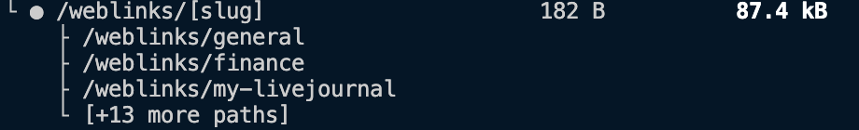
weblinks/[slug]/page.tsx - SSG
SSG – Static Site Generation
Used for statically generate routes
App router, app/weblinks/[slug]/page.tsx:
export async function generateStaticParams() {
const res = await fetch('https://.../subcategories')
const categories = await res.json()
return categories.map(({ slug }) => ({
slug: slug,
}))}
Pages router:
getStaticPaths()
npm run build

Slide 5
App Router file convension loading.js
app/weblinks/[slug]/loading.tsx
export default function Loading() {
return <p>Loading...</p>
}

Slide 6
Capacitor Installation 1
package.json
"static": "next build && next export"
next.config.mjs
const nextConfig = { output:‘export’}
export default nextConfig
capacitor.config.js
…"webDir": "out"

Slide 7
Capacitor installation 2
Installation:
npm i @capacitor/core
npm i -D @capacitor/cli
npx cap init
npm i @capacitor/android @capacitor/ios
Build time:
npm run build
npx cap add ios (npx cap add android)
npx cap sync ( next.js codebase translation to ios/ or android/ codebase) – if fails for ios/ - see Capacitor Installation 3
npx cap open ios (or npx cap open android – opens Xcode IDE or Android Studio)

Slide 8
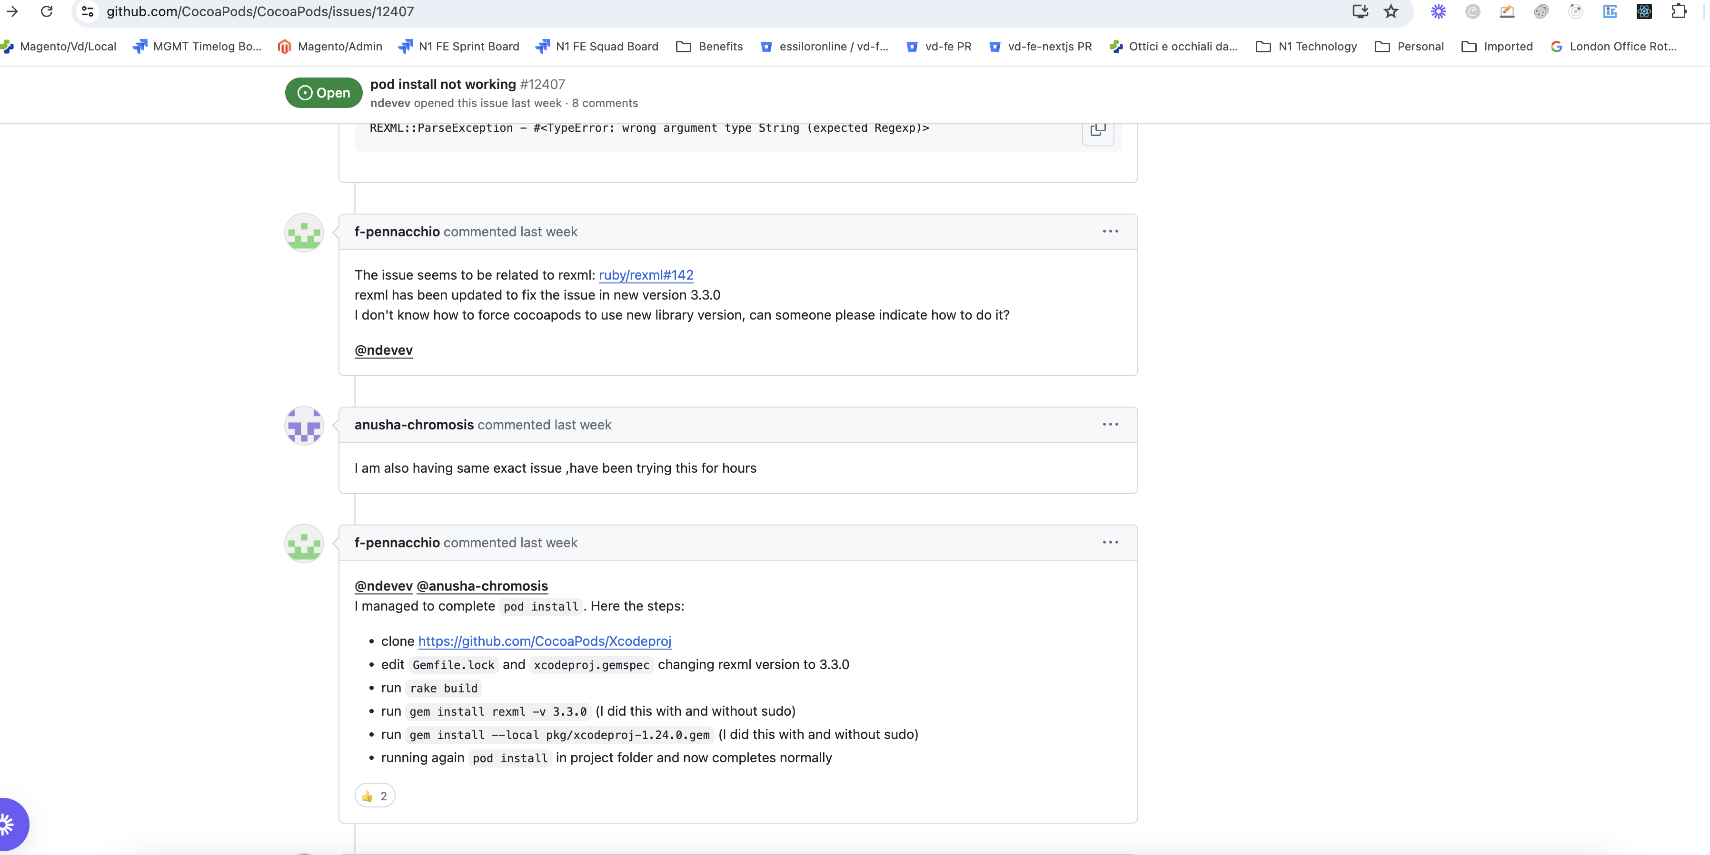
Capacitor Installation 3
For ios/ on some Macs build fails
To fix: follow this: Xcodeproj CocoaPods

Slide 9
Resources:
1.Next.Js Mobile App in minutes with Capacitor
2. Capacitor Installation Instruction
3.Next.Js SSG and ISR
4.Next.Js App Router Migration

