Slide 1

AI-Based Classroom and Course Scheduling System for School of IT and Engineering
School of IT and Engineering
CSCI3613 Artificial Intelligence
Fall 2025
Team 3
Nargiz Aghayeva BSM 2026
Aysu Azammadova BSIT 2026
Lala Musayeva BSCS 2025

Slide 2
Agenda
Problem Statement
Data
Algorithm(s)
Results
Considerations

Slide 3
Project in a Slide
Project Title | AI-Based Classroom and Course Scheduling System for School of IT and Engineering
Value | Automatically generates a feasible and optimized university timetable by efficiently assigning courses to time slots, rooms, and instructors while minimizing instructor overload and scheduling conflicts.
Problem type | Constraint Satisfaction Problem (CSP) with Soft Constraints (Search + Heuristic Optimization)
Preprocessing steps | Load and clean Excel-based datasets (courses, instructors, availability, rooms) Convert time values into discrete scheduling slots Construct meeting variables (two meetings per section) Build feasible domains based on room capacity, instructor qualification, availability, and course level Separate hard constraints (must be satisfied) and soft constraints (penalized)
Algorithm(s) | Naive Backtracking CSP Solver Backtracking with MRV (Minimum Remaining Values) Backtracking with MRV + LCV (Least Constraining Value) Branch-and-Bound optimization with soft-constraint penalties
Evaluation | Total penalty score (daily overload + weekly overload) Runtime comparison across solvers Penalty reduction analysis (Naive → MRV → MRV + LCV) Visualization of instructor workload and constraint violations
Interpretation | Heuristic-based CSP solvers (MRV + LCV) significantly reduce penalty scores and improve solution quality compared to naive search, demonstrating the effectiveness of informed search strategies for real-world university scheduling problems.

Slide 4
Contributions
Team Member | Contribution
Nargiz Aghayeva | 33.3%
Aysu Azammadova | 33.3%
Lala Musayeva | 33.3%

Slide 5
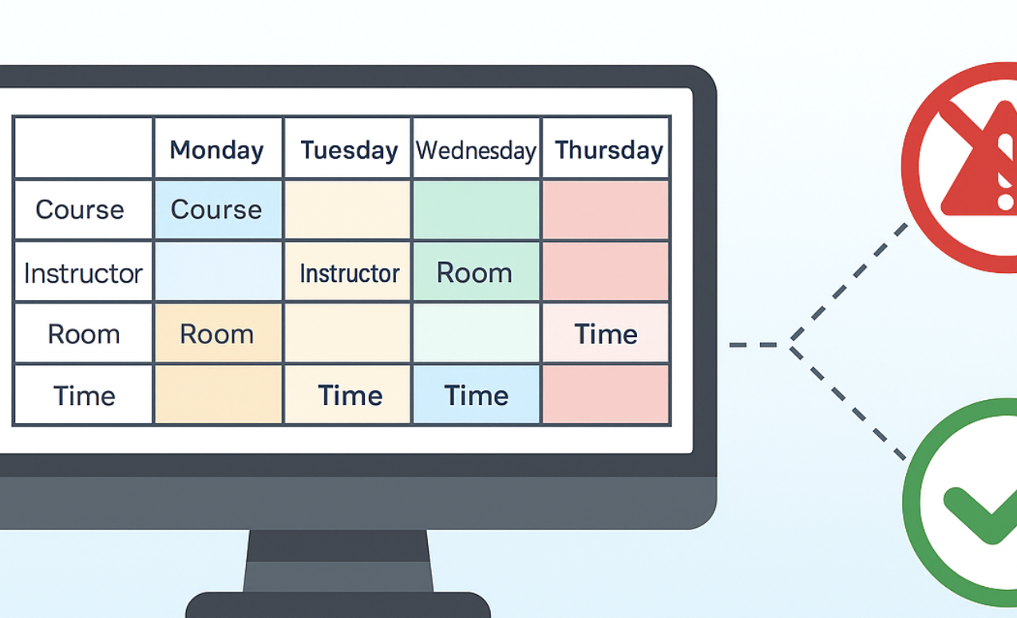
Problem Statement
We are given a set of course sections, each requiring two weekly meetings, and a limited set of time slots, classrooms, and instructors.
The goal is to construct a feasible weekly timetable by assigning, for each meeting:
a day
a start time
a room
an instructor
such that:
All hard constraints (availability, conflicts, academic rules) are satisfied, and
Soft constraints related to instructor workload are minimized.
Due to the large search space and conflicting requirements, the problem is modeled and solved as a Soft Constraint Satisfaction Problem (Soft CSP).

Slide 6
Data
Datasets Used:
Courses: course ID, course name, section ID, number of students
Instructor–Courses: instructor ID, instructor name, assigned courses
Hard Constraints: instructor unavailability (day, start time, end time)
Rooms: room ID and seating capacity
Constraint Representation:
Hard: no overlap, instructor availability, room capacity
Soft: preferred time slots with penalty weights
Entities:
Course sections
Instructors
Rooms
Time slots (day & time intervals)
Time Structure:
5 weekdays (Monday–Friday)
Discrete lecture time intervals
Each section scheduled twice per week
The dataset used in this study was constructed by combining real-world structural information derived from the university’s timetable with synthetic data generated to complete missing components. Instructor availability and certain workload distributions were synthetically generated with the assistance of ChatGPT-5, while preserving realistic academic and operational constraints. The resulting dataset is suitable for evaluating constraint-based scheduling methods but does not represent an official timetable.

Slide 7
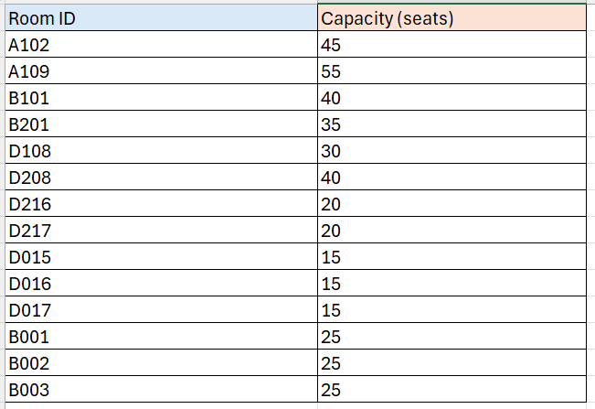
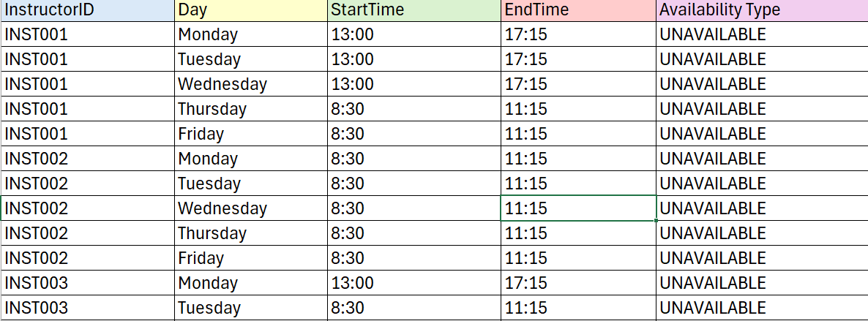
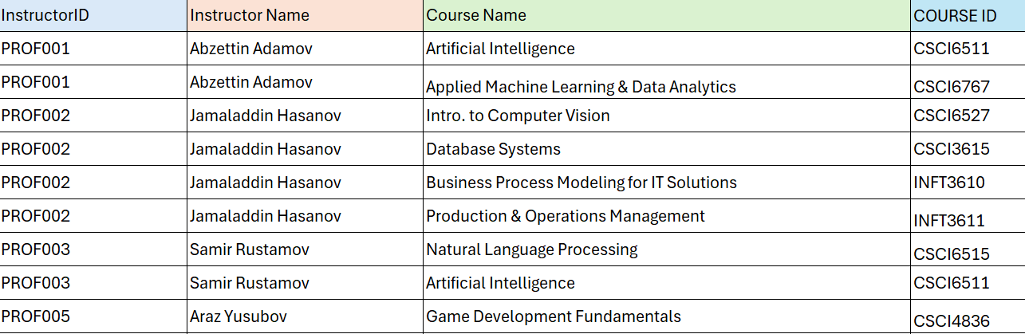
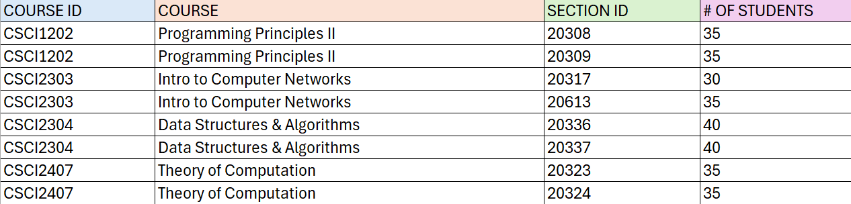

Slide 8
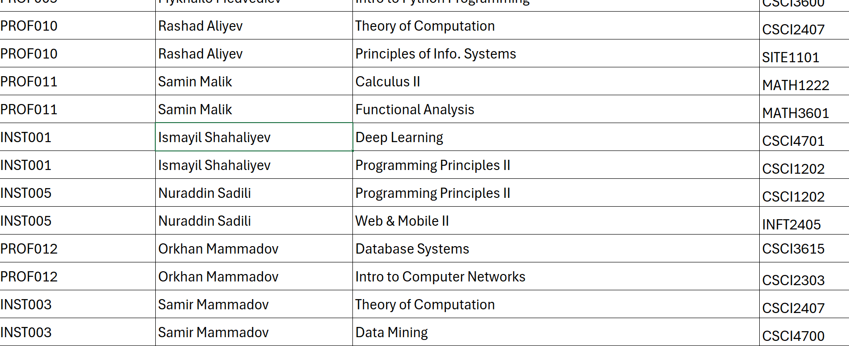
EDA & Preprocessing
Key checks performed:
Section counts per course
To identify courses with ≥3 sections (two-instructor rule)
Instructor coverage
Number of qualified instructors per course
Room capacity vs enrollment
To detect infeasible sections early
Availability density
To identify instructors with limited time windows
Master vs Bachelor course distribution
To validate time-of-day constraints
Purpose: ensure no empty domains and detect unsatisfiable cases before search
Preprocessing Steps
Converted raw time values to minutes
Discretized the week into fixed 75-minute time slots
Generated two meeting variables per section
Filtered:
Rooms by capacity
Instructors by qualification and role
Time slots by availability and academic rules
Built initial domains for all meeting variables

Slide 9
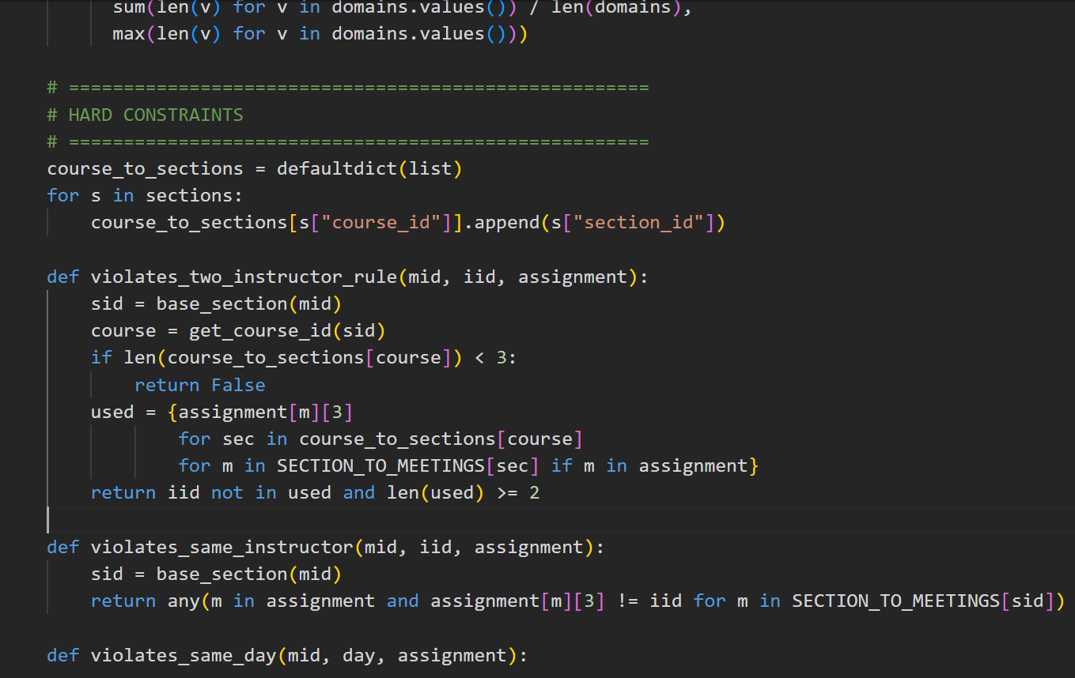
Algorithm(s) Solution Approach- The timetabling problem is modeled as a Soft Constraint Satisfaction Problem (Soft CSP) and solved using backtracking search with optimization heuristics.
Algorithm Steps
Initialize domains for all meeting variables using preprocessed data
Select a variable using Minimum Remaining Values (MRV)
Order values using Least Constraining Value (LCV)
Check hard constraints (conflict, availability, academic rules)
Accumulate soft constraint penalties
Apply Branch & Bound pruning
Backtrack until time limit or best solution is found
Heuristics Used
MRV: selects the most constrained meeting first
LCV: prefers assignments that restrict future choices least
Branch & Bound: prunes solutions worse than the current best
Optimization Objective
Minimize total penalty while satisfying all hard constraints.
We solve the problem as a soft constraint satisfaction problem using backtracking. At each step, we select the most constrained meeting variable using MRV and try values ordered by LCV to minimize future conflicts. Hard constraints are enforced strictly, while soft constraints contribute to a penalty function. Branch and bound pruning allows us to discard partial solutions that cannot outperform the current best solution, enabling us to find low-penalty schedules within a fixed time limit.

Slide 10
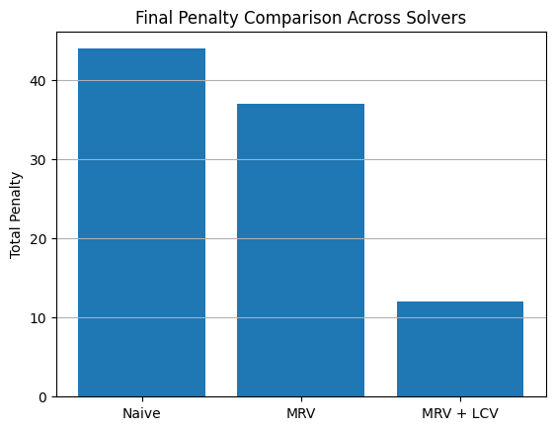
Visualizations

Slide 11
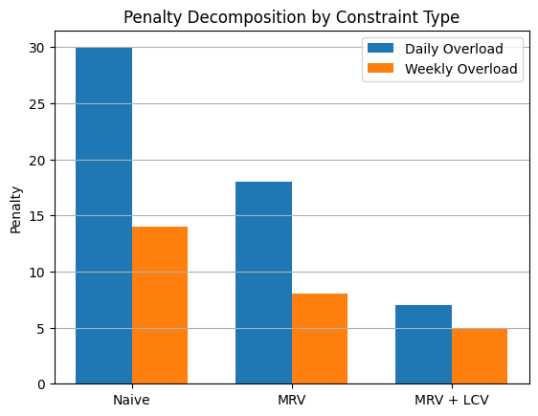
Visualizations

Slide 12
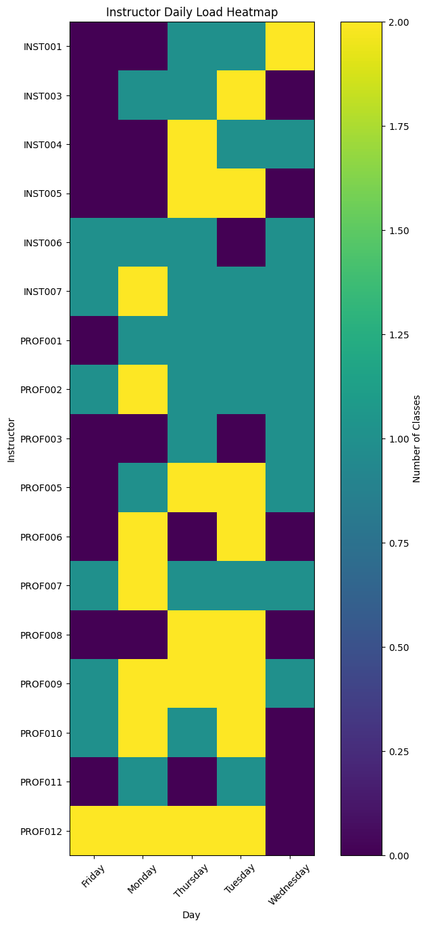
Visualizations

Slide 13
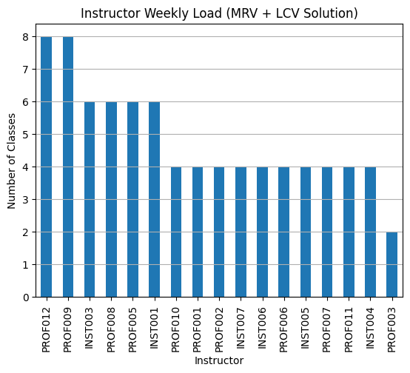
Visualizations

Slide 14
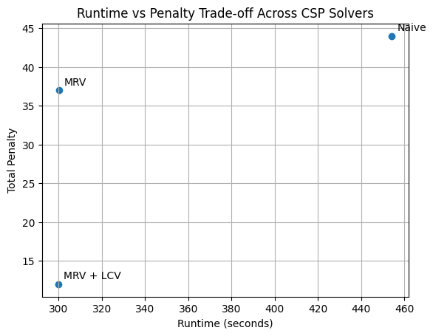
Visualizations

Slide 15
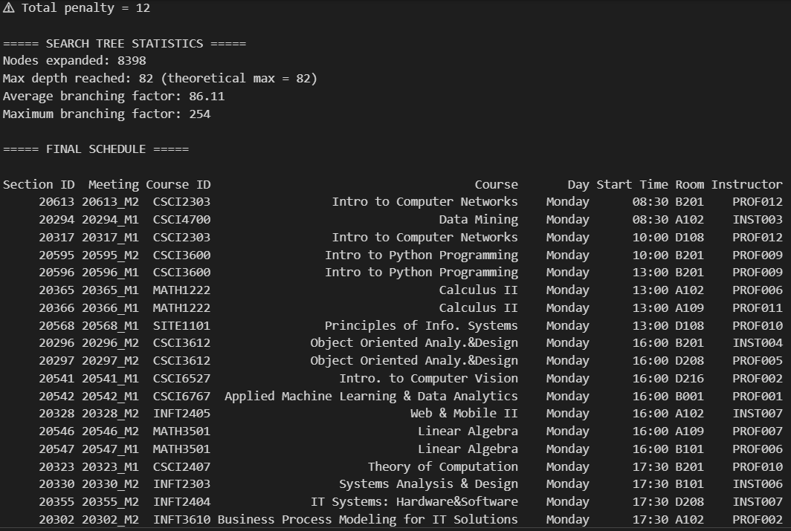
Results The problem variables correspond to individual course meetings. For each section, two variables are defined, each representing one weekly meeting. Assignments to variables specify the day, start time, room, and instructor for that meeting.

Slide 16
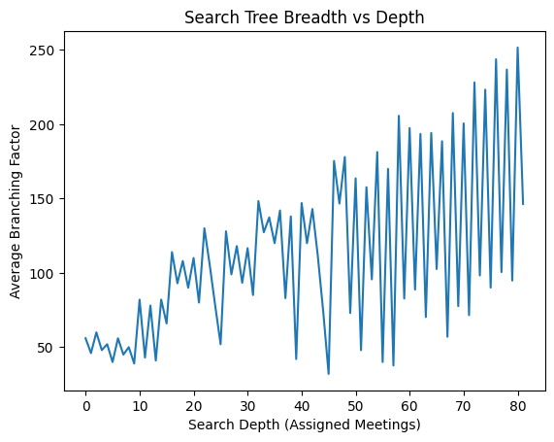
This plot shows the average branching factor as the search progresses. The non-monotonic behavior is expected because we use MRV, which dynamically selects the most constrained variable at each step. As constraints accumulate unevenly, some depths have many options while others have very few. Despite the oscillations, the solver reaches full depth while expanding only 8,398 nodes, showing that the heuristics significantly reduce the effective search space.
Shouldn’t this decrease?
That would be true with a fixed variable order. With MRV, depth corresponds to the order in which constrained variables are resolved, so branching naturally fluctuates.

Slide 17
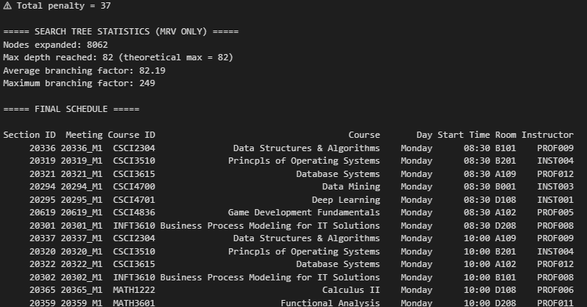
Results

Slide 18
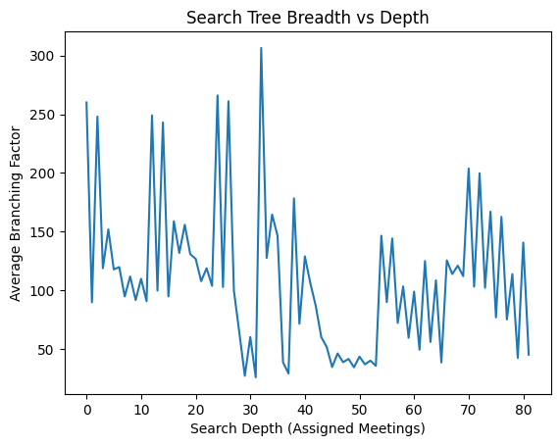

Slide 19
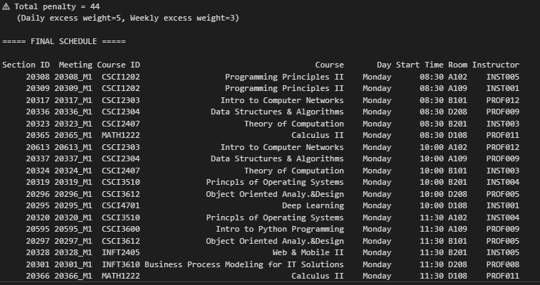
Results

Slide 20
Considerations
Hard constraints must always be satisfied to ensure timetable feasibility
Soft constraints improve schedule quality but increase search complexity
Heuristic choices (MRV, LCV) significantly affect runtime performance
Trade-off between solution optimality and computational efficiency
Constraint conflicts may arise due to limited room capacity or instructor availability
Timetabling is not just scheduling, but balancing fairness, preferences, and feasibility

Slide 21
THANK YOU FOR YOUR ATTENTION!
Questions?

