Slide 1

A Comparative Analysis of Machine Learning Models to Predict the Difficulty of Codeforces Problems Team 12
School of IT and Engineering
CSCI4734 Machine Learning
Fall 2025
Nargiz Aghayeva BSM
Raul Aghayev BSCS
Arzu Mammadova BSCS

Slide 2
Agenda
Problem Statement
Data
Model(s)
Results
Considerations

Slide 3
Project in a Slide
Project Title | A Comparative Analysis of Machine Learning Models to Predict the Difficulty of Codeforces Problems
Value | Automatically predicts problem difficulty from statements and metadata, enabling scalable difficulty labeling, improved problem recommendation, and fairer contest design without relying solely on manual expert ratings.
Problem type | Supervised regression with an emphasis on ranking quality (predicting continuous difficulty ratings and preserving their relative order).
Original and final data shape | Original (9556, 14), After Preprocessing/engineering (9556, 21)
Preprocessing steps | Including cleaning, transformations, feature engineering, augmentation, etc.
Model(s) | Linear Regression, Ridge Regression, Random Forest, XGBoost, CatBoost, LinearSVR, LightGBM
MLOps tool | Used for experiment tracking, parameter logging, fold-level metrics, and model comparison.
Evaluation metric | MAE, RMSE, Spearman correlation, R² score.
Best score(s) | MAE: 267.1, RMSE: 351.2, R²: 0.798, Spearman: 0.904 LightGBM (Final Test)
Interpretation | Tree-based models significantly outperform linear approaches across all feature configurations, highlighting the non-linear relationship between problem characteristics and difficulty. While numeric features alone already provide strong predictive signals, incorporating textual information through TF-IDF further improves performance when combined with gradient-boosted trees. Semantic sentence embeddings, although effective, do not surpass TF-IDF representations, suggesting that lexical and structural cues in problem statements are more informative than high-level semantics for this task. The final LightGBM model with TF-IDF and numeric features achieves the best overall performance, demonstrating strong generalization and ranking consistency.

Slide 4
Contributions
Team Member | Contribution
<Nargiz Aghayeva> | 33%
<Raul Aghayev> | 33%
<Arzu Mammadova> | 33%

Slide 5

Problem Statement
Competitive programming problems are assigned difficulty ratings manually, based on expert judgment and contest outcomes. This process is time-consuming, subjective, and difficult to scale, especially as thousands of new problems are added each year. Our goal is to automatically predict problem difficulty using the problem statement text and contest metadata, while preserving the correct relative ordering of problem difficulty.
We investigate:
How well numeric metadata alone predicts difficulty
How much textual information improves performance
Which machine learning models perform best for this task

Slide 6
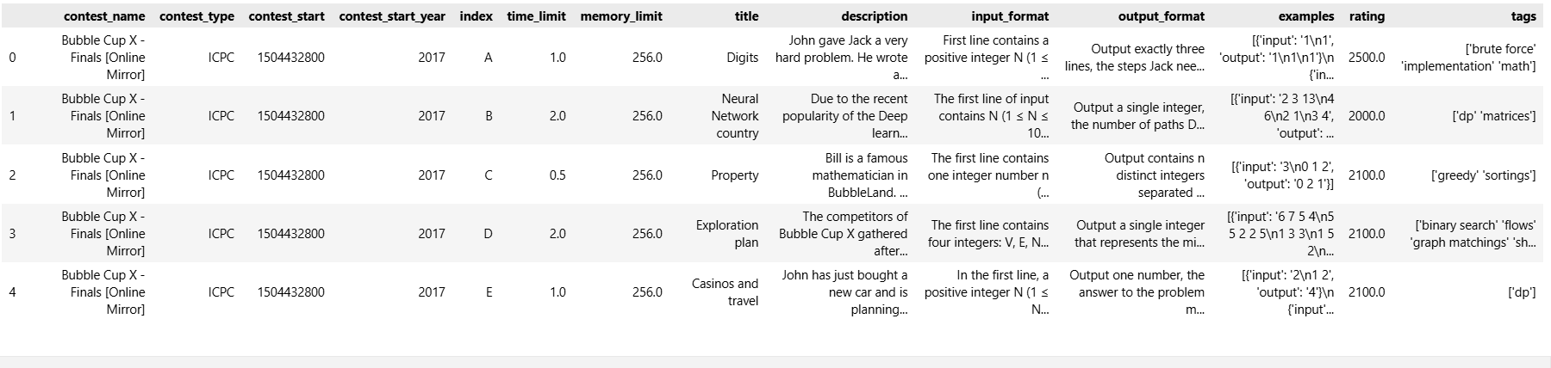
Data
Dataset Overview
9,556 competitive programming problems from Codeforces
Each problem includes textual descriptions and contest metadata
Target variable: problem difficulty rating
Key EDA Observations
Problem statements vary widely in length - Descriptions range from very short to nearly 10,000 characters
Input/output formats show large variance, indicating different implementation complexity
Text fields exhibit strong right-skewed distributions
Numeric features alone show moderate correlation with difficulty
Textual information provides the strongest predictive signal

Slide 7
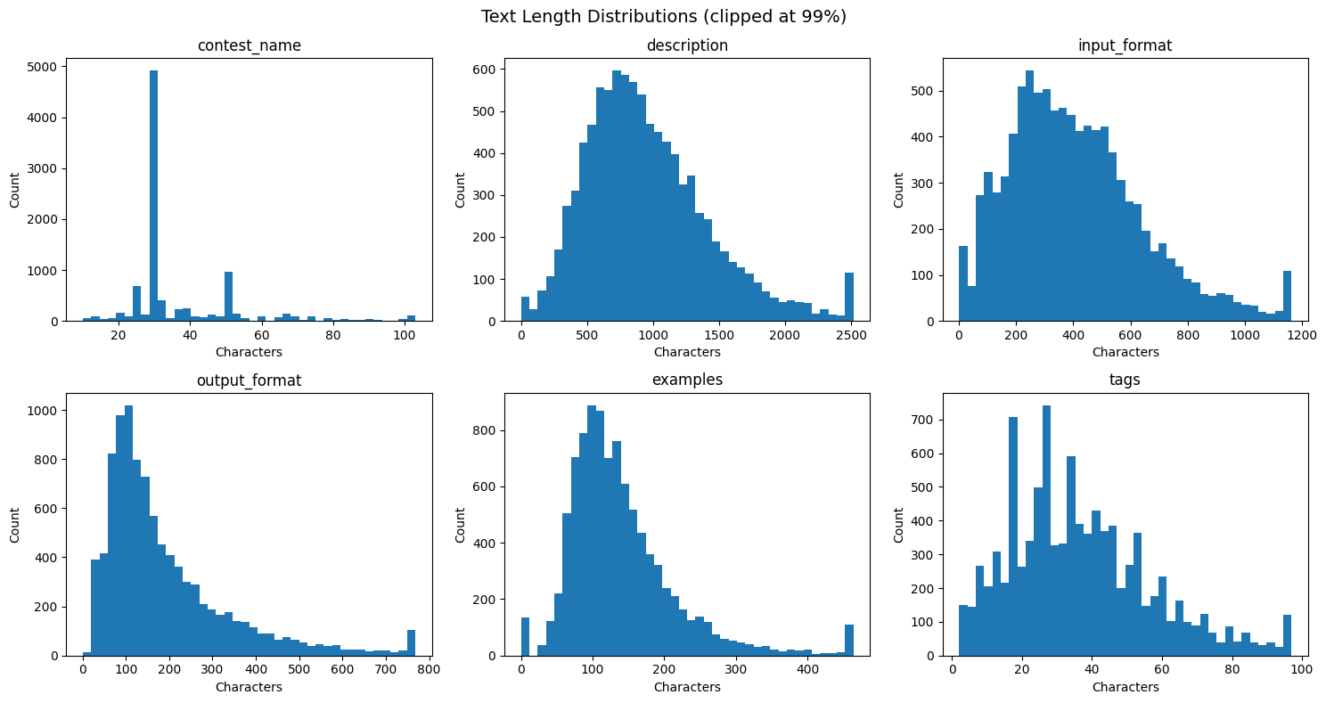

Slide 8
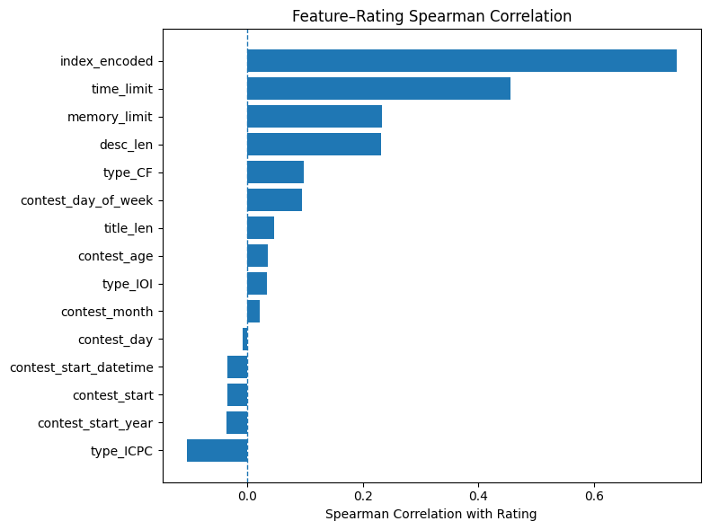
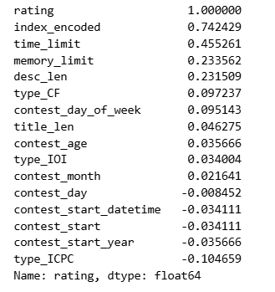
Based on the correlation values we decided to keep or remove certain features.

Slide 9
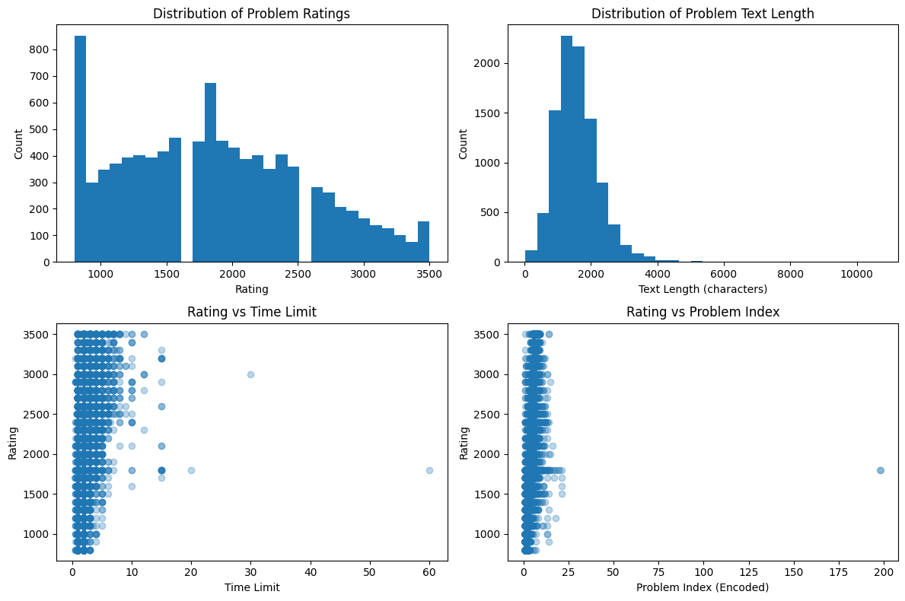
Problem difficulty follows a skewed, multi-modal distribution with most problems in the mid-difficulty range.
Problem statements vary widely in length, but most fall within a moderate range.
Time limit shows only a weak correlation with difficulty, indicating it is a supportive but insufficient feature.
Problem index is strongly correlated with difficulty, making it one of the most informative structured features.

Slide 10
Model(s)
Model | Features Used | MAE ↓ | RMSE ↓ | R² ↑ | Spearman ↑
Linear Regression | Numeric only | 443.8 | 605.5 | 0.26 | 0.715
Ridge Regression | Numeric only | 443.8 | 605.5 | 0.26 | 0.715
Random Forest | Numeric only | 311.1 | 401.1 | 0.68 | 0.827
XGBoost | Numeric only | 272.9 | 359.3 | 0.74 | 0.864
CatBoost | Numeric only | 274.9 | 353.8 | 0.75 | 0.869
LinearSVR | TF-IDF + Numeric | 423.1 | 769.8 | −0.41 | 0.788
Ridge Regression | TF-IDF + Numeric | 382.4 | 498.0 | 0.48 | 0.742
LightGBM (tuned) | TF-IDF + Numeric | 281.2 | 360.4 | 0.73 | 0.859
LightGBM (Final Test) | TF-IDF + Numeric | 262.0 | 351.3 | 0.80 | 0.902

Slide 11
Model | Features Used | MAE ↓ | RMSE ↓ | R² ↑ | Spearman ↑ | Notes
Linear Regression | Numeric only | 445.9 | 606.4 | 0.258 | 0.711 | Underfits, linear assumption too weak
Ridge Regression | Numeric only | 445.9 | 606.3 | 0.258 | 0.711 | Same behavior as LR
XGBoost | Numeric only | 323.9 | 414.7 | 0.655 | 0.817 | Strong non-linear modeling
CatBoost | Numeric only | 304.5 | 384.5 | 0.704 | 0.841 | Best numeric-only model
CatBoost (Final Test) | Numeric only | 341.8 | 424.7 | 0.735 | 0.887 | Excellent generalization
Numeric-only Models - Tree-based models dramatically outperform linear ones. Even without text, structural signals (index, limits) capture much of the difficulty.

Slide 12
TF-IDF + Numeric Models - TF-IDF features significantly improve performance only when paired with tree-based models. Linear models struggle due to sparsity and noise.
Model | MAE ↓ | RMSE ↓ | R² ↑ | Spearman ↑ | Stability
LinearSVR | 378.9 | 715.7 | -0.240 | 0.778 | ❌ Very unstable
Ridge | 388.4 | 507.2 | 0.463 | 0.727 | Moderate
ElasticNet | 446.1 | 595.6 | 0.256 | 0.706 | Weak
LightGBM (tuned) | 282.5 | 362.1 | 0.727 | 0.858 | ✅ Very stable
XGBoost | 285.0 | 364.0 | 0.724 | 0.856 | Stable
LightGBM (Final Test) | 267.1 | 351.2 | 0.798 | 0.904 | ⭐ Best overall

Slide 13
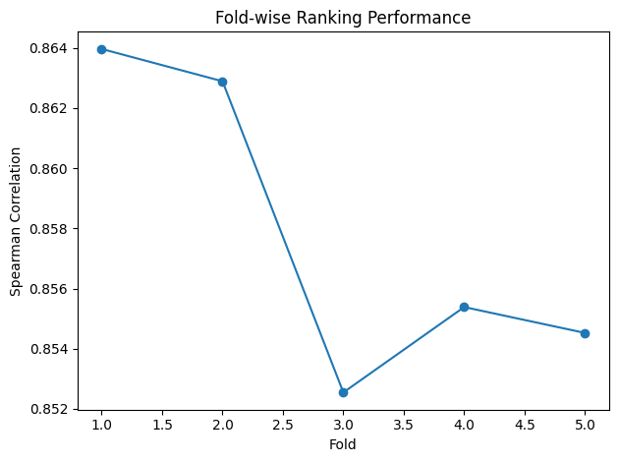
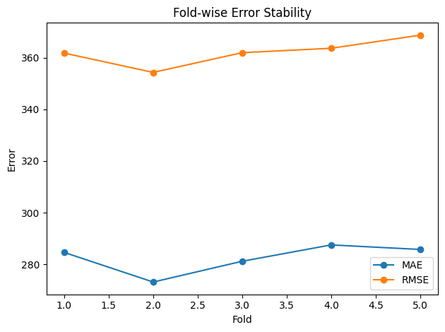
Results
Overall Performance
Best model: LightGBM (TF-IDF + Numeric Features).
Final Test Results
MAE: 262
RMSE: 351
R²: 0.80
Spearman: 0.90
Key Findings
Numeric metadata alone provides a strong baseline
Textual information significantly improves difficulty prediction
Tree-based models outperform linear models
The model preserves relative difficulty ordering very well
Model Comparison Insight
Linear models struggle with complex, non-linear patterns
TF-IDF + LightGBM achieves the best balance between accuracy and ranking quality
Text improves ranking even when absolute error remains non-zero
Our results show that while numeric metadata already captures part of the difficulty signal, textual descriptions are essential for accurately ranking problems. The final LightGBM model achieves a Spearman correlation above 0.9 on future problems, demonstrating strong generalization and reliable difficulty ordering.

Slide 14
Considerations
Difficulty labels are subjective and time-dependent
Problem difficulty ratings are based on human judgment and contest performance, which can vary over time as participant skill levels and problem standards evolve. As a result, the same problem might receive a different rating if introduced in a different era
Tags and editorials excluded to prevent leakage
Tags and editorials are often assigned after difficulty is established and may reflect expert knowledge of the solution. Including them could leak post-hoc information, so they were excluded to ensure realistic and fair evaluation.
Generalization to new contest formats may vary
The model is trained on historical contest data and may be less accurate when applied to significantly different or novel contest formats. Continuous retraining or adaptation would be needed to maintain performance over time.

Slide 15
THANK YOU FOR YOUR ATTENTION!
Questions?

