Slide 1
Data Management Plan of DDBJ Datasets using Shiny-SurrealDB: a study case
Andrea Ghelfi and Takatomo Fujisawa
第27回オープンバイオ研究会
2023-03-11

Slide 2
Overview
INTRODUCTION 3
DATA MANAGEMENT GUIDELINES 4
DATABASE SECURITY: ISSUES TO CONSIDER 5
STUDY CASE: SURREAL VIEWER 6
SURREALDB DATA INTEGRATION 10
SUMMARY 11

Slide 3
Introduction
At DDBJ we deal with a number of databases which occasionally requires new platforms for an easy access, store and integrate a particular dataset.
Having in mind that lose data is a historical problem in scientific research, and even when data is not lost, in some cases precious research time is lost when trying to find or understand what the it means.
Therefore, we understand that implementation of a data management plan should be aimed, so less time finding, understanding, reusing and/or sharing data would be spent by researchers. As well as, reliable procedures should be implemented in order to deal with private data.

Slide 4
Data Management Guidelines
Identify best tools based on evaluation of accessibility, speed, vulnerabilities and limitations.
Documentation
Record the most important information, in README files, codebooks, notebooks, such as GitHub.
Consistency
Organize folders, subfolders and filenames in a logical structure, such as by project and/or date.
Version
Keeping distinct copies, for example keep original files and the clean final version, in a classification system such as Git.
(a) Establish security controls for accession of confidential data. (b) Security breach, such as SQL injection attacks, Malware, etc.
Constraints
Security
Back-up
Automated and with regular frequency, daily or weekly. Also, perform periodical confirmation that backups are working properly.
How To
Where
When
Who can/
Who shouldn’t
Which
Why

Slide 5
Database security: Issues to consider
Encrypt confidential data, such as masking and tokenization should be considered.
Access to database should be restricted to the minimum level.
Web applications that access the database should comply with best practices security guidelines.
Monitoring log activity and automated detection of suspicious activities.

Slide 6
Study Case: Surreal Viewer

Slide 7
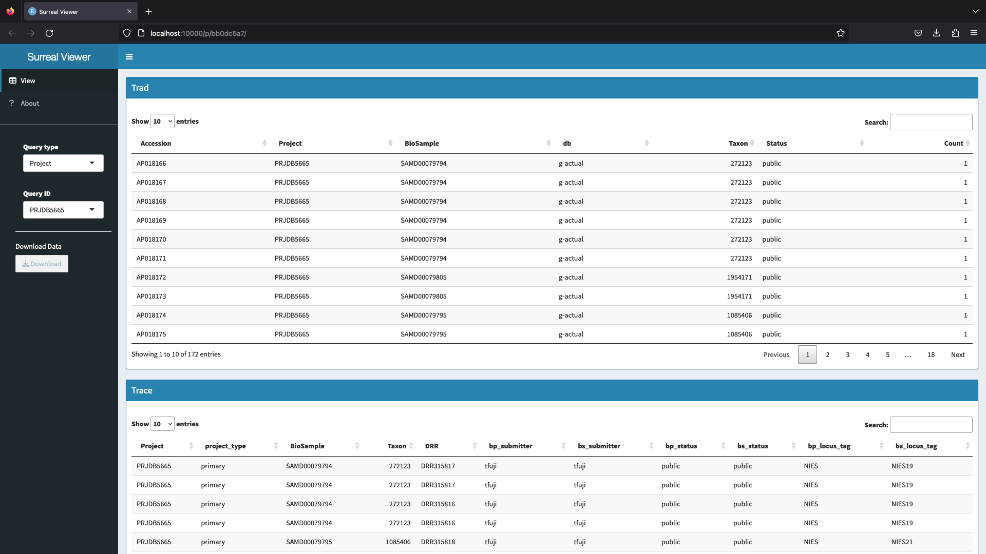

Slide 8
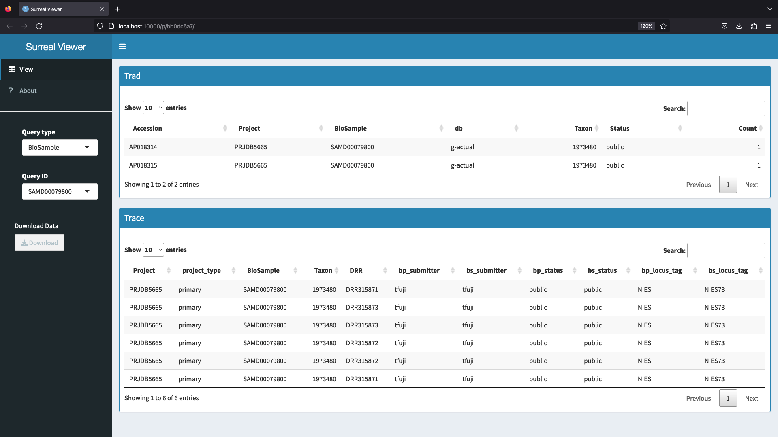

Slide 9
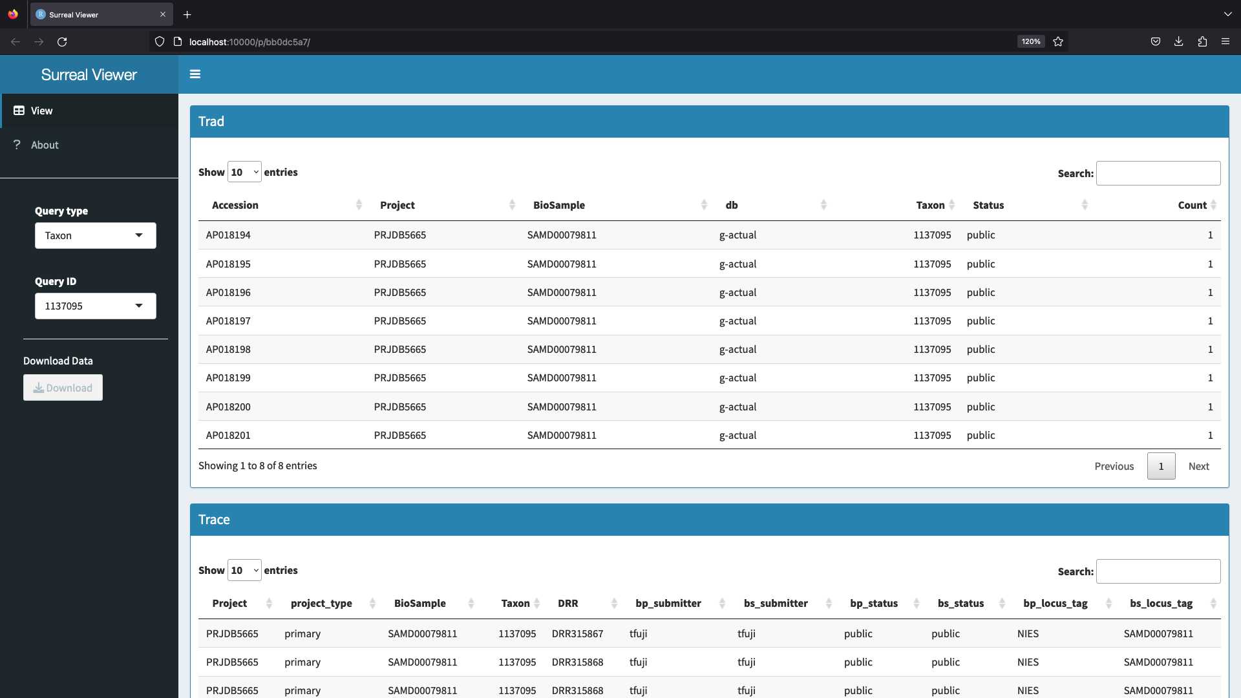
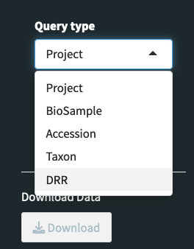

Slide 10
SurrealDB Data Integration
MetaboBank
has
has
BioProject
umbrella
BioProject
has
has
has
Sequence accession
GEA
BioSample
has
DRR
has
DRX
has
DRA

Slide 11
Summary
In order to have a efficient data management there are some important steps to follow, such as:
Good documentation of the procedures used to manage and store data;
Establish rules for directory, sub-directories and filenames, which should be easily understandable;
Versioning all updates in a structured manner such as used in GitHub;
Secure confidential data as well as being aware of security breaches;
Identify strengths and weakness of the tools that have being used in the system;
Automate a periodic backup to secure data.

Slide 12
References
Briney KA, Coates H, Goben A (2020) Foundational Practices of Research Data Management. Research Ideas and Outcomes 6: e56508.
Database security - https://www.ibm.com/topics/database-security.
Database management - https://www.smartsheet.com/database-management.

Slide 13
ありがとうございます
Andrea Ghelfi
andreaghelfi@nig.ac.jp

