Slide 1
Welcome!
daria.cornovan@unicaen.fr
Office – LVE 368

Slide 2
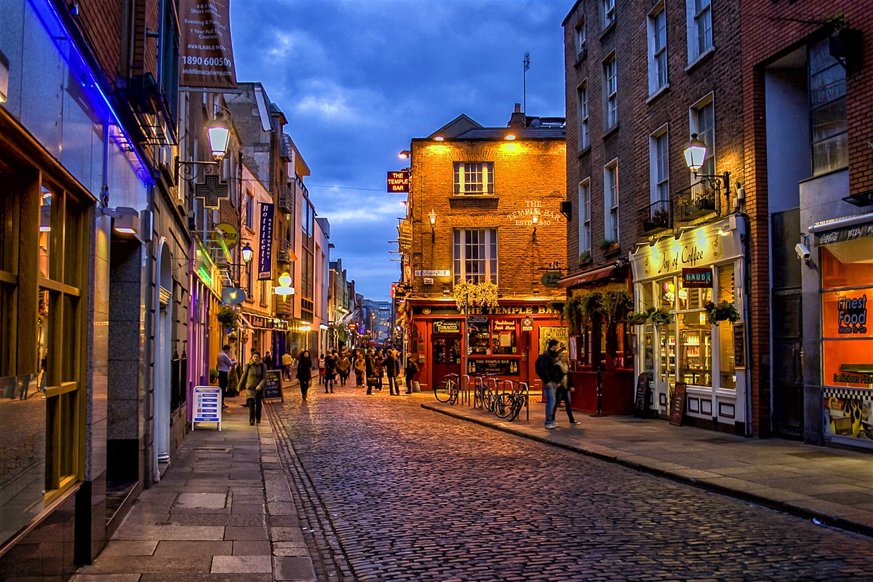

Slide 3


Slide 4
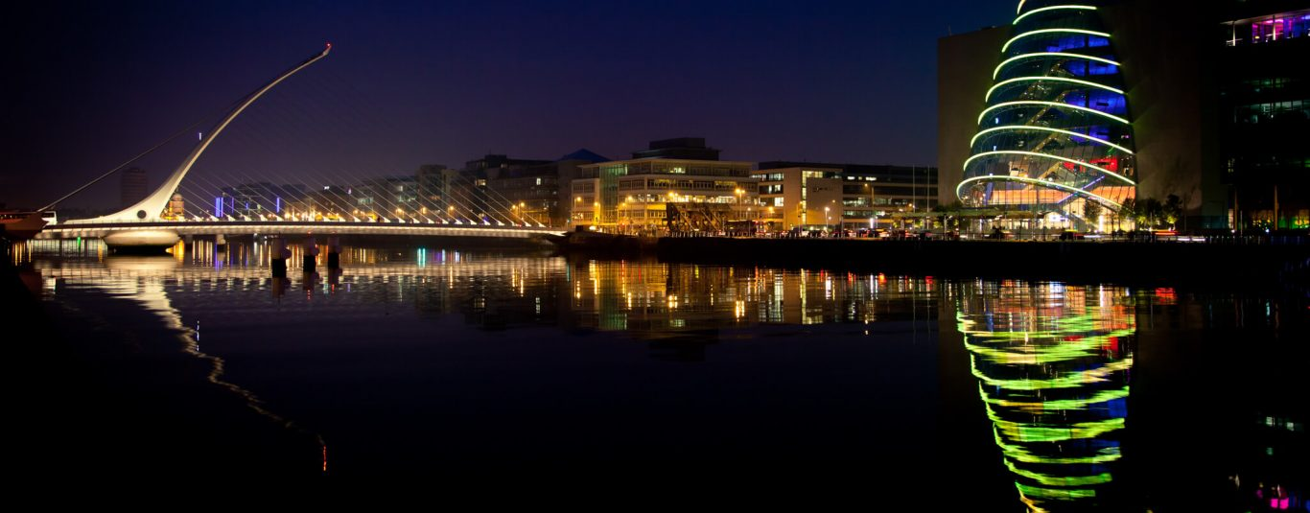

Slide 5
Layout
Semester 1 → 12 weeks of classes
8 weeks → general English
4 weeks → English more specific to your course

Slide 6
Layout
Different topic every 2 weeks
Weeks 1 & 2 → Cybersecurity
Listening and reading
Questions to be completed in class

Slide 7
Exams
Exams throughout the semester in class (not yet told when by department sorry ☹)
End of year exam in amphitheater

Slide 8

End of Year Exam
1 listening comprehension → played 6 times, 1 whole way through, 4 times with pauses, 1 whole way through again
1 reading comprehension
Exercises regarding content / vocabulary / grammar of the comprehensions
2 hours

Slide 9
Icebreaker
Turn to the person beside you and introduce yourselves in English and discuss the question
‘’If you had a superpower what would it be?’’
☺

Slide 10
Cybersecurity
What is cybersecurity?
- All of our safety online
Why do you think cybersecurity is important in this day and age?
Can you think of anything that has been in the news recently where cybersecurity has failed?

Slide 11
Cybersecurity → being protected against the criminal or unauthorized use of electronic data
For example hacking, Facebook scandal

Slide 12
Discussion
Do you think the government has the right to listen to us ‘for security measures’?
Is ‘technical eavesdropping’ okay?
One side for / one side against

Slide 13
Simple Present
Add s/es for the he/she/it form
→ he eats
→ she washes

Slide 14
Present Perfect
Unfinished past actions
Present of ‘to have’ + past participle
→ I/ you/ we / they have made
→ she/he has made

Slide 15
Simple Past / Preterite
Actions completed in the past
Regular verbs end in ‘ed’ or ‘d’ (sometimes t)
Watch → I watched
Eat → ate

