Slide 1
AI-Based Semiconductor Device Temperature Prediction
Capstone Project
Regression-based estimation of device temperature from electrical and thermal operating conditions
Python • Pandas • Scikit-learn

Slide 2
Problem Statement & Objectives
Device temperature is influenced by current, voltage, load, ambient temperature, power loss, and cooling.
Build a model to estimate device temperature.
Compare predictions with reference values using MAE, RMSE, and R².

Slide 3
Dataset & Features
2,400 reproducible synthetic operating samples
Inputs: current (A), voltage (V), ambient temperature (°C), load fraction
Thermal context: estimated power loss, thermal resistance, heat-sink factor
Target: device_temperature_C (°C)
Engineered features: current², voltage × current, power loss / load

Slide 4
Methodology
Generate/import dataset and inspect missing values and ranges
Engineer physically motivated features
80/20 train-test split with fixed random seed
Train Random Forest, Gradient Boosting, and Linear Regression
Select model with lowest test RMSE and save it for inference

Slide 5
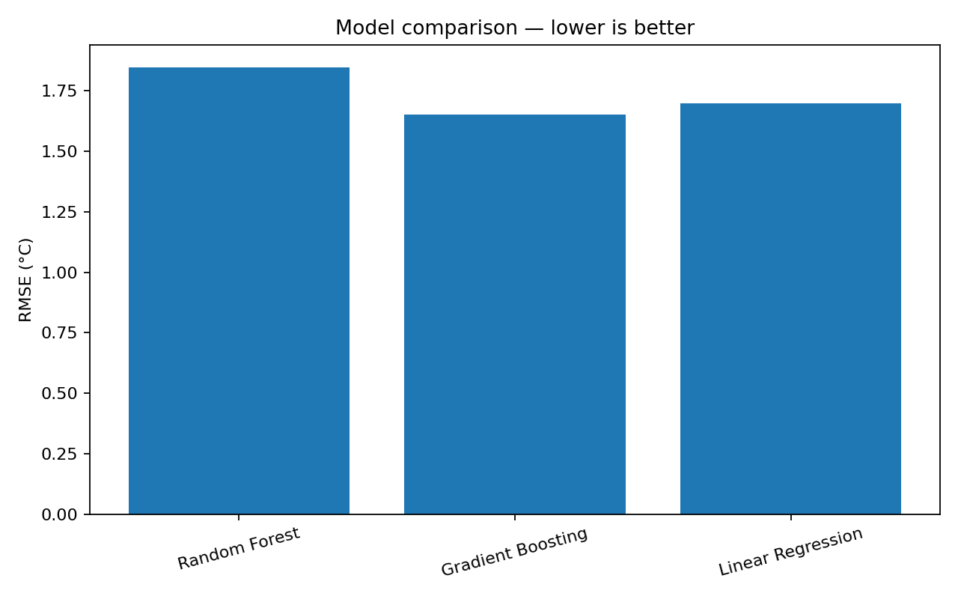
Model Comparison

Slide 6
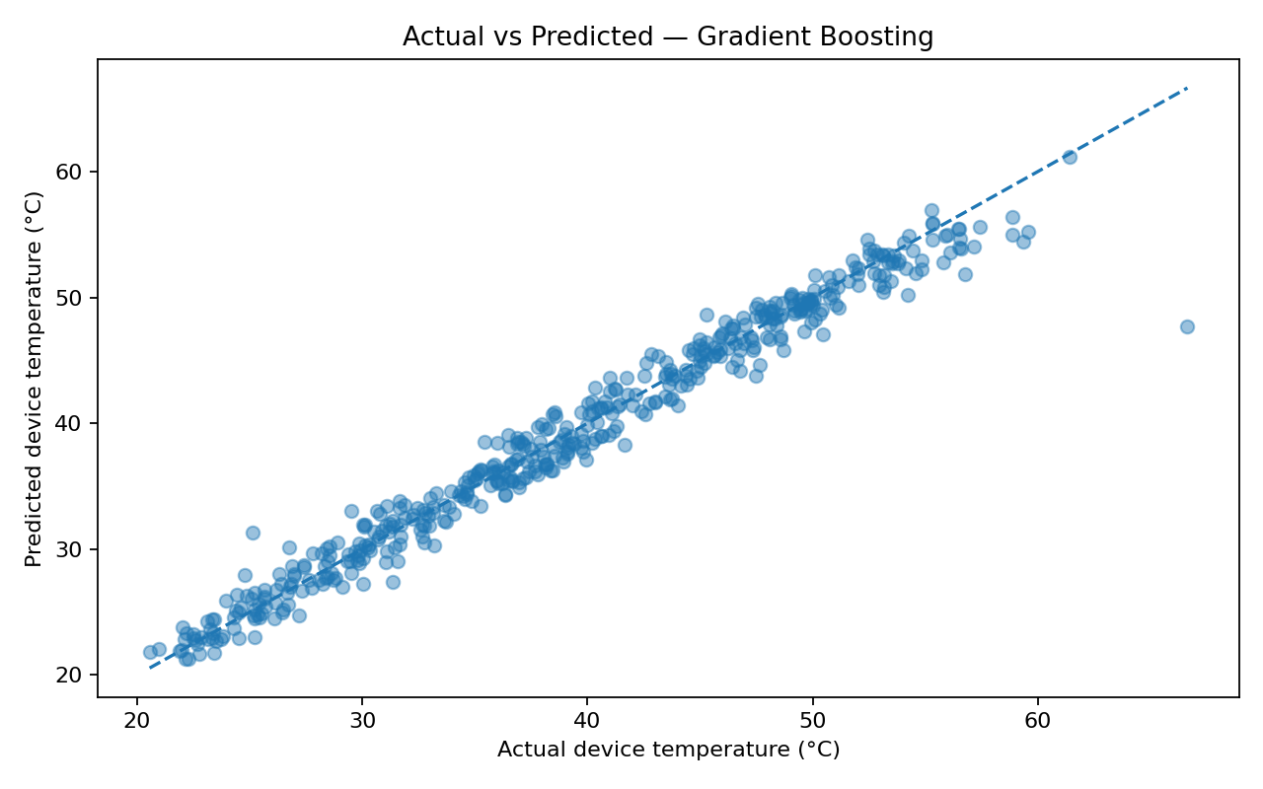
Actual vs Predicted

Slide 7
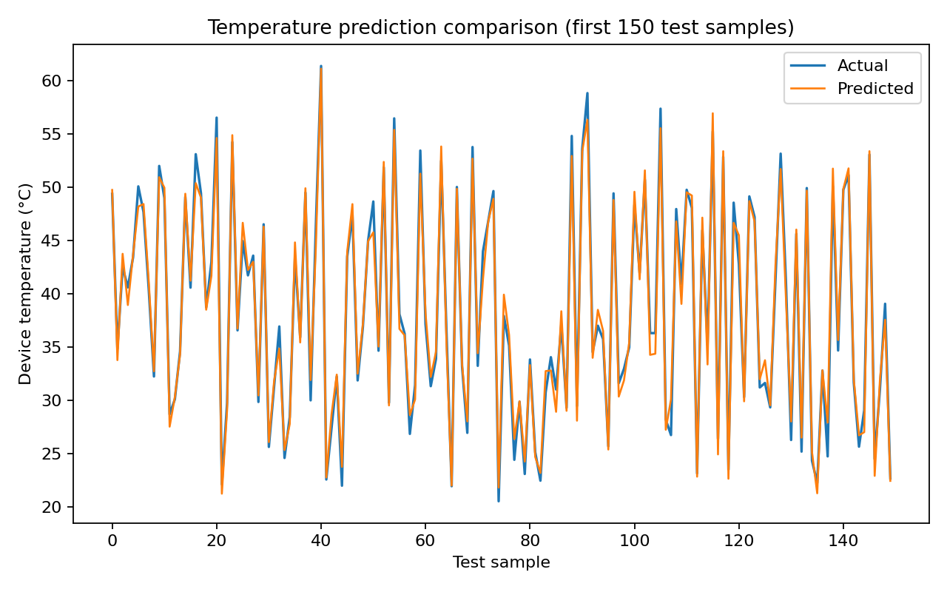
Prediction Trend

Slide 8
Evaluation Results
Random Forest: MAE 1.24 °C | RMSE 1.85 °C | R² 0.964
Gradient Boosting: MAE 1.14 °C | RMSE 1.65 °C | R² 0.971
Linear Regression: MAE 1.23 °C | RMSE 1.70 °C | R² 0.970
Selected model: Gradient Boosting
Metrics are measured on a held-out synthetic test set.

Slide 9
Conclusion & Future Work
Complete ML workflow delivered: dataset, features, models, metrics, graphs, source code, report, and dashboard.
Replace synthetic data with calibrated measurements or LTspice/electrothermal simulation.
Validate across devices, packages, loads, and ambient conditions.
Use datasheet limits and hardware protection independently of ML predictions.

