Slide 1
Programming Adventure Begins
Classroom Presentation
. . .
/>
} /> [
</
July 11, 2026

Slide 2
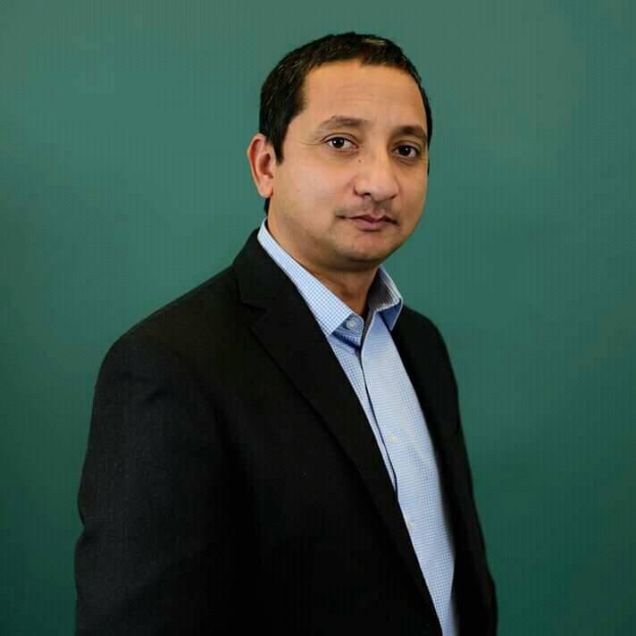
</ Principal of Everest IT
EverestIT Founder
Principal Technology Specialist (Microsoft)
Masters in:
Information Management
Healthcare Management
Senior Technical Leadership
~30 years in IT Field Experience
Bijay>

Slide 3
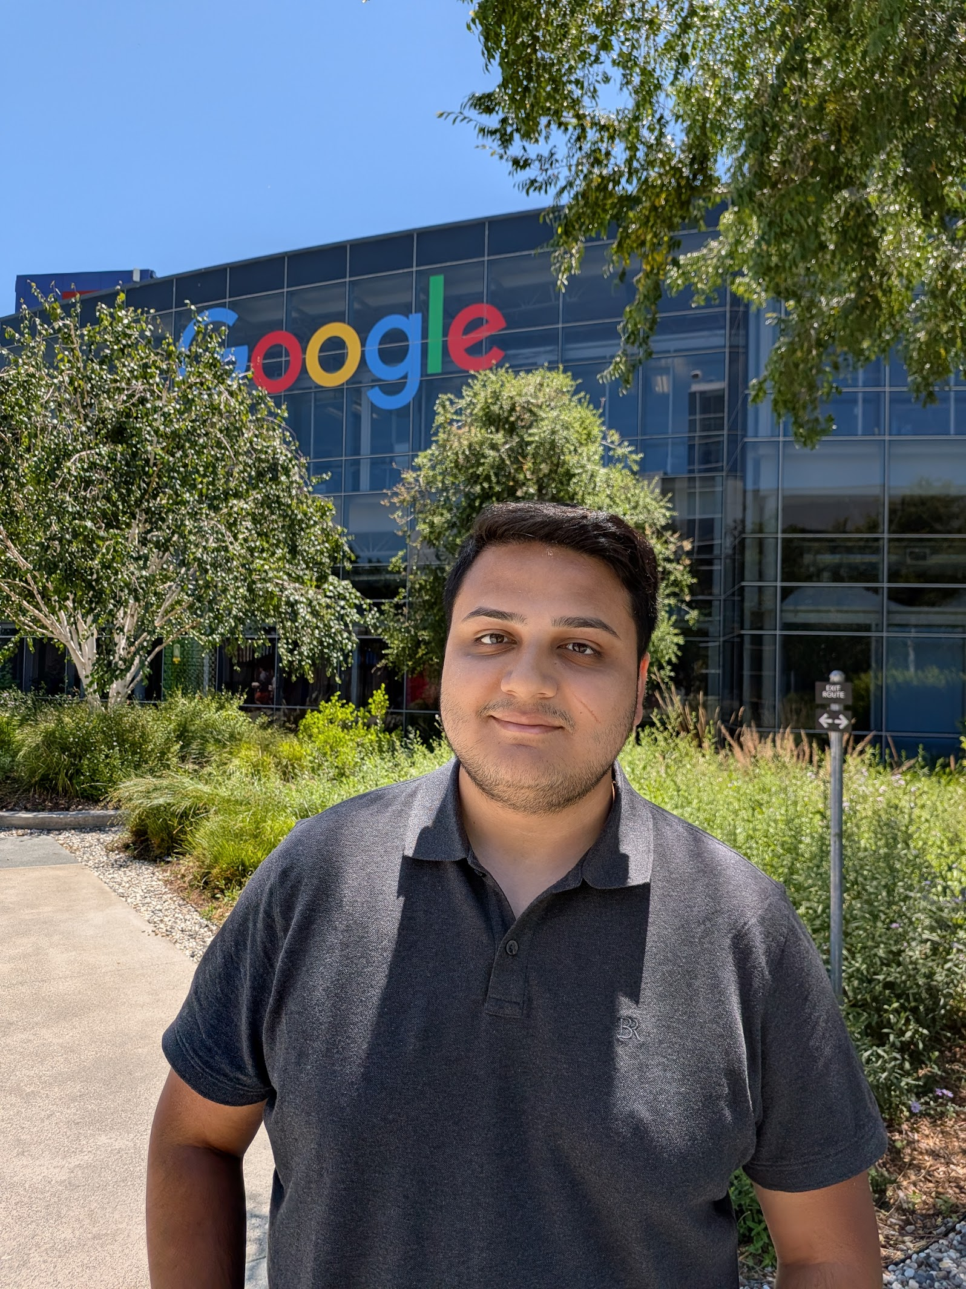
</ Teachers
Bachelors & Masters in Computer Science
Software Engineer Intern at Northrop Grumman and BNY
Software Engineer at Google​
Sanskar>

Slide 4
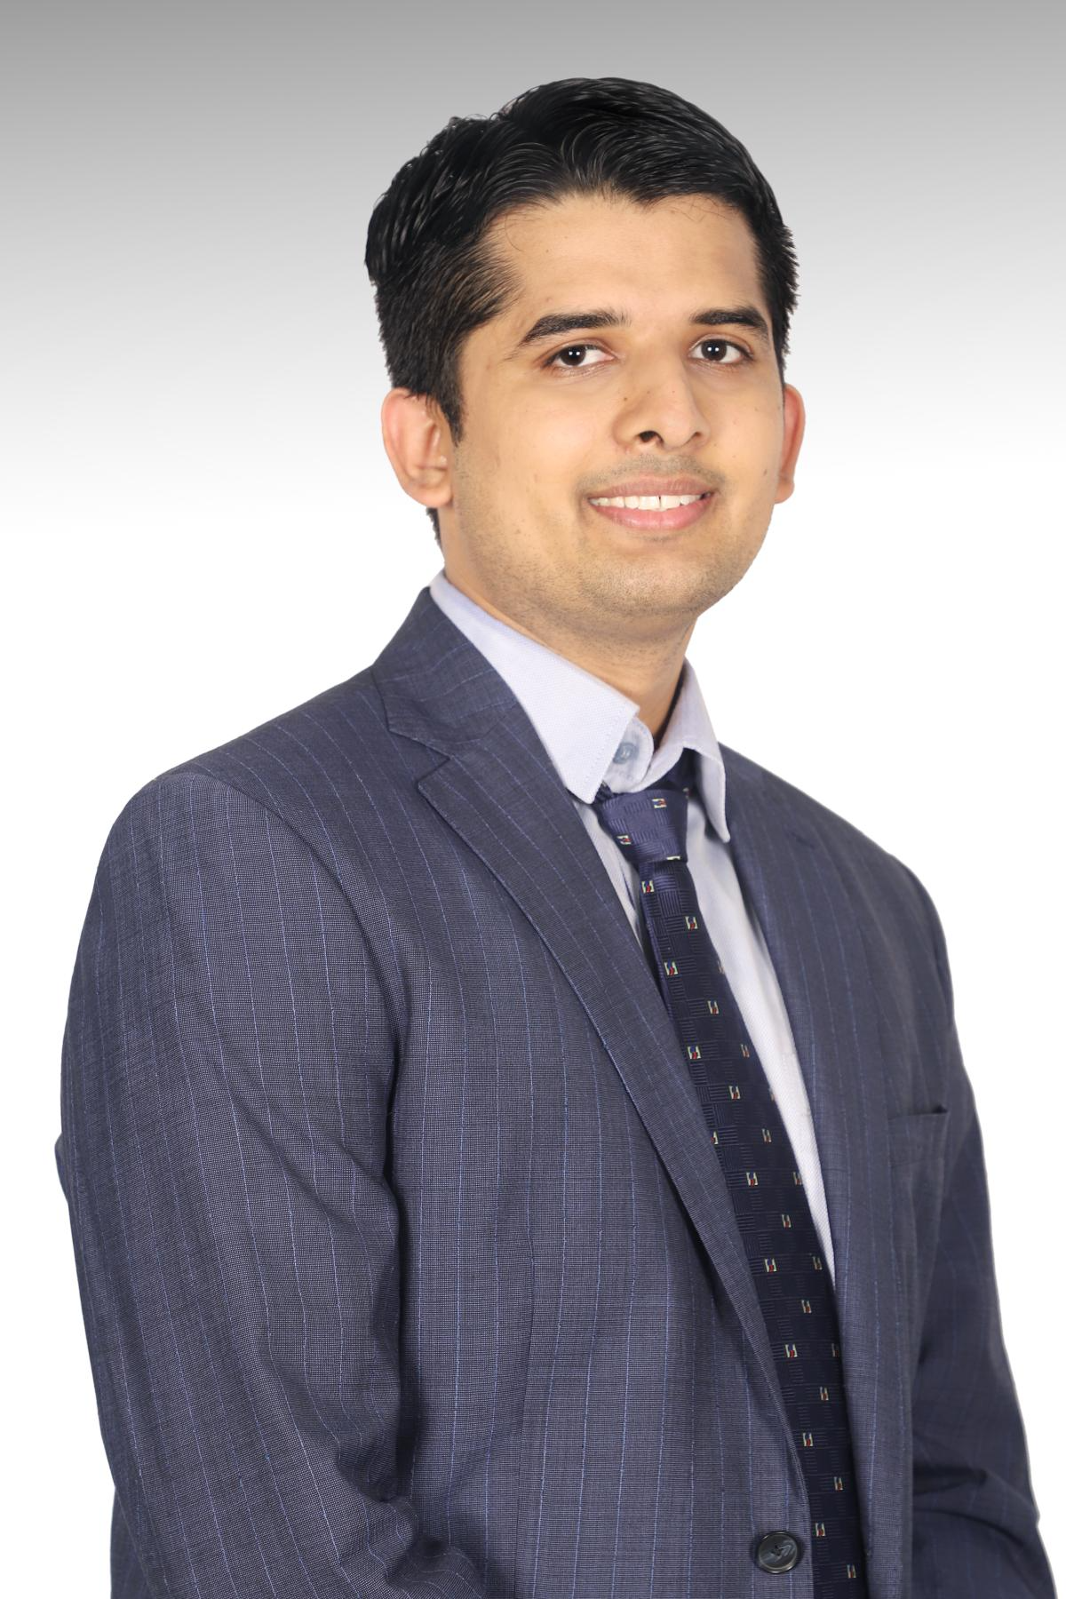
</ Teachers
Lead Software engineer at Flagship Financial Group
Avid learner
Masters in Software Engineering
FOSS contributor - Bitcoin, Large Language Models, OpenAI
Abhigya>

Slide 5
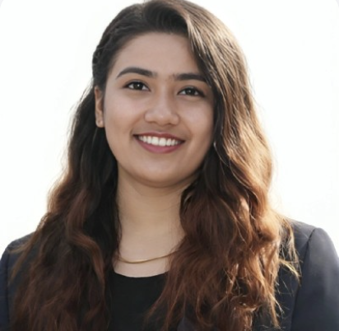
</ Assistant Teachers
/> **
Ishwari Ma'am

Slide 6
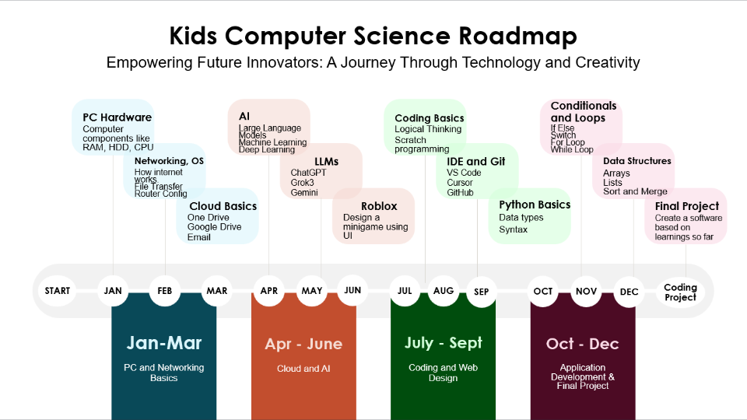
TypeScript
Basics
Types
Logic
Syntax

Slide 7
{Meet}
{Explore}
{Create}
</
Today's mission
} /> [
Learn who is here
Teams, Kahoot, and breakout rooms
Make music with code
/>

Slide 8
{Say your name}
{Share favorites}
{Listen kindly}
</
Introduce yourself
} /> [
City/state or country only
Grade, subject, and hobby
Passing is always okay
/>

Slide 9
{Code.org}
{TypeScript}
{Projects}
</
Programming starts with ideas
} /> [
Visual blocks make ideas move
Writing code starts next week
Build games, apps, and tools
/>

Slide 10
{Class: 9-1}
{Break: 10:30}
{Typing: 11:00}
</
Our Saturday class routine
} /> [
Saturdays, Pacific Time
Rest and recharge
Practice accuracy and speed
/>

Slide 11
{Calendar}
{Join the Team}
{Ask for help}
</
Find class in Microsoft Teams
} /> [
Find the Saturday meeting
Open Kids Computer Science
Use chat or raise your hand
/>

Slide 12
{Updates}
{Assignments}
{Hangout}
</
Know the Teams channels
} /> [
Important teacher updates
Find and submit assignments
Join extra help after class
/>

Slide 13
{4:30-5:30}
{Questions}
{Join Hangout}
</
Use hangout for extra help
} /> [
Pacific Time
Homework, classwork, or setup
Assistant teachers are ready to help
/>

Slide 14
{Be respectful}
{Be on time}
{Be ready}
</
Class habits that help everyone
} /> [
Respect your fellow students and treat them as you want to be treated
Attend the class on time to be successful
Set yourself up for success by bringing the necessary tools
/>

Slide 15
Kahoot time!
Classroom Presentation
. . .
/>
} /> [
</
15 fun questions. Learn the game.

Slide 16
Break time
Classroom Presentation
. . .
/>
} /> [
</
Return at 11:00 AM Pacific.

Slide 17
Typing practice
Classroom Presentation
. . .
/>
} /> [
</
Accuracy first. Speed comes later.

Slide 18
{Captain}
{Coach}
{Reporter}
</
Breakout room jobs
} /> [
Keeps the crew on the mission
Helps when someone gets stuck
Shares one discovery
/>

Slide 19
{Own project}
{Explain}
{Everyone}
</
How to work as a code crew
} /> [
Work on your computer
Help by asking questions
A crew succeeds together
/>

Slide 20
{Music Lab}
{Build a mix}
{Try AI drums}
</
Code.org Music Lab
} /> [
Use the link in Teams
Combine at least two sounds
Notice what changes
/>

Slide 21
{Sequence}
{Event}
{Debug}
</
Programming words we will use
} /> [
Steps run in an order
An action starts something
Find and fix a problem
/>

Slide 22
{AI suggests}
{You choose}
{Humans lead}
</
AI can help, but you decide
} /> [
Music Lab can generate beats
Keep, change, or remix
Creativity and judgment stay yours
/>

Slide 23
{One discovery}
{One project}
{One shout-out}
</
Share what your crew made
} /> [
What did your crew learn?
Show a favorite moment
Thank someone who helped
/>

Slide 24
Final Kahoot
Classroom Presentation
. . .
/>
} /> [
</
Show what you learned today.

Slide 25
{Finish levels}
{Remix it}
{Submit}
</
Homework: Music Lab remix
} /> [
Complete the guided levels
3 sounds, AI drums, 2 changes
Link or screenshot in Teams
/>

Slide 26
{TypeScript}
{Write code}
{Build together}
</
Next week we start TypeScript
} /> [
Our programming language
Start with small, clear steps
Questions are always welcome
/>

Slide 27
Great first day!
Classroom Presentation
. . .
/>
} /> [
</
See you next Saturday.

