Slide 1
NVIC and PULSE WIDTH MODULATION (REFER LPC 1678 MANUAL FOR CLEAR FIGURES)

Slide 2
Basic terminologies on Interrupts
Interrupt
Interrupt Service Subroutine
Interrupt Vector
Interrupt Vector Table
Priority of interrupts

Slide 3
Nested Vectored Interrupt Controller(NVIC)
Controls system exceptions and peripheral interrupts
In the LPC176x, the NVIC supports 35 vectored interrupts
Each peripheral device may have one or more interrupt lines to the Vectored Interrupt Controller.
Interrupt numbers relate to where entries are stored in the Interrupt vector table.
Interrupt Vector – Is the address of Interrupt Service Subroutine (ISR)
Interrupt vector of Interrupt Type N is stored at an offset N*4 from the base address of Interrupt Vector Table(IVT)
If the peripheral device is enabled to generate Interrupt when some event
IVT
Base addr
Type 0 Vector
Type 1 Vector
Type 2 Vector
Type N Vector
Base addr+4
Base addr+8
Base addr+4*N
When Interrupt occurs, NVIC loads vector to PC and executes the ISR to provide the service to peripheral

Slide 4
Nested Vectored Interrupt Controller(NVIC)
If the peripheral device is enabled to generate Interrupt when some event occurs, the INTR request is sent to NVIC
If NVIC is enabled to service the INTR request from the peripheral, it services the INTR request by executing ISR pertaining to the peripheral.( i.e Save the return address, Get the Interrupt Vector from IVT and load that address to PC. Upon completion of ISR execution resumes the calling function )

Slide 5
Nested Vectored Interrupt Controller(NVIC)
In case of Timer, there are 6 INTR enable flags (4 in MCR and 2 in CCR. i.e 4 Match events and 2 Capture events can generate the Interrupt when the event occurs)
When the event occurs the corresponding bit is set automatically in the IR register. This indicates the NVIC about the event
If the NVIC is enabled to service the Timer Interrupt, it executes the corresponding ISR and gives the desired service to the Timer.
In the ISR, clear the corresponding bit, by writing back 1.

Slide 6
C statement to Enable the interrupt at NVIC , written in the main program.
Syntax: NVIC_EnableIRQ(Int_name_IRQn);// red colored content is //fixed/keyword
Ex:to enable the timer 0 interrupt
NVIC_EnableIRQ (TIMER0_IRQn);
To enable the PWM interrupt: NVIC_EnableIRQ(PWM1_IRQn);
C statement to write the interrupt Handler:
Syntax: void INT_NAME_IRQHandler()
{
}
Ex: void TIMER0_IRQHandler();
void PWM1_IRQHandler();

Slide 7
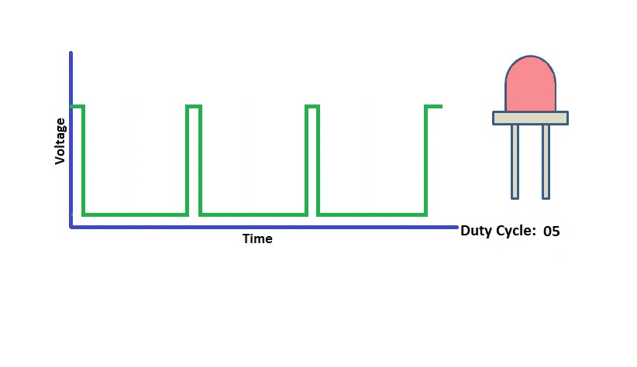
PWM
Pavg = Pmax Ton/(Ton+Toff)

Slide 8
Types of PWM
Single Edge PWM:
Two match registers are used to generate single edge controlled PWM output. PWMMR0 decides the cycle rate by resetting the count after match.
All single edge controlled PWM outputs go high at the beginning of a PWM cycle unless their match value is equal to 0.
Each PWM output will go low when its match value is reached. If no match occurs (i.e. the match value is greater than the PWM rate), the PWM output remains continuously high.
Ex: MR0=100, MR1=40, output at PWM1.1=?

Slide 9
Types of PWM contd..
Double edge PWM
Both edges can be modulated/moved which changes the width of the pulse.
Pulse can be placed anywhere in the period.
Three match registers are used to generate single edge controlled PWM output. PWMMR0 decides the cycle rate by resetting the count after match.
Ex: PWM1.2 uses MR0, MR1 & MR2 registers

Slide 10
Features of LC1768 PWM
Uses a 32-bit timer (features same as discussed before under timers)
Supports 6 PWM outputs : P1.1,…P1.5,P1.6

Slide 11
PWM timer diagram
Ref Fig. 120 PWM block diagram in LPC 1768 reference manual

Slide 12
Single and double edge controlled PWM

Slide 13
Sample PWM waveforms

Slide 14
SFRs OF PWM
MRO TO MR4 :MATCH REGISTERS
CRO TO CR1: CAPTURE REGISTERS

Slide 15
PWM IR
The PWM Interrupt Register consists of 9 INTR Flags (7Match,2Capture) If an interrupt is generated then the corresponding bit in the PWMIR will be high. Otherwise, the bit will be low. Writing a logic 1 to the corresponding IR bit will reset the interrupt.

Slide 16
SFRs OF PWM: TCR
The PWM Timer Control Register (PWMTCR) is used to control the operation of the PWM Timer Counter.
LPC_PWM2->TCR = ? ; //RESET
LPC_PWM2->TCR = ? ; //ENABLE COUNTER AND PWM

Slide 17
SFRs OF PWM: TCR
Bit 0 – Counter Enable
This bit is used to Enable or Disable the PWM Timer and PWM Prescalar Counters
0- Disable the Counters
1- Enable the Counter incrementing.
Bit 1 – Counter reset
This bit is used to clear the PWM Timer and PWM Prescalar Counter values.
0- Do not Clear.
1- The PWM Timer Counter and the PWM Prescale Counter are synchronously reset on the next positive edge of PCLK.
Bit 3 – PWM Enable
Used to Enable or Disable the PWM Block.
0- PWM Disabled
1- PWM Enabled

Slide 18
PWM CTCR

Slide 19
PWM: PCR

Slide 20
PWM:PCR
PWMSELx This bit is used to select the single edged and double edge mode form PWMx (x:2-6) 0- Single Edge mode for PWMx 1- Double Edge Mode for PWMx.
PWMENAx This bit is used to enable/disable the PWM output for PWMx(x:1-6) 0- PWMx Disable. 1- PWMx Enabled.
LPC_PWM2->PCR = ? ; //TO ENABLE O/P AT PWM2

Slide 21
PWM :MCR
The PWM Match Control Register is used to specify what operations can be done when the value in a particular Match register equals the value in TC.
For each Match Register we have 3 options : Either generate an Interrupt , or Reset the TC , or Stop .. which stops the counters and disables PWM. Hence this register is divided into group of 3 bits. The first 3 bits are for Match Register 0 i.e PWMMR0 , next 3 for PWMMR1 , and so on.
1) Bit 0 : Interrupt on PWM1MR0 Match – If set to 1 then it will generate an Interrupt else disable if set to 0.
2) Bit 1 : Reset on PWM1MR0 Match – If set to 1 it will reset the PWM Timer Counter i.e. PWM1TC else disabled if set to 0.
3) Bit 2 : Stop on PWM1MR0 Match – If this bit is set 1 then both PWM1TC and PWM1PC will be stopped & PWMTCR[0] is reset which disables the Counter.

Slide 22
PWM : MCR

Slide 24
PWM LER

Slide 25
Write PWM program to change the intensity of LED connected to (PWM1.4)(P1.23, Funct 2) continuously using single edge controlled

