Slide 1
LCD INTERFACING TO LPC1768

Slide 2
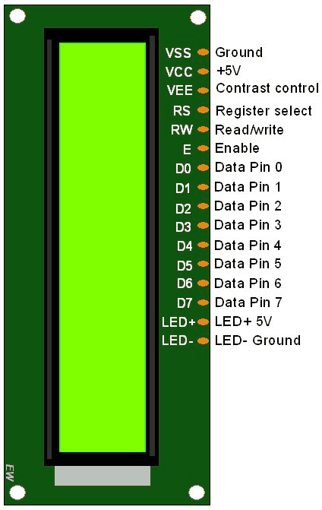
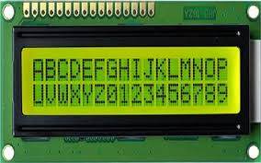
16X2 LCD: 2 ROWS WITH 16 CHARACTERS PER ROW

Slide 3
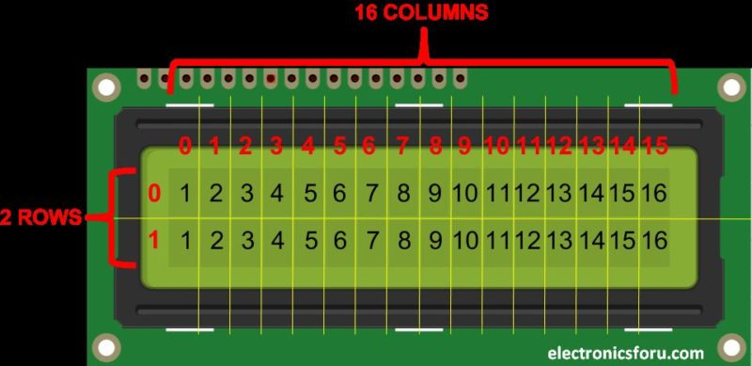
Each character is displayed as a 5x7 pixel matrix

Slide 4
Pins of LCD
RS : Register Select (P0.27)
RS =0 to select command register
RS =1 to select data register
Enable : High to low pulse needs to be given for every data/command write operation (P0.28)
D7 to D0: 8 bit pins used for 8-bit mode. Only D7 to D4 used for 4-bit mode (P0.26 TO P0.23)
VEE: contrast control, voltage is varied using a potentiometer

Slide 5
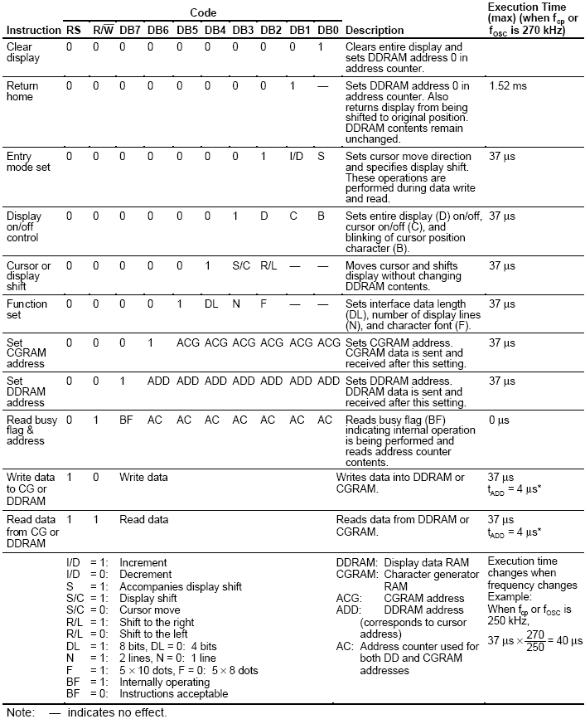
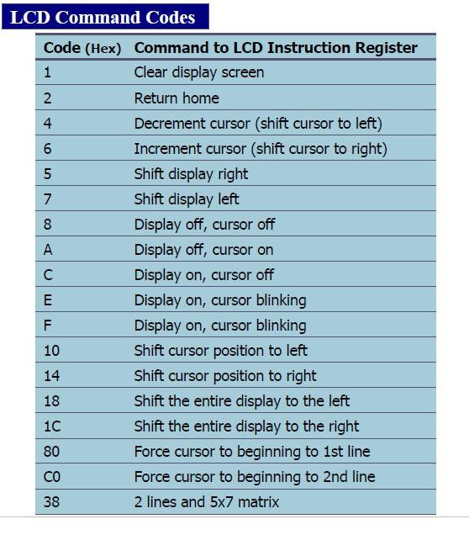
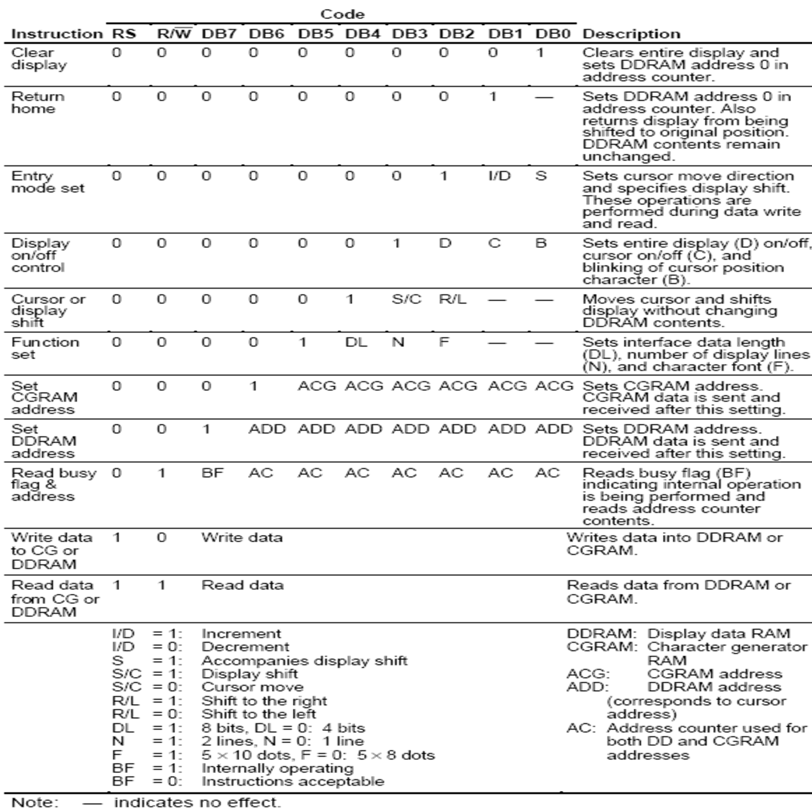

Slide 6
Liquid Crystal Display (LCD) Interfacing
#define RS_CTRL 0x08000000 //P0.27
#define EN_CTRL 0x10000000 //P0.28
#define DT_CTRL 0x07800000 //P0.23 to P0.26 data lines
unsigned long int temp1=0, temp2=0,i,j ;
unsigned char flag1 =0, flag2 =0;
unsigned char msg[] = {"WELCOME "};
void lcd_write(void);
void port_write(void);
void delay_lcd(unsigned int);
unsigned long int init_command[] = {0x30,0x30,0x30,0x20,0x28,0x0c,0x06,0x01,0x80};
int main(void)
{
SystemInit();
SystemCoreClockUpdate();
LPC_GPIO0->FIODIR = DT_CTRL | RS_CTRL | EN_CTRL; //Config output
flag1 =0;//Command
for (i=0; i<9;i++)
{
temp1 = init_command[i];
lcd_write(); //send Init commands to LCD
}
flag1 =1;//Data
i =0;
while (msg[i++] != '\0')
{
temp1 = msg[i];
lcd_write();//Send data bytes
}
while(1);
}
3 times send 8-bit mode command, followed by 4-bit mode

Slide 7
Liquid Crystal Display (LCD) Interfacing
void lcd_write(void)
{
flag2 = (flag1 == 1) ? 0 :((temp1 == 0x30) || (temp1 == 0x20)) ? 1 : 0;//If command is 0x30 (Working in 8-bit mode initially), send ‘3’ on D7-D4 (D3-D0 already grounded)
temp2 = temp1 & 0xf0;//
temp2 = temp2 << 19;//data lines from 23 to 26. Shift left (26-8+1) times so that higher digit is sent on P0.26 to P0.23
port_write(); // Output the higher digit on P0.26-P0.23
if (!flag2) // Other than command 0x30, send the lower 4-bt also
{
temp2 = temp1 & 0x0f; //26-4+1
temp2 = temp2 << 23;
port_write(); // Output the lower digit on P0.26-P0.23
}
}
void port_write(void)
{
LPC_GPIO0->FIOPIN = temp2;
if (flag1 == 0)
LPC_GPIO0->FIOCLR = RS_CTRL; // Select command register
else
LPC_GPIO0->FIOSET = RS_CTRL; //Select data register
LPC_GPIO0->FIOSET = EN_CTRL; //Apply -ve edge on Enable
delay_lcd(25);
LPC_GPIO0->FIOCLR = EN_CTRL;
delay_lcd(30000);
}
void delay_lcd(unsigned int r1)
{
unsigned int r;
for(r=0;r<r1;r++);
return;
}

Slide 8
Liquid Crystal Display (LCD) Interfacing (with few changes in the previous slide.
void lcd_write(void)
{
flag2 = (flag1 == 1) ? 0 :((temp1 == 0x30) || (temp1 == 0x20)) ? 1 : 0;//If command is 0x30 (Working in 8-bit mode initially), send ‘3’ on D7-D4 (D3-D0 already grounded)
/* flag2=0;
if(flag1==0)
if(temp1==0x30 || temp1==0x20)
flag2=1;// only MS 4 bits are sent*/
temp2 = temp1 & 0xf0;
temp2 = temp2 >>4;
port_write(); // Output the higher digit on P0.26-P0.23
if (!flag2) // Other than command 0x30, send the lower 4-bt also
{
temp2 = temp1 & 0x0f; //26-4+1
port_write(); // Output the lower digit on P0.26-P0.23
}
}
void port_write(void)
{
LPC_GPIO0->FIOPIN = temp2<<23;
if (flag1 == 0)
LPC_GPIO0->FIOCLR = 1<<27; // Select command register
else
LPC_GPIO0->FIOSET = 1<<27; //Select data register
LPC_GPIO0->FIOSET = 1<<28 ;//Apply -ve edge on Enable
delay_lcd(25);
LPC_GPIO0->FIOCLR = 1<<28;
delay_lcd(30000);
}
void delay_lcd(unsigned int r1)
{ unsigned int r;
for(r=0;r<r1;r++);
return;
}

