Slide 1
Introduction to parallel programming

Slide 2
Why parallel computing?
From 1986-2002
Performance of microprocessor increased on an average by 50%
But later, the performance gain was reduced by 20%
Because computer designers started focusing on designing parallel computers
Rather than designing complex single core processors
Multi-core processors
But software developers used to develop serial programs
Aren’t single processor systems fast enough?
Why build parallel systems?
Why we need parallel programs?

Slide 3
Why we need ever-lasting increase in performance?
Past improvements in performance of microprocessor resulted in quicker web searcher, accurate and quick medical diagnosis, realistic computer games, etc
Higher computation power means we can solve larger problems:
Climate modelling
Protein folding
Drug discovery
Energy research
Data analysis

Slide 4
Why we are building parallel systems?
Increase in single processor performance has been due the ever-increasing density of transistors
As the size of transistors decreases, their speed can be increased
Their power consumption also increases
Dissipates heats
Highly unreliable
Hence, it was impossible to increase the speed of integrated circuits
But, increasing transistor density can continue
Rather than building ever-faster, more complex, monolithic processors
They started bringing out multiple, relatively simple, complete processors on a single chip

Slide 5
Why we need to write parallel programs?
Most serial programs are designed to run on single core
They are unaware of multiple processors
We can at max run multiple instances of same program on multiple cores
This is not what we want. Why?

Slide 6
Why parallelism?
Transistor to FLOPs
It is possible to fabricate devices with very large transistor counts
How we use these transistors to achieve increasing rates of computation?
Memory and Disk speed
Overall speed of computation is determined not just by the speed of the processor, but also by the ability of the memory system to feed data to it
Bottleneck: Gap between processor speed and memory
Data communication
Data mining: mining of large data distributed over relatively low bandwidth data
Without parallelism its not possible to collect the data at a central location

Slide 7
Applications of parallel computing
Applications in Engineering and Design
Optimization problems
Internal combustion engines
Airfoils designs in aircraft
Scientific Applications
Sequencing of the human genome
Weather modeling, mineral prospecting, flood prediction, etc.
Commercial Application
Web and database servers
Data mining
Analysis for optimizing business and marketing decisions
Applications in Computer Systems

Slide 8
Introduction
Parallel Computing: It is the use of parallel computer to reduce the time needed to solve computational problem
Parallel Computers: It is a multi-processor computer system that supports parallel programming
Two types of parallel computers:
Multi-computer: Parallel computer constructed out of multiple computers and an inter-connection network
Centralized multi-processors: An integrated system in which all CPUs share access to a single global memory

Slide 9
Introduction
Parallel Programming: is programming in a language that allows you to explicitly indicate how different portion of the computation may be executed concurrently

Slide 10
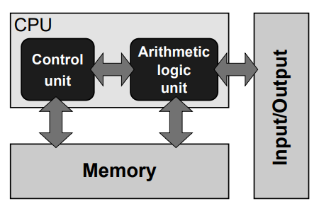
Stored-program computer architecture
Instructions are numbers that are stored as data in memory
Instructions are read and executed by a control unit
Arithmetic logic unit is responsible for actual computation. It manipulates the data along with the instructions
I/O facilities allows for the communication with the users
Control unit and ALU along with appropriate interfaces to memory and I/O is called as CPU

Slide 11
Stored-program computer architecture
Programming a stored program computer requires us to modify the instructions stored in memory
This is generally done by another program called as compiler
This is the general blueprint for all mainstream computers
Has few drawbacks:
Instructions and data must be continuously fed to the control and arithmetic units: This is known as von Neumann bottleneck
The architecture is sequential, processing a single instruction with (possibly) a single operand or a group of operands from memory

Slide 12
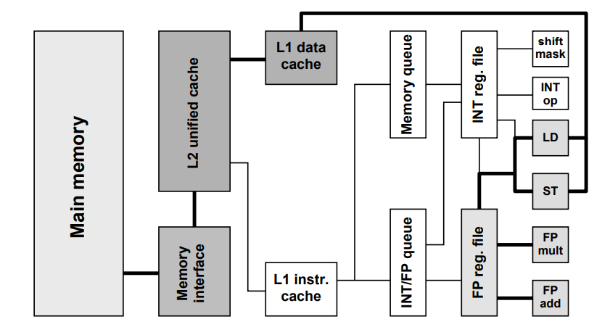
General purpose cache-based microprocessor architecture
Arithmetic units are responsible for running the applications
FP (Floating point) and INT (Integer)
CPU registers hold operands to be accessed by instructions
INT reg. file and FP reg. file
16-128 such registers are generally available
LD and ST units handle instructions that transfer data to and from registers
Instructions are stored in queues to be executed
Cache holds the data for re-use

Slide 13
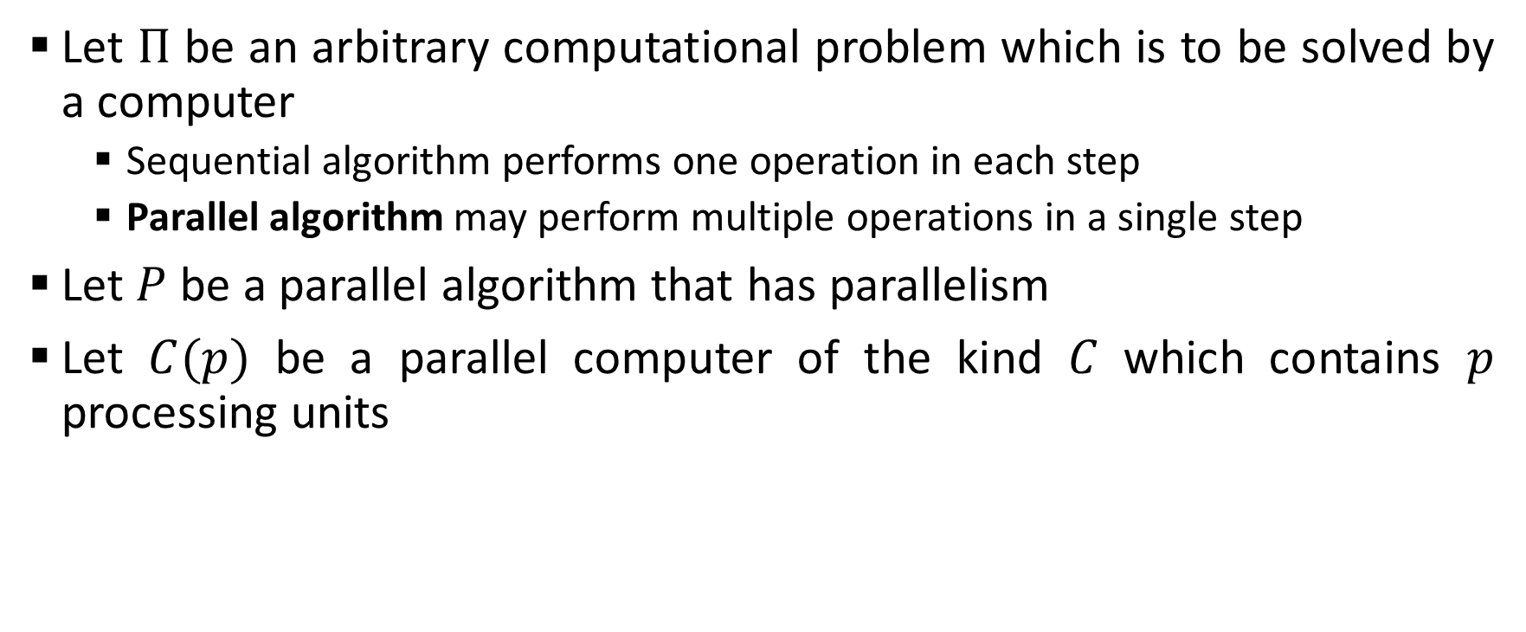
Performance metrics
Let $Π$ be an arbitrary computational problem which is to be solved by a computer
Sequential algorithm performs one operation in each step
Parallel algorithm may perform multiple operations in a single step
Let $P$ be a parallel algorithm that has parallelism
Let $C(p)$ be a parallel computer of the kind $C$ which contains $p$ processing units

Slide 14
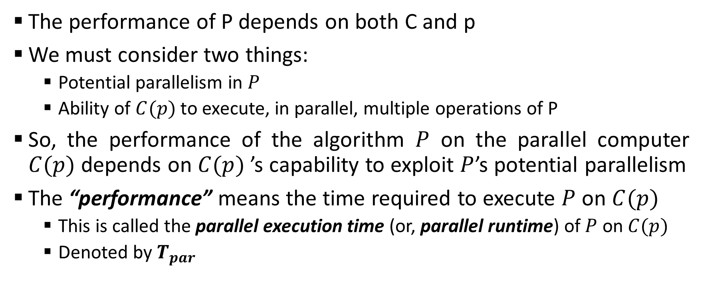
Performance metrics
The performance of P depends on both C and p
We must consider two things:
Potential parallelism in $P$
Ability of $C(p)$ to execute, in parallel, multiple operations of P
So, the performance of the algorithm $P$ on the parallel computer $C(p)$ depends on $C(p)$ ’s capability to exploit $P$’s potential parallelism
The “performance” means the time required to execute $P$ on $C(p)$
This is called the parallel execution time (or, parallel runtime) of $P$ on $C(p)$
Denoted by $T_{par}$

Slide 15
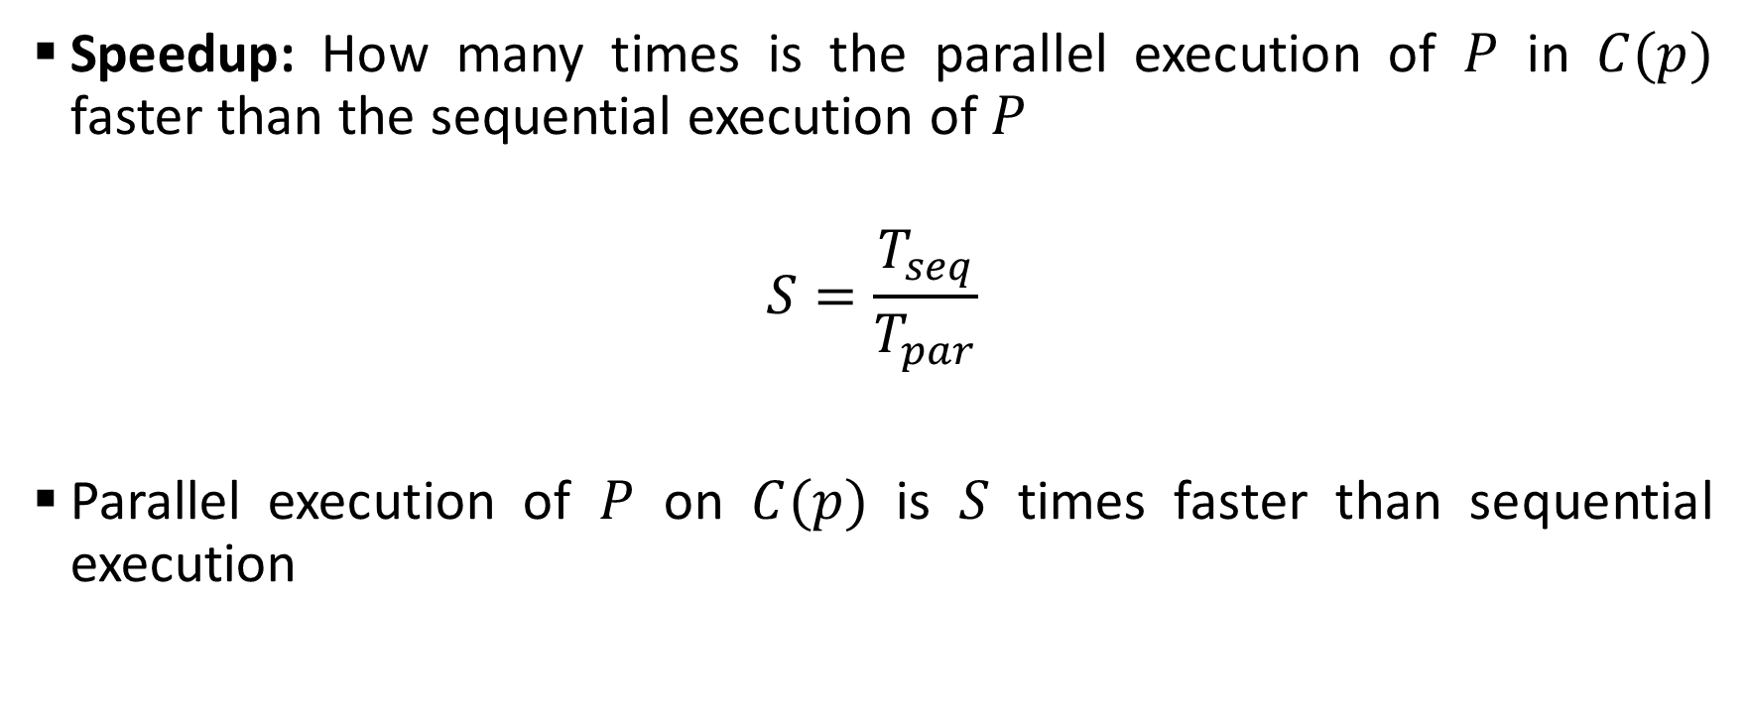
Performance metrics
Speedup: How many times is the parallel execution of $P$ in $C(p)$ faster than the sequential execution of $P$
$$S=\frac{T_{seq}}{T_{par}}$$
Parallel execution of $P$ on $C(p)$ is $S$ times faster than sequential execution

Slide 16
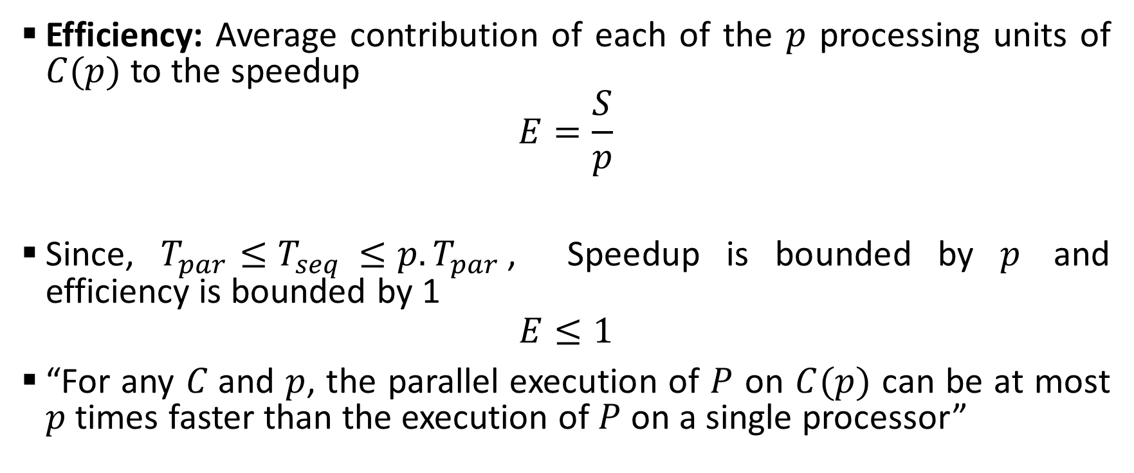
Performance metrics and enhancement
Efficiency: Average contribution of each of the $p$ processing units of $C(p)$ to the speedup
$$E=\frac{S}{p}$$
Since, $T_{par}≤T_{seq }≤p.T_{par}$, Speedup is bounded by $p$ and efficiency is bounded by 1
$$E≤1$$
“For any $C$and $p$, the parallel execution of $P$ on $C(p)$ can be at most $p$ times faster than the execution of $P$ on a single processor”

Slide 17
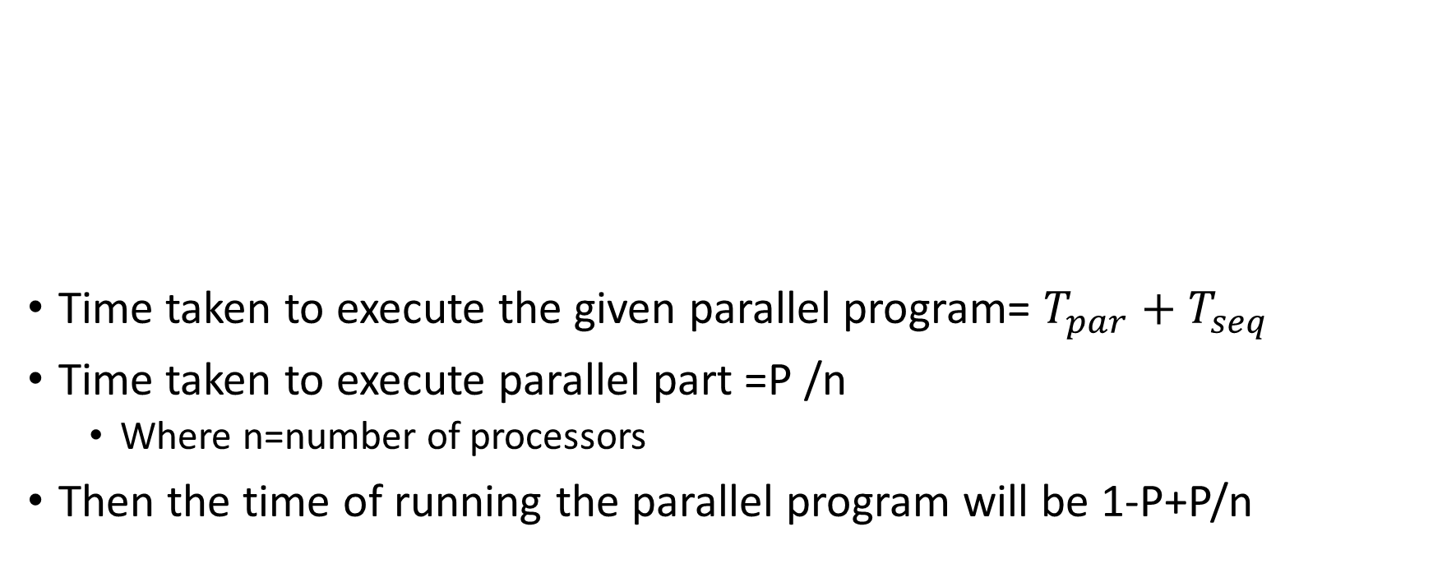
Example:
1
Time taken to execute the given parallel program= $T_{par}+T_{seq}$
Time taken to execute parallel part =P /n
Where n=number of processors
Then the time of running the parallel program will be 1-P+P/n
1-P
P

Slide 18
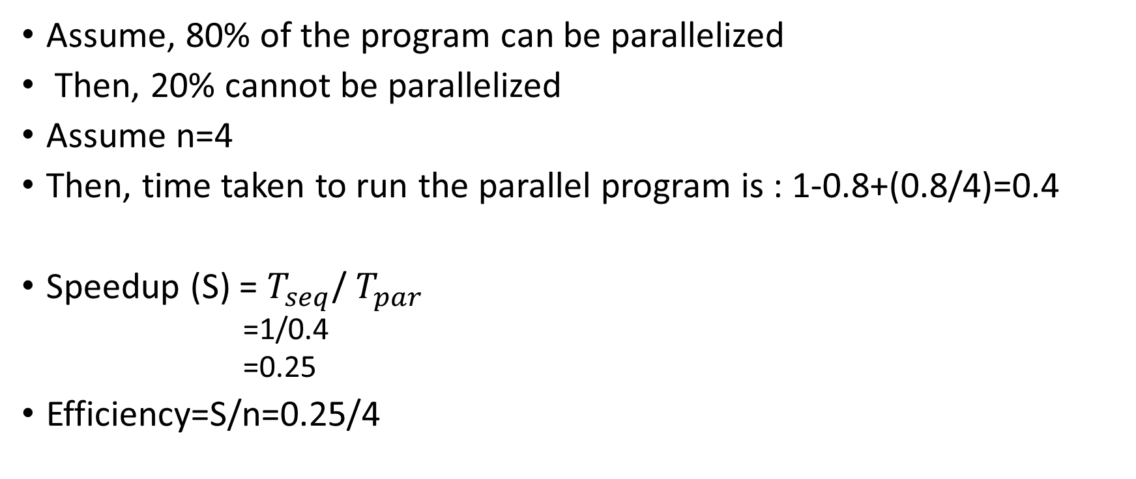
Example:
Assume, 80% of the program can be parallelized
Then, 20% cannot be parallelized
Assume n=4
Then, time taken to run the parallel program is : 1-0.8+(0.8/4)=0.4
Speedup (S) = $T_{seq}$/ $T_{par}$
=1/0.4
=0.25
Efficiency=S/n=0.25/4

Slide 19
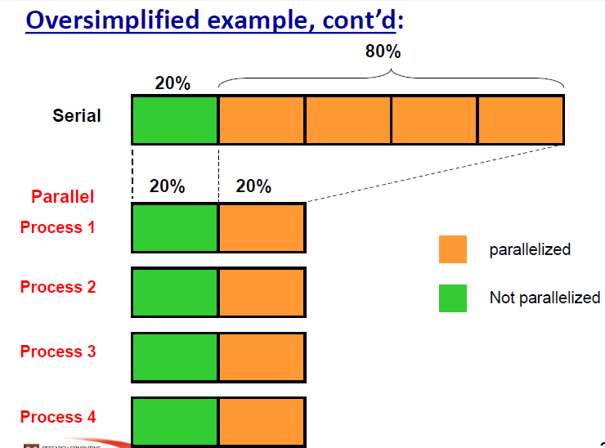

Slide 20
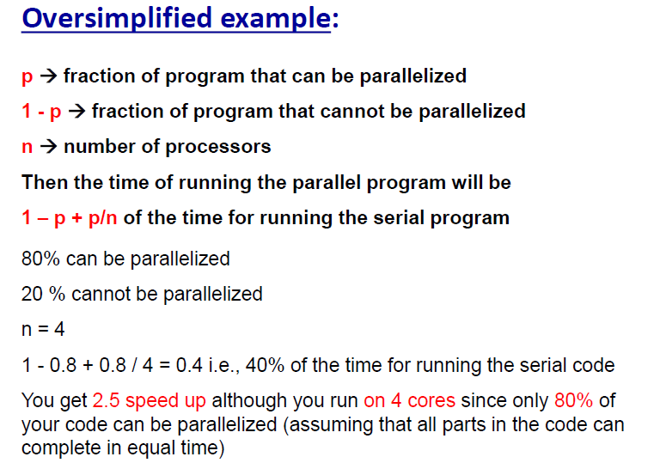

Slide 22
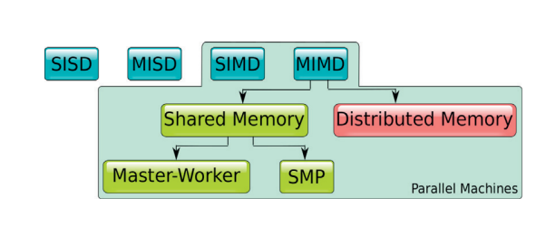
Taxonomy of parallel computers
In 1966, Michael Flynn proposed a taxonomy of computer architectures
Based on how many instructions and data items they can process concurrently
SISD: A sequential machine that can execute one instruction at a time on a single data item (Conventional non-parallel systems)
SIMD: Single instruction is applied on a collection of items (Ex: GPUs)
MISD: Multiple instructions are applied on a single data
MIMD: Multiple instructions are applied on multiple data

Slide 23
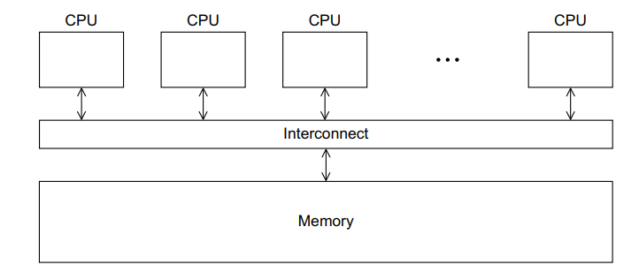
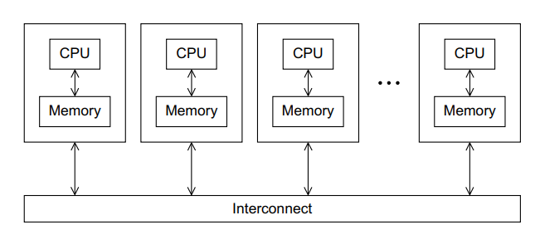
Taxonomy of parallel computers
MIMD can be further divided into two categories:
Shared-memory MIMD
Distributed-memory MIMD

Slide 24
Shared-memory systems
A number of CPUs work on a common, shared physical address space
Two varieties of shared-memory systems
Uniform Memory Access
Latency and bandwidth are same for all processors and memory locations
Also called as Symmetric Multi-Processing (SMP)
On cache-coherent Nonuniform Memory Access
Memory is physically distributed but logically shared
The physical layout of such systems are similar to distributed systems
The network logic makes the aggregated memory of the whole system appear as one single address space
In both these cases, copy of same information may reside in different caches, probably in modified state

Slide 25
Cache-coherence
Copies of the same cache line could potentially reside in several CPU caches
One of those gets modified and evicted to memory
The other caches’ contents reflect outdated data
Cache coherence protocols ensure a consistent view of memory under all circumstances
P1
P2
C1
C2
A1
A2
A1
A2
A1
A2
Memory

Slide 26
Cache-coherence (MESI protocol)
Under control of cache coherence logic discrepancy can be avoided
M modified: The cache line has been modified in this cache, and it resides in no other cache than this one. Only upon eviction will memory reflect the most current state.
E exclusive: The cache line has been read from memory but not (yet) modified. However, it resides in no other cache.
S shared: The cache line has been read from memory but not (yet) modified. There may be other copies in other caches of the machine.
I invalid: The cache line does not reflect any sensible data. Under normal circumstances this happens if the cache line was in the shared state and another processor has requested exclusive ownership.
P1
P2
C1
C2
A1
A2
A1
A2
A1
A2
Memory

Slide 27
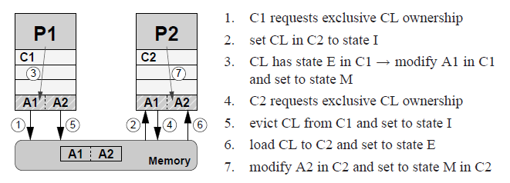
Cache-coherence (MESI protocol)

Slide 28
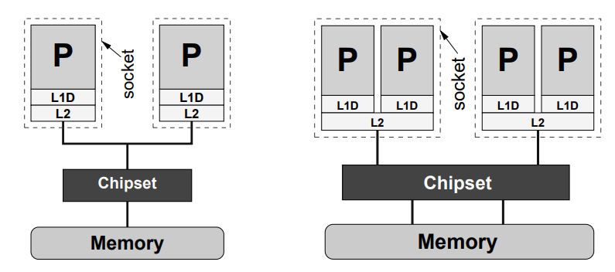
Uniform Memory Access (UMA)
Simplest implementation of a UMA system is a dual-core processor, in which two CPUs on one chip share a single path to memory
Problem of UMA systems is that bandwidth bottlenecks are bound to occur

Slide 29
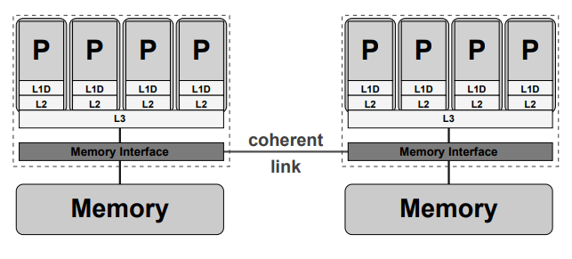
ccNUMA
Locality domain (LD) is a set of processor cores together with locally connected memory
Multiple LDs are linked via a coherent interconnect
Provides transparent access from any processor to any other processor’s memory

Slide 30
Shared-memory systems
Advantages:
Global address space provides a user-friendly programming perspective to memory
Fast and uniform data sharing due to proximity of memory to CPUs
Disadvantages
Lack of scalability between memory and CPUs. Adding more CPUs increases traffic on the shared memory-CPU path
Programmers responsibility for correct access to global memory

Slide 31
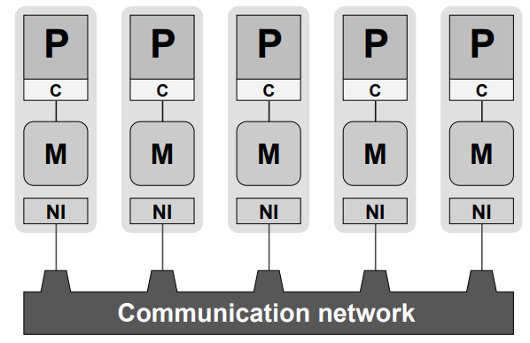
Distributed-memory systems
Each processor P is connected to exclusive local memory
No other CPU has direct access to it
Each node comprises at least one network interface
A serial process runs on each CPU that can communicate with other processes on other CPUs by means of the network

Slide 32
Distributed-memory systems
Advantages:
Memory is scalable with number of CPUs
Each CPU can rapidly access its own memory without overhead incurred with trying to maintain global cache coherence
Disadvantages
Programmer is responsible for many of the details associated with data communication between processors
It is usually difficult to map existing data structures to this memory organization, based on global memory

Slide 33
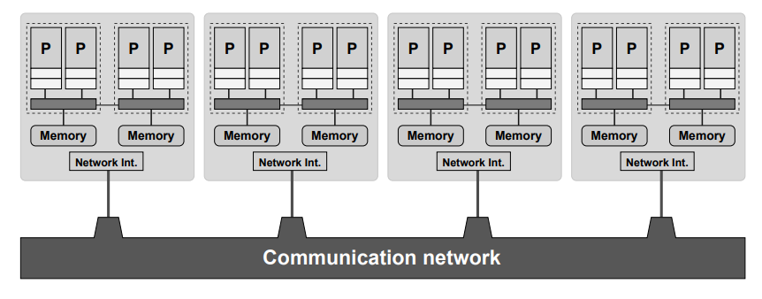
Hybrid systems
Large-scale parallel computers are neither of the purely shared-memory nor of the purely distributed-memory
Shared-memory building blocks connected via a fast network
Advantages:
Increased scalability
Disadvantages:
Increased programming complexity

