Slide 1
Retail Price Calculator
The course project of (2025W) Object-Oriented Programming-2477-WA
Professor: Dr. Jinan Fiaidhi
Student: Aydin Ghojogh
Student ID: 1166949

Slide 2
Question of the project:
Create a GUI application where the user enters the wholesale cost of an item and its markup percentage into text fields. (For example, if an item’s wholesale cost is $5 and its markup percentage is 100 percent, then its retail price is $10.) The application should have a button that displays the item’s retail price when clicked. Create the GUI programmatically. Do not use FXML.

Slide 3
Outline
The final GUI appearance
Creating the class
Overriding the method
Label and text field for wholesale
Label and text field for markup
Button for calculate
Label for result of calculation (retail price)
Layout of GUI
Size and title of window
Icon for the window
Event handling for the button
Main for running the code
A few example runs of the program

Slide 4
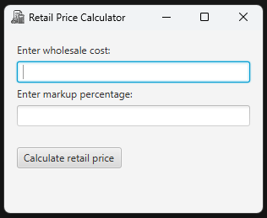
The final GUI appearance
The final GUI appearance that I made is shown here.
In the next slides, I explain the code which resulted in this GUI.

Slide 5
Creating the class
Importing the class Application from javafx.application
Creating the class RetailPriceCalculator which inherits from the class Application

Slide 6

Overriding the method
Overriding the method start() in the class Application

Slide 7


Label and text field for wholesale
Creating the label and text field for wholesale:
Result:
label
text field

Slide 8

Label and text field for markup
Creating the label and text field for markup:
Result:
label
text field

Slide 9

Button for calculate
Creating the button for calculate:
Result:
button

Slide 10
Label for result of calculation (retail price)
Creating the label for retail price (result of calculation):
Result:
label (currently not showing any text)

Slide 11

Layout of GUI
Vertical box (VBox) for layout container:
  I put the labels and textfields and button below each other.
  I put 5 pixels space between them.
Padding (gap) around the box: 15 pixels
Add extra space (20 pixels) above the button:

Slide 12


Size and title of window
Make an object of class Scene with size 300 pixels (horizontal) and 200 pixels (vertical)
Title of window:
Title of window
300 pixels
200 pixels

Slide 13

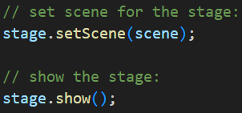
Icon for the window
Icon of the window
I downloaded the icon from Internet:
https://www.flaticon.com/free-icons/finance
Set the scene for the stage and show the stage:
Icon of window

Slide 14
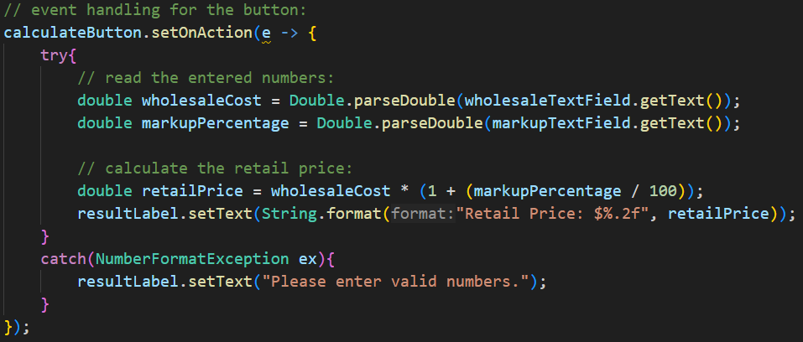
Event handling for the button
Event handling for the button:
  Read the entered numbers in the wholesale textfield and markup text field
  Calculate the retail price
  Set the text of retail price label
Exception handling:
  If the user does not enter valid numbers in wholesale textfield and markup text field
  I catch it and set the text of retail price label to: “Please enter valid numbers.”

Slide 15

Main for running the code
Main for running the code and launch the GUI
  The method launch() is in the class Application

Slide 16
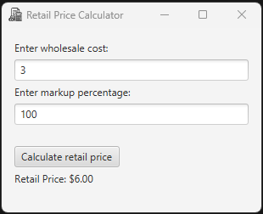
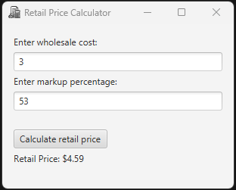
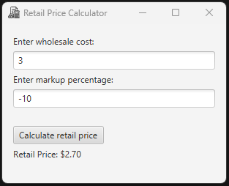
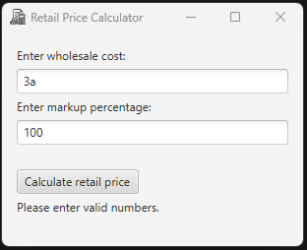
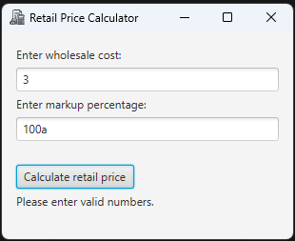
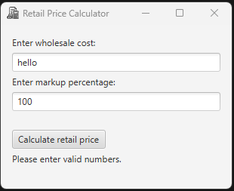
A few example runs of the program

