Slide 1
Unit-2

Slide 2
ACPO Principles of Computer Based Evidence
Nature of computer based electronic evidence
Computer based electronic evidence is information and data of investigation value that is stored on or transmitted by a computer. As such, this evidence is latent evidence in the same sense that fingerprints or DNA evidence is latent.
In its natural state ,we cannot see what is contained in the physical object that hold our evidence. Equipment and software are required to make the evidence available. Testimony may be required to explain the examination and any process limitations.
Computer based electronic evidence is by its very nature, fragile. It can be altered, damaged, or destroyed by improper handling or improper examination. for this reason, special precautions should be taken to document, collect, preserve and examine this type of evidence. Failure to do so may render it unusable or lead to an inaccurate conclusion

Slide 3
ACPO Principles of Computer Based Evidence
Devices subjected to digital investigation
Desktop and laptop computers
Personal organisers
Main unit: usually the box to which the monitor and keyboard are attached
Monitor, keyboard and mouse
Leads
Power supply units and batteries
Hard disks not fitted inside the computer
Dongles
Modems(some contain phone numbers)

Slide 4
External drives and others external devices
Wireless network cards, Modems, Routers
Digital cameras
Floppy disks
Backup tapes
Jaz/Zip cartridges
CDs,DVDs
PCM CIA cards
Memory sticks, memory cards
USB/firewire connected devices

Slide 5
Home networks & wireless technology
Switches, hubs, routers, firewalls (or devices which combine all three)
Embedded network cards(e.g.intel centrino)
Access points.
Printers and cameras.
Bluetooth devices-PDA, Mobile phones,dongles etc.
Hard drives both wired and wireless.

Slide 6
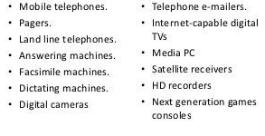
Other digital devices

Slide 7
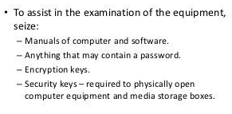
considerations

Slide 8
Association of Chief Police Officers Guidelines (ACPO)
Principle 1
No action taken by officers or their agents should change data held on a computer or other media which may subsequently be relied upon in court.
Principle 2
In exceptional circumstances where a person finds it necessary to access original data held on a target computer that person must be competent to do so and to give evidence explaining the relevance and implications of their actions.

Slide 9
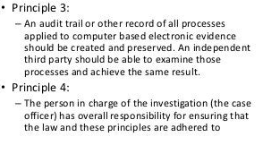
APCO Guidelines

Slide 10
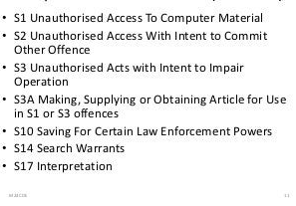
Computer Misuse Act 1990(UK Wide)

Slide 11
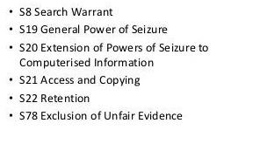
The police & criminal Evidence Act 1984

Slide 12
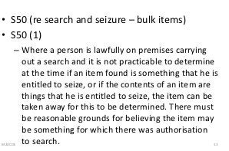
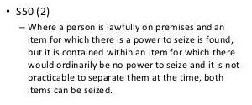
Criminal justice & police Act 2001

Slide 13
Investigation process
Identification
Acquisition
Preservation
Search
Analysis
Reconstruction
presentation

Slide 14
Introduction to computer Storage Formats
Data Acquisition
● Types of acquisition
● Digital evidence storage formats
● Acquisition methods
● Contingency planning
● Using acquisition tools
● Validating data acquisition
● RAID acquisition methods
● Remote network acquisition tools
● Some forensics tools

Slide 15
Types of Acquisition
● Static Acquisition
– Acquire data from the original media
– The data in the original media will not change
● Live Acquisition
– Acquire data while the system is running
– A second live acquisition will not be the same
● Will focus on static acquisition

Slide 16
Digital Evidence Storage Formats
● Raw formats
– Bit by bit copying of the data from the disk
– Many tools could be used
● Proprietary formats
– Vendors have special formats
● Standards
– XML based formats for digital evidence
– Digital Evidence Markup Language (Funded by National Institute of Justice)
– Experts have argued that technologies that allow disparate law enforcement jurisdictions to share crime-related information will greatly facilitate fighting crime. One of these technologies is the Global Justice XML Data Model (GJXDM).
– http://ncfs.ucf.edu/digital_evd.html

Slide 17
Acquisition Methods
● Disk to Image File
● Disk to Disk
● Logical acquisition
– Acquire only certain files if the disk is too large
● Sparse acquisition
– Similar to logical acquisition but also collects fragments of unallocated (i.e. deleted) data

Slide 18
Compression Methods
● Compression methods are used for very large data storage
– E.g., Terabytes/Petabytes storage
● Lossy vs Lossless compression
– Lossless data compression is a class of data compression algorithms that allows the exact original data to be reconstructed from the compressed data. The term lossless is in contrast to lossy data compression, which only allows an approximation of the original data to be reconstructed, in exchange for better compression rates.

Slide 19
Contingency Planning
● Failure occurs during acquisition
– Recovery methods
● Make multiple copies
– At least 2 copies
● Encryption decryption techniques so that the evidence is not corrupted

Slide 20
Storage Area Network Security Systems
● High performance networks that connects all the storage systems
– After as disaster such as terrorism or natural disaster (9/11 or Katrina), the data has to be availability – Database systems is a special kind of storage system
● Benefits include centralized management, scalability reliability, performance
● Security attacks on multiple storage devices
– Secure storage is being investigated

Slide 21
Network Disaster Recovery Systems
● Network disaster recovery is the ability to respond to an interruption in network services by implementing a disaster recovery plan
● Policies and procedures have to be defined and subsequently enforced
● Which machines to shut down, determine which backup servers to use, When should law enforcement be notified
Using Acquisition Tools
● Acquisition tools have been developed for different operating systems including Windows, Linux, Mac
● It is important that the evidence drive is write protected
● Example acquisition method:
– Document the chain of evidence for the drive to be acquired
– Remove drive from suspect’s computer
– Connect the suspect drive to USB or Firewire write-blocker device (if USB, write protect it via Registry write protect feature)
– Create a storage folder on the target drive

Slide 22
RAID Acquisition Methods
● RAID: Redundant array of independent disks
● RAID storage is used for large files and to support replication
● Data is stored using multiple methods – E.g, Striping
● When RAID is acquired, need special tools to be used depending on the way the data is stored
Remote Network Acquisition Tools
● Preview suspects file remotely while its being used or powered on
● Perform live acquisition while the suspect’s computer is powered on
● Encrypt the connection between the suspect’s computer and the examiner’s computer
● Copy the RAM while the computer is powered on
● Use stealth mode to hide the remote connection from the suspect’s computer
● Variation for the individual tools (ProDiscover, EnCase)

Slide 23
Forensic Duplication
A file that contains every bit of information from the source in a raw bitstream format.
Tools that create forensic duplicates:
1.dd
2. FTK Imager, Access Data
3. Dfcldd, US DOD Computer Forensics Lab version of the dd command.
Qualified Forensic Duplicate?
A file that contains every bit of information from the source, but may be stored in a altered form.
Tools that create qualified forensic duplicate output files:
SafeBack
2. EnCase
3. FTK Imager

Slide 24
Restored Image
A restored image is what you get when you restore a forensic duplicate or a qualified forensic duplicate to another storage medium.
Mismatched drive geometries can cause problems.
For example, partition table or mbr problems
Mirror Image
Created from hardware that does at bit for bit copy from one hard drive to another.
Requires two identical hard drives
Doesn’t happen very often.

Slide 25
HD Development
When hard drives grew beyond 512MB, the PC-BIOS needed to be updated (to recognize larger drives).
…software emulated a modern BIOS.
Software pushed all of the real data on the drive down one sector and stored its program and information in sector 2.
The real partition table would be at cylinder 0, head 0, sector2.
Safeback, EnCase, FTK Imager, and dd will create a restored image from the qualified forensic duplicate.
EnCase and dd images may not need to be restored.
Treat images as virtual disks, eliminating the need for restoration.
Note, FTK Imager can create images in the EnCase Format.

Slide 26
Tool Requirements: Forensic Duplication
Tool must:
Create a forensic duplicate or mirror image of the original.
Handle read errors in a robust and graceful manner.
Not make any changes to source medium.
Capable of scientific and peer review.
Results must be third party repeatable and verifiable.

Slide 27
Legal Issues
Tools used for forensic duplication must pass the legal tests for reliability.
Note, when tool is generally accepted by others in the field, it is easier to prove that information was gathered in a reliable, accurate manner.

Slide 28
Creating a Forensic Duplicate of a Hard Drive
dd, part of the GNU software suite.
dcfldd, from the DOD
dd utility the most reliable tool for creating a true forensic duplicate image.
Dd a tool that you should be intimately familiar with before you need to use it on a real investigation.

Slide 29
Process
Creating Linux boot media
Start with a precompiled version of Linux.
Once you have the basic package up and running, disassemble the packages and add your own binaries, such as dcfldd.
In certain situations, duplications will be stored in a series of files that are sized to fit on a particular media type (such as CDs or DVDs) or file system type (such as files under 2.1 GB).
Called a segmented image.
Most commercial forensic packages have the ability to process segmented images.

Slide 30
Creating A Qualified Forensic Duplicate
Never boot from evidence drive.
In preparation, create a bootable disk
To prevent compressed disks from loading and changing time stamps, disable the DRVSPACE.BIN driver file
Hack IO.SYS
4 instances need to be changed

Slide 31
SafeBack
SafeBack, a small application that is designed to run from a DOS boot floppy
Requires a clean DOS environment ready on a boot floppy.
Offered by New Technologies Inc. (NTI)
Four operating modes
Backup function
Produces a forensically sound image file for the source media.
Restore function
Restores forensically sound image files.
Verify function
Verifies the checksum values within an image file.
Copy function
Performs the Backup and Restore operations in one action.

