Slide 1
App 1
Applications
App 2
POSIX + TCP
Library OS
IPC + VM
Exokernel
Secure Bindings
Hardware
Frame Buffer
TLB
Network
Memory
Disk

Slide 2
Application 1
Application 2
Application 1
Application 2
TCP
IPC
TCP
POSIX
threads
VM
IPC
OS
POSIX
threads
VM
Exokernel
Hardware
Hardware
Monolithic OS
Exokernel

Slide 3

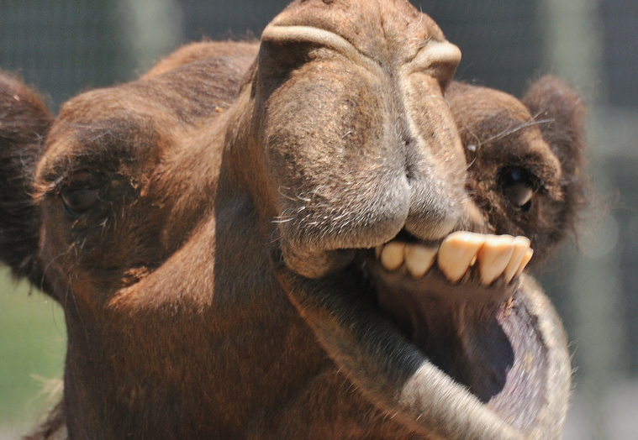

Slide 4
Hello world
App + GC
LibOS-1
Hello world
LibOS-2
App + GC
OS
LRU paging
Custompaging
LRU paging
Exokernel
Hardware
Hardware
Monolithic OS
Monolithic OS

Slide 5
Configuration Scripts
Application
Runtime
Database
Processes
Application
Database library
Guest OS
PL Runtime
Hypervisor
Hypervisor
Hardware
Hardware
Standard deployment
Unikernel

Slide 6
Enclave
Application
LibOS
Application
Windows OS
Windows OS
Hardware
Hardware
Standard
Haven

Slide 7
Un-trusted DRAM
Protected Region
Trusted
Encrypted
Integrity protected
CPU
Regular
Traffic

Slide 8
Exokernel
Unikernel
Haven

Slide 9
Exokernel
Unikernel
Haven

Slide 10
Exokernel
Unikernel
Haven

Slide 11
Exokernel
Unikernel
Haven
Research Proposal

