Slide 1
Modern Kernel Design
Adrien Ghosn – Candidacy Exam

Slide 2
Outline
Introduction
“What’s wrong with the world today?”
Challenges
Haven
confidentiality in the Cloud
Exokernel
performance
Unikernel
modern tools and deployment
Research Proposal

Slide 3







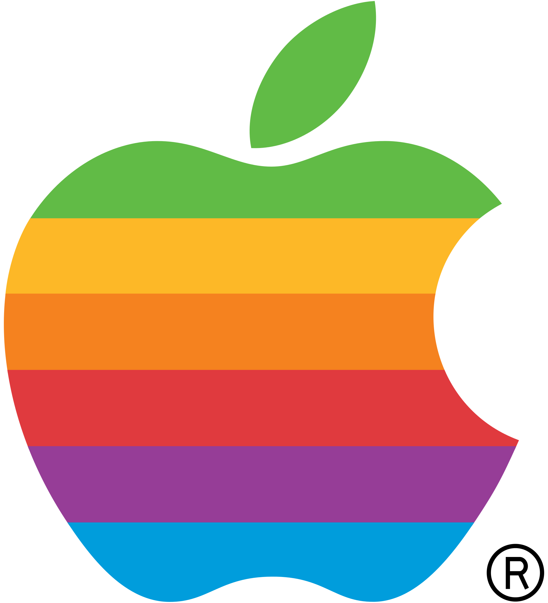


















A (biased) Timeline
Computer World:
…
OS abstractions:
POSIX
My Graduation
…
68
70
77
81
85
88
91
95
2050
Notes:
PC -> 1977 for lisa 2, Internet, OO, Cloud services -> 2006, smartphone -> 2007, tablet-> 2010 ipad, linux -> 1991, 1991 WWW, ARPANET 1968
Put lots of things at the very end.

Slide 4

Apps & Kernels: a divorce
Non-flexible abstractions
Frameworks
User-level (re-)implementations
Non-satisfactory performances
Kernel bypasses
Security model evolved
“Don’t trust the Cloud!”
“Pirates are back!”
“Data is better than oil.”

