Slide 1

LibOS in the Cloud
Adrien Ghosn
DCSL, I&C, EPFL
June 29 2017
Notes:
Hi, and thank you for assisting to my second dry-run.
Today I’ll talk about how the Library Operating System design can be leveraged to answer modern concerns in terms of performance & security in cloud deployments.

Slide 2

Outline
Motivation.
Exokernel:
An OS Architecture for Application-Level Resource Management.
Unikernels:
Library Operating Systems for the Cloud.
Haven:
Shielding Applications from an Untrusted Cloud.
Discussion.
Research Proposal.
Notes:
This is the outline for the presentation today.
We’ll have a short introduction to present the goals we want to achieve in cloud deployments.
I’ll then proceed with the description of the three papers that I selected: The exokernel, a radical design for Operating systems that allows application-level management of resources.
After that, I’ll present two papers, inspired by the Exokernel architecture, that target cloud deployments.
The Unikernel & Haven.
At the end of the presentation, I’ll gather the insights from all papers and present my research proposal.

Slide 3
Motivation
Setup:
Cloud services have become popular.
We want to provide:
Efficiency
Make the most out of what you pay for.
Performance
Security
Isolate co-located applications, and protect the host.
Security inside the application.
Protect the guest from the host, e.g., confidentiality & integrity.
Notes:
Nowadays, Cloud services are a popular option to host applications.
They allow even small size organization to quickly deploy their app, and provide flexibility as they offer means to adapt resources to the current load it has to face.
While attractive, such services raise important challenges.
Resources are rented. As a tenant, you therefore want to optimize your expenses.
That means that you want to limit the amount of resources your application consumes, and make the most out of what you pay for.
Second, we do not want the deployment environment to impede the application’s performance.
Third, tenants have to think about security when deploying their applications on cloud services.
CPs often rely-on sandboxing mechanisms to actually isolate different apps, from different sources, that execute on the same physical machine.
These sandboxes also allow to protect the host from a potentially malicious application.
While this ensures that no malicious application will be able to hurt the host or any other app running on the same machine, it does not protect the application from a malicious user .
App developers therefore still have to build security within their applications themselves.
Another concern related to security pertains to the confidentiality and integrity of a tenant’s application code and data.
What happens if a host gets compromised ? Or if a CSPs employee abuses its privileges to access you private data?
What if the physical machine is located in a country where the government enforces policies to gain access to hardware infrastructures?
As a tenant, you therefore might want to have some security guarantees that protect you application from the CSP/host as well!

Slide 4
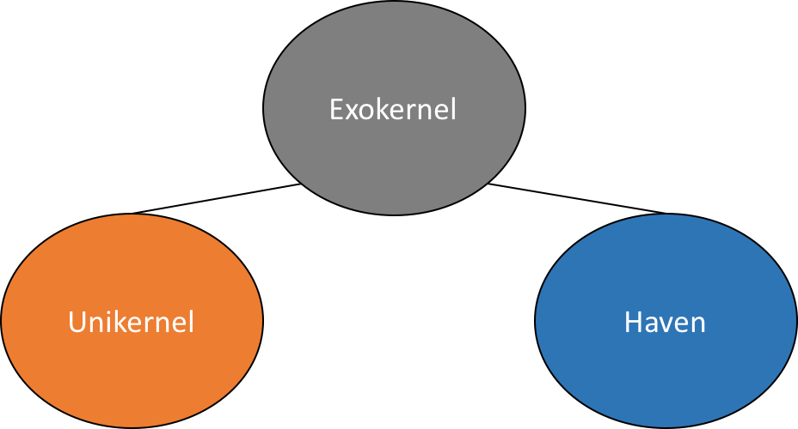
Introduction
Goal:
We study two systems, derived from the Exokernel architecture, that target cloud services.
We look for performance, efficiency, and security.
Notes:
We propose to answer all these concerns by studying two systems, based on the Exokernel design, that target cloud services.
We’ll study how Library OS design is leveraged in such systems to provide the performance, efficiency, and security for cloud deployments.

Slide 5
The Exokernel Design
Dawson R. Engler, M. Frans Kaashoek, and James O’Toole Jr.
SIGOPS ’95
Notes:
We first begin by describing the exokernel original design.

Slide 6
Exokernel: Motivation
Problem:
Traditional OSes fix the interface and implementation of OS abstractions.
It limits the application’s performance, flexibility, functionality.
Solution:
Allow application-level management of physical resources.
Notes:
The observation made by the exokernel authors is that traditional operating system fix the interface and implementation of OS abstractions.
Which hurts the application’s performance, flexibility, and functionality, as it can not pretend to suit all heterogeneous apps requirements.
The solution adopted by the exokernel is radical:
Allow application level management of physical resources.

Slide 7
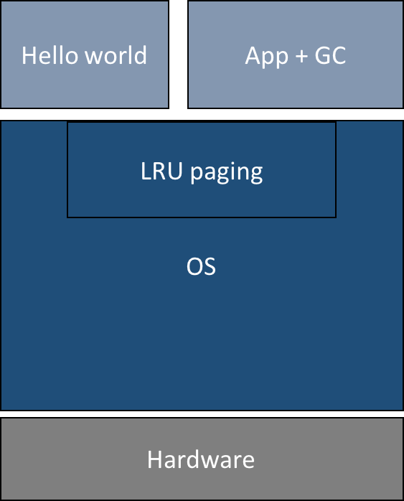
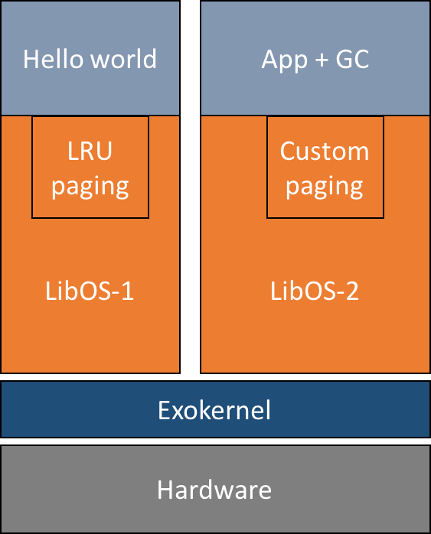
Exokernel: Example
Monolithic OS
Exokernel
Notes:
To take an example, let’s consider this figure.
Here we have two applications, a simple hello world program, and a more complex one that runs with a garbage collector.
They both run on top of a monolithic OS, that fixes the implementation of OS abstractions, and more specifically the virtual memory abstraction.
The OS implements a LRU paging policy that cannot be modified by any of the applications.
Pagin at the time was a real concern, and it is not a problem for the Hello World program , the GC performance might be impacted by this policy choice.
A typical scenario where LRU performs poorly is if the GC collects all objects on a page and keeps it on the side for further allocations.
The page was recently used, so the OS will not chose to collect it and will instead pick another page that actually contains things that the program needs.
The exokernel solves this by allowing application-specific management of resources.
It separates protection from management, that means that :
The kernel itself only securely exposes all hardware resources, and delegates the management to the application, which in turn, is free to implement its own abstractions and policies efficiently.
The application links to a library Operating system, the orange part, that provides the required implementation for these system abstractions.
Here we can see that the HW program picked a LibOS that implements LRU, while the GC picked one with a custom paging algorithm.

Slide 8
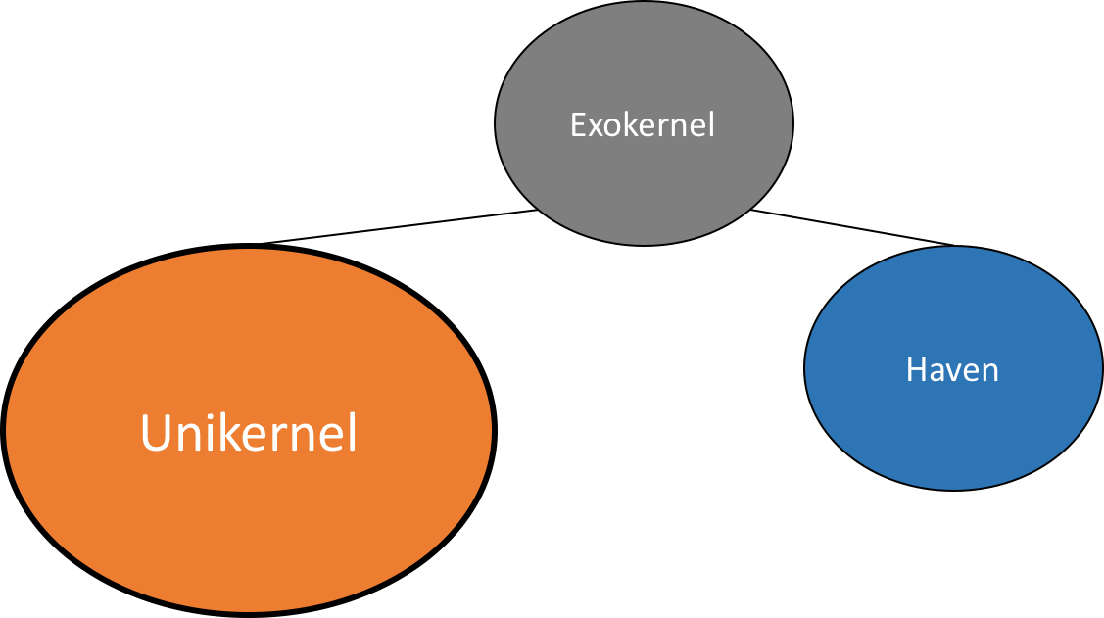
Notes:
The exokernel adopts a radical approach, that proved to be efficient but is actually hard to implement in the way described by the authors.
It however influenced the design of many systems, among which the Unikernel, that targets cloud deployments and that I’ll present now.

Slide 9
Unikernels
Anil Madhavapeddy, Richard Mortier, Charalampos Rotsos, David Scott, Balraj Singh, Thomas Gazagnaire, Steven Smith, Steven Hand and Jon Crowcroft
ASPLOS’13
Notes:
The unikernel paper was published in 2013

Slide 10
Unikernels: Motivation
Problem:
Single-purpose VMs deployed in the cloud are not specialized enough!
It impacts efficiency & security.
Solution:
Eschew backward compatibility!
Application & LibOS implemented in one high-level language.
Leverage static analysis & verification tools.
Runs on top of a hypervisor.
Notes:
Traditionally applications are deployed in the Cloud as virtual machines.
The VM can be seen as a single purpose packs an entire OS, e.g., Linux or Windows, and runs unmodiifed application processes, which, in most cases, is on application supported by smaller services.
This way to deploy applications actually presents several disadvantages.
First, scripts are used as glue code between different services that need to colaborate.
Second, he VM is not specialized, it still packs un-used services, which increases the size of the image deployed, hence requiring more resources to be hosted.
But also increases the attack surface exposed by the application ! Default services my be used to subvert the application, and removing all such services is actually hard in commodity operating system.
The solution proposed by the unikernel is to deploy a fully specialized standalone sealed kernel that runs on top of a hypervisor!
It eschews backward compatibility and requires to reimplement the entire application and the services required by the application in the same high-level language.
This allows to use the same static analysis & verification tools on the entire stack, optimize the whole system at once.

Slide 11
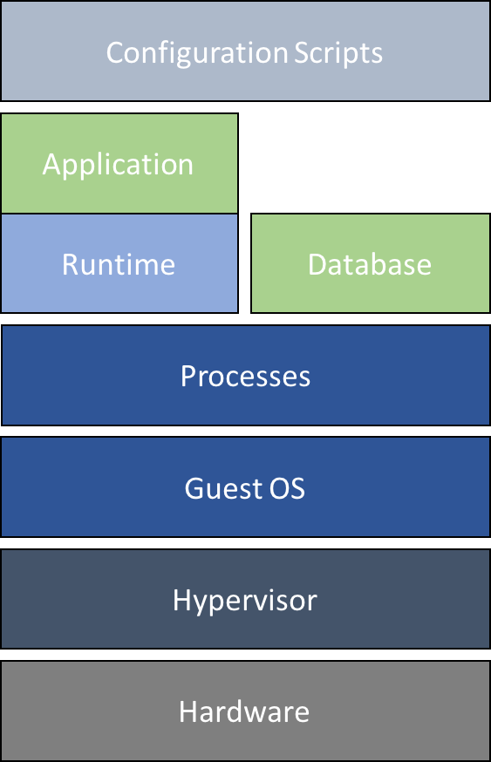
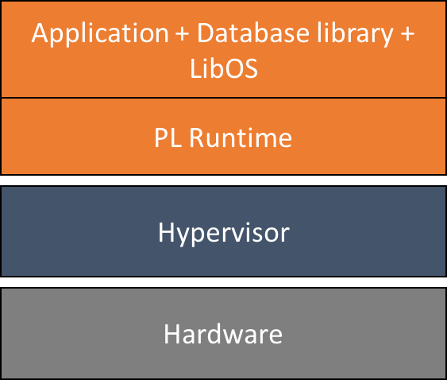
Unikernel: Example
Standard deployment
Unikernel
Notes:
Let’s consider an example.
Here we have a standard deyploment.
We have a guest OS that runs on top of the hypervisor.
Different services are run in different processes and glued together using a configuration script.
If we now look at the approach taken by Unikernel, the application and library operating system are compiled at once, fully specialized, and execute in a runtime directly on-top of the hypervisor.
Static configuration is by the compiler by simply linking the necessary libraries to the application, hence removing the need for configuration scripts.
Since the entire stack is compiled at once, unused portions of code are pruned away and the whole system benefits from compiler optimizations.

Slide 12
Unikernel: Evaluation
Performance/Efficiency
Security
Boot time
50ms vs. 2.2s for Linux
Small size
Hundreds of kB
General performance
Comparable to state-of-the-art
DNS, Web Server
Allows app-specific resource management.
Reduce attack surface
Remove dead code.
Extra protections from PL
Type safety
Memory safety
Host protected from guest
Guest not protected from host
Notes:
If we consider our requirements for performance, efficiency & security.
We first see that:
Unikernel have a small boot time. Which means that services can be efficiently restarted on the cloud.
They usually exhibit small size, hundreds of kB. That implies that less resources are required to host the program’s code and data.
Unikernel perform well on the provided experiments and exhibit performance comparable to state-of-the-art implementations.
Finally, by design, the Unikernel allows application-specific algorithms to be implemented.
In terms of security,
The small size and the fact that unused parts are pruned away allows to reduce the attack surface exposed.
Then, extra protections are obtained via the use of high-level PL, like type-safety (which prevents type-errors) and garbage collected memory than prevent a certain (memory dealocation errors) class of attacks.
Then, we still retain the advantages of running on top of a hypervisor for isolation.
Unfortunately, they do not provide any mechanism to protect the application’s code and data from a malicious host.

Slide 13
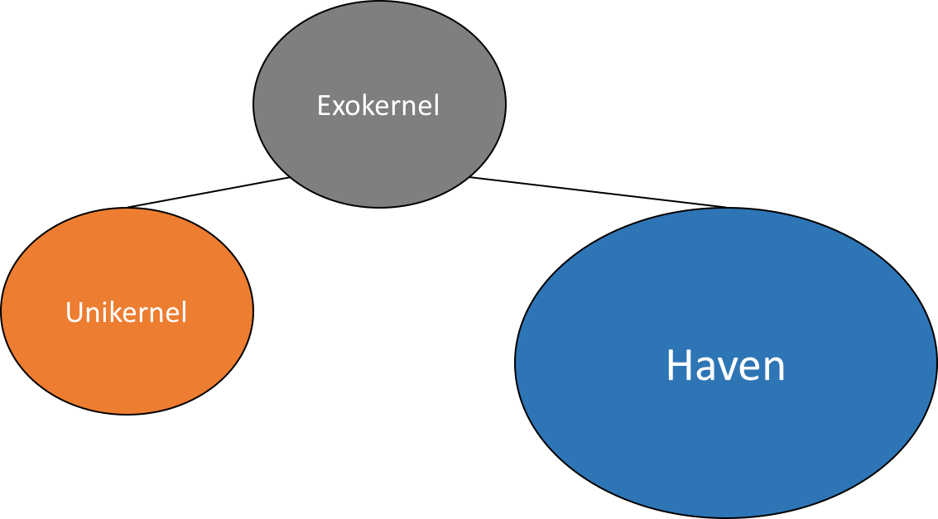
Notes:
To address this last point, we’ll study Haven, another system, based on the Exokernel design, that targets cloud deployments.

Slide 14
Haven
Andrew Baumann, Marcus Peinado, and Galen Hunt
USENIX 2014
Notes:
Haven is a microsoft research project from 2014.

Slide 15
Haven: Motivation
Problem:
Classical hierarchical security model allows CSP to access a cloud tenant’s data and application code.
It fails to protect against a compromised/malicious host.
Solution:
Provide shielded execution of legacy applications.
Confidentiality & Integrity
Leverage Intel SGX to create a protected region, i.e., enclave.
Execute application & LibOS inside a protected region.
Notes:
Typically, cloud service provider wrap applications in a sandbox to isolate them from each other & protect themselves.
In this security model, the software management stack executed by the CSP is privileged, and retains access to the application’s code and sensitive data.
It is considered to be part of the trusted computing base.
This security model, however, fails to consider cases where the host itself might be compromised or malicious.
By compromising a machine, a hacker gains complete access to all app code and data.
Another important thing to keep in mind is that trusting the CSP requires to extend our trust to all its employees.
It already happened in the past that one employee abused its privileges to access private data.
Haven addresses these concerns by providing shielded execution of legacy applications.
Shielded execution protects the conf and integr of a program. Confidentiality means that intermediate state are not observable by the rest of the system, while integrity means that if the program terminates, the output is correct.
Haven relies on Intel SGX to create a protected region in which the application executes.
System services are provided by a LibraryOS that executes along the application inside the protected region.

Slide 16
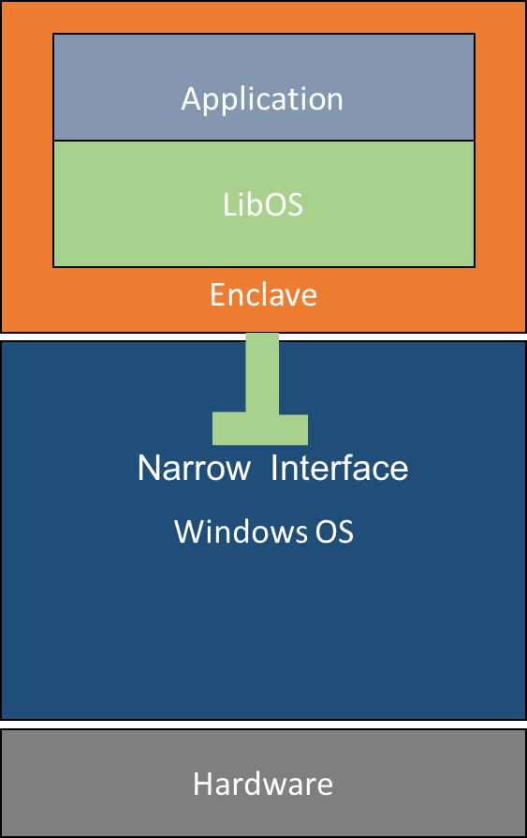
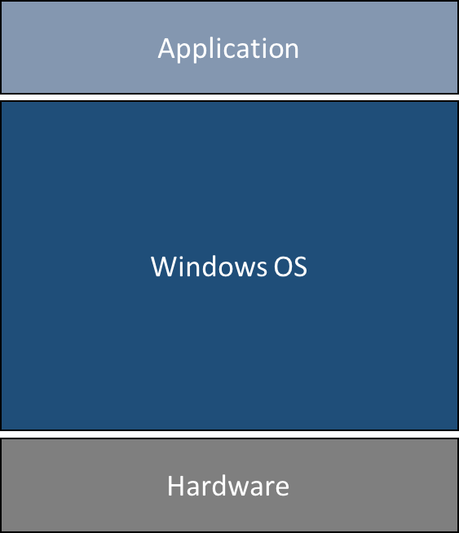
Haven: Example
Standard
Haven
Notes:
If we look at an example, this is the standard way to execute an application.
With haven, it looks like this. The application relies on the library operating system, and they both execute within the enclave.
As we see the application is unmodified and doesn’t have to be aware that it executes within a special protected environment.
The enclave guarantees that the application data cannot be read or modified by the software outside of the enclave, even if it runs at a higher privilege level.
Haven relies on Intel SGX to create this enclave.
So how does the enclave works?

Slide 17
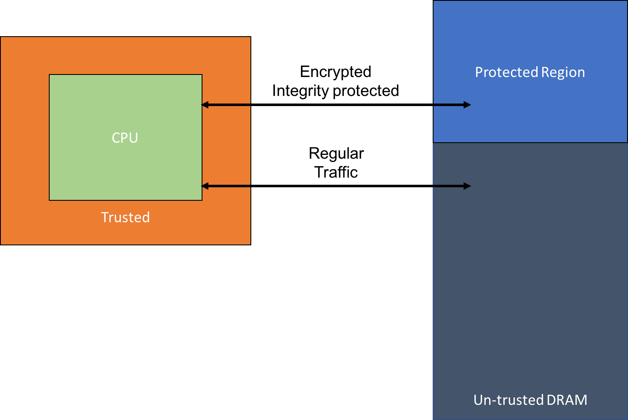
Intel Software Guard Extension (SGX)
Notes:
Well, Intel Software ... allows to create portions of the address space that are encrypted and integrity protected, even from software running at higher privilege levels.
Well, enclave memory pages come from a specific area of main memory.
The CPU, when in enclave mode, encrypts and integrity protects all traffic that goes to this region and decrypts and verifies its it when loading data. If the loaded data was illegaly modified, the Memory controler gets blocked and requires a system reboot.
The CPU is the root of trust here and keeps track of the pages that belong to a particular enclaves, as well as their access rights.

Slide 18
Haven: Evaluation
Performance/Efficiency
Security
General performance
2X slowdown
Haven overheads
SGX overheads
Resizing enclave
Enclave crossings
Access to enclave pages
Resources consumption
Packs entire Windows OS
Large attack surface
Host protected from guest
Guest protected from host
Notes:
Now, considering our requirements for performance, efficiency, and security.
Haven incurs some overheads, that come both from its complex layered architecture, and from the cost of SGX.
In fact, resizing the amount of memory allocated to the enclave, doing enclave crossings, and access enclave pages have non-negligible costs.
On the other hand, considering the security aspect, haven provides bi-directional isolation.
Unfortunately, as it packs an entire windows operating system inside the enclave, we can have concerns about the attack surface exposed.
Good, so now that we’ve studied all three papers, let’s discuss what we’ve seen.

Slide 19
Discussion & Research Proposal
Notes:
Good, so now that we’ve studied all three papers, let’s discuss what we’ve seen.

Slide 20
Discussion
Performance/Efficiency
Security
Boot time
Small size
Comparable perfs with VMs
App-specific management
Reduce attack surface
Extra protections from PL
Isolation from guest
Isolation from host
Notes:
If we summarize what we’ve learned so far, we see that the unikernel present several advantages in terms of performance/efficiency, and also in terms of security.
Unfortunately, it lacks the bi-directional isolation that haven provides and that we so desire for Cloud services.
Both systems are based on the Library Operating system design described by the exokernel, but have very different implementations.
Haven strives to support legacy applications.
As a result, it needs to pack the entire windows operating system inside the enclave and presents performance overheads.
This choice was, in my opinion, made to provide a proof-of-concept and test the limits of SGX, rather than actually a desired feature.
Cloud appliance are often providing a single service. Therefore the approach taken by Unikernel, that gives up on backward compatibility, actually seems reasonable and enables to performa several optimizations that improve the performance, efficiency, and security of the appliance compared to a standard VM deployment.
And this actually leads to my research proposal which tries to extract all the benefits listed here and fit them into one system.

Slide 21
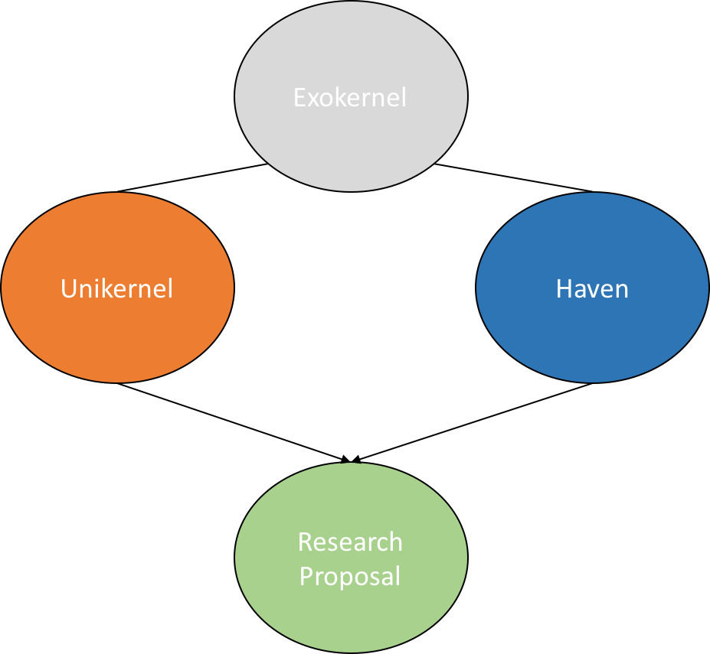
Research Proposal
I propose to integrate SGX in a Unikernel.
This will allow to:
Consume less enclave pages.
Potentially improve locality.
No need for enclave resizing.
Tune implementation for performance.
Leverage PL features.
Provide bi-directional isolation.
Notes:
I propose to integrate SGX support in a Unikernel architecture.
I believe that the unikernel design provides several advantages that would enable to solve Haven’s limitations.
First, the small size of unikernels reduces the amount of enclave pages that we need to consume to host the programs code and data.
Second, the small size of the program might improve cache locality and amortize the cost of accessing the enclave pages.
Another advantage is that Unikernels can be sealed, meaning that its page mappings are fixed and do not change. That removes the need for dynamic allocation of physical pages, which introduced overheads in Haven.
At the same time, we can still benefit from the advantages provided by Unikernels, you can tune the implementation to your needs, you can tune the runtime to move data that is not sensitive to pages outside the enclave to speed up the whole execution.
We can also leverage high level PL features such as type-safety, garbage collectors, or more recent paradigms like the ownership system provided by rust, or Communicating Sequential Processes concurrency model provided by GO.
Implementing such as system would actually enable to achieve all our goals, in terms of performance, efficiency, and security, while having a very flexible environment to experiment with various solutions.

Slide 22
Thanks!
Notes:
That’s all. Thanks

Slide 23
Backup slides

Slide 24
Exokernel: Evaluation
Aegis & ExOS vs. a Monolithic OS (Ultrix):
Aegis syscalls are at least an order of magnitude faster than Ultrix’s.
Aegis exception dispatch is 5X faster than state-of-the-art.
Aegis control transfer is 6.6X faster than state-of-the-art.
ExOS pipe is 10X faster than Ultrix.
ExOS LRPC 40 to 60X faster than Ultrix.
Notes:
Exception unaligned pointer accesses, arithmetic overflow, access to protected pages.
Control transfer is called L3.

Slide 25
Haven: Performance details
General performance.
Haven overheads.
Web server, 55% slowdown compared to native.
We server, 25% slowdown compared to VM.
Web server, 44% slowdown compared to drawbridge.
SQL + TPC-E, 15% slowdown compared to native.
SQL + TPC-E, 11% slowdown compared to VM.
SQL + TPC-E, 13% slowdown compared to drawbridge.
Authors predicted 31% to 51% slowdown compared to VM.
But miss-predicted impact of EPC.
Notes:
Now, considering our requirements for performance, efficiency, and security.
Haven incurs some overheads, that come both from its complex layered architecture, and from the cost of SGX.
In fact, resizing the amount of memory allocated to the enclave, doing enclave crossings, and access enclave pages have non-negligible costs.
On the other hand, considering the security aspect, haven provides bi-directional isolation.
Unfortunately, as it packs an entire windows operating system inside the enclave, we can have concerns about the attack surface exposed.
Good, so now that we’ve studied all three papers, let’s discuss what we’ve seen.

Slide 26
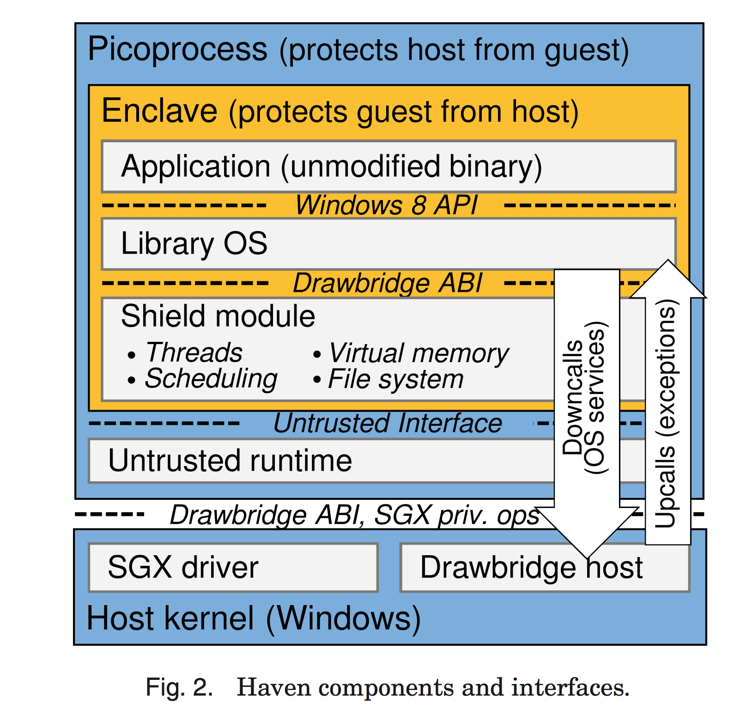

Slide 27
Unikernel: Performance details.
Networking & Storage:
Flooding ping
Mirage has 4-10% latency due to type-safety.
TCPv4 stack
Comparable with Linux.
Receive throughput slightly higher since 0-copy.
Transmit throughput slightly lower due to higher CPU usage.
Storage access
Comparable throughput with Linux direct I/O.

Slide 28
Unikernel: Performance details.
DNS Server Appliance
Compare to Bind and NSD.
Mirage 75-80 kqueries/s.
Bind 55 kqueries/s.
NSD 70 kqueries/s.
OpenFlow Controller
Mirage ~110 requests/s batch and 30 requests/s single.
Maestro > 20 requests/s for batch and single.
NOX ~120 requests/s batch and 35 requests/s single.
Has more variance than Mirage.
Web Server Appliance
Mirage > 2000 connections/s, w/ 6 unikernels.
Linux 1700 connections/s, w/ 6 hosts in 1 vcpu.

