Slide 1

OS Design When the OS Cannot Be Trusted
Adrien Ghosn – Candidacy Exam
29.06.2017

Slide 2
Outline
Introduction
Challenges
Exokernel
Unikernel
Haven
Research Proposal

Slide 3
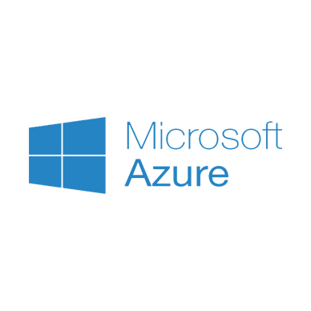




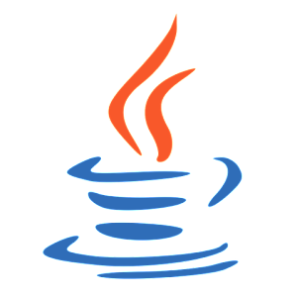

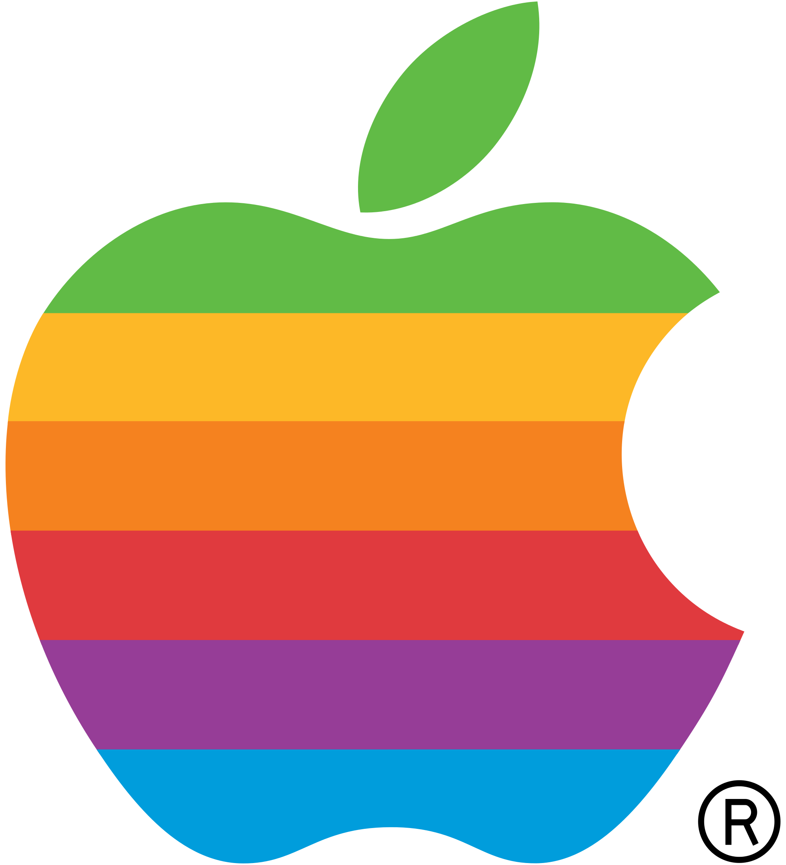
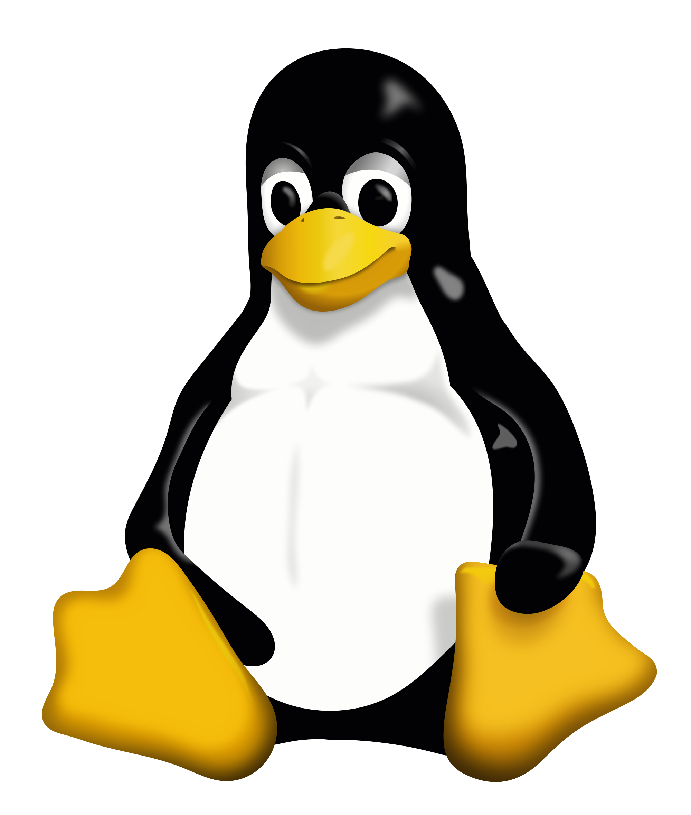




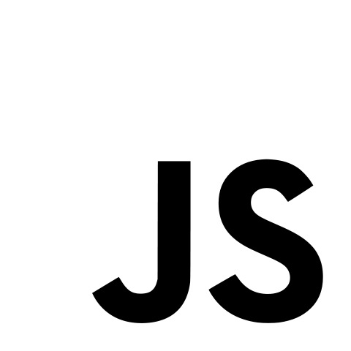








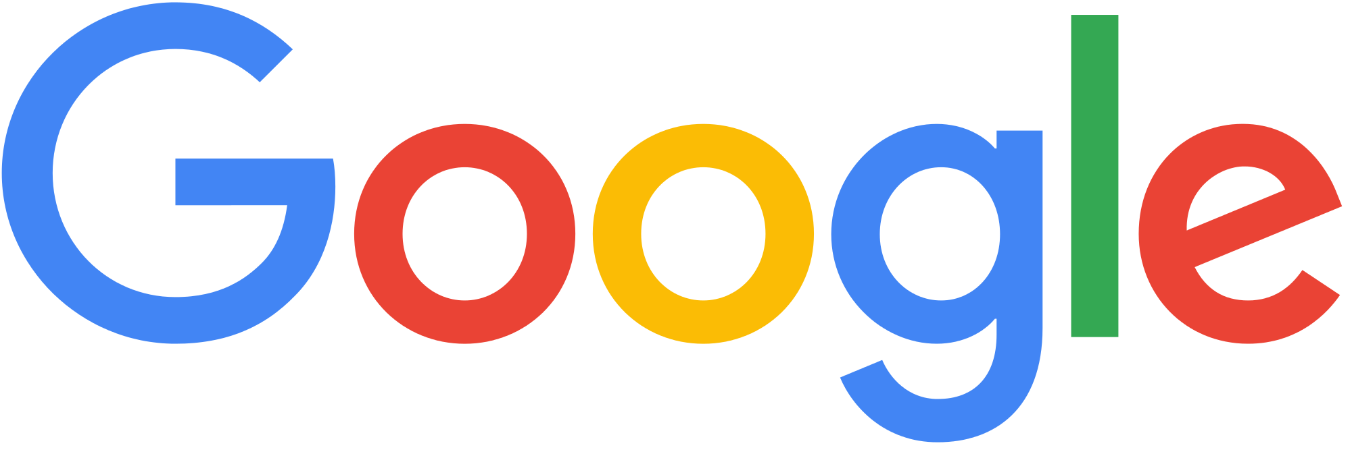



A (biased) Timeline
Computer World:
…
OS abstractions:
POSIX
My Graduation
…
68
70
77
81
85
88
91
95
2050
Notes:
PC -> 1977 for lisa 2, Internet, OO, Cloud services -> 2006, smartphone -> 2007, tablet-> 2010 ipad, linux -> 1991, 1991 WWW, ARPANET 1968
Put lots of things at the very end.
Say number of devices that appear, number of things connected to the internet.

Slide 4

Apps & OS: A Divorce
Non-flexible abstractions
Frameworks.
User-level (re-)implementations.
Non-satisfactory performances
Kernel bypasses.
Security model evolved
“Pirates are back!”
“Don’t trust the Cloud… or ANYTHING!”
“You’re worth less than the data you produce.”

Slide 5
Desired Features
What do we really want from a modern kernel?
Performance for heterogeneous applications.
Ease of deployment, e.g., for Cloud platforms.
Support modern security model, e.g., bi-directional isolation.

Slide 6
How can we achieve this?
Claim: All three requirements can be satisfied with a common set of design principles!
Performance
Deployment
Security
Exokernel
Unikernel
Haven

Slide 7
Exokernel & Performance
End-to-End, Separation of protection & management
Separation of policies & mechanisms

Slide 8


Motivation
Problem: No single, fixed, implementation for high-level abstractions can provide best performance for ALL applications.
So, what can we do now?
Answer: Surrender! Just don’t try to do it!

Slide 9
Exokernel Design
Principle
Translates to…
End-to-End
Sep. protection & management
Avoid management
Sep. policies & mechanisms
App-level physical resource mgmt
Securely expose all hardware
Use physical names
Secure bindings mechanisms
Notes:
Say library operating system

Slide 10
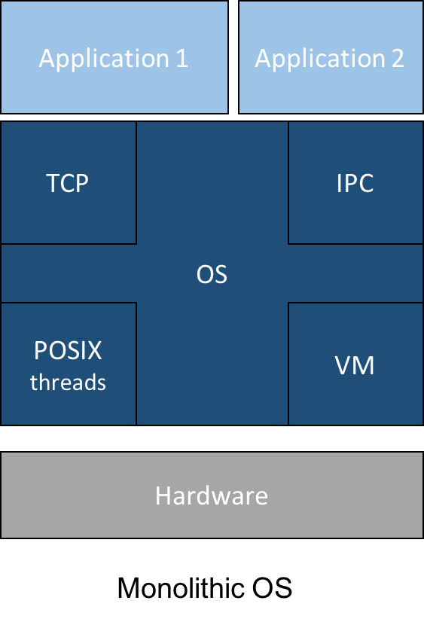
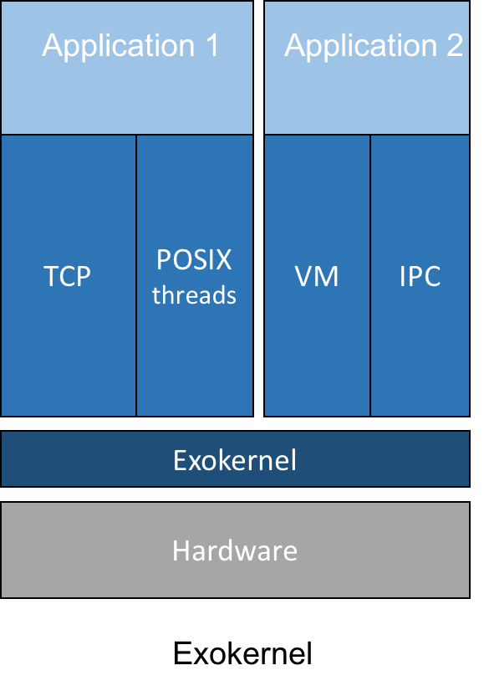
Exokernel Architecture

Slide 11
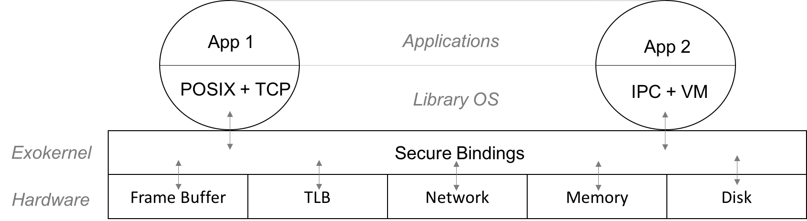
Exokernel Mechanisms
Secure Bindings
Hardware.
Software.
Code Download.
Access time checks
Revocation protocol

Slide 12

Exokernel Discussion
Good
But…
Efficient.
Clear separation between host/guest.
Close to cloud logic.
Heterogeneous hardware makes it unpractical.
Virtualization!

Slide 13
Unikernels & The Cloud
Library operating system, Virtualization, High-level programming languages

Slide 14

Motivation
Problem: Single-purpose VMs deployed in the cloud are not specialized!
Ad-hoc configuration.
Consumes too many resources.
Large attack surface.

Slide 15
Haven & Intel SGX
Why do people use Cloud services: IaaS, SaaS, PaaS, WaaS AaaP*?
Fast deployment
Low start-up cost
Pay-per-use
Adapt resources to load
Sounds fancy (like Big data, Machine learning, IoT, etc.)
*This one is made up.

Slide 16



How it works
“You have to share!”
Co-locating Apps.
“Wrap it!”
Containers, VMs, etc.
“I won’t look… I promise”
CSP is privileged
Corrupted/malevolent host
“Solve the rebus”

Slide 17


Haven - Thanks Microsoft.
Unmodified legacy applications
Shielded execution
Confidentiality
Integrity
Leverages Intel SGX
Provides feedback.

Slide 18
Intel Software Guard Extension (SGX)
Enclaves
Portion of user address space.
Protected against modification…
… even from privileged code!
CPU in enclave mode
EPC.
Encrypted traffic to DRAM.
Attestation mechanism
App must know about SGX
Before loading nothing is safe
Iago attacks
DoS

