Slide 1
EEMs Data share!
Reservoir Meeting
1 October 2020

Slide 2
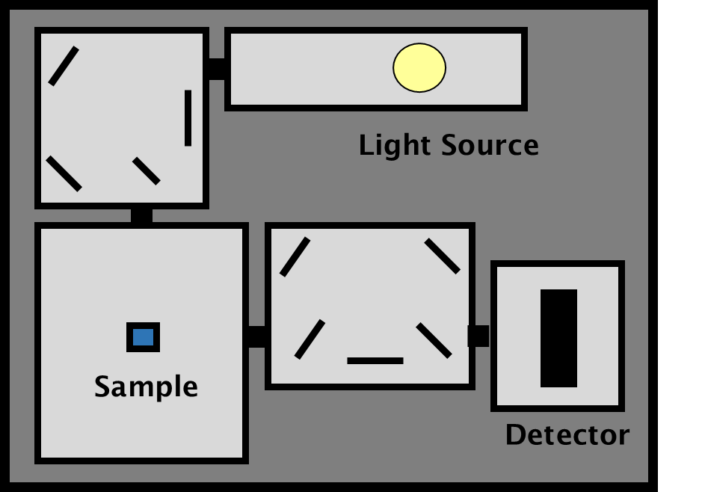
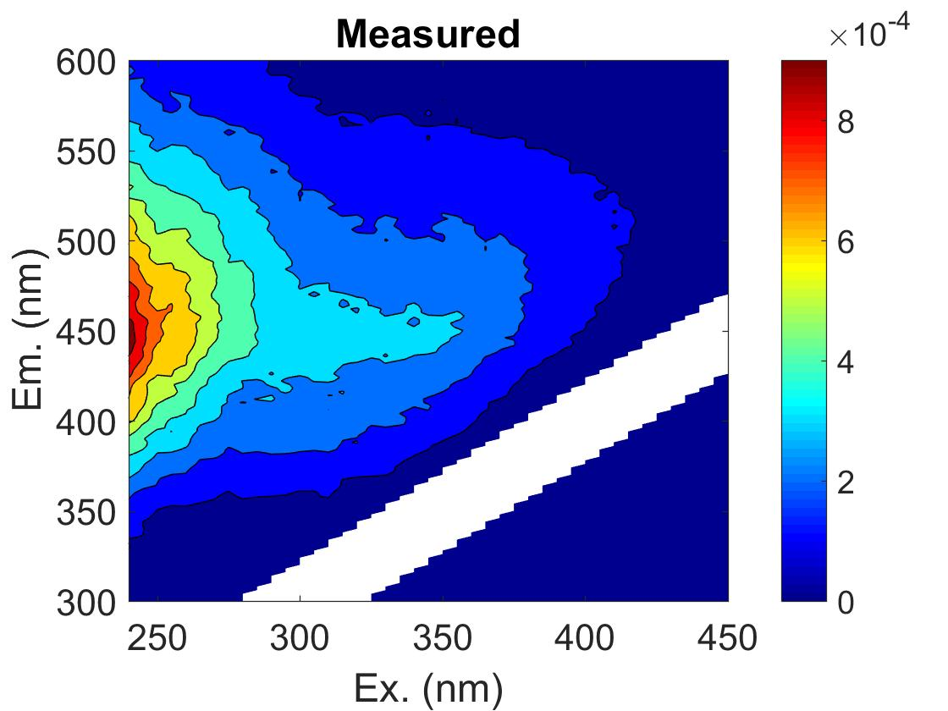
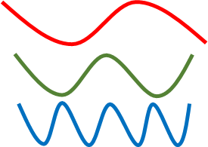
What is an EEM?!
Fluorescence spectroscopy
Excitation emission matrix (EEM)
=
Notes:
Shines light at a range of wavelengths into a sample; OM in the sample can then emit light at a range of wavelengths. Form a 3D topographical map of fluorescence; the location of fluorescence gives an understanding of the quality of OM

Slide 3
Fluorescence indicators
Previously identified ‘peaks’ which correspond to types of OM
  Peak A
  Peak C
  Peak T
  Peak M
Also ratio of peak areas:
  HIX (Humification index)
  BIX (Biological index)
A
C
M
T
Humic, terrestrial-like
Microbial, autochthonous

Slide 4
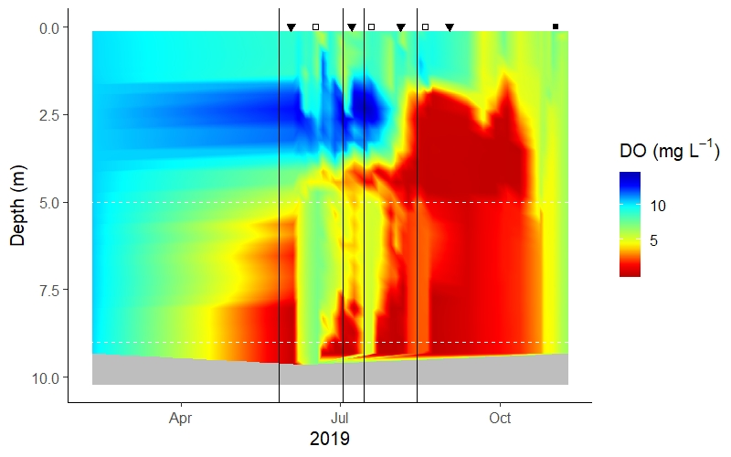
Summer 2019 was a unique year in FCR (we think!)!
Variable oxygenation throughout the summer
Via oxygenation system on/off cycles (3 total) then left on through turn-over

Slide 5
What does this have to do with Carbon cycling?!
Understand how C cycling (DOM quality via EEMs, DOC concentration, GHG concentration) might change due to variable oxygen concentrations
Focusing on Site 50 (greatest impact of oxygenation)
Hoping to link DOC concentration + DOM quality with GHG concentration
  Pie in the sky…
But also, figure out what is ‘driving’ patterns of DOM and GHG (separately and together)

Slide 6
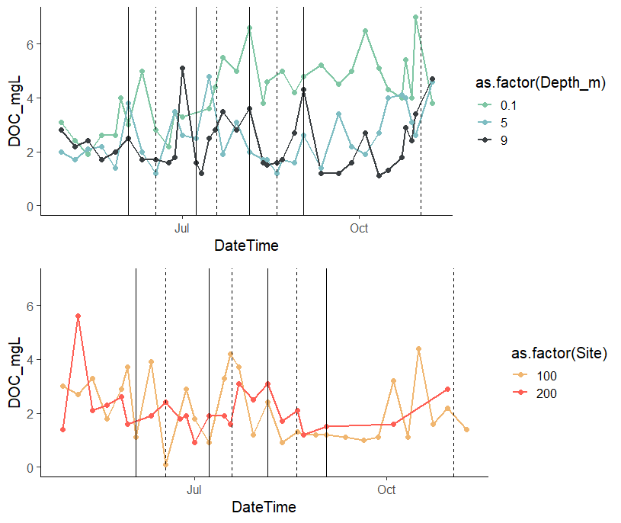
Let’s start with DOC concentration!
Surface DOC > Meta and Hypo DOC
Why?
  Primary Production?
  Not from inflows…
Stream and wetlands inflow are surprisingly similar!
  And also similar in magnitude to Meta and Hypo DOC concentrations

Slide 7
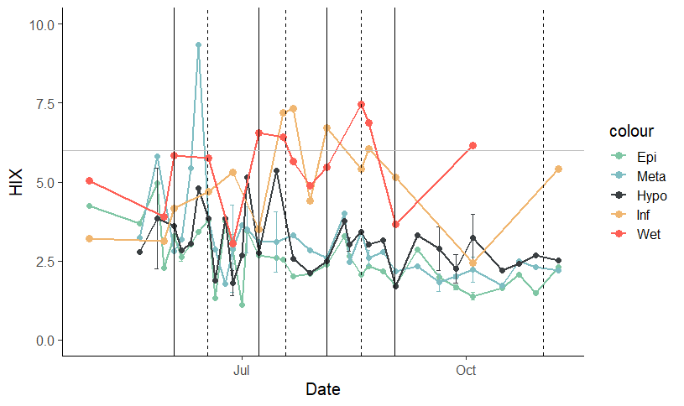

Slide 8
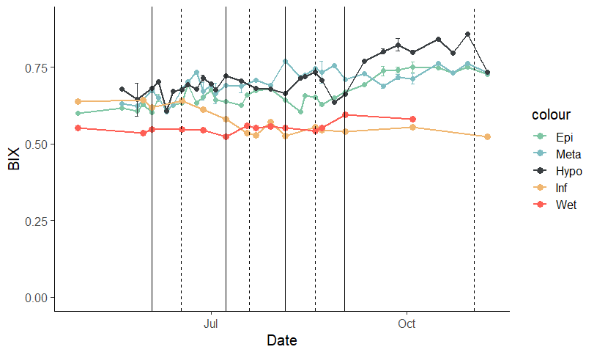

Slide 9
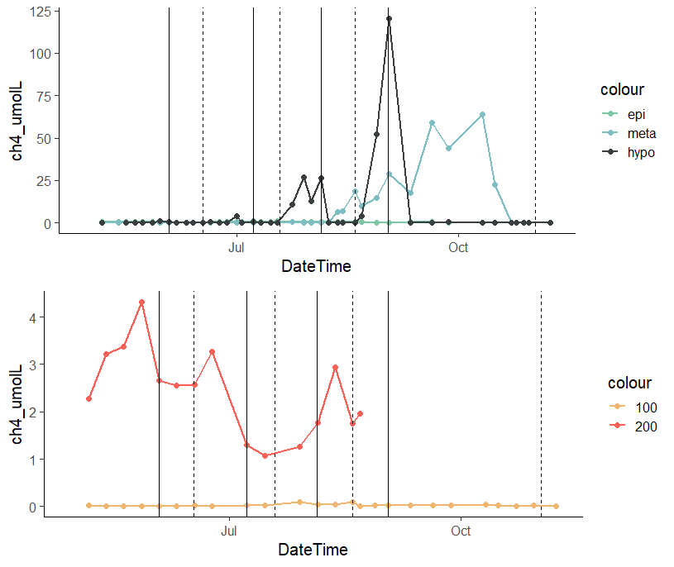

Slide 10
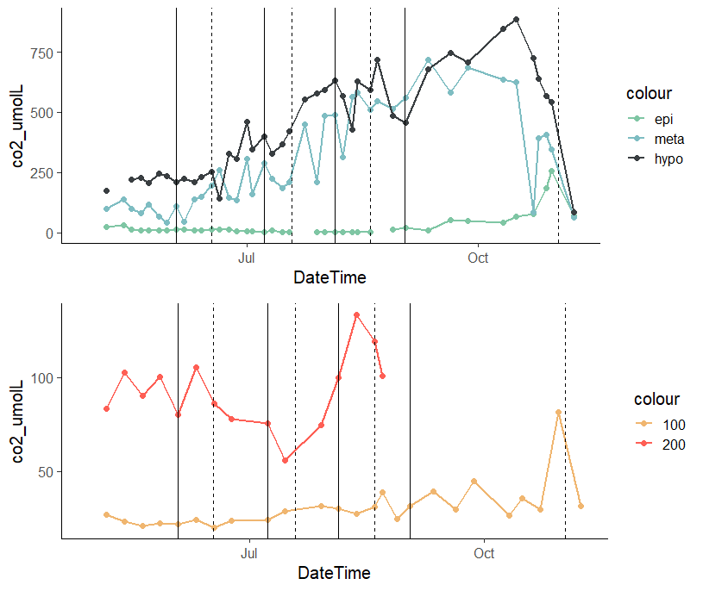

Slide 11
