Slide 1

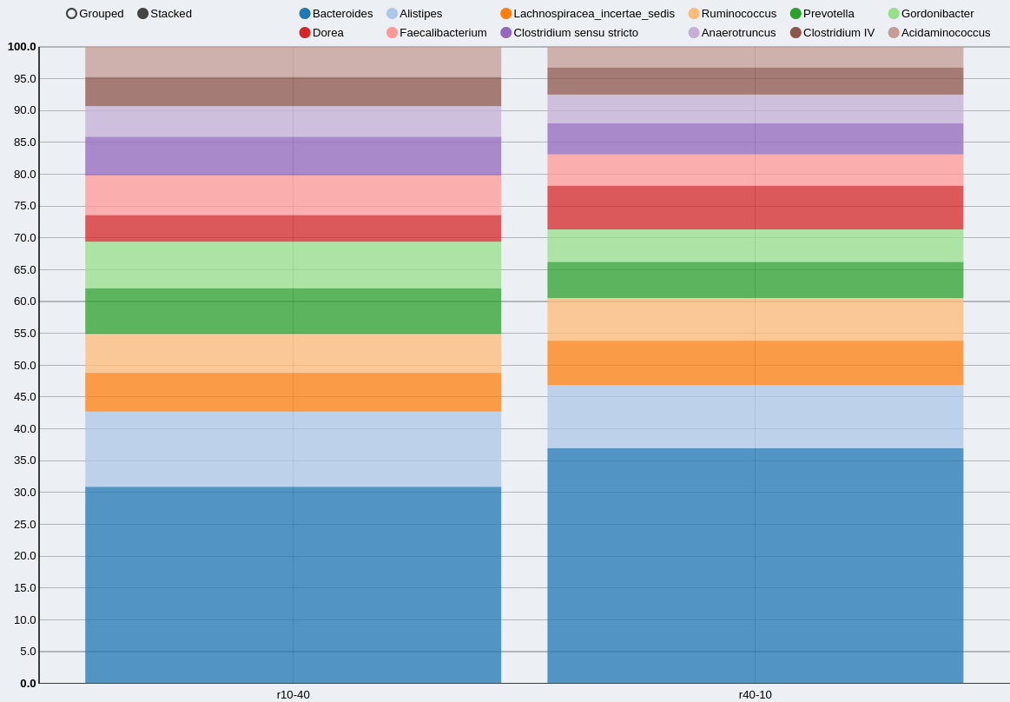
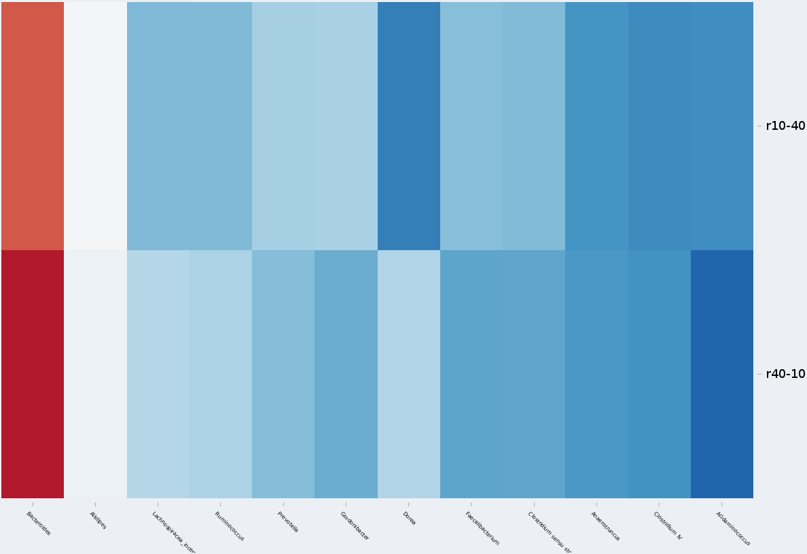
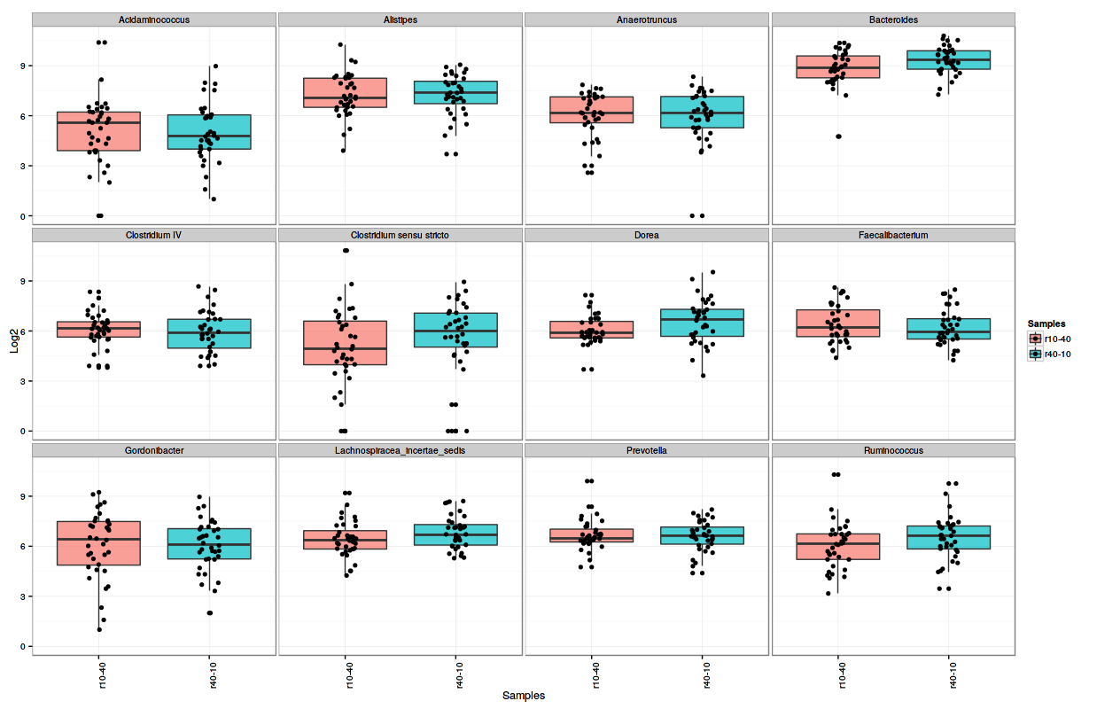
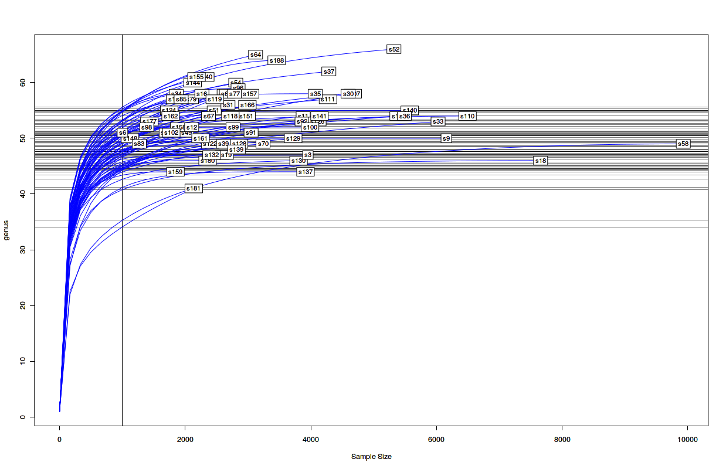
+
Barplot
Counts
Annotation
Metadata (target file)
Quantitative Metagenomic
Heatmap
RLE normalization at OTU level
Run DESeq2
Boxplots
Merge normalized counts at the user selected level
Statistical Analysis
Rarefaction
Define contrasts (comparaisons)
Get differential abundant features
Diffrential Analysis
Visualization

Slide 2
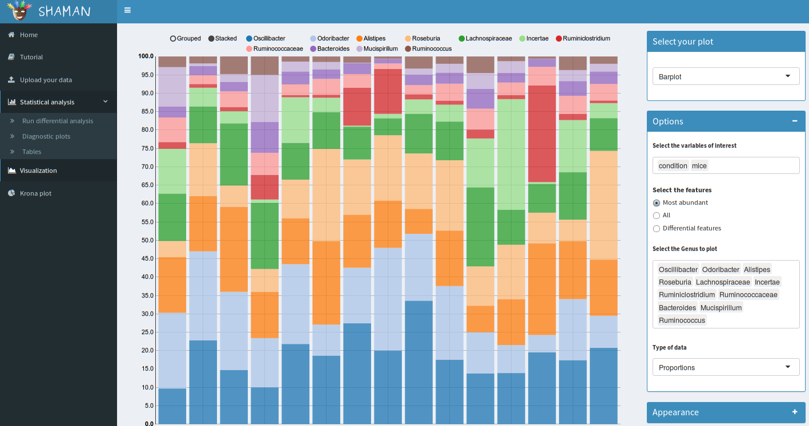

Slide 3
Metagenomic vs RNA-seq
DESeq2 approach is usually used for RNA-seq dataset
 | Metagenomic | RNA-seq
Distribution | Overdispersed counts → Negative binomial | Overdispersed counts → Negative binomial
Constraints | Presence of majority OTU | Presence of majority genes
Goal | Find differentially abundant features (species, familly, …): 16S distributions and abundances vary between conditions | Find differentially expressed genes: Distributions and expression vary between conditions
Metagenomic data (16S) are similar to RNA-seq

Slide 4
Data normalization
Why ?
  To correct technical biaises and make samples comparables.
How ?
  Fitting the distributions (Total Read Count, UpperQuartile, Median, Full Quantile)
  Account for the feature length (RPKM)
  Concept of « effective reads number » (TMM, DESeq2)
Remarks?
  Some methods normalize the counts, others the library sizes
  Some are designed for differential analysis

Slide 5
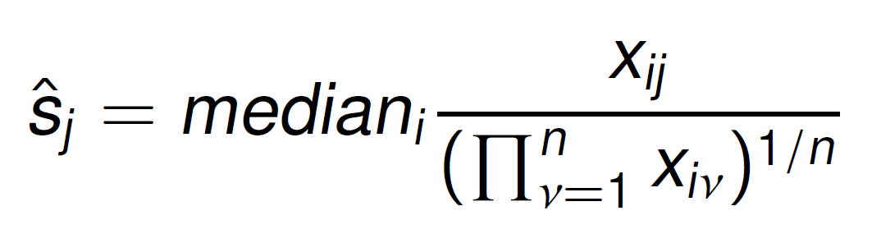
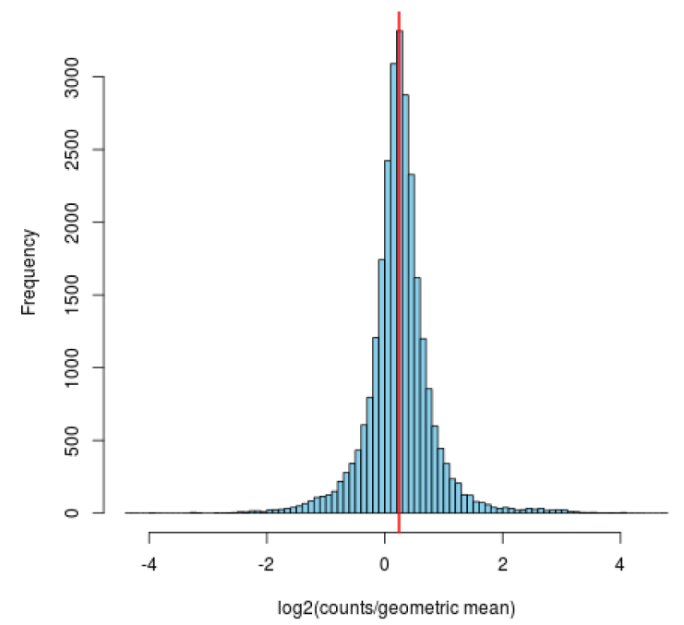
DESeq2 normalization
at the OTU level
Assumption
  Most of the OTU have the « same » abundance between 2 conditions
Normalization factor :
where
Xij : Number of mapped reads of the OTU i in sample j
n: Number of samples

Slide 6
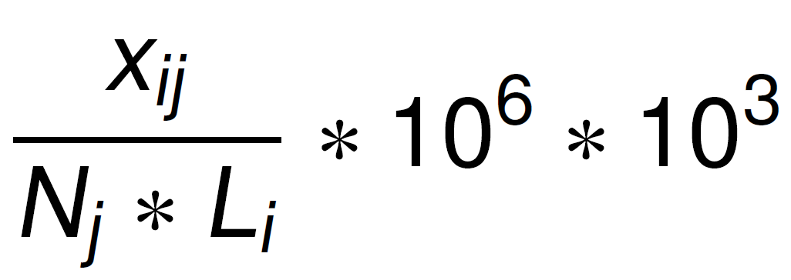
Comparison with RPKM (1/3)
RPKM : Reads Per Kilobase per Million mapped reads
Assumption
  Counts are proportional to abundance, the length and the sequencing deepth.
Method
per Million
Per Kilobase
Normalized counts =
Number of reads of sample j
Length

Slide 7
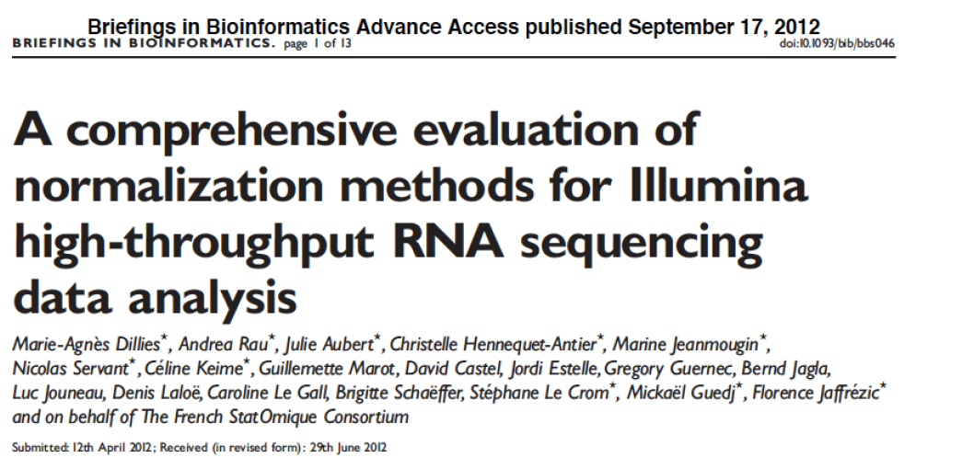
Comparison with RPKM (2/3)
Comparison of 7 normalization methods

Slide 8
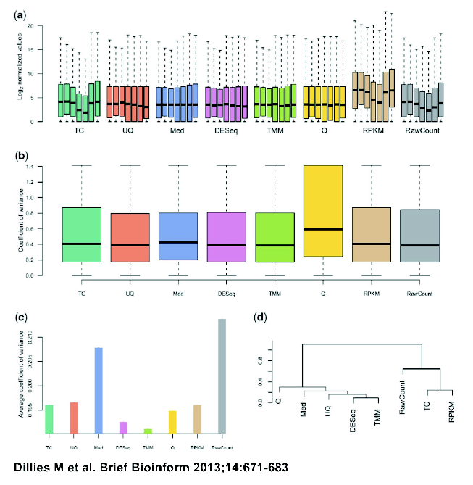
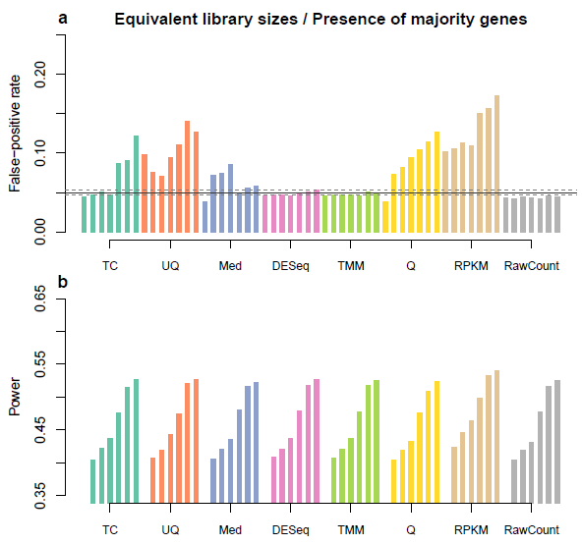
Comparison with RPKM (3/3)
Results on real data
FDR and Power

Slide 9
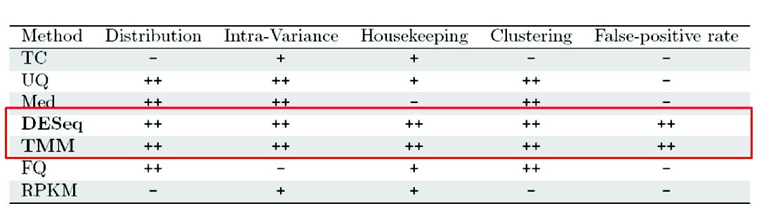
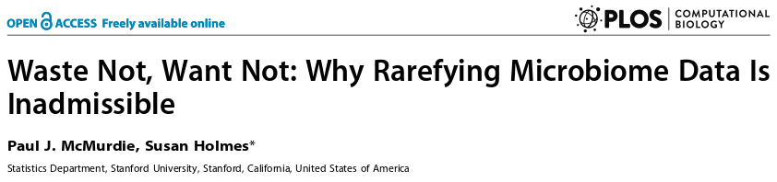
To sum up
DESeq2 normalization provides better results
Recommend using DESeq2 to perform analysis of differential abundance

Slide 10
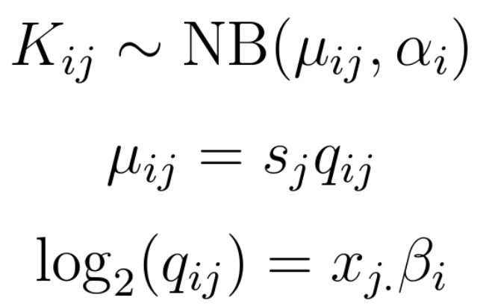
Statistical model of DESeq2
Generalized Linear Model
Dispersion
Log2 fold change
Advantages
  Allows complex experimental design.

