Slide 1

B.Sc. THESIS DEFENCE · SOFTWARE ENGINEERING
KooGYMaa
An Integrated Platform for Gyms, Trainers and Athletes
Next.js 16 · React 19 · TypeScript · Prisma · SQLite / Turso
Author: ____________________
Supervisor: ____________________
Faculty of Electrical & Computer Engineering
Semnan University
Notes:
[0:00] Title — 20s
Good morning. I'm presenting KooGYMaa, an integrated platform for gyms, trainers and athletes. It is a full-stack web application built with Next.js 16, React 19, TypeScript and Prisma.

Slide 2
15 MINUTES
Agenda
1. The problem
4. Live walkthrough
Why gyms still run on paper and chat apps
Member → Trainer → Gym owner
2. The solution
5. Security & quality
One platform, three roles
Access control, payments, tests
3. Architecture & data model
6. Results & future work
How it is built
KooGYMaa
01
Notes:
[0:20] Agenda — 20s
Fifteen minutes: the problem, the solution, how it is built, a walkthrough of all three roles, then security, quality and future work.

Slide 3
CONTEXT
The problem
Gym operations, coaching and athlete progress live in three disconnected worlds.
Paper & spreadsheets
Chat apps as a coaching tool
Memberships, renewals and cash tracked by hand
Plans sent as photos and PDFs, lost in scroll
No progress history
Blind business decisions
Nothing to compare, nothing to prove
No revenue, retention or expiry visibility
KooGYMaa
02
Notes:
[0:40] The problem — 1:20
Gyms run on paper and spreadsheets. Coaches send plans as photos in chat apps. Athletes have no progress history. And owners have no visibility into revenue, retention or expiries. Three worlds that never talk to each other.

Slide 4
THE SOLUTION
One platform, three roles
MEMBER
TRAINER
GYM OWNER
Train & track
Coach & assign
Operate & sell
Find a gym, subscribe, follow plans,
log workouts, meals and body metrics
Build reusable workout and diet plans,
manage clients, sessions and feedback
Approve members and trainers, sell plans,
track subscriptions, payments, revenue
Every action one role takes becomes visible to the other two — in real time.
KooGYMaa
03
Notes:
[2:00] Solution — 1:10
One platform, three roles. Members train and track. Trainers coach and assign. Owners operate and monetise. The key point: every action one role takes is immediately visible to the other two.

Slide 5
AT A GLANCE
Scope of the system
33
76
3
73
database models
API routes
role workspaces
automated tests
16 enums, fully relational
all validated server-side
admin · trainer · member
typecheck + build green
Bilingual UI (English / Persian with full RTL), light & dark theme, responsive down to mobile.
KooGYMaa
04
Notes:
[3:10] Scope — 50s
In numbers: 33 database models, 76 API routes, three role workspaces and 73 automated tests. Bilingual English/Persian with full RTL, light and dark themes, responsive to mobile.

Slide 6
HOW IT IS BUILT
Technology stack
Frontend
Next.js 16 App Router
React 19
TypeScript
Tailwind CSS 4
Backend
Route Handlers
Server Components
Domain layer (lib/)
Data
Prisma ORM 7
SQLite (dev)
Turso / libSQL (cloud)
Platform
JWT + HttpOnly cookies
Vitest
GitHub Actions CI
KooGYMaa
05
Notes:
[4:00] Stack — 40s
Next.js App Router with React Server Components on the front, route handlers and a separate domain layer on the back, Prisma over SQLite locally and Turso libSQL in the cloud.

Slide 7
SYSTEM DESIGN
Architecture
A single Next.js application: rendering, API and domain logic in one deployable unit.
Browser · React 19 UI
Server Components + Client Components
Next.js App Router
app/**/page.tsx · app/api/**/route.ts
Auth & session layer
JWT in HttpOnly cookie · role guard on every route
Payment gateway
checkout · webhook · refund
Domain layer (lib/)
auth · payments · subscriptions · finance · scheduling · validation
Daily scheduler
/api/cron/subscriptions
Prisma ORM 7 → SQLite / Turso libSQL
33 models · migrations as source of truth
KooGYMaa
06
Notes:
[4:40] Architecture — 1:00
One deployable Next.js application. Requests hit either a server page or an API route; both pass through the auth layer, which validates the JWT session cookie and the role. Business rules live in the domain layer, never in the components. A daily scheduler handles expiries and renewals.

Slide 8
33 MODELS
Data model
Relationships — not flags — carry the business rules.
Identity & access
Gym & commerce
Coaching & content
Progress & trust
User · TrainerProfile
GymStaff · Session
AuditLog
Gym · GymMembership
GymTrainer · SubscriptionPlan
Subscription · Payment · PaymentEvent
TrainerClient · WorkoutPlan
DietPlan · PlanDay · Exercise
Meal · FoodItem · Assignment
WorkoutLog · NutritionLog
BodyCheckIn · Feedback
GymReview · TrainerReview · Notification
Money is stored as integers in the smallest currency unit · plans are versioned and immutable once assigned.
KooGYMaa
07
Notes:
[5:40] Data model — 1:00
33 models in four groups. The important design decision: relationships carry the business rules, not boolean flags. A membership is a row with a status and a lifecycle, not a flag on a user. Money is stored as integers in the smallest currency unit, and plans become immutable once assigned.

Slide 9
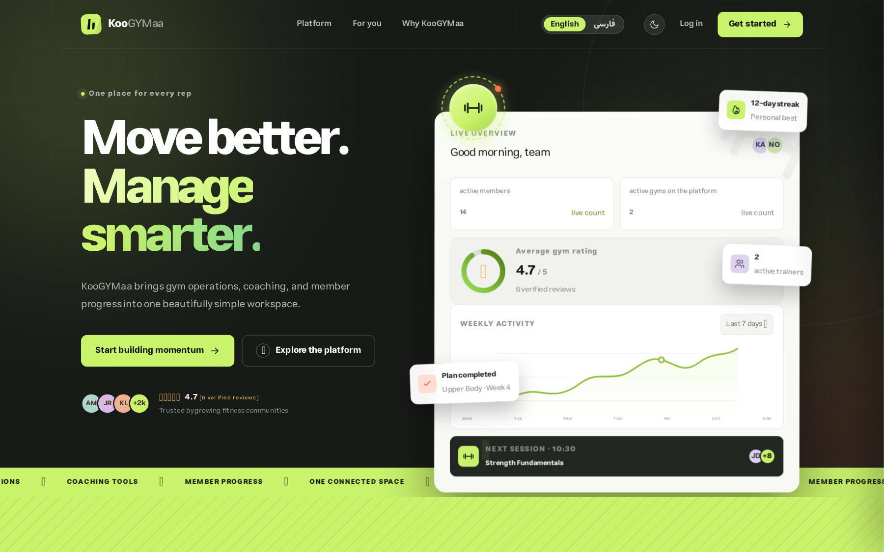
WALKTHROUGH
The product
Public marketplace
Browse gyms and trainers before signing up
Self-service sign-up
Member or trainer, in one step
EN / فارسی
Full RTL layout, Jalali dates
Light & dark
Persisted per user
KooGYMaa
08
Notes:
[6:40] The product — 40s
This is the public side: anyone can browse gyms and trainers before signing up, in English or Persian, light or dark.

Slide 10
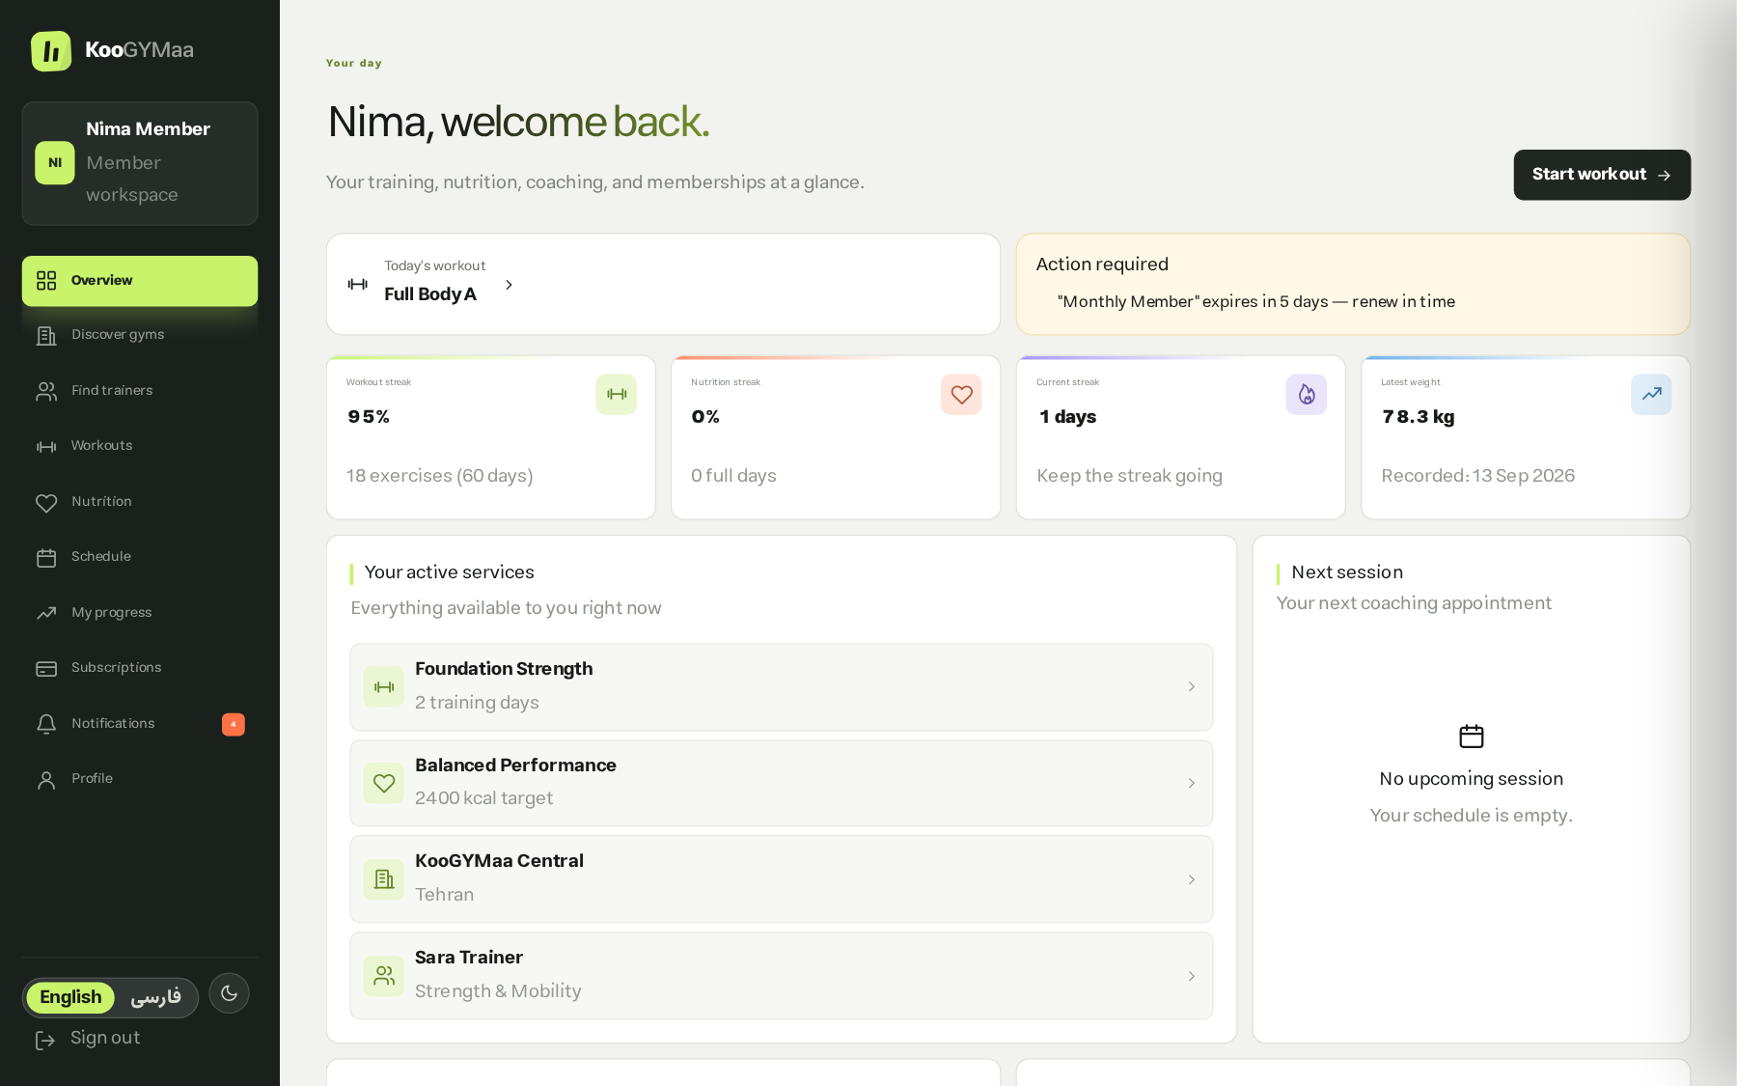
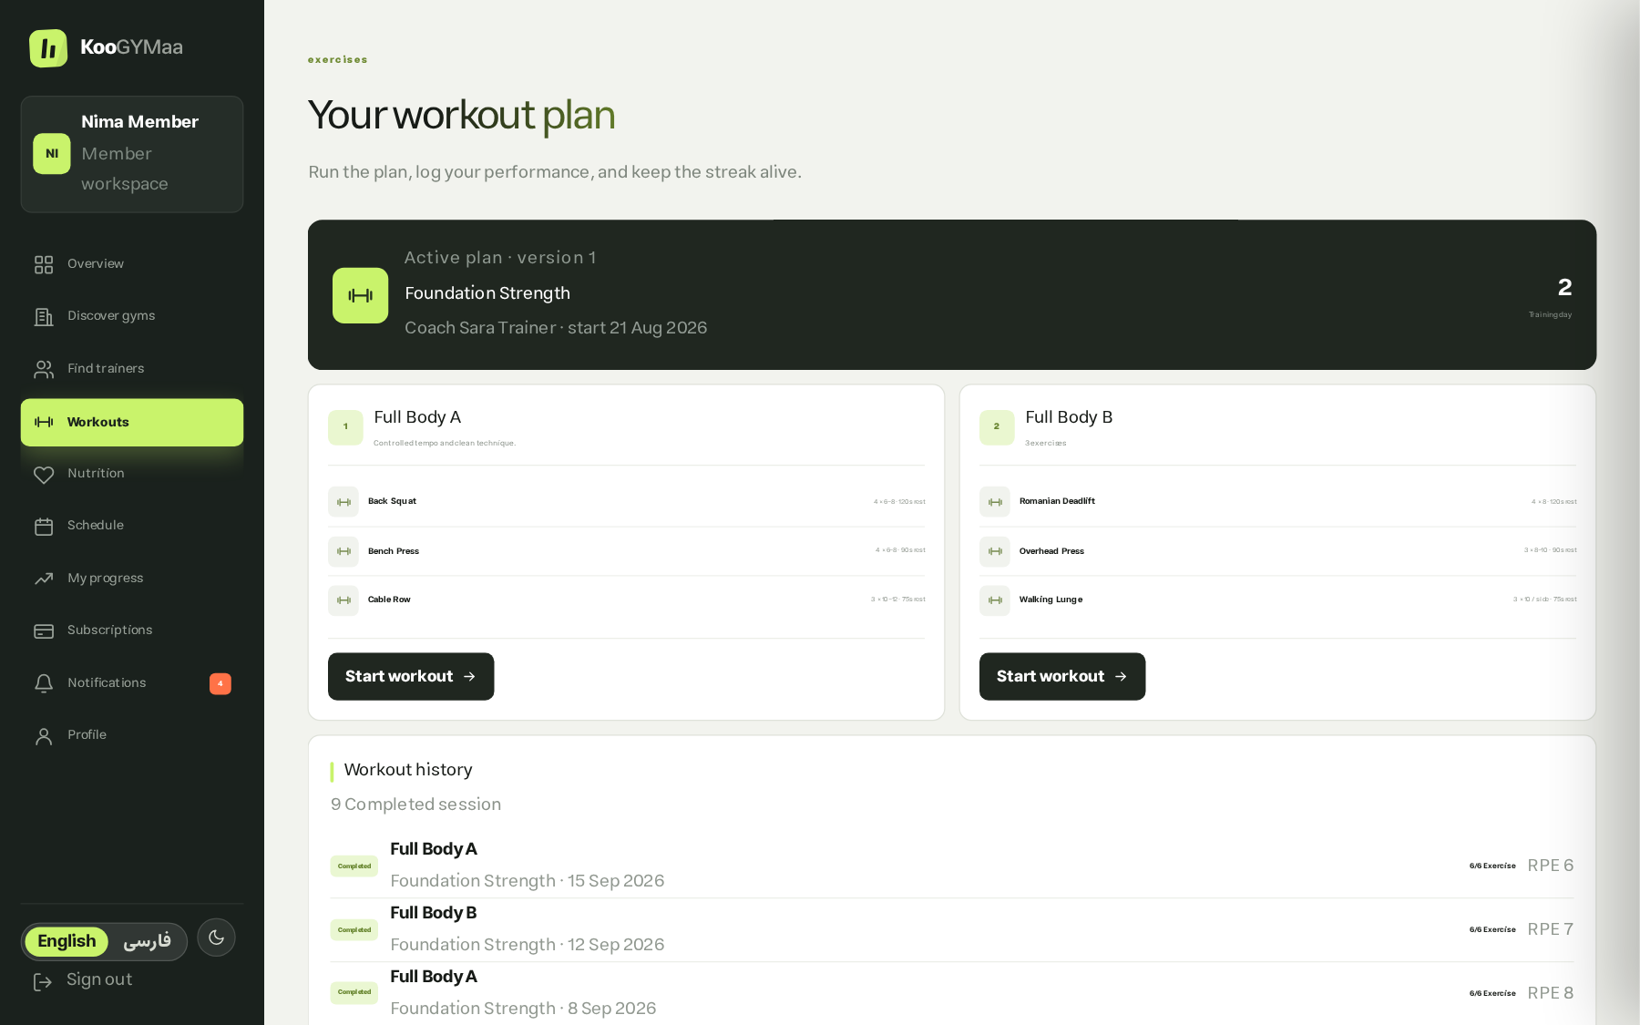
WALKTHROUGH · 1 OF 3
Member journey
Member dashboard
Assigned workout plan
Discover a gym → subscribe & pay → request a trainer → follow the plan → log every session
KooGYMaa
09
Notes:
[7:20] Member journey — 1:20
The member discovers a gym, subscribes and pays, requests a trainer, follows the assigned plan and logs every session. The dashboard on the left is live data: streaks, adherence, next session, active services.

Slide 11
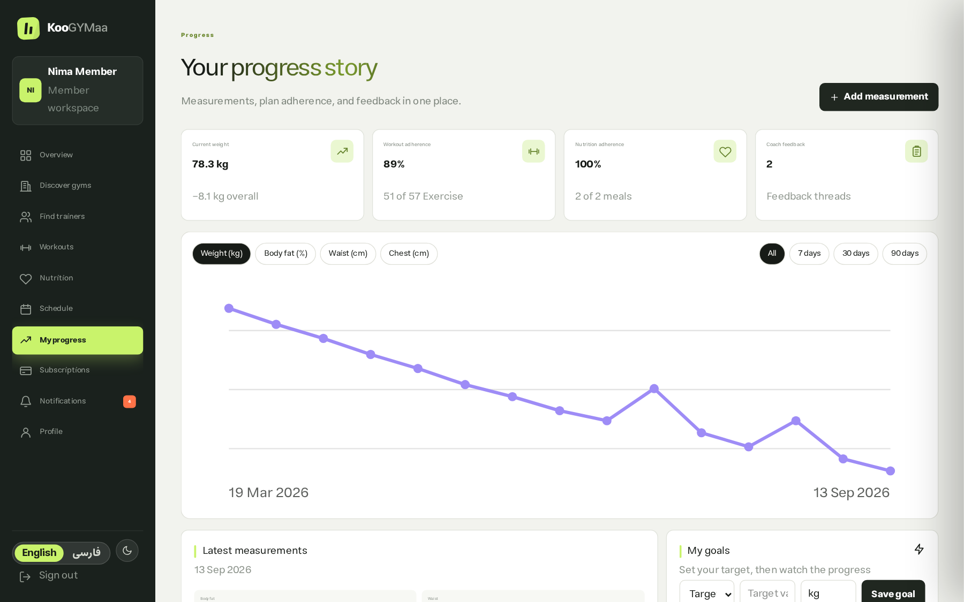
WALKTHROUGH · 1 OF 3
Progress that is actually measured
Workout logs
Prescribed vs. actual sets, load, RPE
Nutrition logs
Meal completion, portions, substitutions
Body check-ins
Weight, body fat, measurements, photos
Two-way feedback
Trainer comments on a specific log
KooGYMaa
10
Notes:
[8:40] Progress — 1:10
This is the part that matters most. Workout logs compare prescribed against actual load and RPE. Nutrition logs track completion and substitutions. Body check-ins record weight, body fat and measurements. And the trainer can attach feedback to one specific log — a two-way thread.

Slide 12
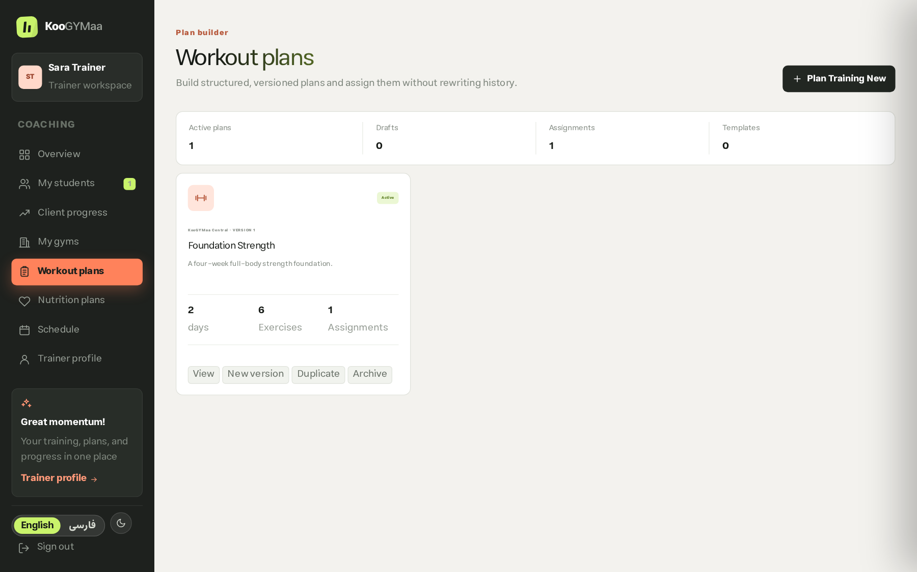
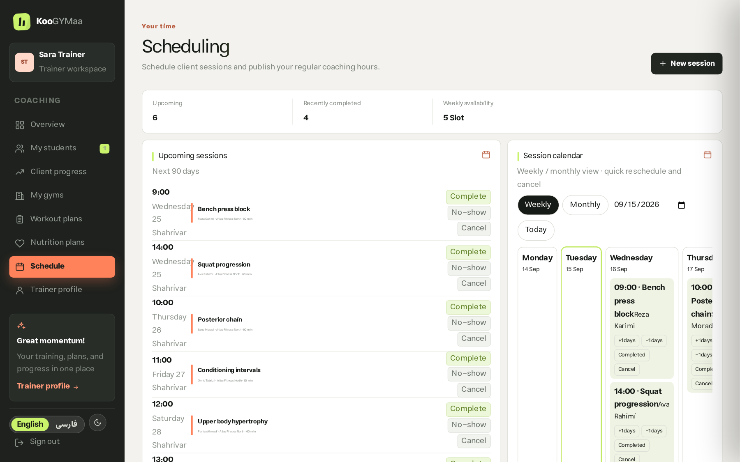
WALKTHROUGH · 2 OF 3
Trainer workspace
Plan builder — days, exercises, versions
Availability & sessions
Reusable plans · versioning & duplication · conflict-checked scheduling · client progress review
KooGYMaa
11
Notes:
[9:50] Trainer workspace — 1:10
Trainers build reusable, versioned plans. Publishing locks a version; 'New version' keeps the family and increments. Scheduling checks for conflicts and only allows sessions with active students at a shared gym.

Slide 13
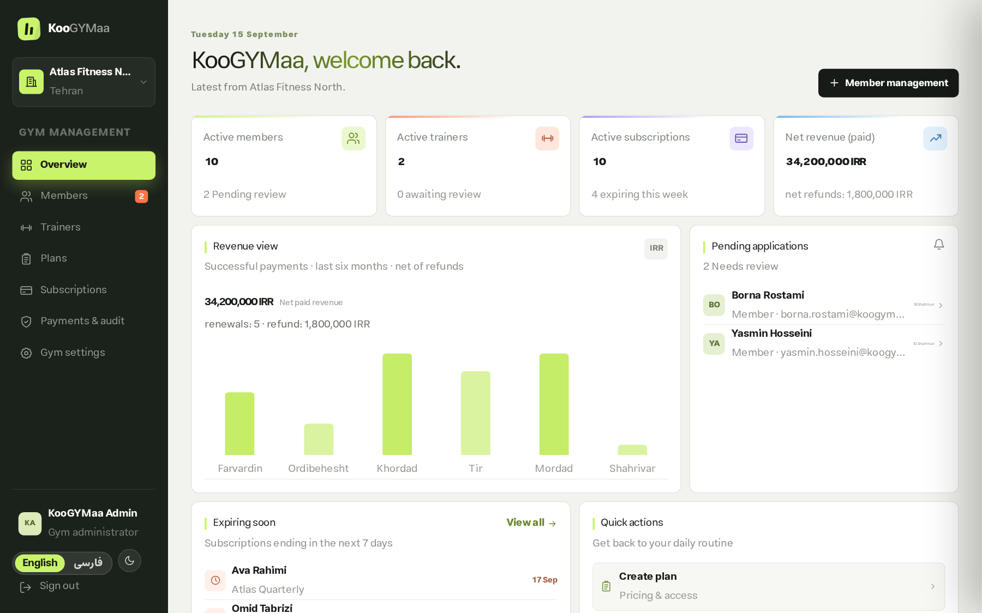
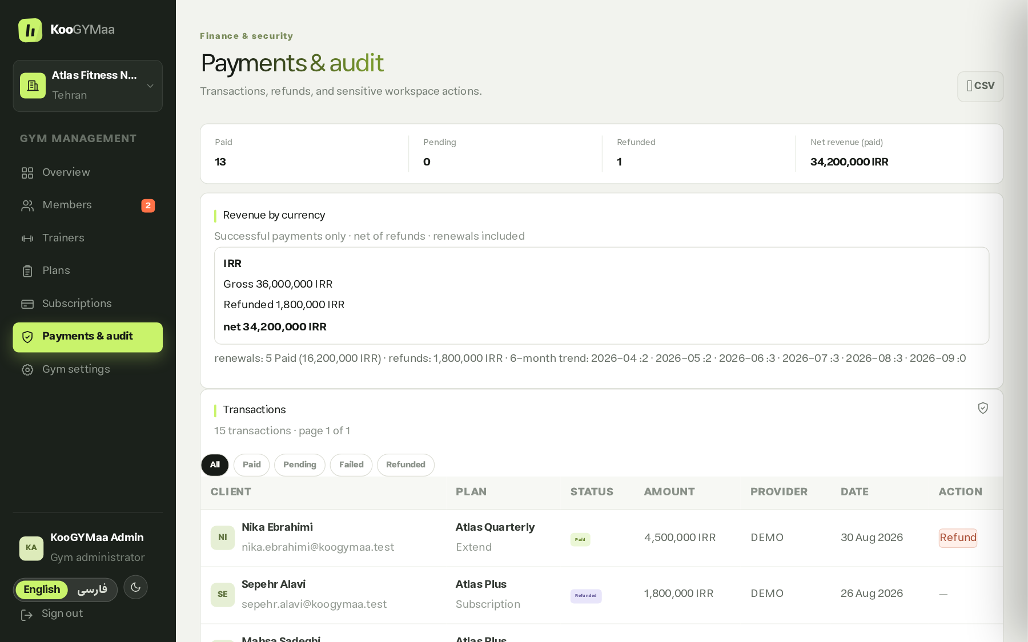
WALKTHROUGH · 3 OF 3
Gym owner workspace
Live KPIs: members, trainers, revenue, expiries
Payment ledger & refunds
Approve applications · price subscription plans · reconcile payments · audited actions
KooGYMaa
12
Notes:
[11:00] Gym owner — 1:10
The owner approves applications, prices subscription plans, and reconciles payments. These are real KPIs computed from the database: active members, net revenue after refunds, expiries this week. Sensitive actions are audited.

Slide 14
CORE FLOW
Payments & subscriptions
Idempotent checkout, signed webhooks, and access that follows the money.
Checkout
created
Provider
redirect
Signed
webhook
Payment
confirmed
Subscription
active
Idempotency
Refunds
Daily cron
The same checkout is never charged twice
Owner-initiated, access reconciled automatically
Expiry, renewal and notification sweep
KooGYMaa
13
Notes:
[12:10] Payments — 50s
Checkout is idempotent, so the same cart is never charged twice. The provider calls back through a signed webhook, and only a confirmed payment activates the subscription. Refunds reconcile access automatically.

Slide 15
NON-NEGOTIABLES
Security & quality
Server-side authorisation
73 automated tests
Every mutation re-checks role and ownership
Validation, auth, scheduling, finance, schema
Signed HttpOnly sessions
Strict TypeScript
JWT, revocable, suspended users locked out
tsc --noEmit clean, ESLint enforced
Hardened headers
CI on every push
CSP, HSTS, no external font or script hosts
GitHub Actions: lint → test → typecheck → build
Audit log
Reproducible data
Sensitive admin and payment actions recorded
Migrations + idempotent seed script
KooGYMaa
14
Notes:
[13:00] Security & quality — 50s
Authorisation is re-checked server-side on every mutation — middleware is only an optimistic first layer. Sessions are signed, HttpOnly and revocable. 73 tests, strict TypeScript and CI on every push.

Slide 16
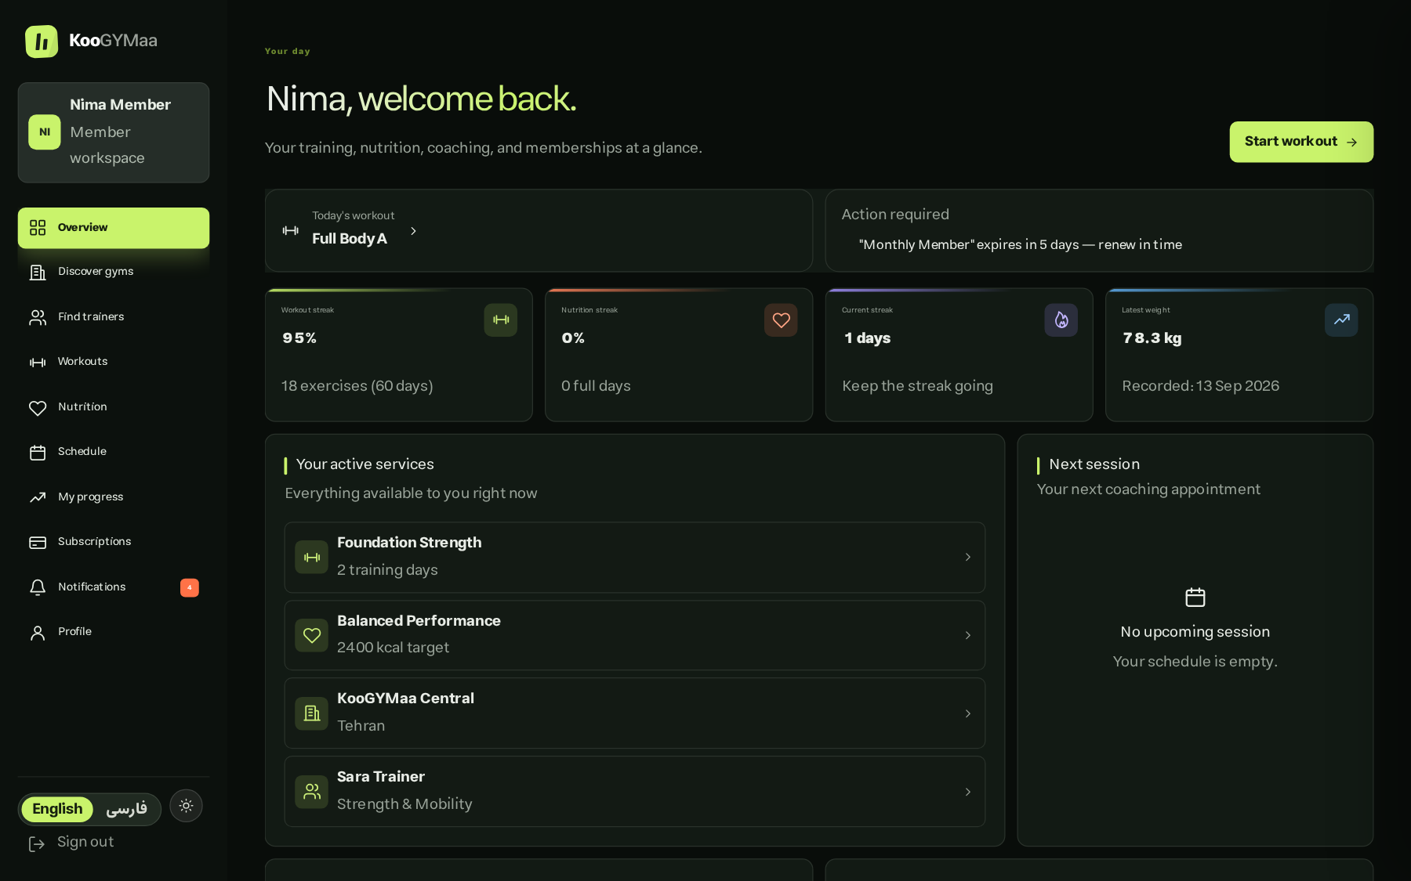
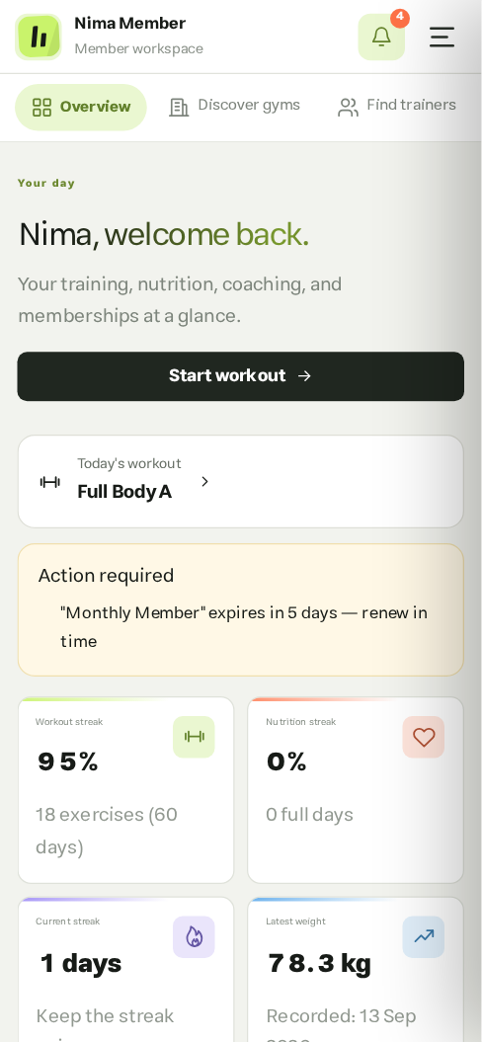
EXPERIENCE
Built for real users
Bilingual
EN · فارسی, one dictionary
RTL-aware
Layout mirrors, not just text
Jalali dates
Persian numerals & currency
Accessible
Keyboard, contrast, states
Dark theme
Responsive
KooGYMaa
15
Notes:
[13:50] Real users — 30s
Bilingual with a mirrored RTL layout, Jalali dates and Persian numerals, and it works down to a phone.

Slide 17
CONCLUSION
Results & future work
DELIVERED
NEXT
End-to-end working platform
Real payment provider
All three roles, deployed and seeded
Swap the demo adapter for a local gateway
Commerce layer
Mobile app & notifications
Plans, checkout, webhooks, refunds
Push reminders for sessions and plans
Verified trust layer
Analytics & recommendations
Reviews only from real members and clients
Retention insight, plan suggestions
KooGYMaa
16
Notes:
[14:20] Results & future — 30s
Delivered: a working end-to-end platform with a real commerce and trust layer. Next: a production payment gateway, a mobile app with push reminders, and analytics.

Slide 18
Thank you
Questions & live demo
KooGYMaa · github.com/aghrabooti/KooGYMaa
Notes:
[14:50] Thank you — 10s
Thank you. I am happy to take questions, and the app is running live if you would like to see anything specific.

