Slide 1
Fast & Approximate
What is CLEAR?

Slide 2
DATA LABELLING
Dataset Meaning

Slide 3
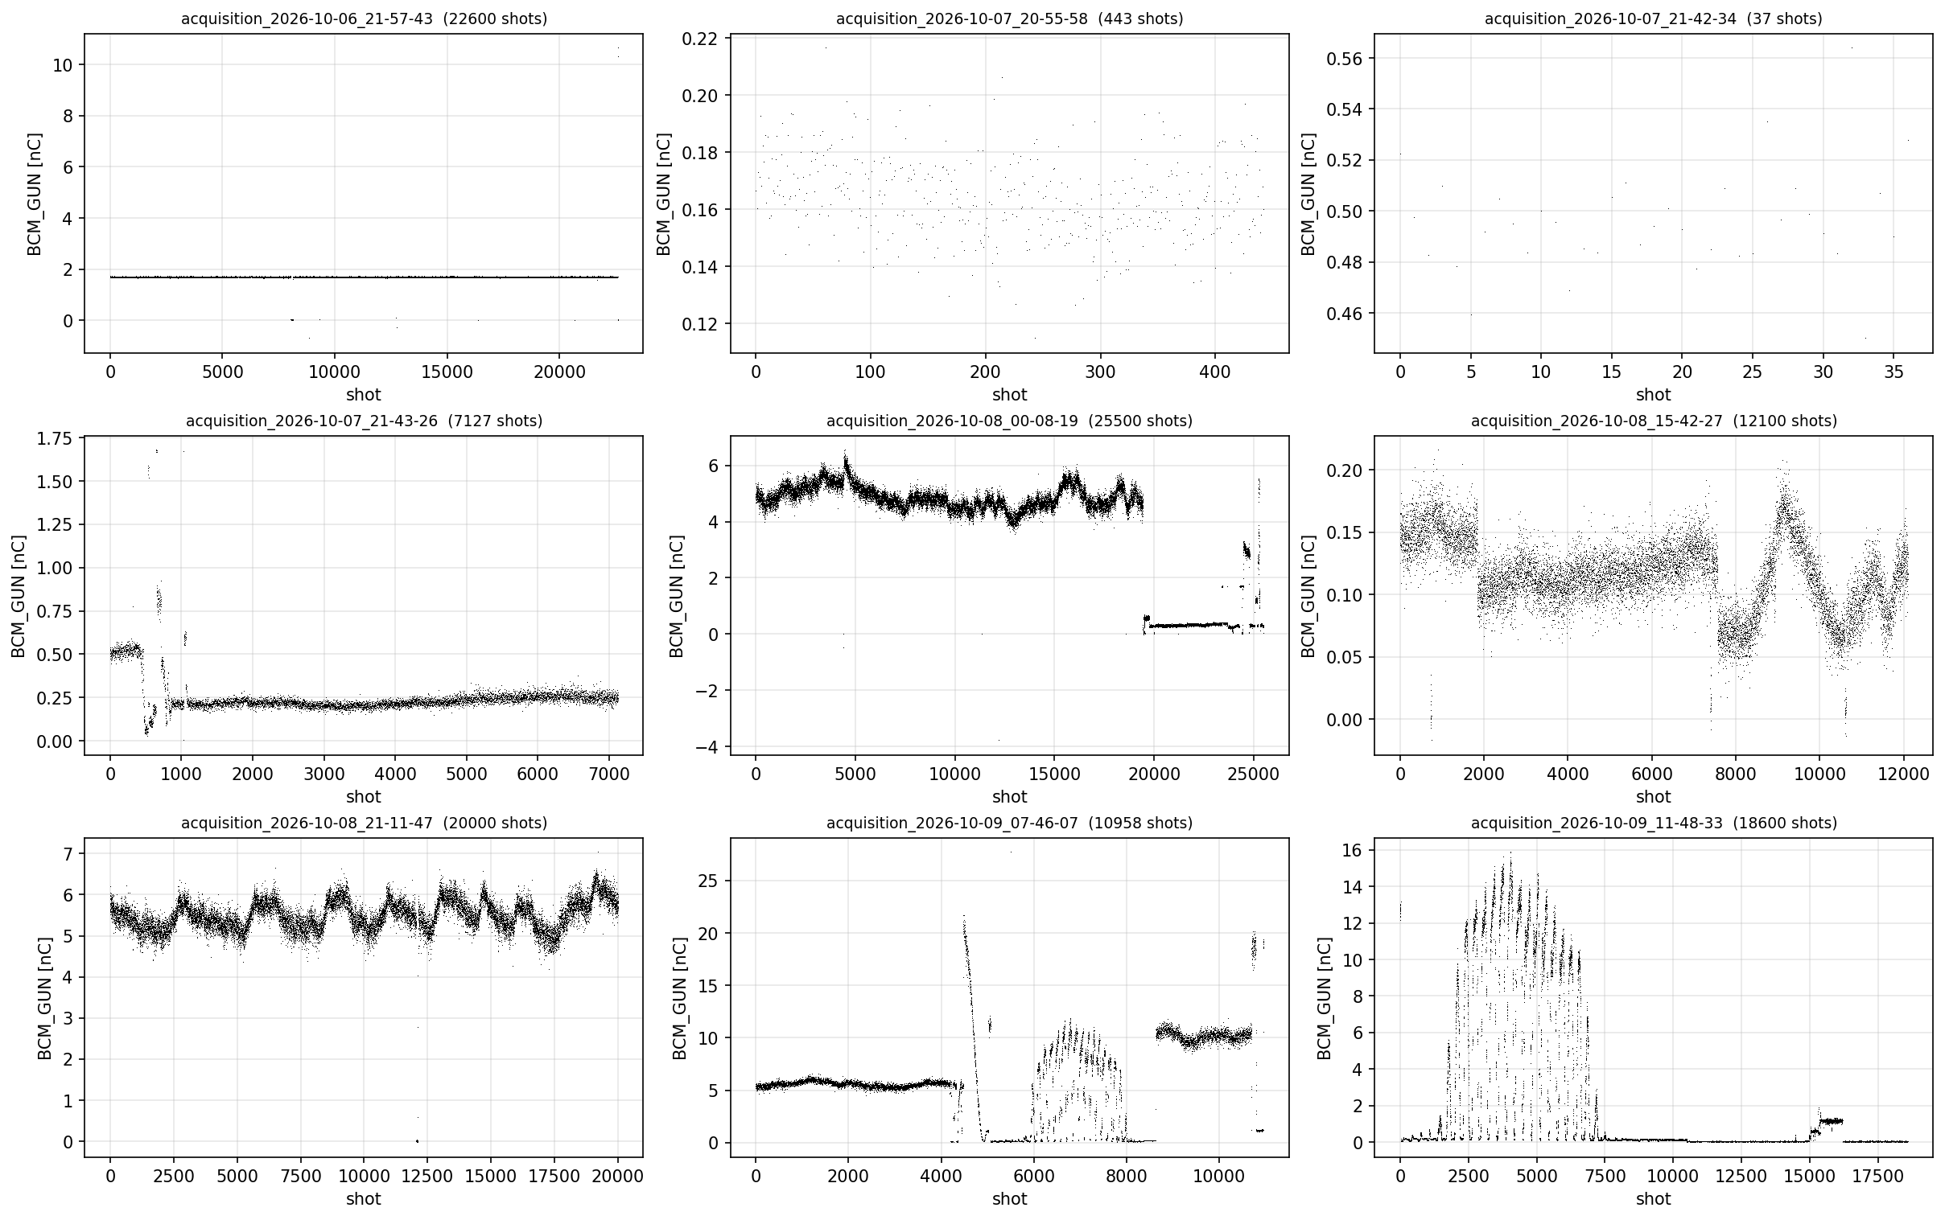

Slide 4
DATA STUDY
Scalar
  Magnets
  Laser power
Waveform
  RF
  Laser
Image
  Laser
Self correlation

