Slide 1
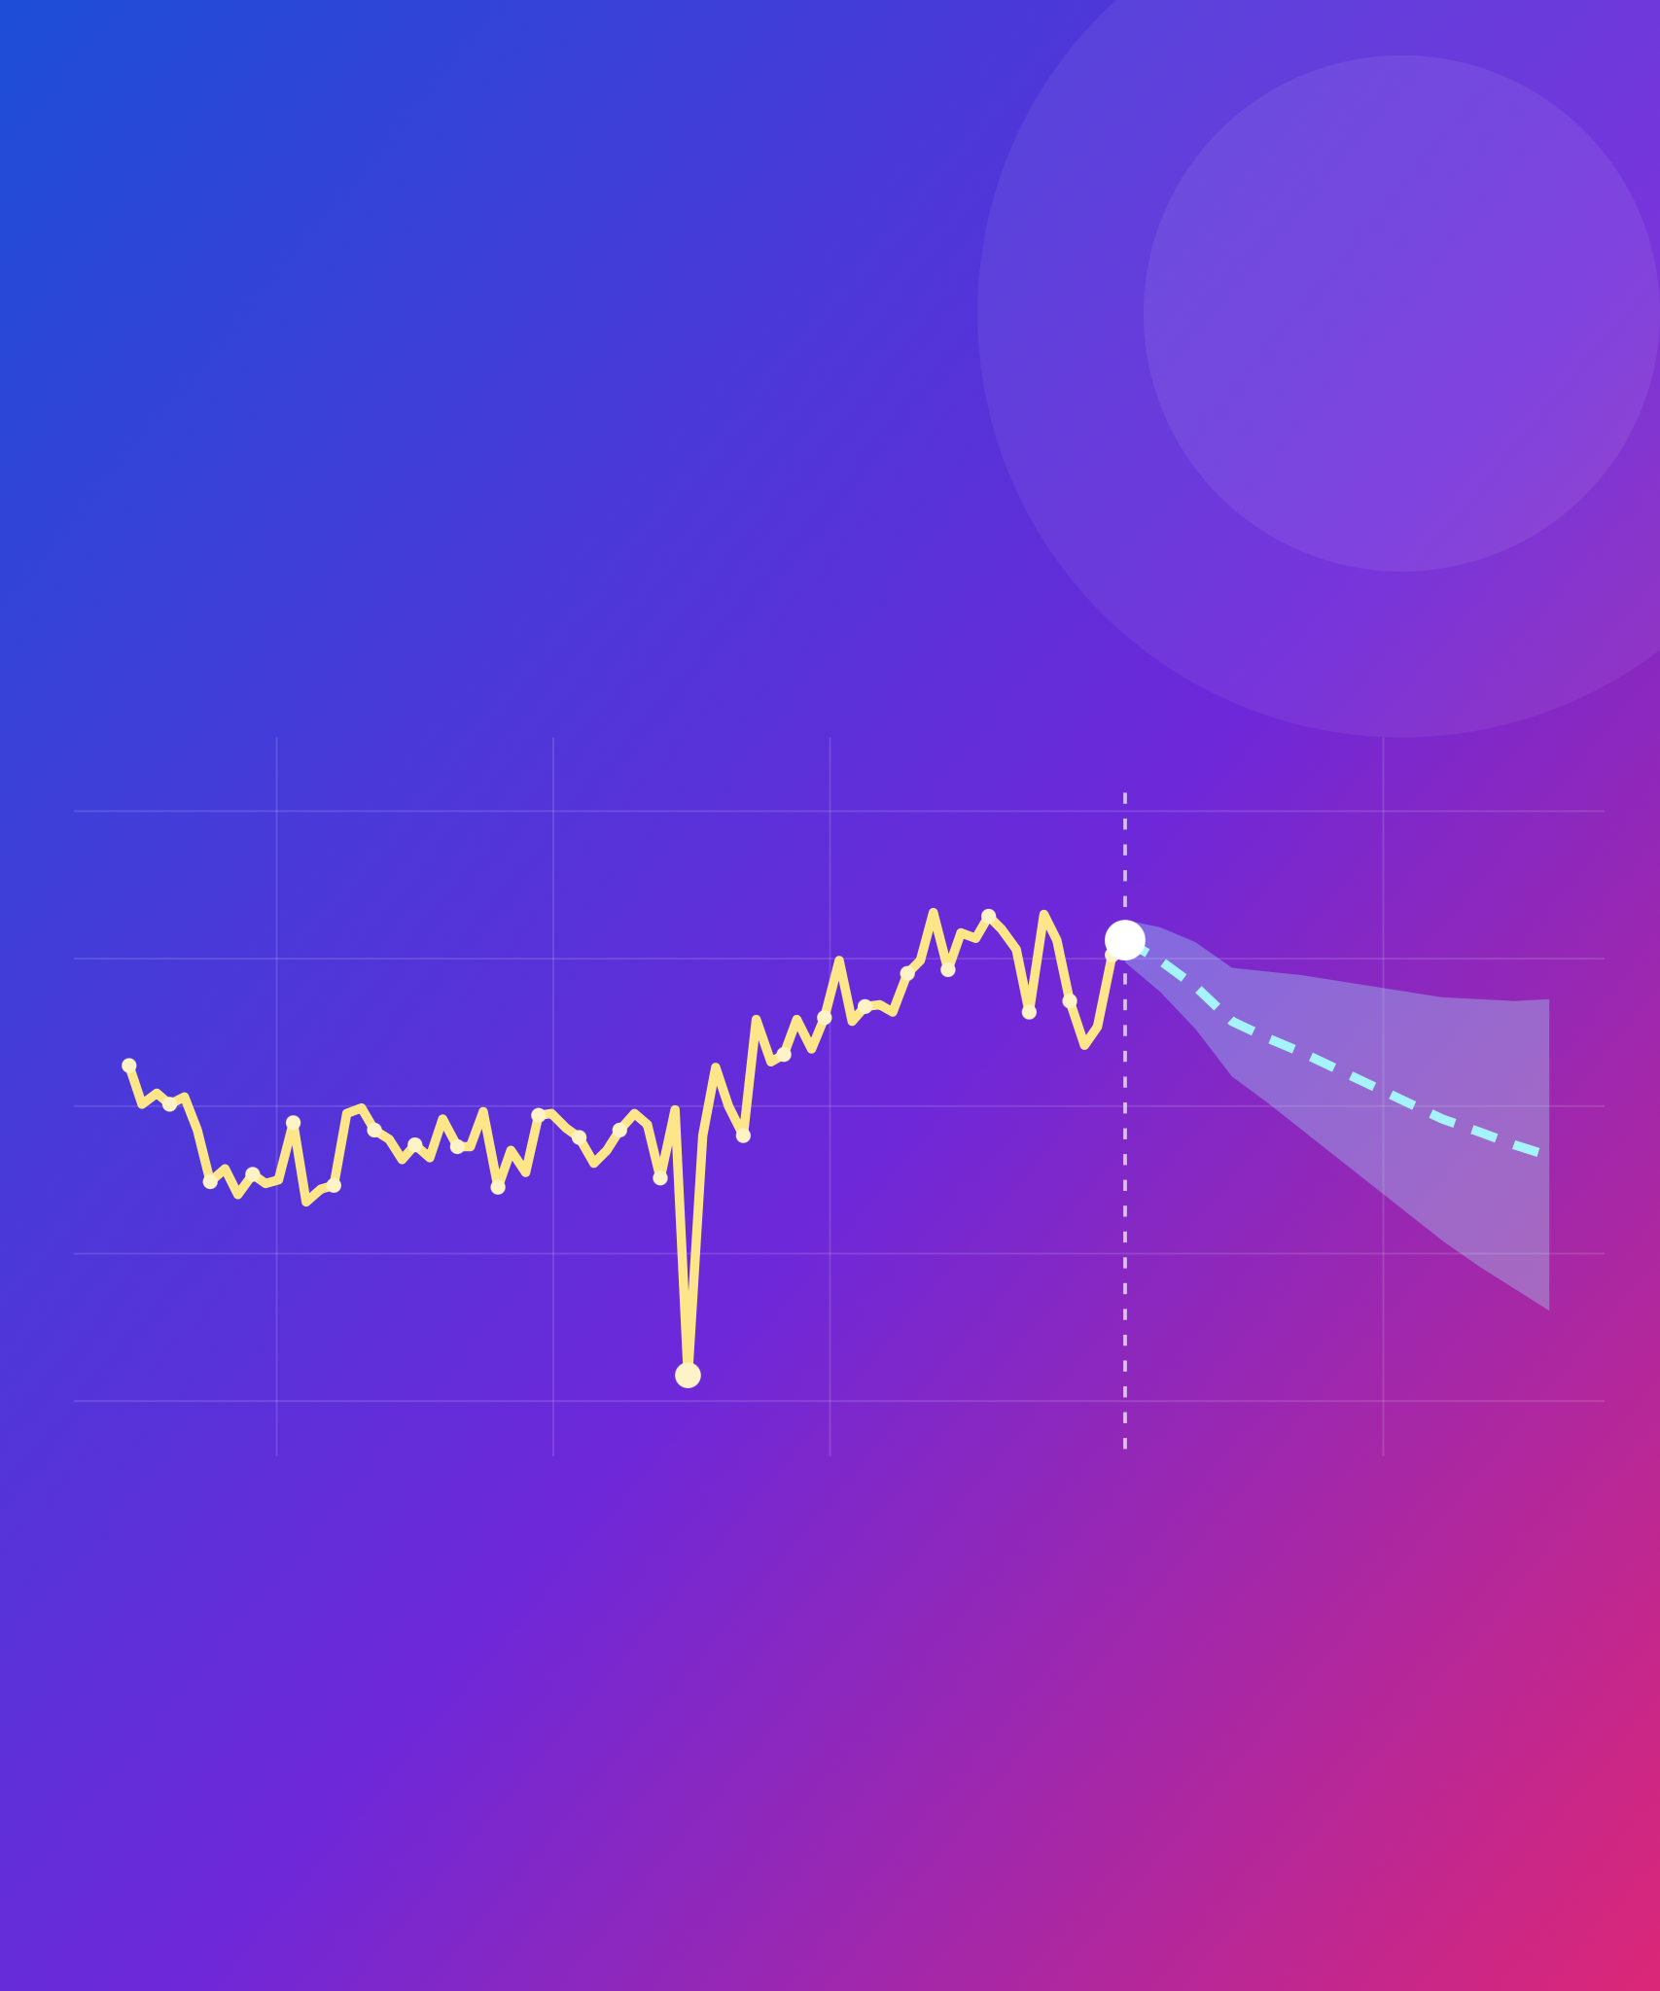
Forecasting the CLEAR beam charge
AISSAI ACCELERATOR HACKATHON 2026
OPTIMISATION CHALLENGE
now
forecast
How will the beam behave next, and can we see it coming?
dropout
Antonio Gilardi (Team Leader & Case Holder)
CERN · CLEAR · antonio.gilardi@cern.ch
past shots
Jan Jug
Quentin Bruant
Alex Brynes
Notes:
Welcome. This is the forecasting part of the optimisation challenge, on real data from CLEAR at CERN. The picture is the whole story: the beam charge jitters and drifts shot by shot, sometimes drops out, and the question is whether we can see where it goes next.

Slide 2
Three steps, one question
THE CHALLENGE
STEP 1 · EASY
STEP 2 · MEDIUM
STEP 3 · HARD
Understand
Virtual diagnostic
Forecast
raw run → clean table
Q[t] = f(X[t])
Q[t+1…t+H] = f(X[≤t], Q[≤t])
Clean, synchronise, rank every signal.
This shot's charge from this shot's signals.
The next shots' charge, from the past.
Close the loop with a controller g(x) on laser power or RF phase. Extremely promising results can earn real beam time on CLEAR.
THEN, OPTIONAL
11
Notes:
The parent challenge asks how to find the best settings. This one adds time: how will the beam behave next? Three steps, which are also the three tiers. First understand the data. Then a virtual diagnostic: the charge of a shot from the other signals of the same shot. Then forecasting: the charge of the next shot, or several shots ahead, from the past only. The long-term goal is to put the forecast inside a controller, which brings us back to optimisation. And if a team gets extremely promising results, we can ask for real beam time to test it on CLEAR.

Slide 3
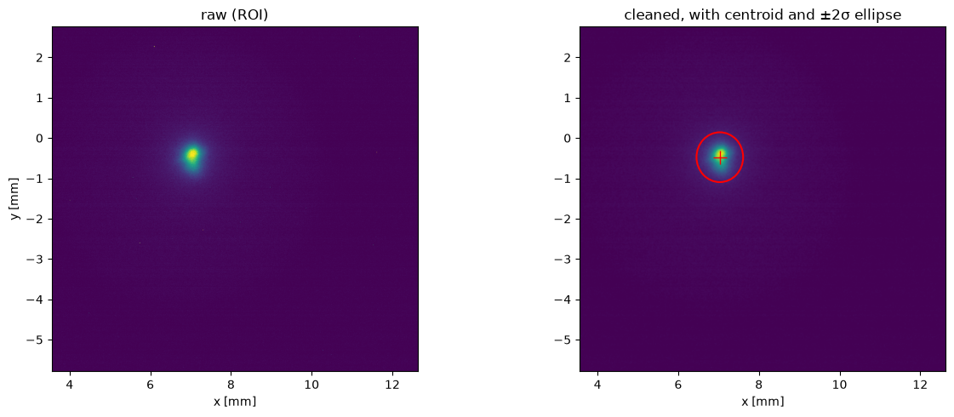
The data: 63k shots, 123 signals each
TIER 1 · EASY · RESULTS
October 2026 acquisitions reduced to one row per shot (HDF5, 100 shots per chunk).
9 runs, 1176 chunks, ~117k shots; 5 runs usable: 758 chunks, 136 GB
Per shot: BCM_GUN (target), lab + clex laser meters, laser scope trace (2002 samples, 50 ns)
BTV0125 virtual-cathode camera, 1216 × 1936 px
7 RF traces × 960 samples (gun PGIA/PGRA/PGLA/PGIP, klystron PKI15A/P, PKR15A), magnets, temperature, humidity
Machine pulses every 1.2 s, but the acquisition skips pulses: rows are 1.2, 2.4 or 3.6 s apart
Photoinjector laser pulse: raw (left) and cleaned (right)
20

Slide 4
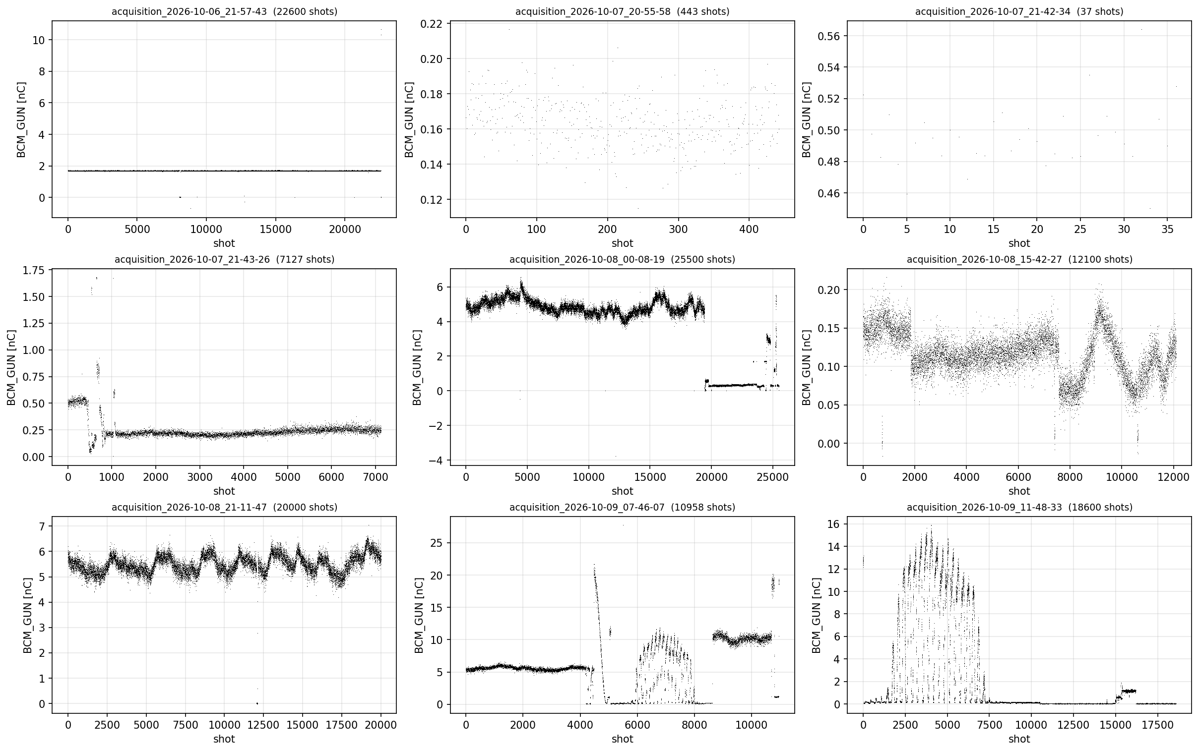
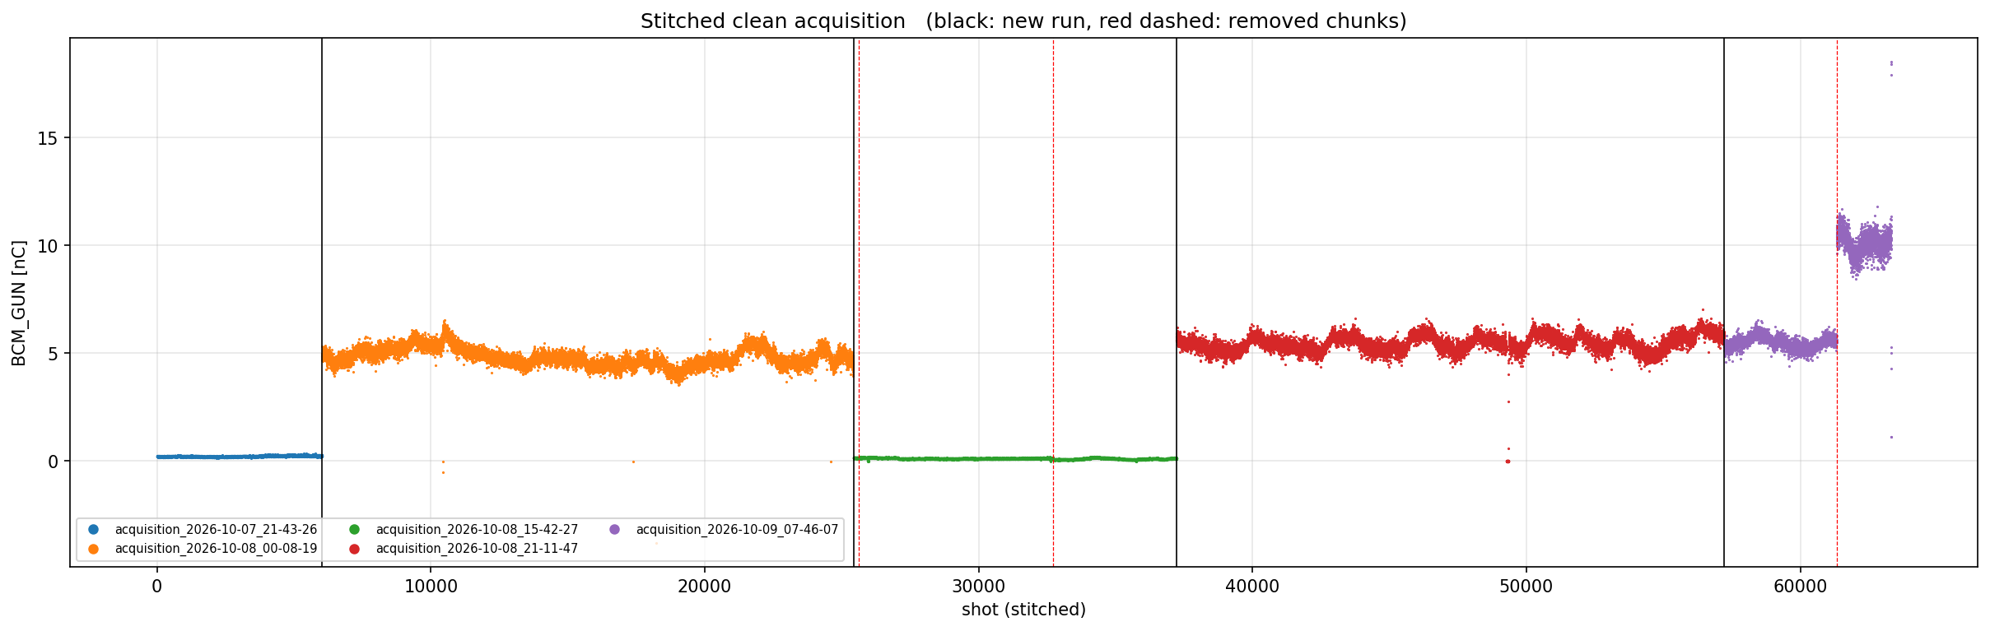
Run regimes, clean cuts and bad shots
TIER 1 · EASY · RESULTS
Every run was taken in different conditions.
Plateaus at 0.1, 0.22, 4.8, 5.5 and 10 nC, laser scans, and a BCM stuck at a 1.67 nC ceiling
Clean cuts by inspection: 634 chunks, 63,327 shots, 8 contiguous segments in 3 regimes:
  Low charge (0.1 - 0.5 nC)
  High charge (5 - 20 nC), relatively stable
  High charge (5 - 20 nC), periodic drifts
Flagged: frozen laser scope (repeats its trace on up to 20 % of shots) and frozen camera frames
The BCM itself is sometimes wrong while the PGLA beam-loading step still sees the charge
All useful datasets stitched together
All 9 datasets
21

Slide 5
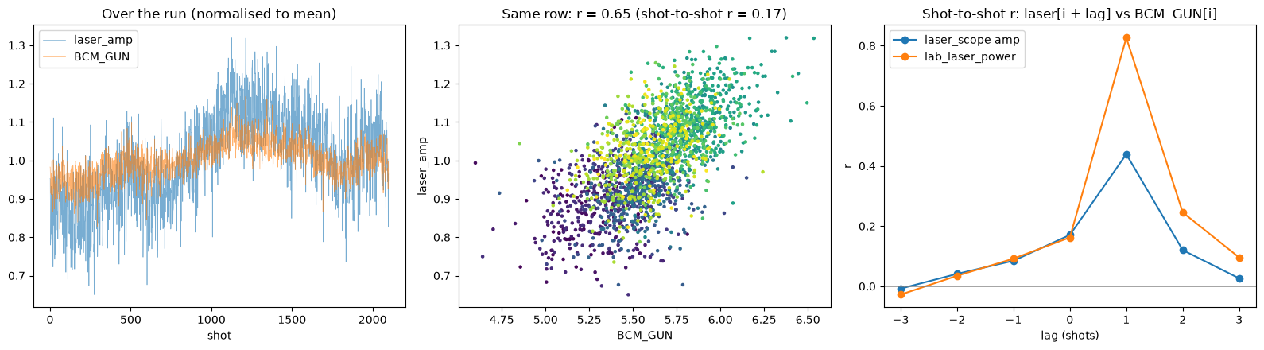
Synchronisation on the pulse grid
TIER 1 · EASY · RESULTS
Pulses are skipped, so a fixed one-row shift is wrong: readings go on the 1.2 s pulse grid.
Lag scans: lab laser vs charge r = 0.17 at lag 0, 0.83 at lag +1; camera peaks at lag 0
Laser meters hold the previous pulse when read < 2.2 s after the trigger
RF traces hold the pulse before the one their stamp names; the camera stamp is one pulse late on 15 % of shots
Aligned datasets (pulses.py, extract_features_aligned.py): readings of unrecorded pulses become NaN instead of a neighbour's value
Laser vs charge over a run, scatter, and the lag scan peaking at +1 row
ridge test R² (common rows) | seg 3 | seg 4 | seg 5 | seg 1 | seg 7
row-shifted datasets | 0.19 | 0.54 | 0.65 | 0.44 | 0.38
pulse-aligned datasets | 0.25 | 0.41 | 0.89 | 0.38 | 0.76
22

Slide 6
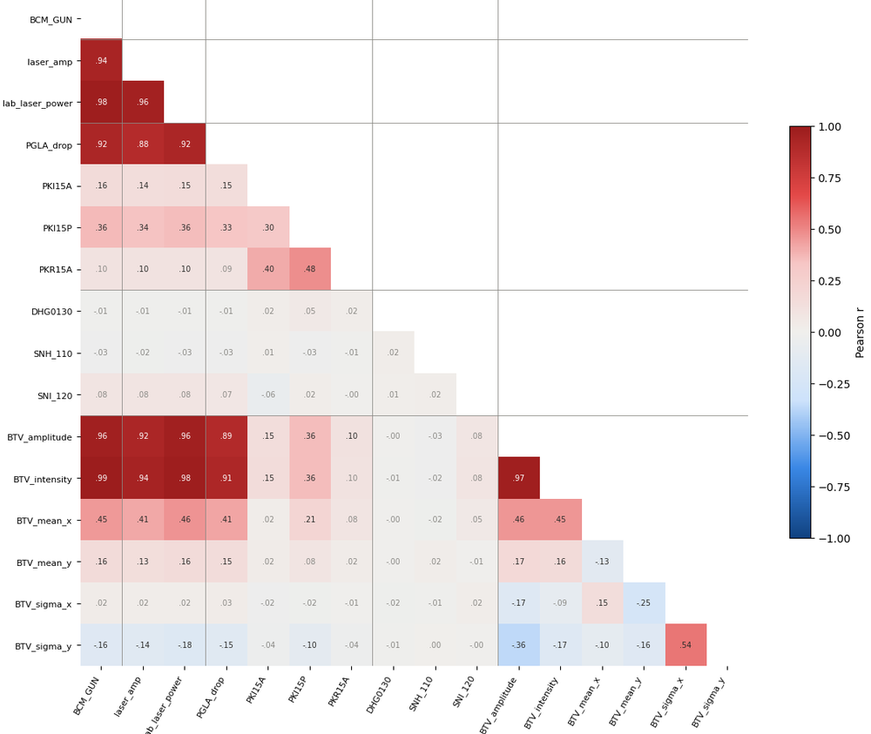
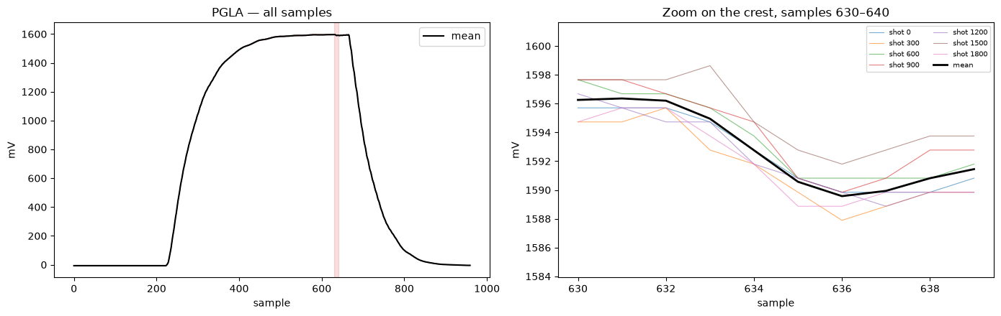
What correlates with the charge
TIER 1 · EASY · RESULTS
Pearson r of the shot-to-shot parts
Strongest: lab laser power, camera intensity (0.79), PCA PC3, laser scope amplitude
Klystron, magnets and climate: |r| < 0.1; ridge on all klystron samples has CV R² ≈ 0
PGLA beam-loading dip (~7 mV, samples 631→636) is linear in charge 0.3–10.4 nC: a second charge monitor
Charge is very persistent: "same as previous shot" R² = 0.96; shot-to-shot autocorrelation 0.67 at lag 1, 0 by lag 10
RF forward power. Left: full trace; Right: beam loading (peak-to-peak) could be used as proxy for bunch charge.
Pearson R between all variables in the dataset: BCM_GUN (leftmost column) is the target
23

Slide 7
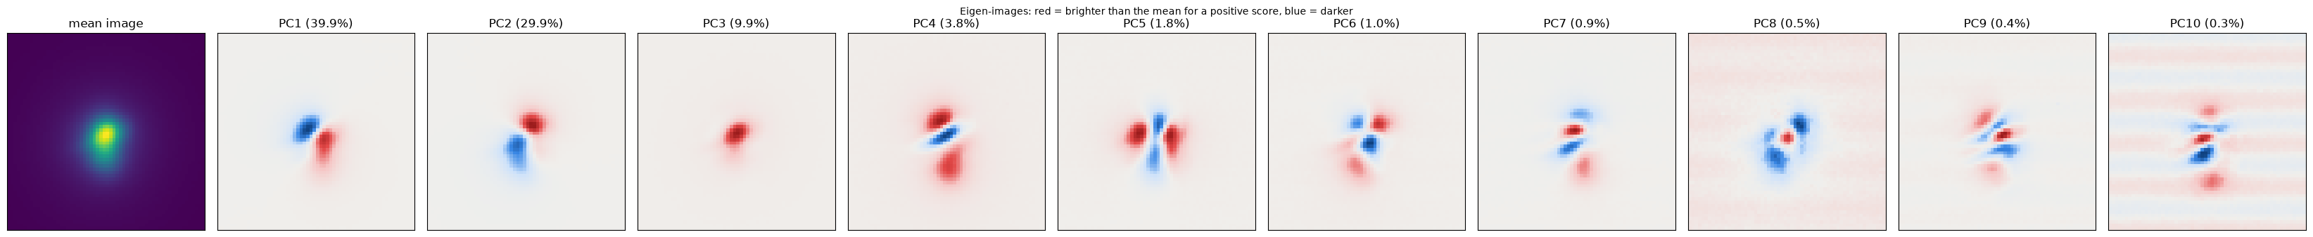
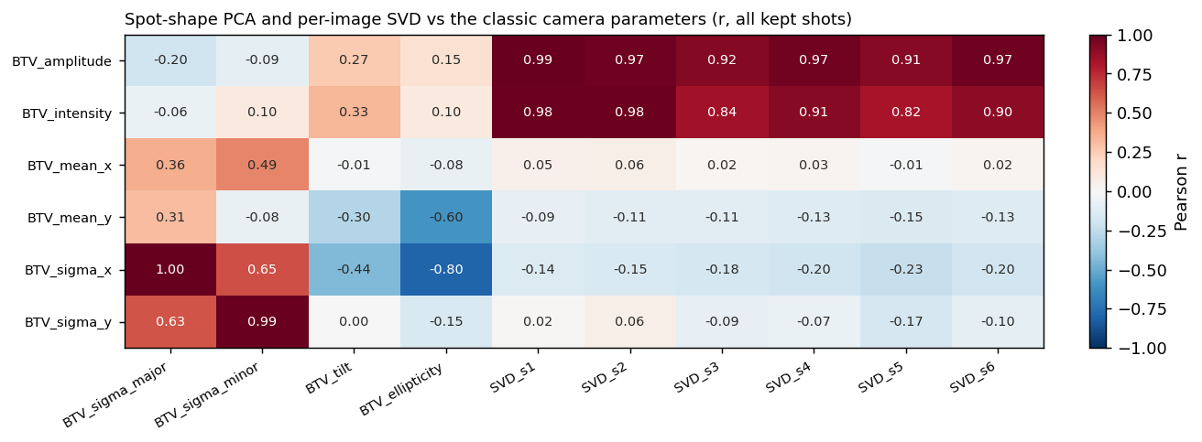
Camera features: PCA, SVD, autoencoder
TIER 1 · EASY · RESULTS
Beyond peak and integral: what in the laser spot image carries the charge.
Classic moments after ROI, background and median filter: intensity, centroid, sizes, tilt
PCA over all shots: PC1 81.5 %, 6 PCs 97.5 %; PC1–2 = centroid motion, PC3–4 = brightness and size
Per-image SVD: s1 ≈ brightness (r = 0.98 with intensity), no basis fitted across shots, so no leakage
Greedy selection keeps 10 features: lab laser, PGLA drop, SVD s1/s4–s6, camera intensity, PKI15A, tilt, x
CNN autoencoder (16-d latent) + LSTM on the latent sequence: prototype, no charge result yet
24

Slide 8
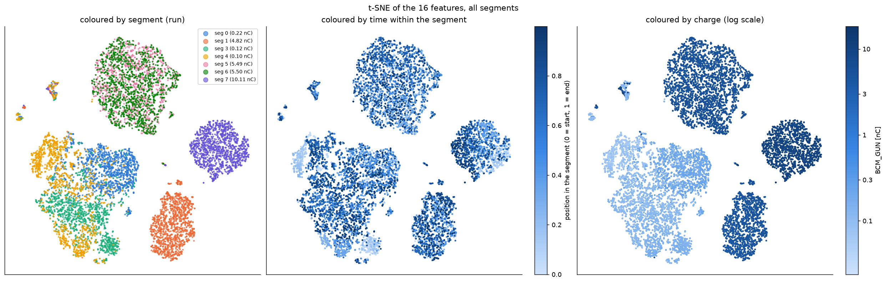
Structure across runs: t-SNE of the 16 features
TIER 1 · EASY · RESULTS
Shots cluster by run and charge level; the features themselves carry little memory.
Segments 5 and 6 (both ~5.5 nC) overlap, segment 7 (10 nC) sits apart, the low-charge segments merge
Predicting a feature from its previous shot: R² between −0.15 and 0.18, so the past adds little beyond the charge history
10,500 shots, coloured by segment, by time and by charge.
25

Slide 9
Virtual diagnostic
TIER 2 · MEDIUM
Examine the performance of various model and try with and without BCM_GUN in the loop
THE GOAL
Obtain good performance in the virtual diagnostic fashion.
Identify the right metric and try some basic model (ElasticNet, Random Forest, XGBoost and MLP).
Compare a linear model, a tree ensemble and a neural network
Show what drives each model
Cross-run: train on one run, test on another
Report how much the metrics change with different past history
Forecasting the CLEAR beam charge
26
Notes:
Medium is the virtual diagnostic: infer the charge of a shot from the other signals of that same shot, without using any charge. Compare at least a linear model, a tree ensemble and a neural network, and show what drives each one: does it agree with your correlation study? Then the interesting part: train on one run and test on another, across days or across regimes. How much does it degrade, and which features stop transferring?

Slide 10
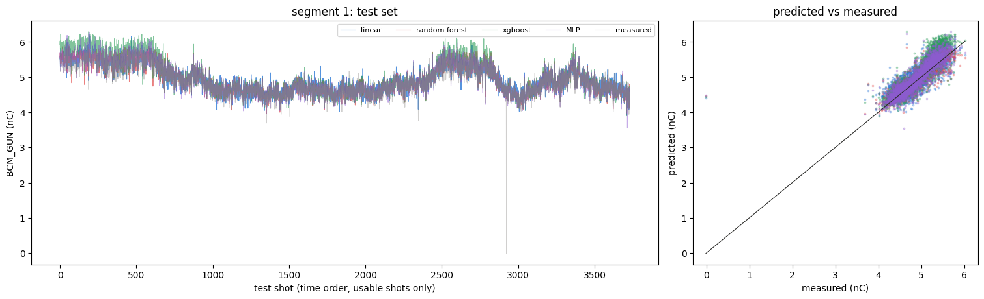
Model zoo without BCM history
TIER 2 · MEDIUM · RESULTS
Absolute charge from the same shot's inputs; per segment, chronological 80/20, shots with a camera frame.
MAE pC | seg 0 | seg 3 | seg 4 | seg 5 | seg 1 | seg 6 | seg 7
train mean | 35.1 | 14.5 | 18.2 | 384 | 306 | 167 | 428
linear | 13.4 | 11.0 | 9.5 | 143 | 167 | 47.8 | 278
random forest | 12.0 | 10.1 | 9.3 | 96 | 134 | 63.8 | 265
XGBoost | 16.8 | 10.7 | 9.2 | 91 | 185 | 57.2 | 247
MLP (32-16) | 11.2 | 9.9 | 9.6 | 86 | 141 | 50.4 | 211
MLP best on 4 of 7 segments (R² 0.91 on seg 5)
Trees cannot extrapolate beyond the training range (XGBoost 185 pC on seg 1)
A never-seen segment is off by 12–60 %; refitting only its intercept fixes it: the slopes transfer
Forecasting the CLEAR beam charge
27

Slide 11
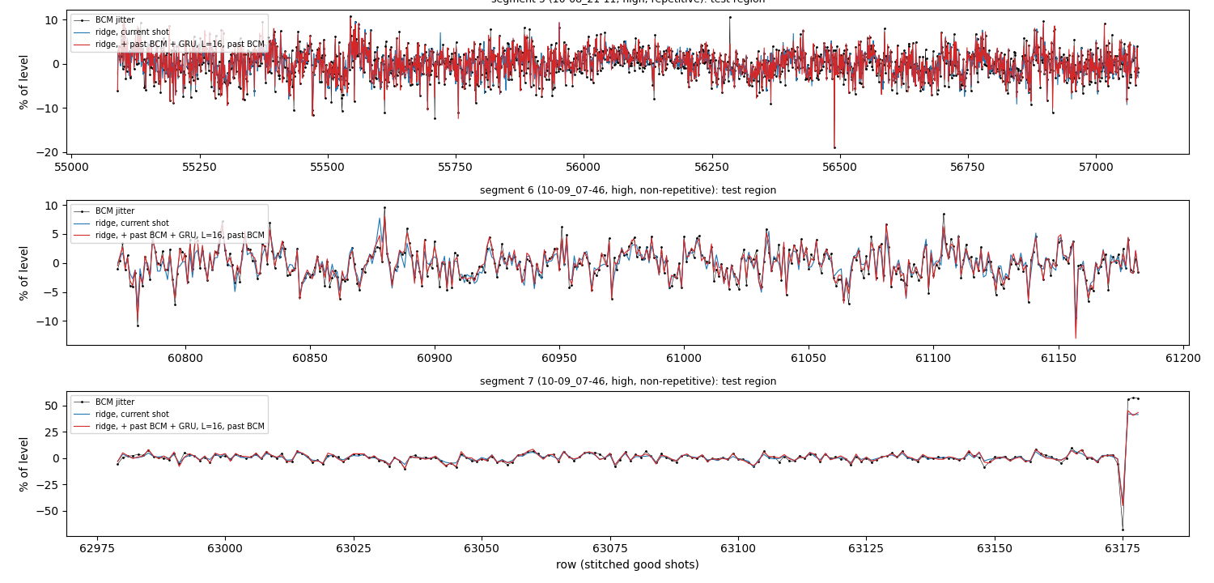
Slow level + shot-to-shot model
TIER 2 · MEDIUM · RESULTS
Target: log charge minus the trailing 50-shot mean; one model per regime; test = last 10 %.
MAE pC | seg 0 | seg 3 | seg 4 | seg 5 | seg 1 | seg 6 | seg 7
trailing level only | 18.2 | 12.4 | 11.7 | 145.5 | 143.3 | 122.2 | 428.1
ridge, current shot | 10.0 | 9.4 | 8.9 | 69.5 | 84.6 | 57.0 | 174.4
GRU, window 16 | 9.1 | 9.2 | 8.1 | 42.1 | 47.2 | 31.2 | 226.3
ridge + past BCM + GRU (64) | 9.2 | 9.1 | 8.1 | 40.8 | 45.7 | 31.0 | 147.0
+ online refit | 9.1 | 9.2 | 8.1 | 40.7 | 45.8 | 27.8 | 133.2
BCM noise rms (floor) | 11.7 | 11.8 | 11.0 | 40 | 57 | 34 | 73
GRU halves the ridge error at high charge; the gain is the nonlinearity, not memory (window 1 ≈ 64)
Ridge under the GRU keeps extrapolating on seg 7's jump to 18 nC (226 → 147 pC)
Cross-run: trained on the other runs only, within 0–10 % of pooled training
Forecasting the CLEAR beam charge
28

Slide 12
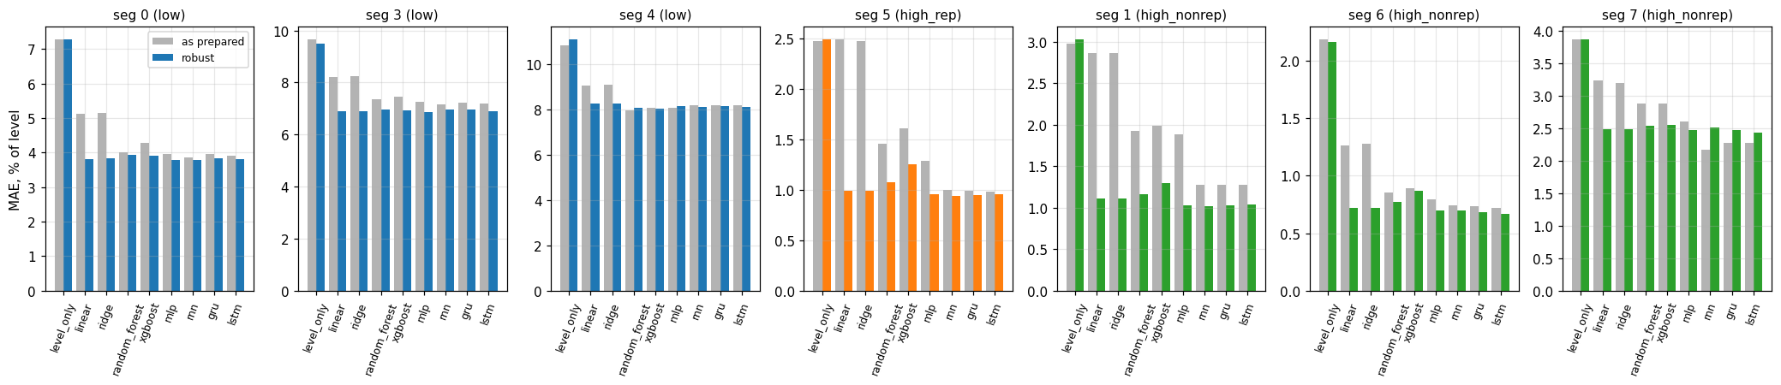
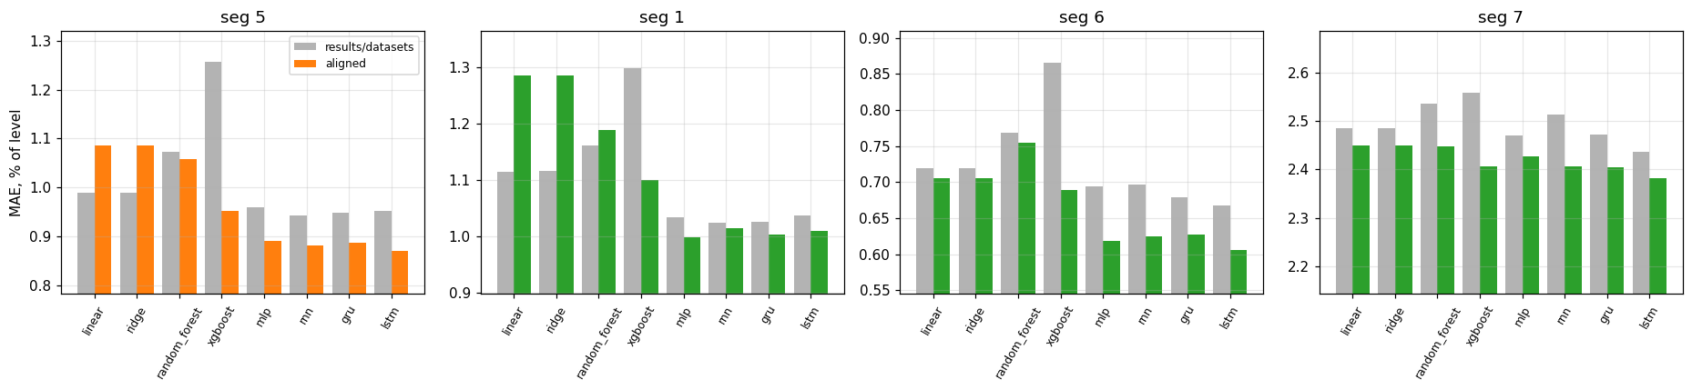
Nine model families converge
TIER 2 · MEDIUM · RESULTS
Linear, ridge, random forest, XGBoost, MLP, RNN, GRU, LSTM, sparse GP and ensembles; MAE in % of the level.
Outlier-robust preparation brings all families within ~10 %: squared-loss models were chasing camera spikes (seg 1 ridge 2.86 → 1.12 %)
Pulse alignment helps the nonlinear models: XGBoost seg 5 1.26 → 0.95 %, best LSTM 0.87 %; GRU / GP beat ridge by 11–22 % at high charge
Ensembles match the best single model; stacking does not help
Forecasting the CLEAR beam charge
29

Slide 13
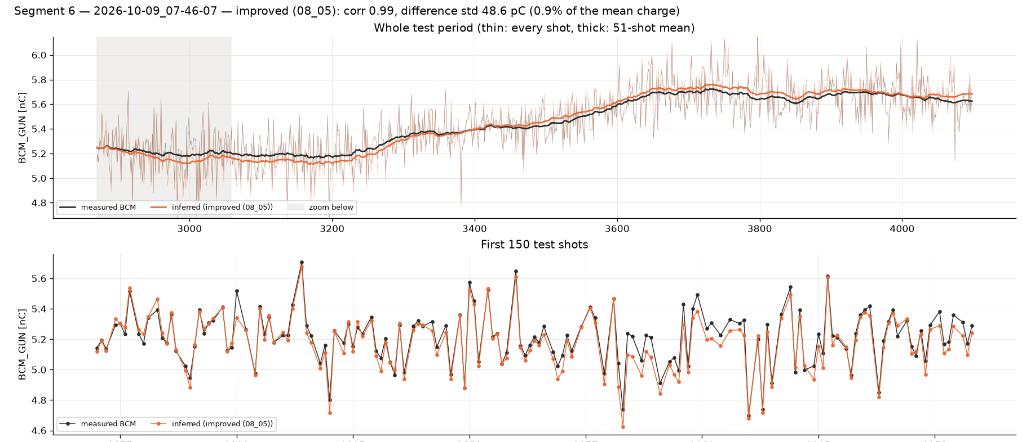
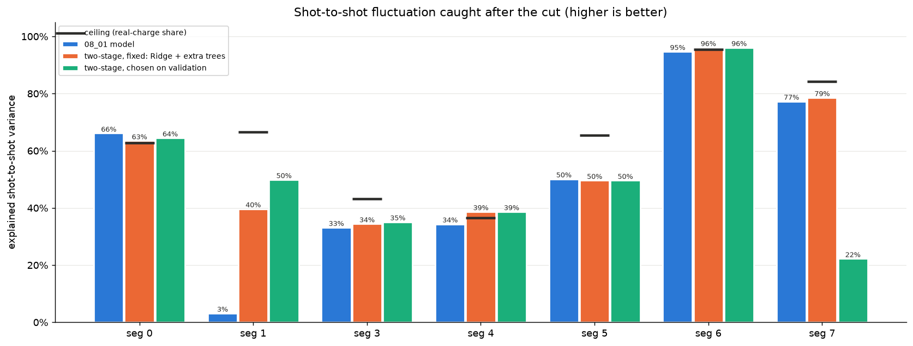
BCM lost for good: cut at 70 % of each segment
TIER 2 · MEDIUM · RESULTS
Train before the cut, infer after it with no BCM at all: trend from recent shots + MLP on the shot-to-shot part.
MAE pC | seg 0 | seg 3 | seg 4 | seg 5 | seg 1 | seg 6 | seg 7
Ridge + HGB trend | 11.8 | 9.1 | 9.0 | 85.2 | 186 | 42.5 | 163
trend + MLP (CCC loss) ×6 | 11.1 | 8.9 | 9.9 | 83.5 | 101 | 39.3 | 146
physics-constrained | 12.1 | 9.1 | 10.1 | 96.3 | 107 | 39.5 | 143
TCN trend (1-D conv) | 17.4 | 9.0 | 10.4 | 85.8 | 113 | 44.4 | 161
pretrained + fine-tuned | 11.0 | 9.3 | 9.4 | 82.3 | 102 | 36.0 | 139
Concordance (CCC) loss restores the fluctuation size: ~90 % of it vs 55–65 % with MSE
Seg 6: correlation 0.99, difference std 48.6 pC (0.9 %)
Monotonic physics constraint removes "more laser → less charge" violations
Forecasting the CLEAR beam charge
30

Slide 14
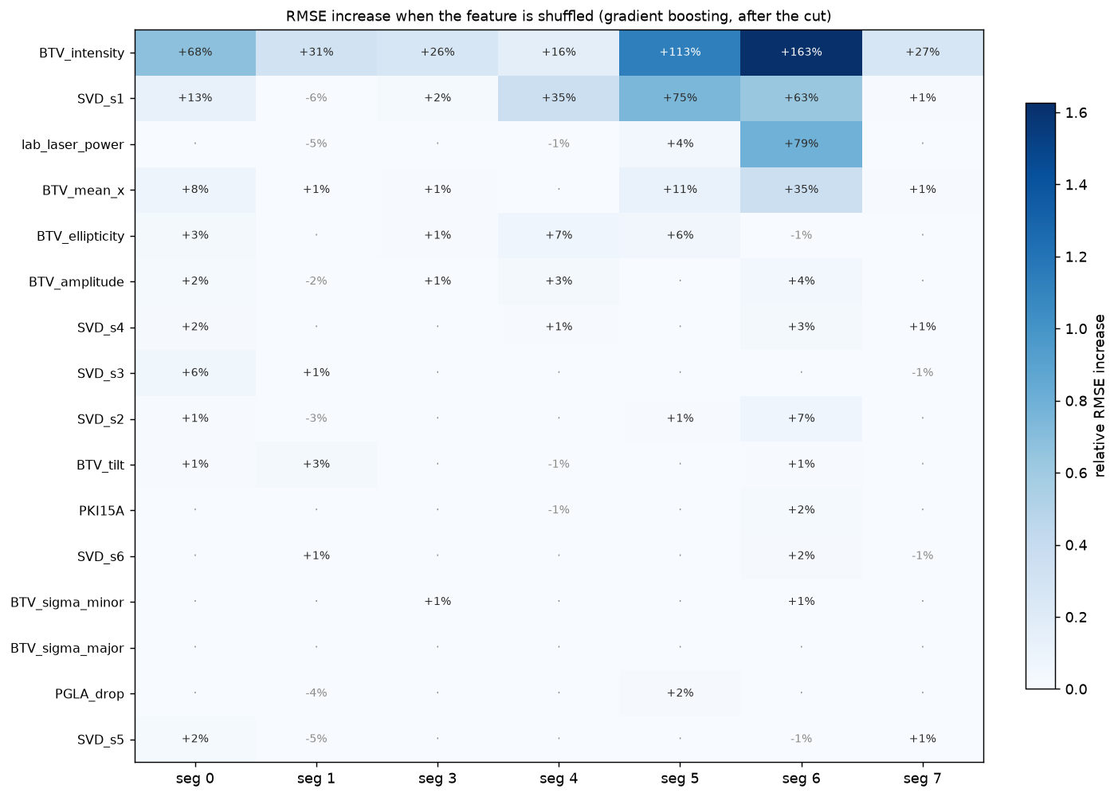
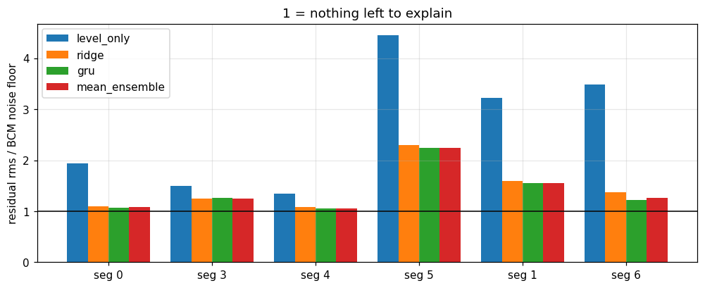
Drivers and the noise floor
TIER 2 · MEDIUM · RESULTS
Feature importance and the distance to the BCM's own noise.
Camera intensity carries most of it: shuffling it costs +16 to +163 % RMSE; then SVD s1, lab laser (high charge), clex (low charge)
Laser pulse shape and RF add < 1.2 points
BCM noise measured with a three-cornered hat: σ² = (10.7 pC)² + (0.72 % Q)²
Best models are at the noise floor on segs 0, 4, 6 and 1.3–2× above it on segs 1, 3, 5
Missing camera frames (~18 % at high charge) triple the error: the largest errors come from them
Forecasting the CLEAR beam charge
31

Slide 15
Forecasting
TIER 3 · HARD
Repeat what done for virtual diagnostic in a more complex scenario
THE GOAL
Identify the right metric and try some basic model
Beat the rolling mean
Deploy in the machine the model
One step ahead, then up to 50 shots
At least one sequence model: TFT, DeepAR, LSTM/GRU or a time-series foundation model
Tune the context window and show its effect
Forecasting the CLEAR beam charge
32
Notes:
Hard is forecasting: predict the charge of future shots from everything known up to now. First beat the rolling mean, which is not trivial. Then beat the notebook's XGBoost on lag features. Go multi-step and find the horizon where your model stops beating the rolling mean. Use at least one model built for sequences. And tell us where the forecast comes from: the charge's own history, or the machine.

Slide 16
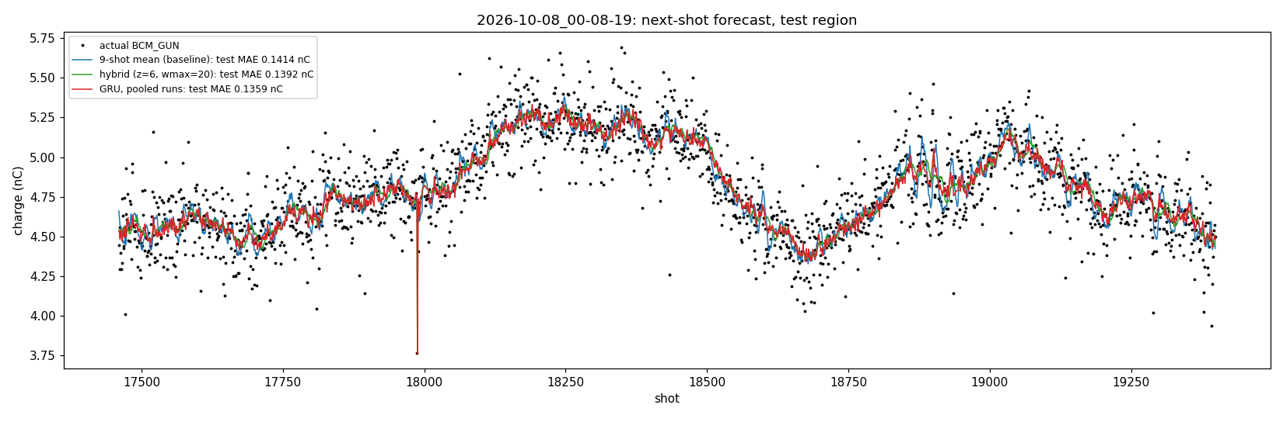
Next shot: beating the rolling mean of 9
TIER 3 · HARD · RESULTS
Charge of shot n+1 from everything up to shot n; last 10 % of each run.
MAE vs 9-shot mean | run 1 (10 nC) | run 2 (5.5) | run 3 (4.8) | run 4 (0.2) | run 5 (0.1)
9-shot mean (nC) | 0.343 | 0.144 | 0.141 | 0.0195 | 0.0122
hybrid level | −8.0 % | −1.9 % | −1.6 % | −1.7 % | −2.5 %
GRU, pooled runs | −9.2 % | −3.0 % | −3.9 % | −4.6 % | −3.3 %
GRU, other runs only | −8.8 % | −2.3 % | −3.1 % | −4.8 % | −3.6 %
GRU gain significant on all 5 runs (block bootstrap); persistence is 25 % worse
Run 1's gain is mostly its final level jump (3.6 % on its stable shots)
Context window 8–256 shots: ≤ 1.3 pC difference; laser and other inputs add nothing
33

Slide 17
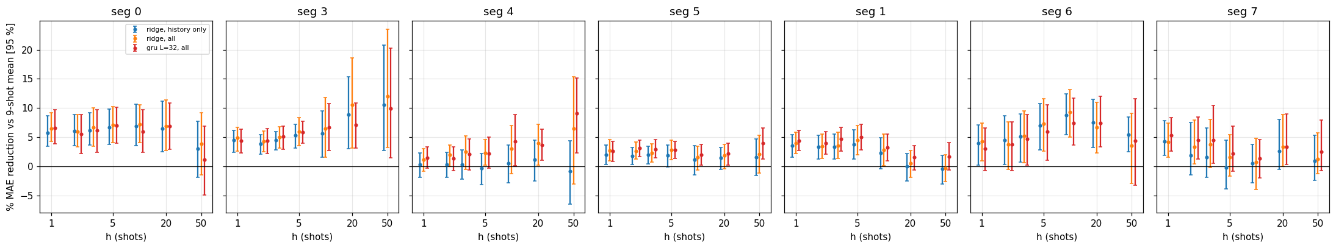
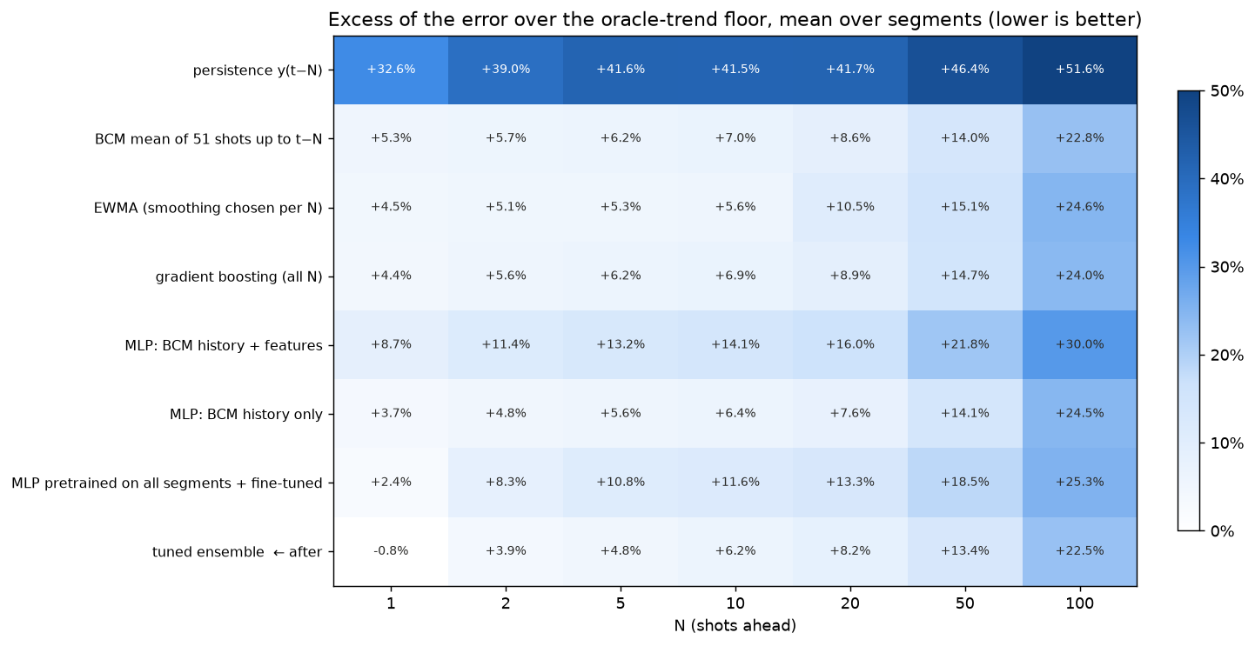
Further ahead, smaller gains
TIER 3 · HARD · RESULTS
Multi-step forecasts against the 9-shot mean and the oracle-trend floor.
h = 1–5: 1.5–7 % better than the 9-shot mean, significant on 5–7 of 7 segments; h = 50 mostly not
Ensemble at the floor up to N ≈ 2, +6 % at N = 10, +22 % at N = 100
Instruments add ~0.5–1 point: the next laser pulse is not predictable (R² ≤ 0.35)
34

Slide 18
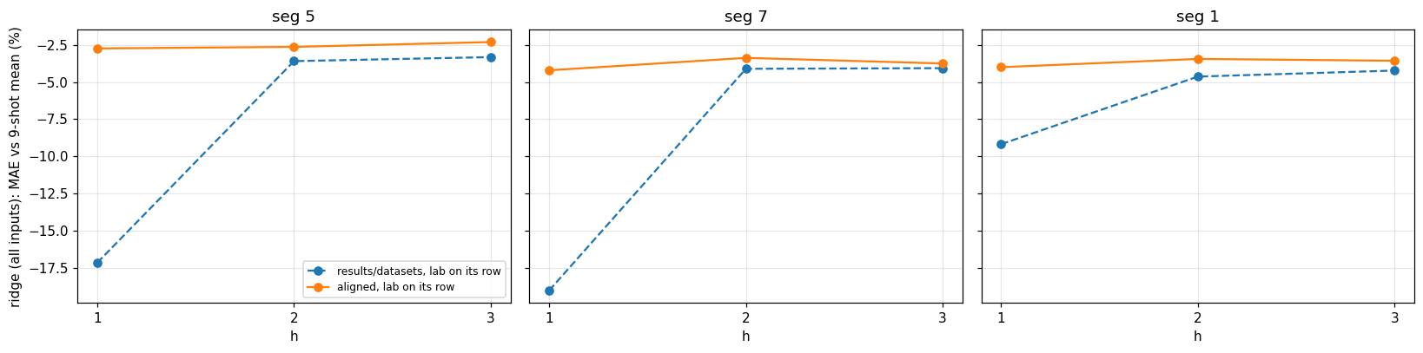
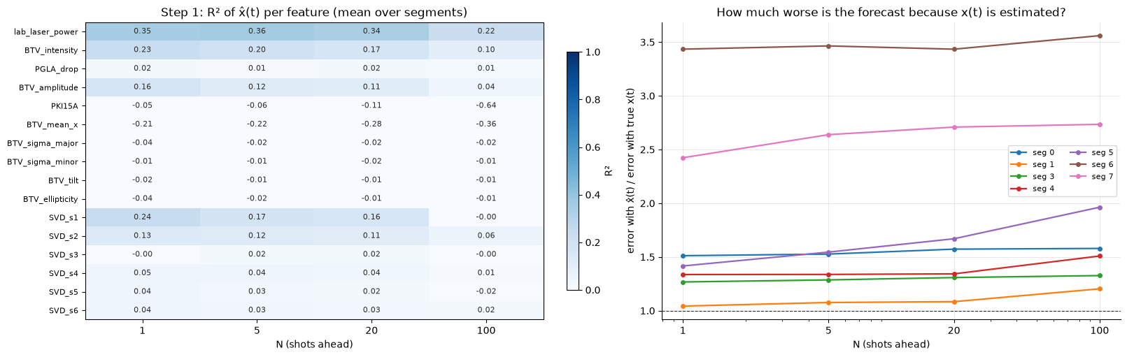
Pitfall: a fake gain from misaligned data
TIER 3 · HARD · RESULTS
With the laser meter on the wrong row, the "forecast" sees the future.
Row-shifted datasets: h = 1 gain of −17 to −19 % vs the 9-shot mean
Pulse-aligned: −3 to −4 %, flat over horizon
Two-step model (past → present features → charge) no better than the 51-shot mean: present features cannot be forecast
Lesson: check every variable's lag on the pulse grid before trusting a gain
35

Slide 19
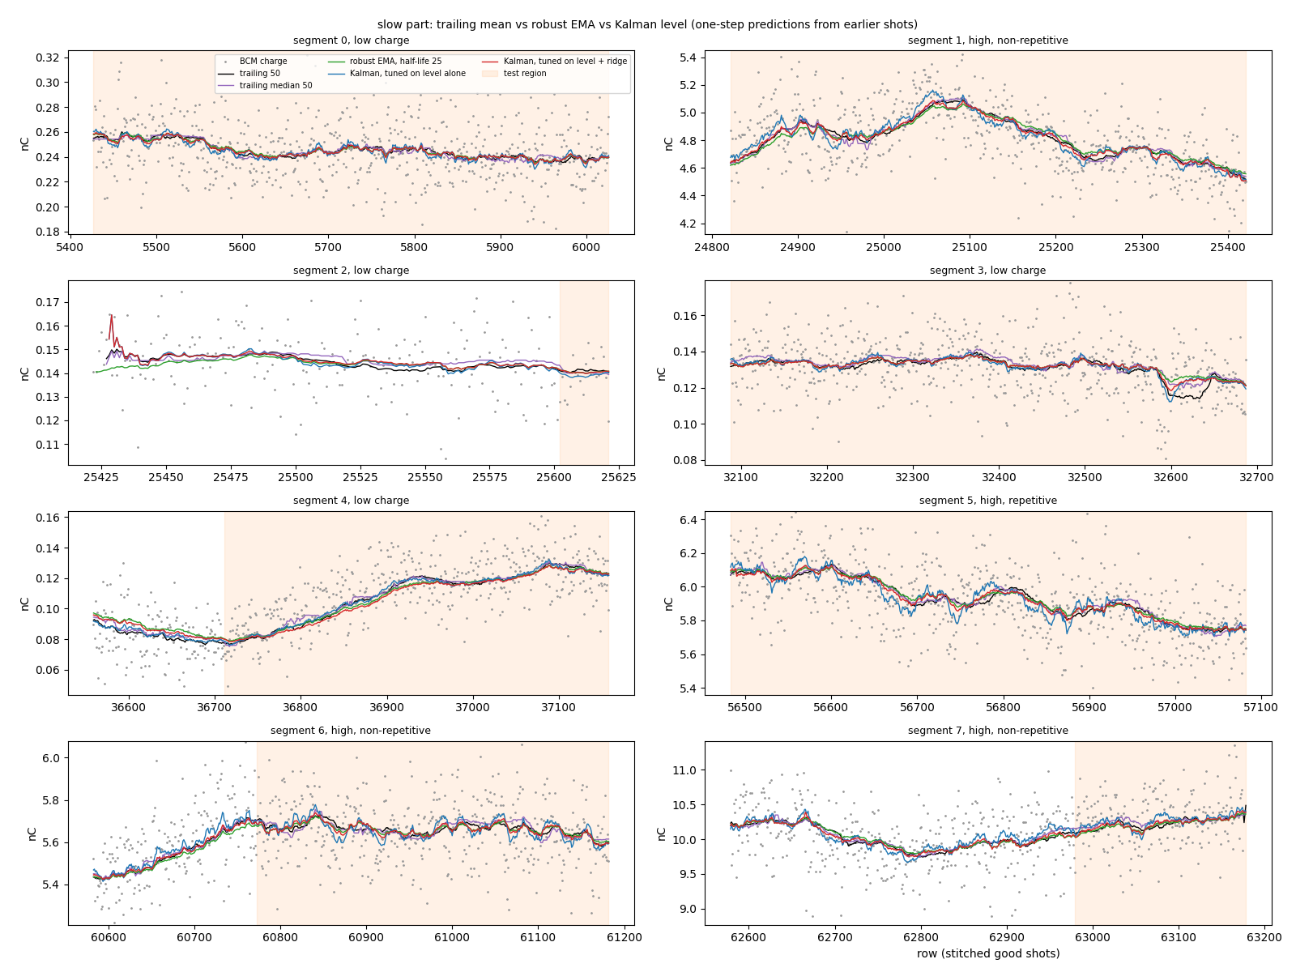
Filtering the slow level: simple wins
TIER 3 · HARD · RESULTS
Trailing mean vs median vs robust EMA vs Kalman level filter, with and without a ridge on top.
MAE pC, + ridge | seg 3 | seg 5 | seg 1 | seg 6
trailing mean 50 | 9.4 | 69.5 | 84.6 | 57.0
trailing median 50 | 9.2 | 71.2 | 84.6 | 59.0
robust EMA (half-life 25) | 9.2 | 72.5 | 88.0 | 56.9
Kalman level | 9.2 | 72.1 | 85.6 | 57.3
Kalman tuned on the level alone is the best level (seg 5: 140.5 vs 145.5 pC) but absorbs predictable jitter
Spectrum: no lines, residual white; only seg 3 has a slow drift the trailing mean misses
Online refit after every shot: −22 to −43 % on the ridge, seg 6 31 → 28 pC on the best model
36

Slide 20
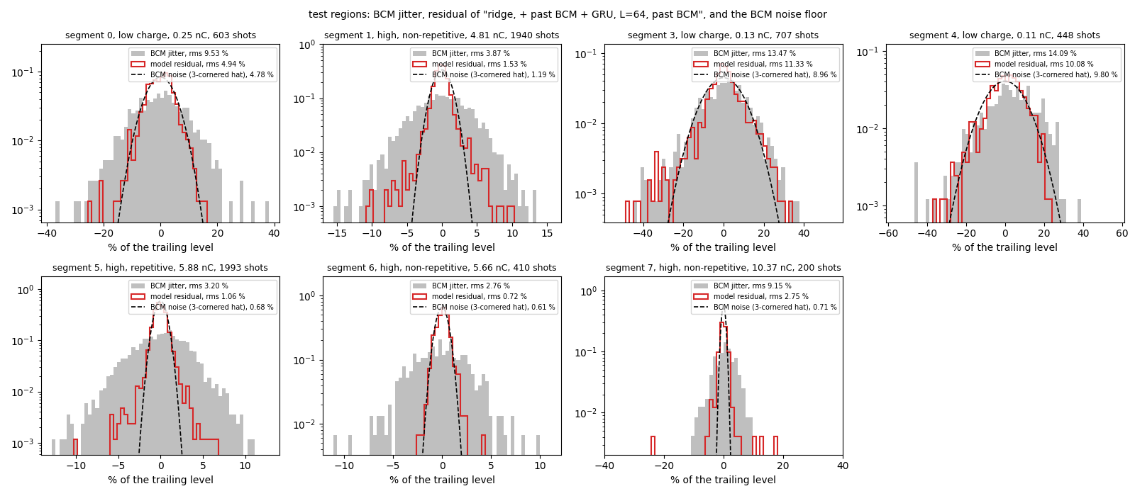
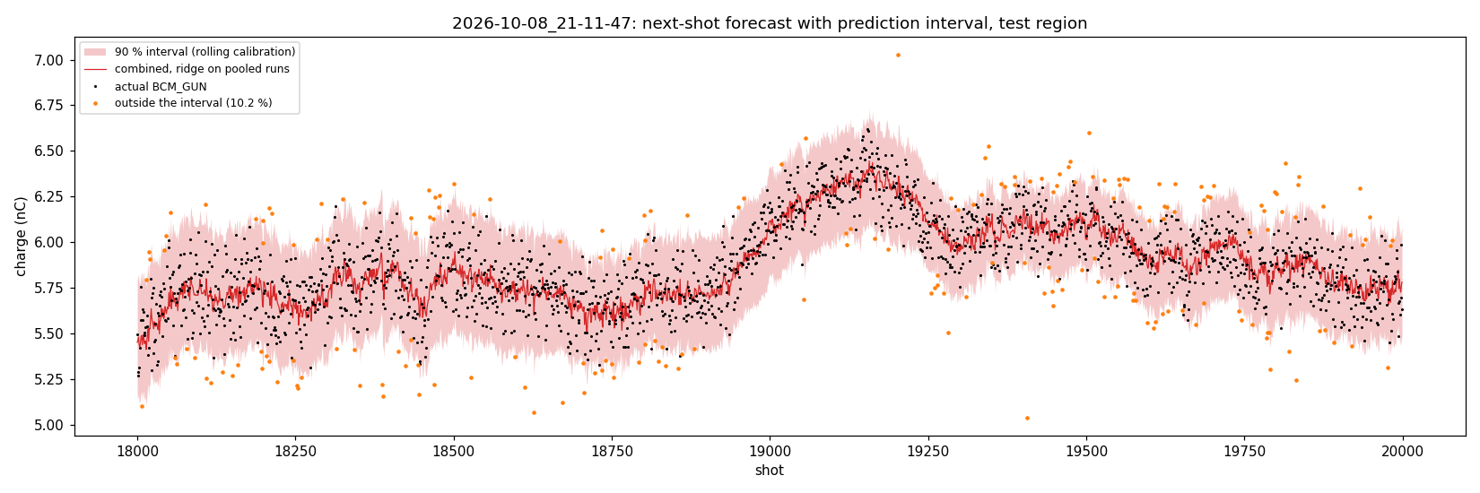
How low can it go: noise floor and uncertainty
TIER 3 · HARD · RESULTS
The BCM's own noise sets the floor; prediction intervals checked on the test region.
BCM noise: white, Gaussian core with heavy tails (0.2–1.5 % beyond 4σ); ~50 % of the jitter at low charge
Rolling 90 % interval covers 87–92 % (±5–7 % at 5–10 nC)
GP with the measured noise as its kernel noise: no better MAE, right intervals once missing camera frames get extra variance (86–95 %)
Minimax (max-error) training does not reduce the worst error
37

Slide 21
Summary: what worked and what did not
TIER 3 · HARD · RESULTS
Worked
Pulse-grid alignment of every reading
Slow + fast split: trailing level + GRU, at the noise floor on 3 segments
Beating the 9-shot mean on every run (−2 to −9 %)
Measured BCM noise for honest intervals
Did not help
Kalman / EMA / median levels, periodic terms
Forecasting the instruments (two-step models)
Attention, autoencoders, minimax training
RF, climate and magnet inputs
38

Slide 22






Same rules
SCORING
Chronological split
Metric in nC
Dropouts not scored
Test on the last 10 % of each run. No shuffling; fit everything on the first 90 %.
Try different and understand their physical meaning.
Charge below 30 % of the local median.
Decomposition
Forecasts
Ranking
Careful in the approach to be sure to be leakless
Complex problem try feature engineering
Try different model and rank them by performance
39
Notes:
The rules are fixed in score.py, so every team is scored the same way. The split is chronological: the last 10 % of each run is the test region, and nothing is shuffled. The score is MAE in nanocoulombs. Charge dropouts are not scored, but shots with a device flag are, because their charge is real. Report every scored run, not your best one. For forecasting, also report the gain over the rolling mean. Ranking is the highest tier with a bar beaten, ties broken by that tier's MAE.

Slide 23
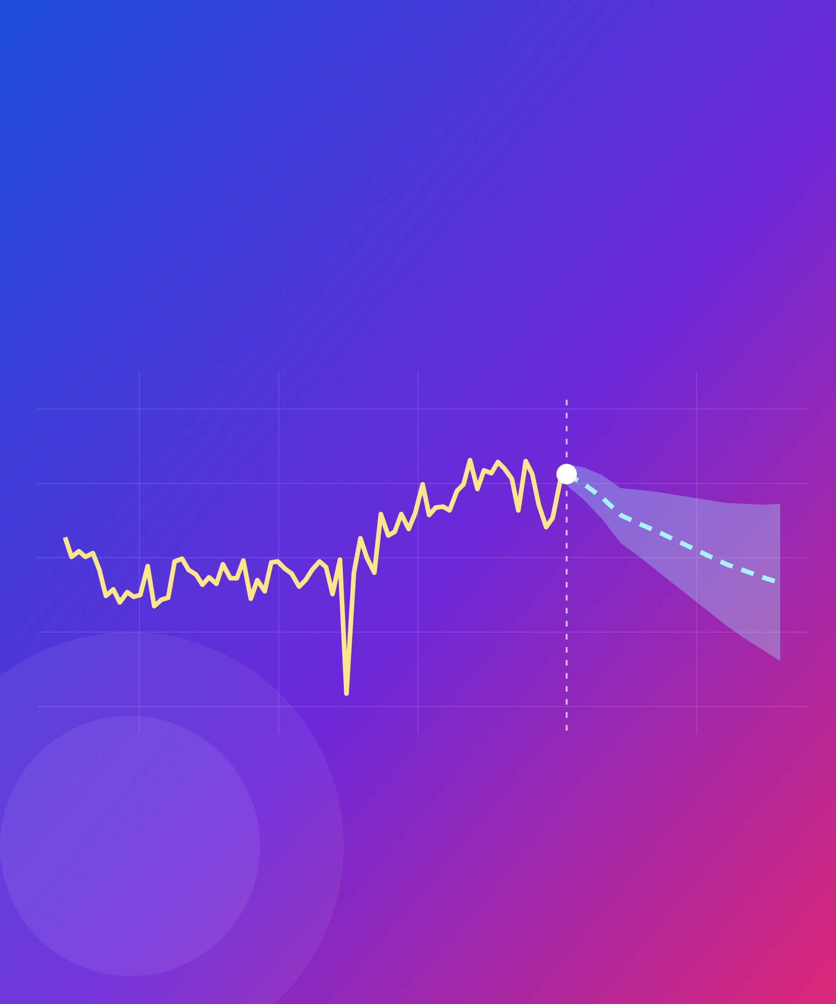
Let's predict the next shot
THANK YOU
Antonio Gilardi
antonio.gilardi@cern.ch
Notes:
That is the challenge: understand the data, infer the charge, then try to predict the next shot. Questions now, or any time during the week: find me at the Tuesday hands-on session or the Wednesday check-in.

