Slide 1
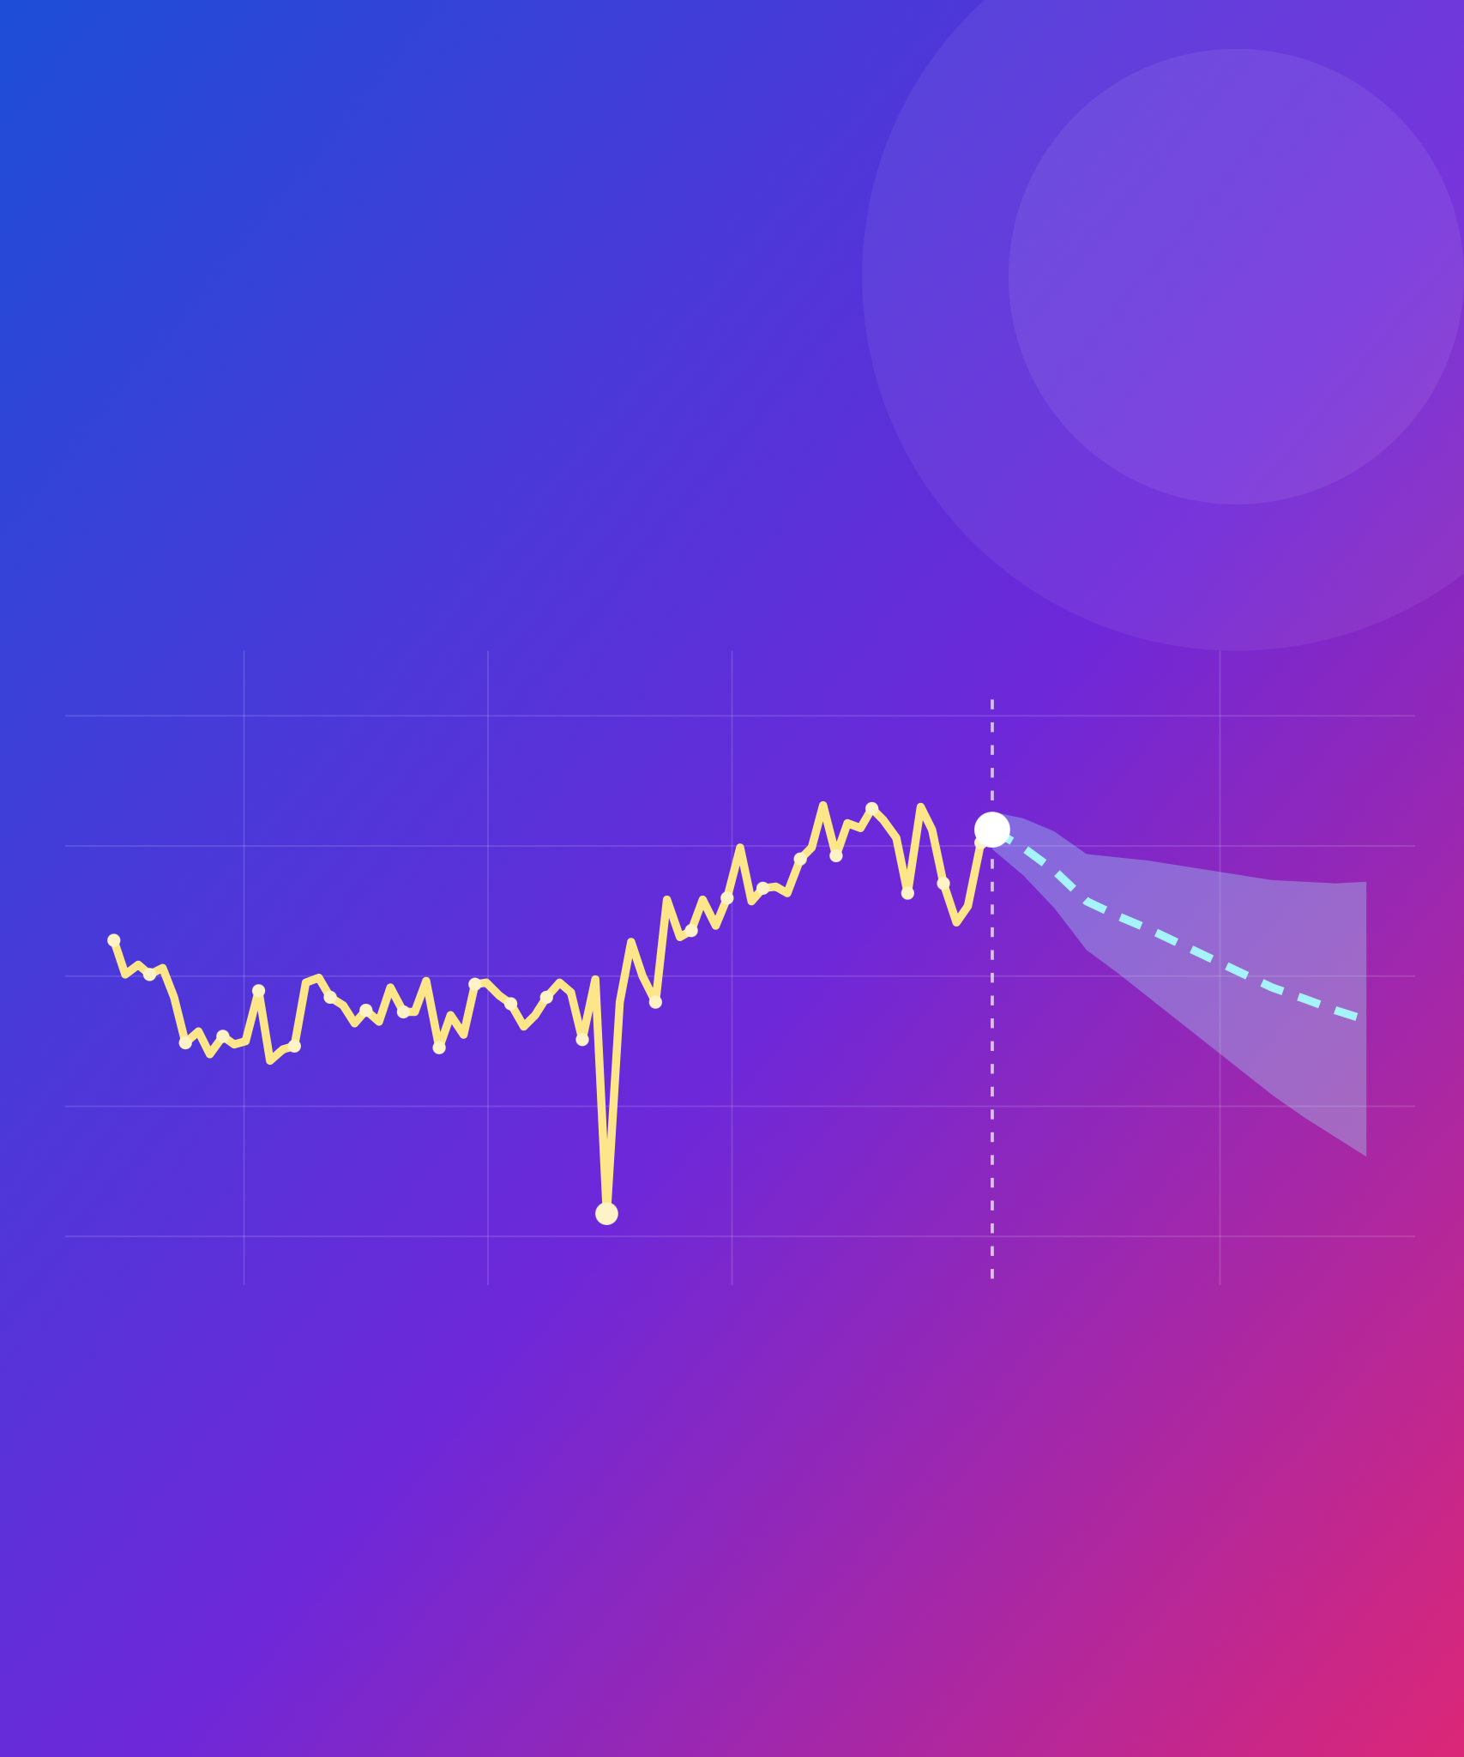
Forecasting the CLEAR beam charge
AISSAI ACCELERATOR HACKATHON 2026
OPTIMISATION CHALLENGE
now
forecast
How will the beam behave next, and can we see it coming?
dropout
Antonio Gilardi (Team Leader & Case Holder)
CERN · CLEAR · antonio.gilardi@cern.ch
past shots
Jan Jug
Quentin Bruant
Alex Brynes
Notes:
Welcome. This is the forecasting part of the optimisation challenge, on real data from CLEAR at CERN. The picture is the whole story: the beam charge jitters and drifts shot by shot, sometimes drops out, and the question is whether we can see where it goes next.

Slide 2
Three steps, one question
THE CHALLENGE
STEP 1 · EASY
STEP 2 · MEDIUM
STEP 3 · HARD
Understand
Virtual diagnostic
Forecast
raw run → clean table
Q[t] = f(X[t])
Q[t+1…t+H] = f(X[≤t], Q[≤t])
Clean, synchronise, rank every signal.
This shot's charge from this shot's signals.
The next shots' charge, from the past.
Close the loop with a controller g(x) on laser power or RF phase. Extremely promising results can earn real beam time on CLEAR.
THEN, OPTIONAL
Notes:
The parent challenge asks how to find the best settings. This one adds time: how will the beam behave next? Three steps, which are also the three tiers. First understand the data. Then a virtual diagnostic: the charge of a shot from the other signals of the same shot. Then forecasting: the charge of the next shot, or several shots ahead, from the past only. The long-term goal is to put the forecast inside a controller, which brings us back to optimisation. And if a team gets extremely promising results, we can ask for real beam time to test it on CLEAR.

Slide 3
Outline
First step:
  Problem description
  Data handling
  Data cleaning
  Main challenges
Can we diagnose?
  Problem description
  Approach used
  Model results
  Main and open challenges
Let’s try to go further!
  Problem description
  Approach used
  Model results
  Main and open challenges
Conclusion & Outlook
  Where we are
    What was done, what were the main challenges
    Colorful solution
    Highlights of the results
  What we plan
    Challenge identified
    Future scheduling work

Slide 4
Let’s try to understand
TIER 1 · EASY · RESULTS
Process our raw material to extract the meaningful, quintessential piece of information
THE GOAL
Clean the raw datasets
Understand the weight of each variables in the output charge of CLEAR beam
In this part, we talk about cutting, stashing, synchronizing and correlating
Forecasting the CLEAR beam charge
Notes:
Medium is the virtual diagnostic: infer the charge of a shot from the other signals of that same shot, without using any charge. Compare at least a linear model, a tree ensemble and a neural network, and show what drives each one: does it agree with your correlation study? Then the interesting part: train on one run and test on another, across days or across regimes. How much does it degrade, and which features stop transferring?

Slide 5
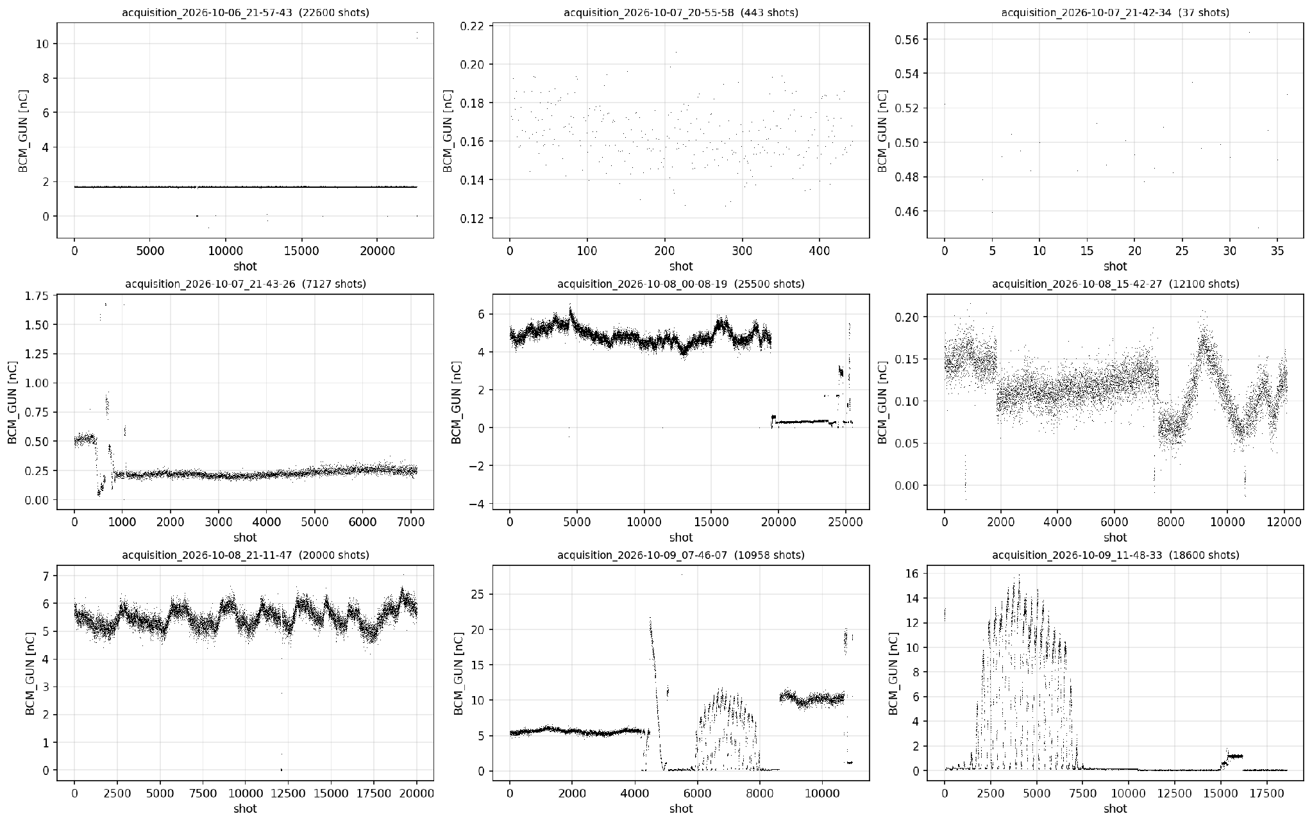
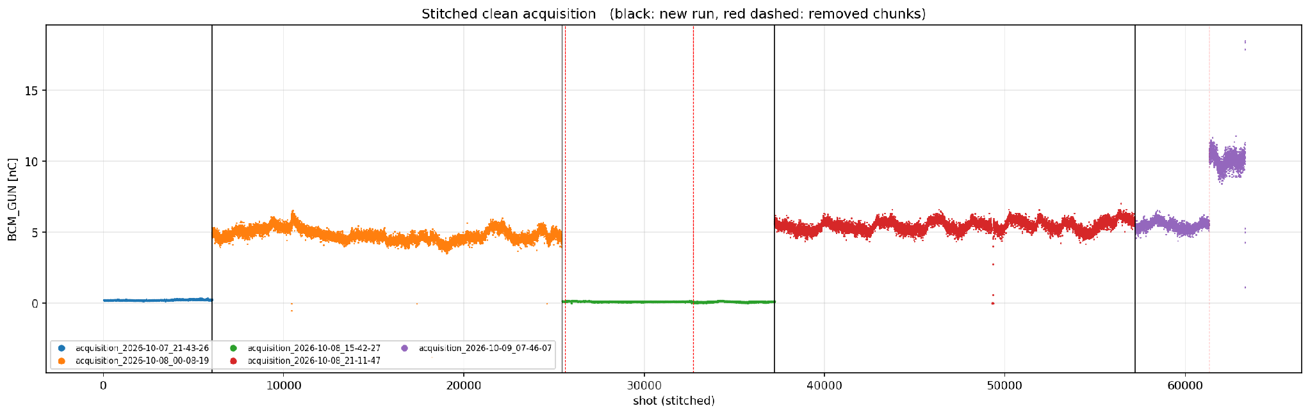
Run regimes, clean cuts and bad shots
TIER 1 · EASY · RESULTS
All useful datasets stitched together
Every run on a different situation
Plateaus at 0.1, 0.22, 4.8, 5.5 and 10 nC, laser scans, and a bunch charge monitor (BCM) stuck at a 1.67 nC ceiling
Clean cuts by inspection: 634 chunks, 63,327 shots, 8 contiguous segments in 3 regimes:
  Low charge (0.1 - 0.5 nC)
  High charge (5 - 20 nC), relatively stable
  High charge (5 - 20 nC), periodic drifts
21

Slide 6
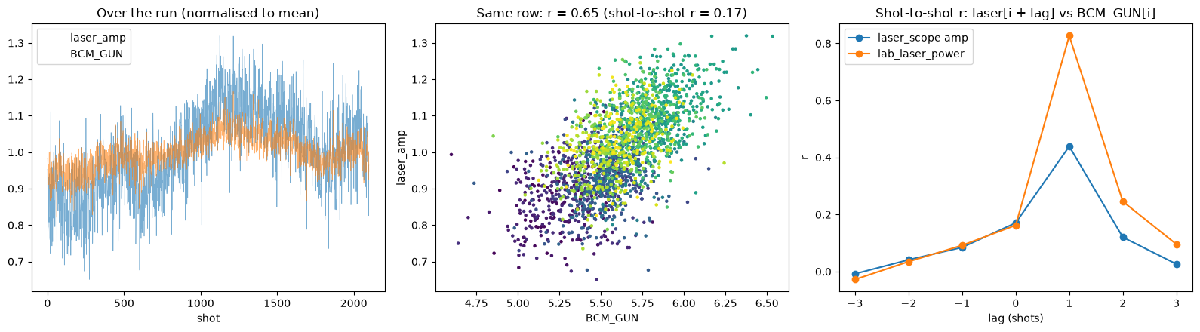
Synchronisation on the Beam pulse
TIER 1 · EASY · RESULTS
Each variable has its own timestamp so we need to match them
Lag scans: lab laser vs charge:
  at lag = 0: R = 0.17
  at lag = +1: R = 0.83
  camera peaks at lag 0
Laser diode sensor repeat the previous pulse when read before 2.2 s after the trigger
RF traces displays a +1 lag compared to their respective stamp; the camera stamp is one pulse late on 15 % of shots
ridge test R² (common rows) | seg 3 | seg 4 | seg 5 | seg 1 | seg 7
row-shifted datasets | 0.19 | 0.54 | 0.65 | 0.44 | 0.38
pulse-aligned datasets | 0.25 | 0.41 | 0.89 | 0.38 | 0.76
Laser vs charge over a run, scatter, and the lag scan peaking at +1 row
Building of synchronized datasets : readings of unrecorded pulses become NaN instead of a neighbour's value
22

Slide 7
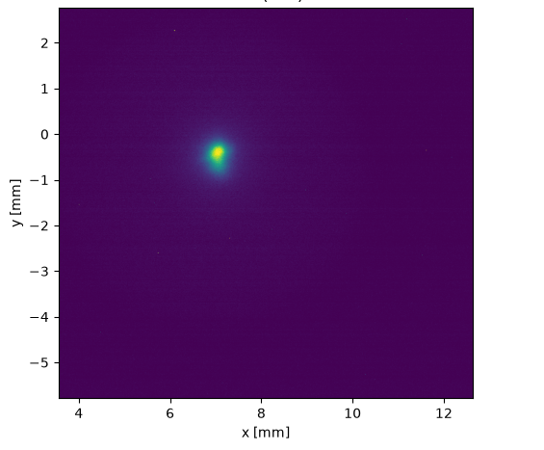
The first step
TIER 1 · EASY · RESULTS
~120 k shots, stored in 100 shot chunks
Very heterogeneous datasets:
  1 series of image (BTV)
  72 series of scalars
  19 series of waveforms
Unequal quality of the measurements
Need for a selection of representative situations to work on

Slide 8
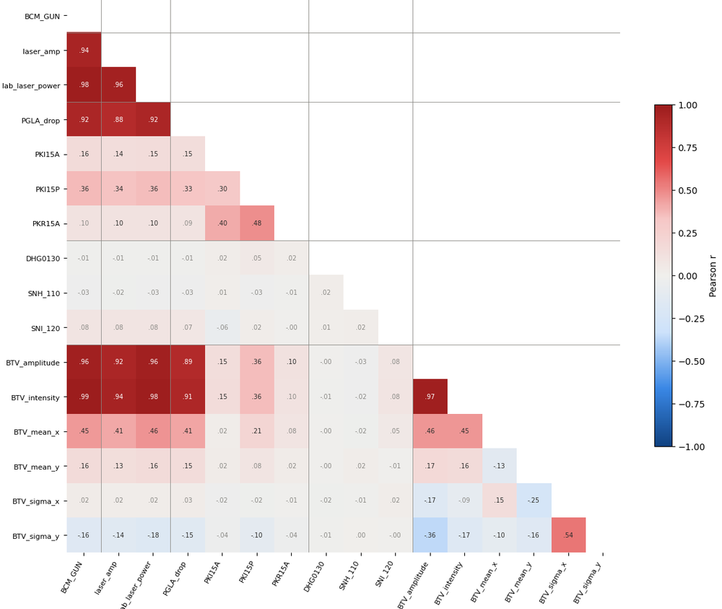
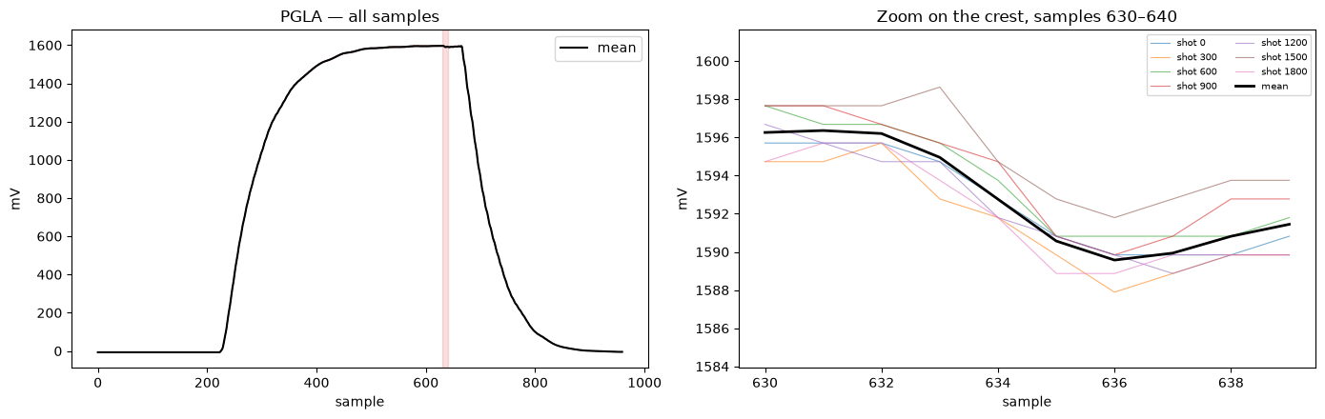
Independent variables?
TIER 1 · EASY · RESULTS
Pearson Cross Correlation (R) enters
Strongest: lab laser power, camera intensity (0.79), PCA PC3, laser scope amplitude
Klystron, magnets and climate: |R| < 0.1; ridge on all klystron samples has CV R² ≈ 0
RF beam-loading dip (~7 mV, samples 631→636) is linear in charge 0.3–10.4 nC: a second charge monitor
Charge is very persistent: "same as previous shot" R² = 0.96; shot-to-shot autocorrelation 0.67 at lag 1, 0 by lag 10
RF forward power. Left: full trace; Right: beam loading (peak-to-peak) could be used as proxy for bunch charge.
Pearson R between all variables in the dataset: BCM_GUN (leftmost column) is the target

Slide 9
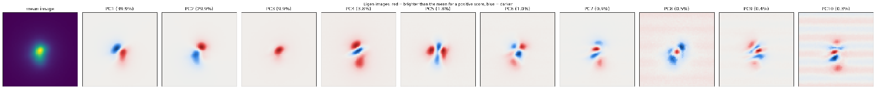
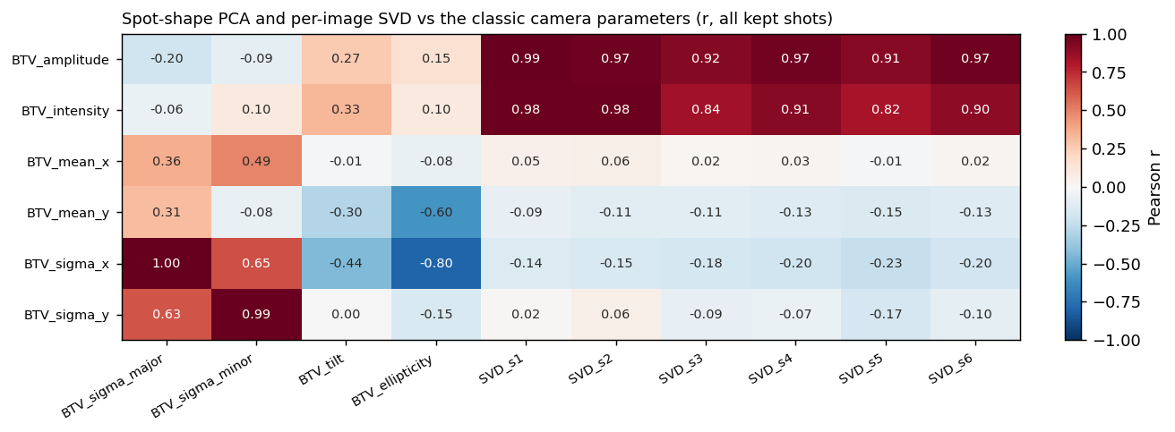
Camera input: PCA, SVD, AE?
TIER 1 · EASY · RESULTS
Beyond peak and integral: what information drive the output charge?
Classic moments after ROI, background and median filter: intensity, centroid, sizes, tilt
PCA over all shots: PC1 81.5 %, 6 PCs 97.5 % of variance explainability:
  PC1–2 = centroid motion,
  PC3–4 = brightness and size
Per-image SVD:
  s1 ≈ brightness (r = 0.98 with intensity)
    no basis fitted across shots, so no leakage
  Greedy selection keeps 10 features:
    lab laser, RF beam loading, SVD s1/s4–s6, camera intensity, Klystron power delivery, tilt, x
CNN autoencoder (16-d latent) + LSTM on the latent sequence: prototype, no charge result yet

Slide 10
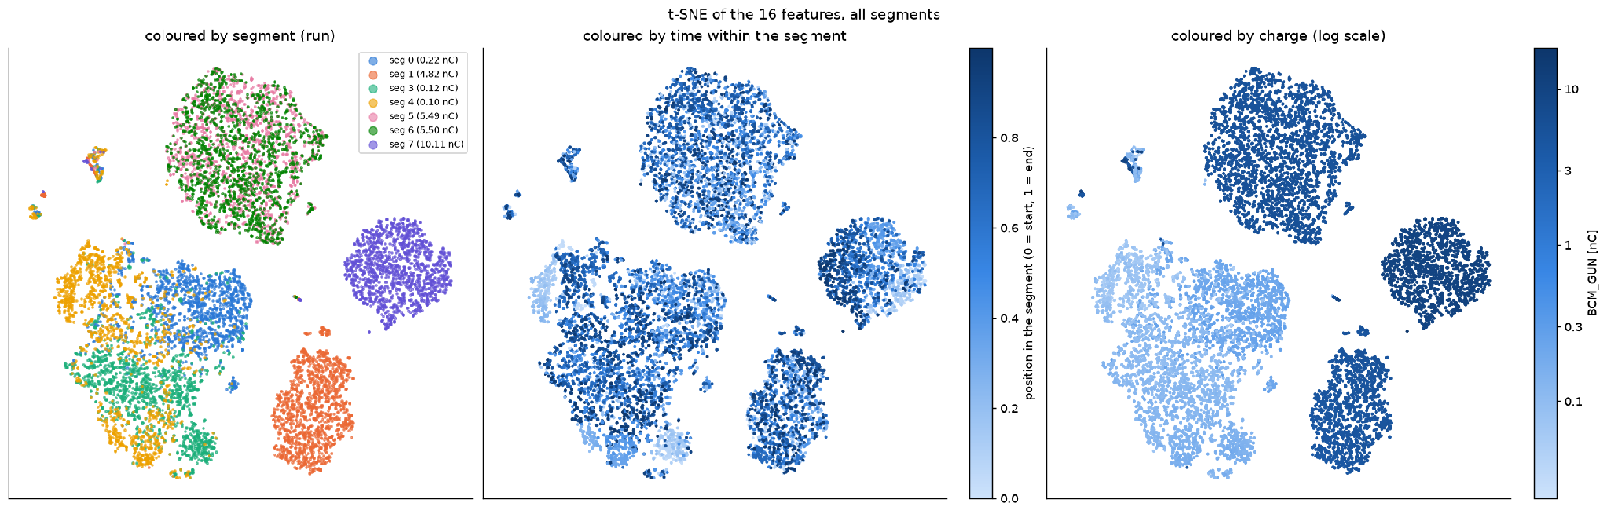
Structure across runs: t-SNE of the 16 features
TIER 1 · EASY · RESULTS
Shots cluster by run and charge level; the features themselves carry little memory.
10,500 shots, coloured by segment, by time and by charge.
Segments 5 and 6 (both ~5.5 nC) overlap, segment 7 (10 nC) sits apart, the low-charge segments merge
Predicting a feature from its previous shot: R² between −0.15 and 0.18,
The past adds little beyond the charge history

Slide 11
Can we diagnose?
TIER 2 · MEDIUM
Examine the performance of various models and try with and without BCM_GUN in the loop
THE GOAL
Obtain good performance in the virtual diagnostic fashion.
Identify the right metric and try some basic model (Linear Regression, Random Forest, XGBoost and MLP).
Models tried:
  linear regression
  random forest + xgboost
  mlp
  CNN: AE for images and temporal for history
  RNNs: LSTMs, GRUs
Forecasting the CLEAR beam charge
Notes:
Medium is the virtual diagnostic: infer the charge of a shot from the other signals of that same shot, without using any charge. Compare at least a linear model, a tree ensemble and a neural network, and show what drives each one: does it agree with your correlation study? Then the interesting part: train on one run and test on another, across days or across regimes. How much does it degrade, and which features stop transferring?

Slide 12
Vanilla models
TIER 2 · MEDIUM · RESULTS
How the different models behave on our data?
seg | regime | BCM mean pC | BCM std pC | linear | random forest | XGBoost | MLP (32-16)
0 | low charge | 251 | 23.3 | 13.4 | 12.0 | 16.8 | 11.2
3 | low charge | 126 | 20.6 | 11.0 | 10.1 | 10.7 | 9.9
4 | low charge | 107 | 21.2 | 9.5 | 9.3 | 9.2 | 9.6
5 | high, repetitive | 5583 | 427 | 143 | 96.1 | 90.7 | 85.7
1 | high, non-repetitive | 4862 | 376 | 166 | 134 | 185 | 141
6 | high, non-repetitive | 5571 | 191 | 47.8 | 63.8 | 57.2 | 50.4
7 | high, non-repetitive | 10106 | 1024 | 278 | 265 | 247 | 211
Forecasting the CLEAR beam charge

Slide 13
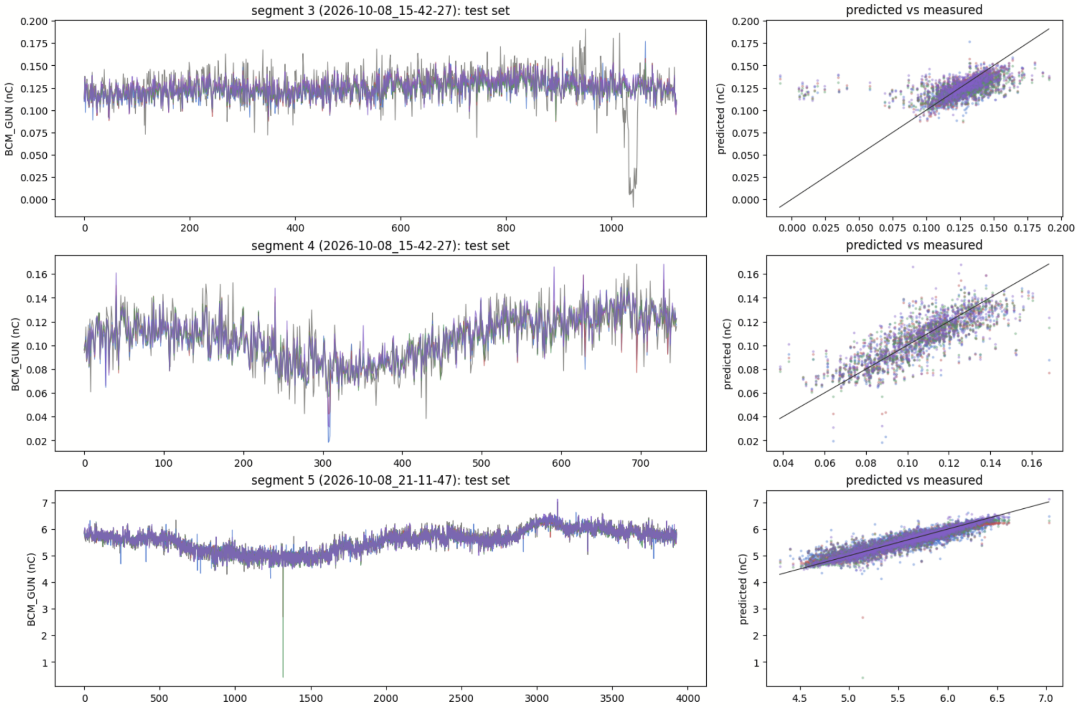
Vanilla models
TIER 2 · MEDIUM · RESULTS
Visual inspection shows that the models have learned to predict the BCM from the features
Outliers still penalize a lot the models performances as seen on the correlation plot
  The trend is well matched
Data might need better cleaning :
  Use of robust method such as MedianAE

Slide 14
Detrending
TIER 2 · MEDIUM · RESULTS
What happen when we introduce the trend followed by the BCM?
seg | regime | BCM mean pC | BCM std pC | linear | random forest | XGBoost | MLP (32-16)
0 | low charge | 251 | 23.3 | 10.8 | 9.9 | 10.0 | 9.7
3 | low charge | 126 | 20.6 | 10.8 | 10.4 | 10.4 | 10.4
4 | low charge | 107 | 21.2 | 9.5 | 8.7 | 8.8 | 8.9
5 | high, repetitive | 5583 | 427 | 131 | 90.4 | 87.6 | 86.6
1 | high, non-repetitive | 4862 | 376 | 130 | 96.5 | 97.3 | 92.7
6 | high, non-repetitive | 5571 | 191 | 29.1 | 43.0 | 33.6 | 29.1
7 | high, non-repetitive | 10106 | 1024 | 279 | 250 | 242 | 199
Forecasting the CLEAR beam charge

Slide 15
Sequence models
TIER 2 · MEDIUM · RESULTS
How LSTM applied on a CNN2D latentspace and a temporalCNN compare?
seg | regime | BCM mean pC | BCM std pC | temporal CNN (L = 50) | latent + features LSTM
0 | low charge | 251 | 23.3 | 13.1 | 10.2
3 | low charge | 126 | 20.6 | 9.6 | 9.7
4 | low charge | 107 | 21.2 | 8.9 | 8.7
5 | high, repetitive | 5583 | 427 | 84.2 | 81.7
1 | high, non-repetitive | 4862 | 376 | 119 | 205
6 | high, non-repetitive | 5571 | 191 | 63.5 | 155
7 | high, non-repetitive | 10106 | 1024 | 270 | 404
Forecasting the CLEAR beam charge

Slide 16
Slow level + shot-to-shot model
TIER 2 · MEDIUM · RESULTS
seg | regime | BCM mean pC | BCM std pC | Trailing level only | Ridge, current shot | GRU, window 16 | Ridge + past BCM + GRU (64) | online refit
0 | low charge | 251 | 23.3 | 18.2 | 10.0 | 9.1 | 9.2 | 9.1
3 | low charge | 126 | 20.6 | 12.4 | 9.4 | 9.2 | 9.1 | 9.2
4 | low charge | 107 | 21.2 | 11.7 | 8.9 | 8.1 | 8.1 | 8.1
5 | high, repetitive | 5583 | 427 | 145.5 | 69.5 | 42.1 | 40.8 | 40.7
1 | high, non- repetitive | 4862 | 376 | 143.3 | 84.6 | 47.2 | 45.7 | 45.8
6 | high, non-repetitive | 5571 | 191 | 122.2 | 57.0 | 31.2 | 31.0 | 27.8
7 | high, non-repetitive | 10106 | 1024 | 428.1 | 174.4 | 226.3 | 147.0 | 133.2

Slide 17
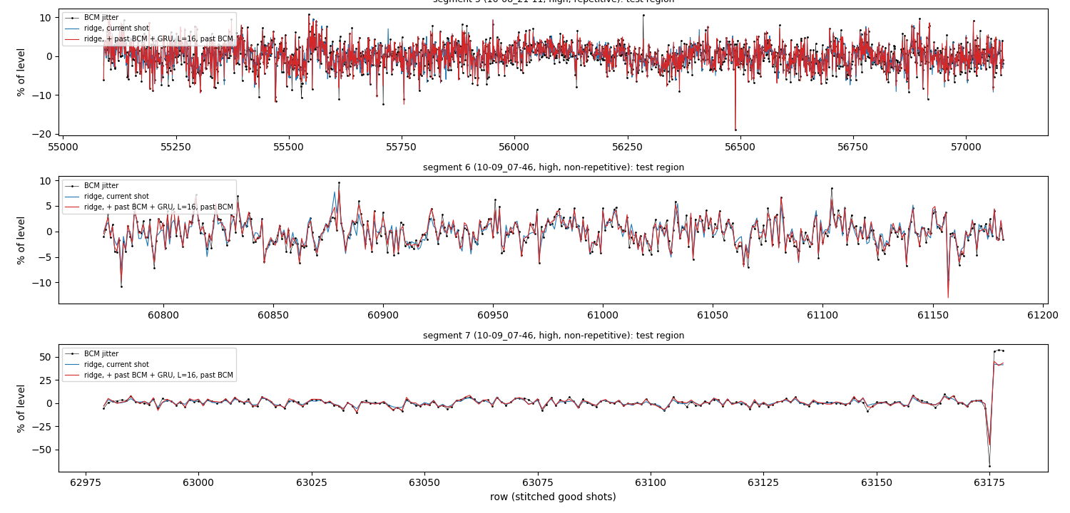
Slow level + shot-to-shot model
TIER 2 · MEDIUM · RESULTS
Trailing level: baseline from 50 shot MA (zero jitter)
Ridge: predicts jitter from multiple instruments
GRU: can capture nonlinear effects beyond Ridge
Ridge+past BCM+GRU: two stages – ridge plus 16 jitter values, then 64-window GRU for the nonlinear correction
  (good for combining jumps with jitter)
+online refit: same as above, with weighted ridge based on recent errors

Slide 18
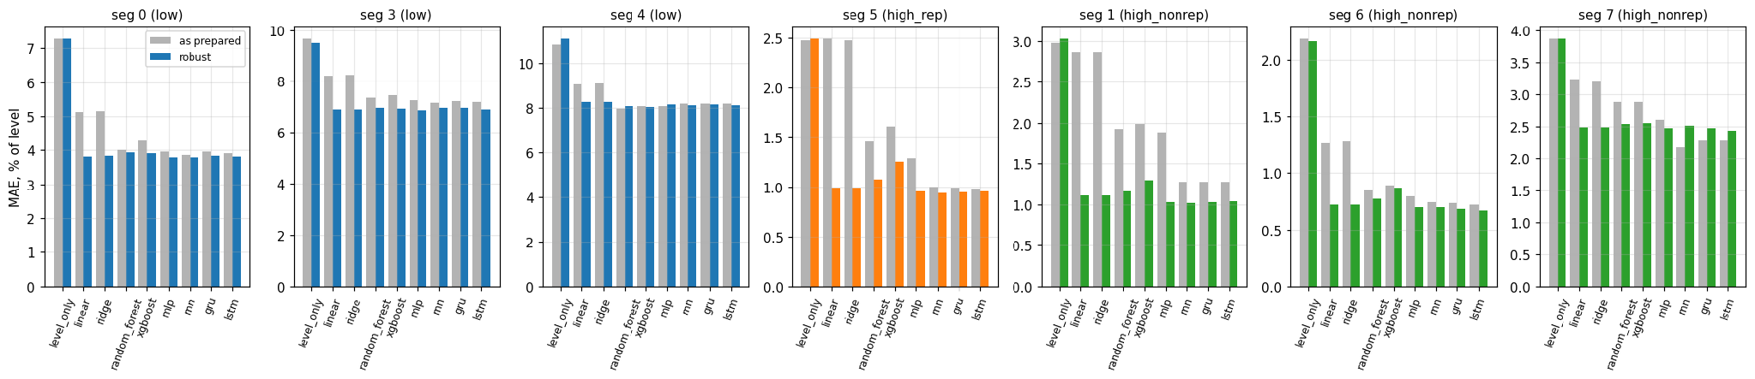
Nine model families converge
TIER 2 · MEDIUM · RESULTS
Linear, ridge, random forest, XGBoost, MLP, RNN, GRU, LSTM, sparse GP and ensembles; MAE in % of the level.
Outlier-robust preparation brings all families within ~10 %:
  squared-loss models were chasing camera spikes (seg 1 ridge 2.86 → 1.12 %)
Pulse alignment helps the nonlinear models:
  XGBoost: MAE = 1.26 → 0.95 %
  best LSTM: MAE = 0.87 %
  GRU / GP beat ridge by 11–22 % in high charge regime
Forecasting the CLEAR beam charge

Slide 19
Forecasting
TIER 3 · HARD
Repeat what has been done for virtual diagnostic in a more complex scenario
THE GOAL
Identify the right metric and try some basic model
Beat the rolling mean
Deploy in the machine the model
One step ahead, then up to 50 shots
At least one sequence model: TFT, DeepAR, LSTM/GRU or a time-series foundation model
Tune the context window and show its effect
Forecasting the CLEAR beam charge
Notes:
Hard is forecasting: predict the charge of future shots from everything known up to now. First beat the rolling mean, which is not trivial. Then beat the notebook's XGBoost on lag features. Go multi-step and find the horizon where your model stops beating the rolling mean. Use at least one model built for sequences. And tell us where the forecast comes from: the charge's own history, or the machine.

Slide 20
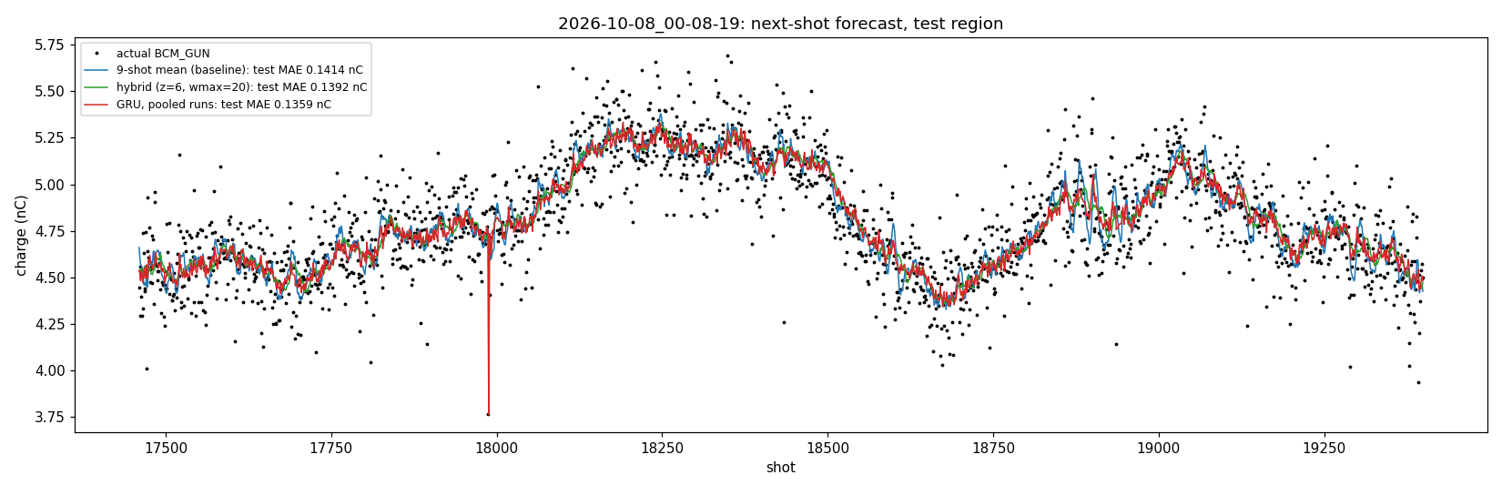
Next shot: beating the rolling mean of 9
TIER 3 · HARD · RESULTS
Charge of shot n+1 from everything up to shot n; last 10 % of each run.
MAE vs 9-shot mean | Explanation | run 1 (10 nC) | run 2 (5.5) | run 3 (4.8) | run 4 (0.2) | run 5 (0.1)
9-shot mean (nC) | Used by operators – the target to beat | 0.343 | 0.144 | 0.141 | 0.0195 | 0.0122
hybrid level | Same as above, but with a reset after a level change (deviation by 6x jitter, dropout, etc.) | −8.0 % | −1.9 % | −1.6 % | −1.7 % | −2.5 %
GRU, pooled runs | GRU trained on first 90% of all 5 runs, tested on last 10% | −9.2 % | −3.0 % | −3.9 % | −4.6 % | −3.3 %
GRU, other runs only | GRU trained on four runs and tested on the remaining one | −8.8 % | −2.3 % | −3.1 % | −4.8 % | −3.6 %
Block bootstrap*
Fake additional data by drawing from error of GRU and 9-shot mean
Since consecutive errors are related, we randomize them in blocks of 50 shots
GRU significantly better on all 5 runs (block bootstrap*)
  persistence is 25 % worse
Run 1's gain is mostly its final level jump
  (3.6 % on its stable shots)
Context window 8–256 shots:∆ ≤ 1.3 pC
  laser and other inputs add nothing
33

Slide 21
Next shot: the models from Tier 2
TIER 3 · HARD · RESULTS
The last 5 BCMs + the current features and the L=50 temporal CNN
seg | regime | BCM mean pC | BCM std pC | mean of last 9 | mean of last 50 | linear | random forest | XGBoost | MLP (32-16) | temporal CNN (L = 50)
0 | low charge | 251 | 23.3 | 18.6 | 17.6 | 17.5 | 17.4 | 17.6 | 17.5 | 17.6
3 | low charge | 127 | 16.2 | 12.2 | 11.9 | 11.9 | 11.9 | 11.9 | 12.1 | 11.9
4 | low charge | 107 | 21.2 | 12.1 | 11.9 | 11.9 | 12.0 | 11.9 | 12.0 | 11.9
5 | high, repetitive | 5583 | 427.1 | 146.5 | 147.4 | 141.7 | 141.7 | 142.0 | 141.7 | 142.4
1 | high, non-repetitive | 4862 | 375.9 | 141.8 | 142.5 | 136.2 | 136.0 | 136.6 | 137.6 | 136.7
6 | high, non-repetitive | 5571 | 190.8 | 118.0 | 114.4 | 111.2 | 111.4 | 113.7 | 113.9 | 112.2
7 | high, non-repetitive | 10086 | 680.3 | 340.5 | 337.7 | 335.0 | 340.9 | 338.3 | 344.5 | 333.4
Mean of last 50 performs approximately the same as any model, meaning that the there is little extra information available
Temporal CNN basically performs as well as the rolling average
Note: no hyperparameter search was performed - these are vanilla models with default hyperparameter values

Slide 22
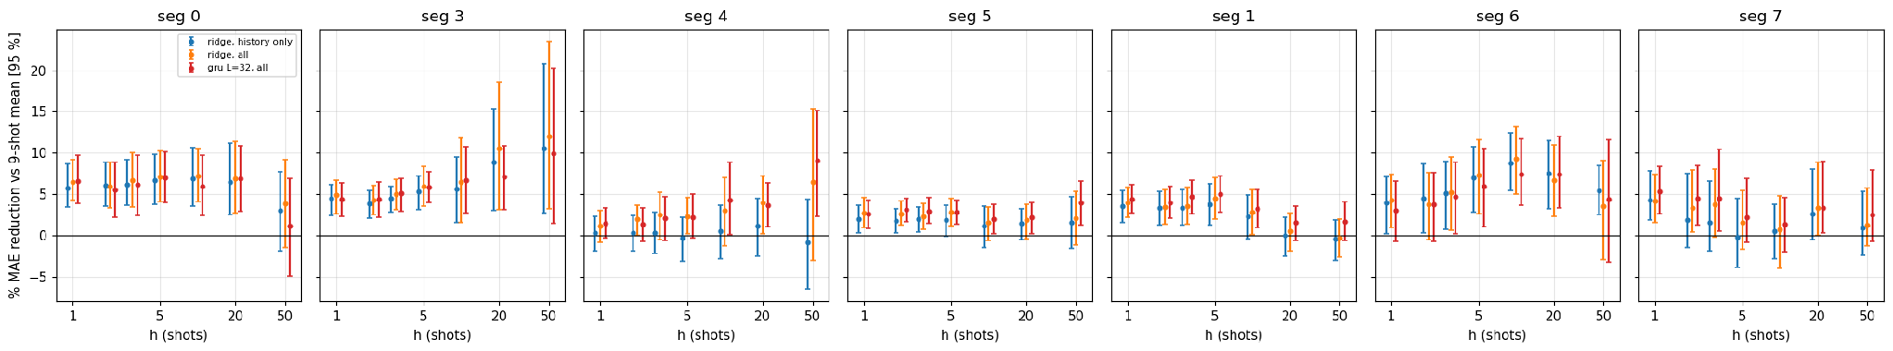
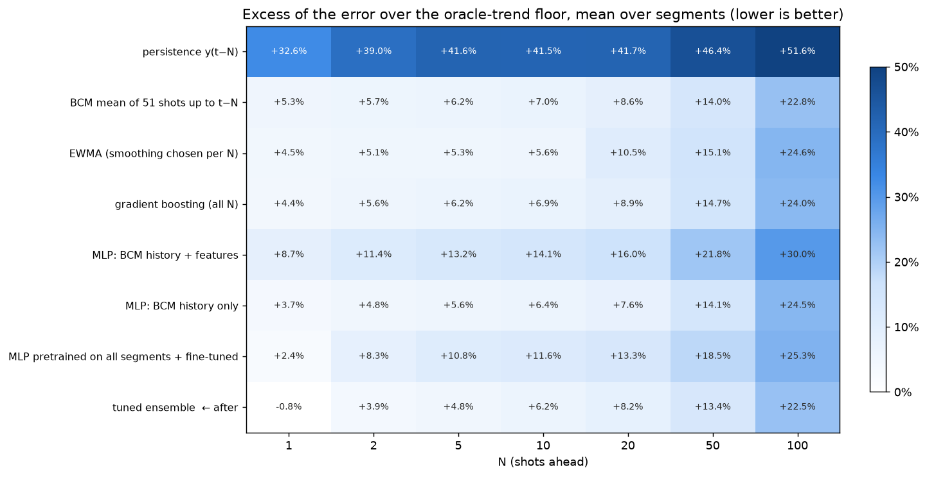
Further ahead, smaller gains
Model used
Ridge, past charge only (blue)
Ridge, past charge plus other diagnostics (orange)
GRU, past charge plus other diagnostics (red)
TIER 3 · HARD · RESULTS
Multi-step forecasts vs the 9-shot mean & the oracle floor (slow trend + random noise from both past and future).
h = 1–5: 1.5–7 % better than the 9-shot mean, significant on 5–7 of 7 segments; h = 50 mostly not
Ensemble at the floor up to N ≈ 2, +6 % at N = 10, +22 % at N = 100
Instruments add ~0.5–1 point: the next laser pulse is not predictable (R² ≤ 0.35)
Simple and exponential moving average give ~5% excess error.
The heavier models help, but not by much
34

Slide 23
Summary: what worked and what did not
TIER 3 · HARD · RESULTS
Worked
Pulse-grid alignment of every reading
Slow + fast split: trailing level + GRU, at the noise floor on 3 segments
Beating the 9-shot mean on every run (−2 to −9 %)
Measured BCM noise for honest intervals
Did not help
Kalman / EMA / median levels, periodic terms
Forecasting the instruments (two-step models)
Attention, autoencoders, minimax training
RF, climate and magnet inputs

Slide 24
Further work
TIER 3 · HARD · RESULTS
Step 1:
Review the work - a lot was done, all of it in a Fast & Approximate manner
New information as we proceeded was not necessarily propagated properly back into the data preparation stage
Step 2:
Better data alignment
Redo the feature selection, perhaps with a full grid search
Step 3:
Understand the model limitations and why they performed little better than the rolling means
Select the most promising models and do a proper hyperparameter search
Step 4:
Publication

Slide 25
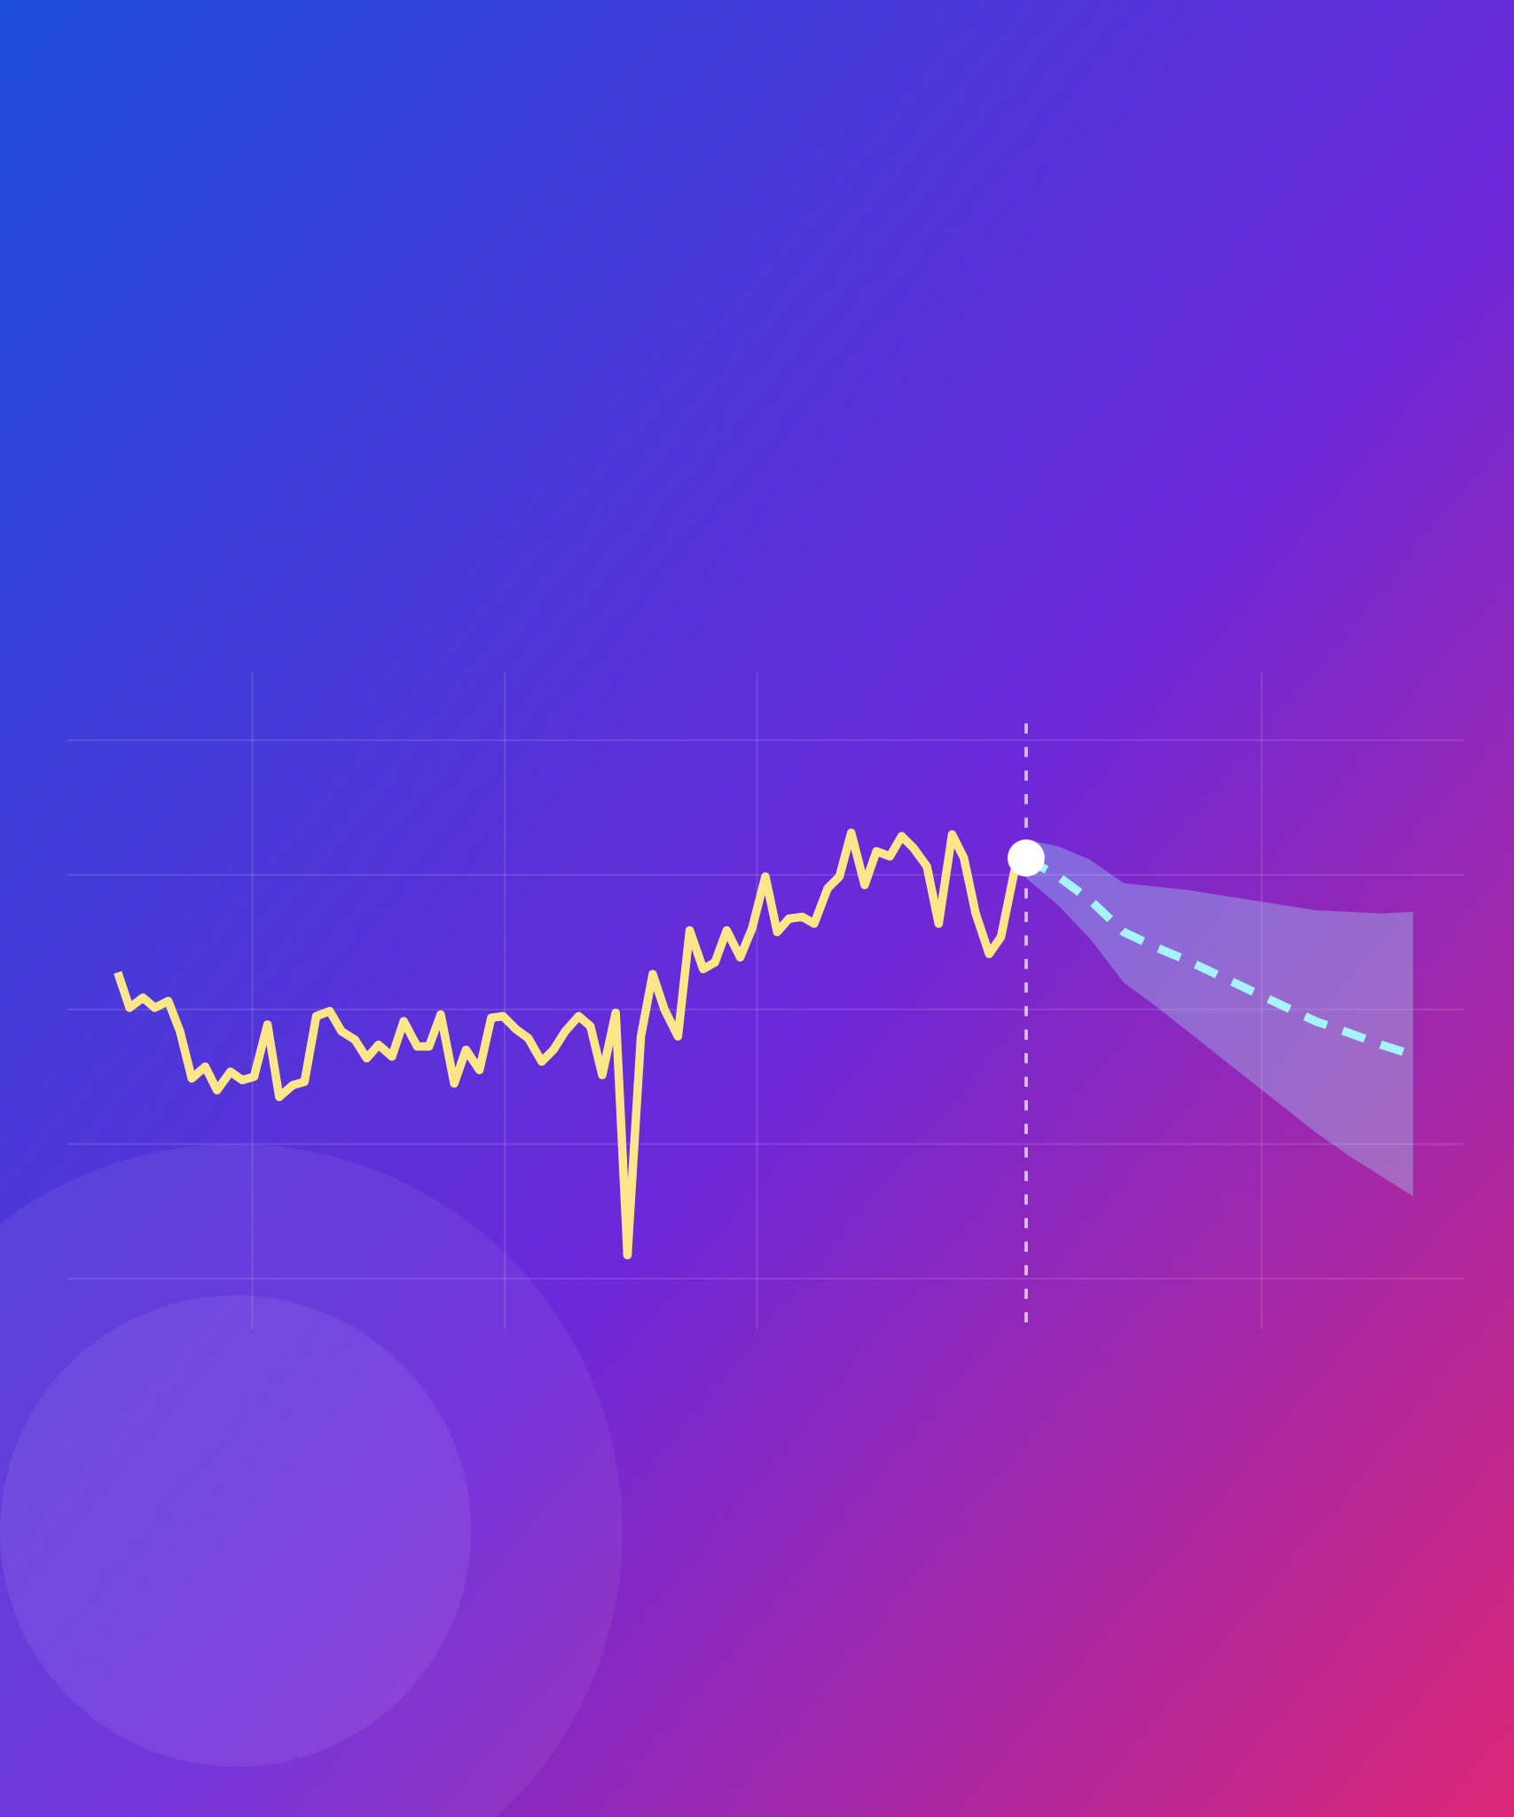
Let's predict the next shot
THANK YOU
Antonio Gilardi
antonio.gilardi@cern.ch
Notes:
That is the challenge: understand the data, infer the charge, then try to predict the next shot. Questions now, or any time during the week: find me at the Tuesday hands-on session or the Wednesday check-in.

Slide 26
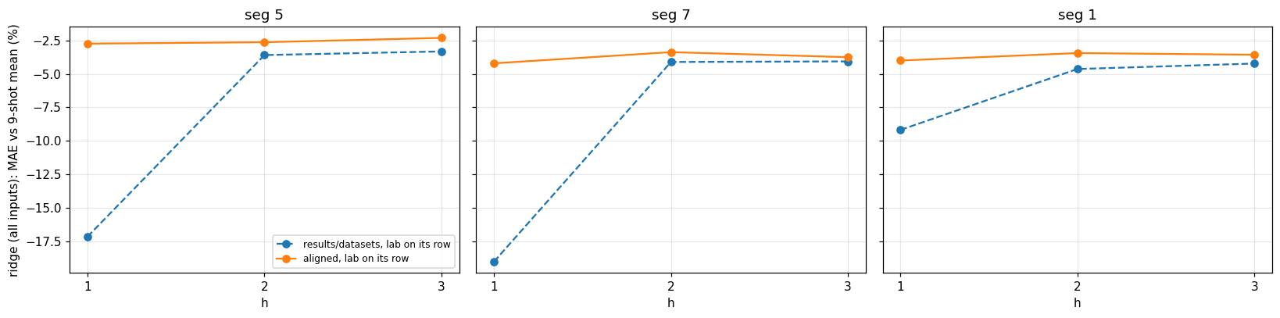
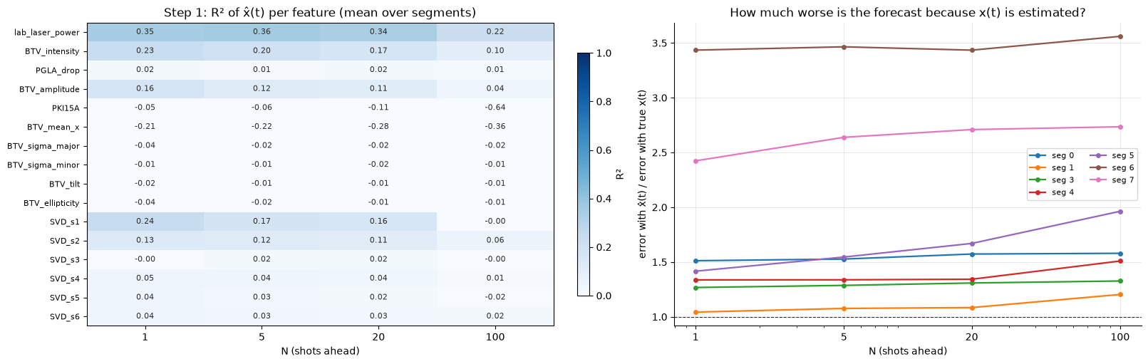
Pitfall: a fake gain from misaligned data
TIER 3 · HARD · RESULTS
With the laser meter on the wrong row, the "forecast" sees the future.
Row-shifted datasets: h = 1 gain of −17 to −19 % (!!) vs the 9-shot mean.
BUT: the laser meter is often read before it has updated, so it still shows the previous pulse’s value – a next-shot forecast can cheat.
Pulse-aligned: −3 to −4 %, flat over horizon
Two-step model (reusing the virtual diagnostic to feed into the forecast) is no better than the 51-shot mean: present features cannot be forecast reliably.
Lesson: check every variable's lag on the pulse grid before trusting a gain
Ridge model using all inputs, predicting h shots ahead
R2 at shot h for each feature
Forecasting for different segments
35

Slide 27
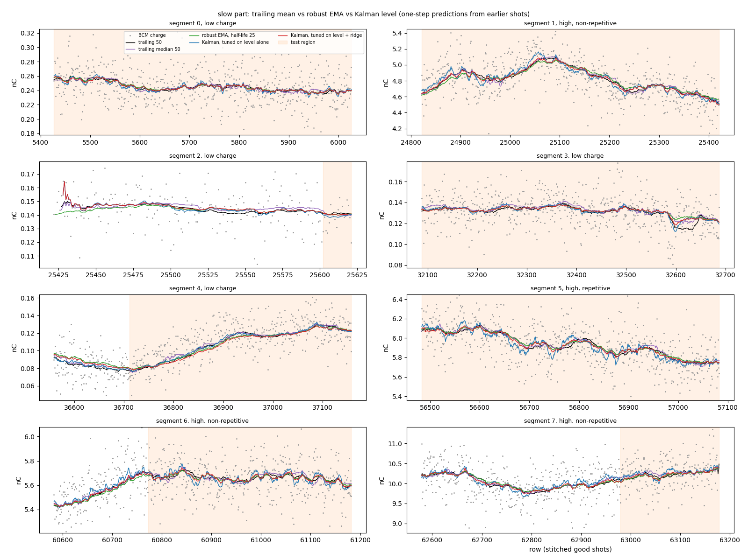
Filtering the slow level: simple wins
TIER 3 · HARD · RESULTS
Trailing mean vs median vs robust EMA vs Kalman level filter, with and without a ridge on top.
MAE pC, + ridge | seg 3 | seg 5 | seg 1 | seg 6
trailing mean 50 | 9.4 | 69.5 | 84.6 | 57.0
trailing median 50 | 9.2 | 71.2 | 84.6 | 59.0
robust EMA (half-life 25) | 9.2 | 72.5 | 88.0 | 56.9
Kalman level | 9.2 | 72.1 | 85.6 | 57.3
Kalman tuned on the level alone is the best level (seg 5: 140.5 vs 145.5 pC) but absorbs predictable jitter
Spectrum: no lines, residual white; only seg 3 has a slow drift the trailing mean misses
Online refit after every shot: −22 to −43 % on the ridge, seg 6 31 → 28 pC on the best model
36

Slide 28
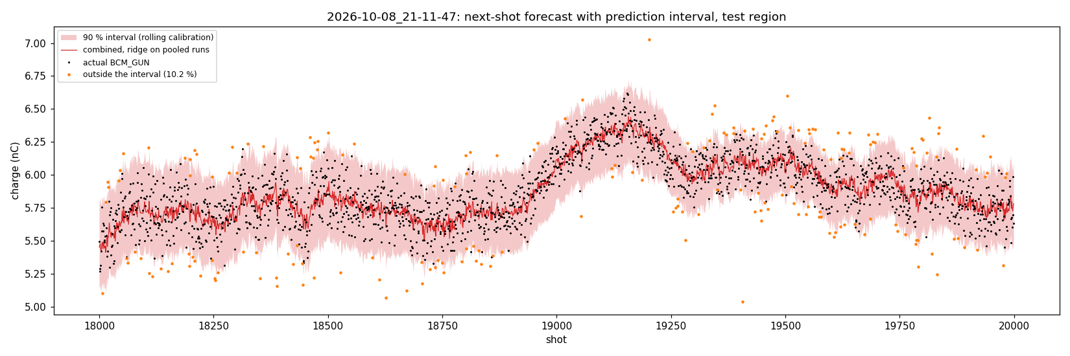
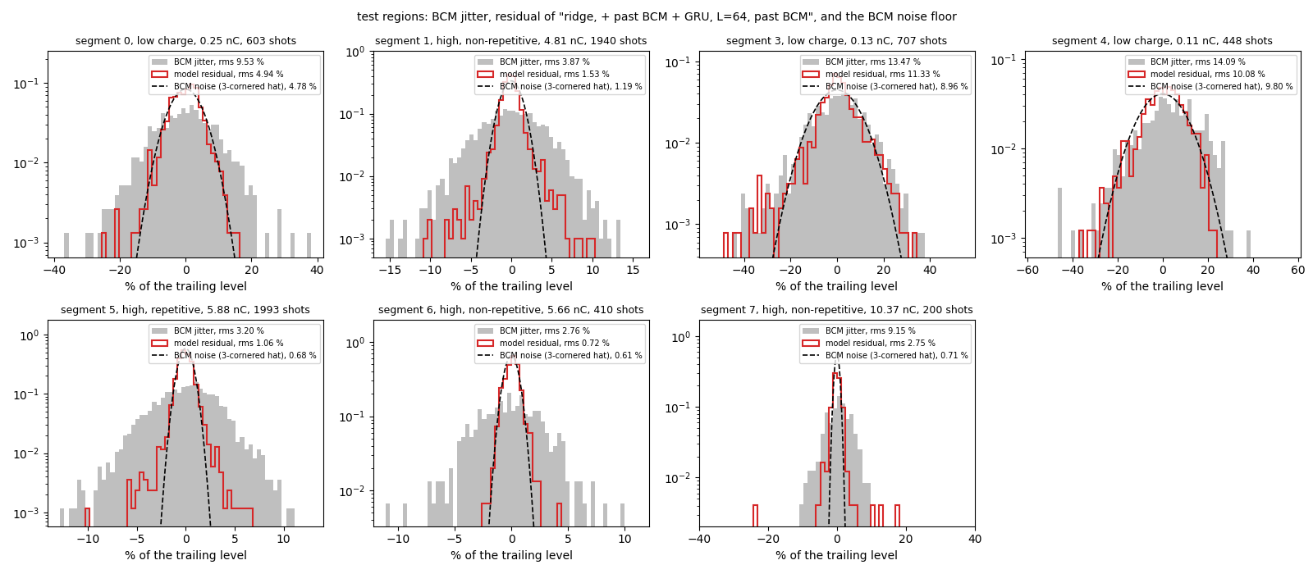
Noise floor and uncertainty
TIER 3 · HARD · RESULTS
The BCM's own noise sets the floor;
prediction intervals checked on the test region.
BCM noise: white, Gaussian core with heavy tails (0.2–1.5 % beyond 4σ); ~50 % of the jitter at low charge
Rolling 90 % interval covers 87–92 % (±5–7 % at 5–10 nC)
GP with the measured noise as its kernel noise: no better MAE, right intervals once missing camera frames get extra variance (86–95 %)
Minimax (max-error) training does not reduce the worst error
37

