Slide 1

DEPARTMENT OF ARTIFICIAL INTELLIGENCE AND DATA SCIENCE ACADEMIC YEAR 2025 - 2026 SEMESTER III ARTIFICIAL INTELLIGENCE LABORATORY MINI PROJECT REVIEW STUDENT PERFORMANCE PREDICTION USING LINEAR REGRESSION
REGISTER NUMBER | 2117240070009
NAME | AGILA K
YEAR | ll
SECTION | A
FACULTY IN-CHARGE | Mrs. M. Divya

Slide 2
PROBLEM STATEMENT
To develop a machine learning model to predict student academic performance.
To analyze the impact of factors such as study hours, attendance, previous scores, sleep, and participation on student results.
To identify students who are at risk of poor performance at an early stage.
To improve accuracy and efficiency compared to traditional evaluation methods.
To build a simple and cost-effective prediction system using Linear Regression.
To assist educators in making data-driven decisions for improving student outcomes.

Slide 3
IMPLEMENTATION AND CODE
Link to code in Git-hub Repository
List | Git-hub Repository Links
Implementation of Code Link | student-performance-prediction-ml-project/edupredict_-student-performance-analyzer.zip at main · agila1010-creator/student-performance-prediction-ml-project
Word Document Report Link | student-performance-prediction-ml-project/agila_ML_mini_project_report.docx at main · agila1010-creator/student-performance-prediction-ml-project
PPT Link | student-performance-prediction-ml-project/agila_ml_ppt.pptx at main · agila1010-creator/student-performance-prediction-ml-project

Slide 4
THEORETICAL BACKGROUND
The project is based on Machine Learning, specifically Supervised Learning
The model is trained using historical student data with input features and corresponding output values.
It is treated as a regression problem, where the output is a continuous value (student performance score).
Linear Regression is used as the main algorithm for prediction.
It assumes a linear relationship between input variables (study hours, attendance, etc.) and output.
The model calculates a weighted sum of input features along with an intercept term.
The trained model can be used to predict student performance for new data inputs.

Slide 5
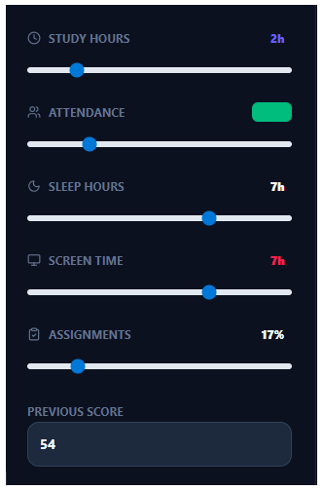
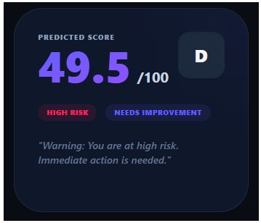
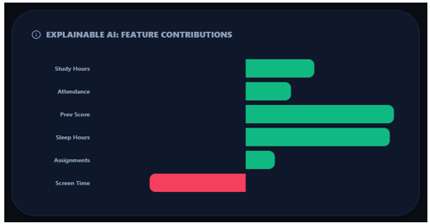
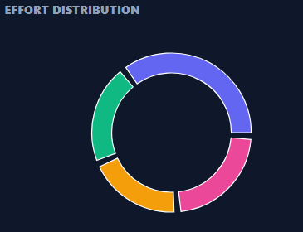
OUTPUT AND RESULTS

Slide 6
OUTPUT AND RESULTS
The model successfully predicts student performance using Linear Regression.
It shows good accuracy with low prediction error.
Important factors like study hours, attendance, and previous scores were identified.
The model provides quick and efficient predictions.
The results are reliable for small to medium datasets.
It is simple to implement and requires less computational power.
It helps in identifying students who need improvement.
Compared to complex models, it is easier to understand and use.

Slide 7
REFERENCES
Python Documentation – https://docs.python.org/
Pandas Documentation – https://pandas.pydata.org/docs/
NumPy Documentation – https://numpy.org/doc/
Matplotlib Documentation – https://matplotlib.org/
Seaborn Documentation – https://seaborn.pydata.org/
Kaggle Dataset – https://www.kaggle.com/

