Slide 1

Leadership Qualities
What Makes an Effective Leader?
Name · Department · Year / Section · Roll Number
Notes:
Good morning everyone. Today we're exploring what leadership truly means — not just in theory, but in practice. We'll look at the qualities that define great leaders, how they differ from managers, and how each one of us can start developing these skills right here in college. Let's dive in.

Slide 2

What Is Leadership?
Leadership is the ability to influence and guide others toward a shared goal — not through authority, but through vision and trust.
Vision
Action
Set a clear direction
Take initiative and drive momentum
People
Results
Inspire and support others
Achieve meaningful outcomes together
Anyone — including you — can develop these skills.
Notes:
Leadership isn't about having a title or a corner office. It's about setting a vision, bringing people together, taking action, and achieving results. The key idea here is that leadership is a skill — not a position. Anyone in this room can start developing it today.

Slide 3
Leader vs. Boss
The Leader
The Boss
Inspires and motivates
Listens actively
Guides and develops people
Takes responsibility
Works with the team
Gives orders
Focuses on authority
Controls outcomes
Assigns blame
Works above the team
People follow leaders because they trust them — not simply because they have authority.
Notes:
This is one of the most important distinctions in leadership. A boss relies on authority and control. A leader earns trust and inspires people to give their best. Think about your project teams — who do you naturally want to follow? That's the difference we're talking about.

Slide 4







7 Essential Leadership Qualities
Communication
Integrity
Empathy
Decision-Making
Confidence
Adaptability
Accountability
Notes:
These seven qualities form the foundation of effective leadership. We'll dive deeper into a few of them next — but notice they're all interconnected. Great communication builds trust, empathy strengthens your team, and accountability earns respect. These aren't just corporate buzzwords; they're practical skills you can practice every day.

Slide 5
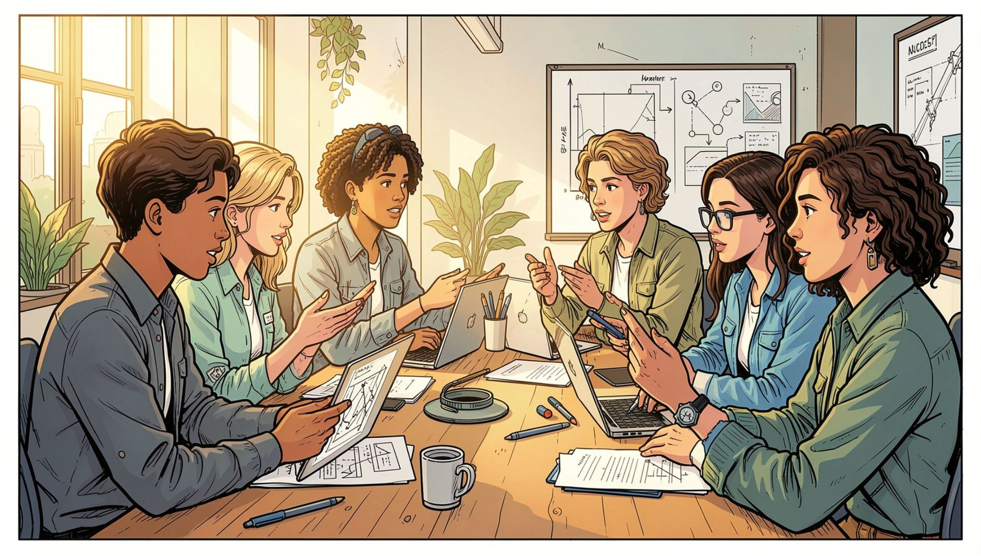
Communication & Empathy
Communication
Express ideas clearly and confidently
Listen actively — not just wait to speak
Give constructive, honest feedback
Empathy
Understand others' perspectives
Respect different opinions
Support teammates through challenges
Notes:
Communication and empathy go hand in hand. It's not enough to speak well — you need to truly listen. In your project teams, the best leaders are the ones who notice when someone is struggling and take the time to understand their perspective. That's what builds real team cohesion.

Slide 6
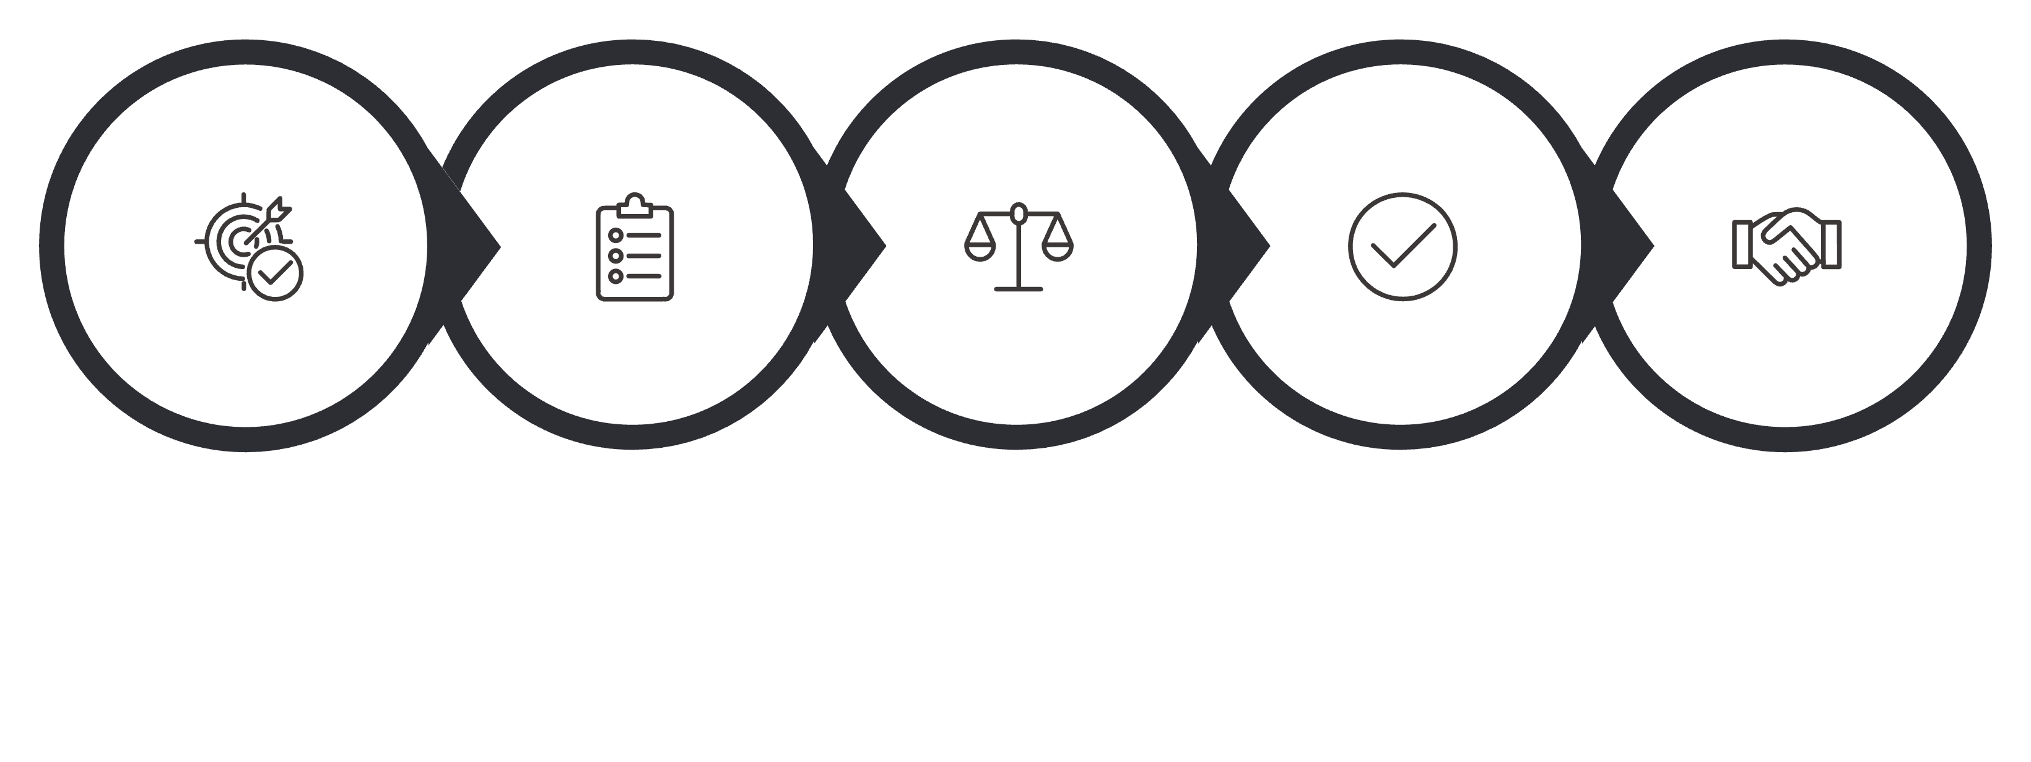
Decision-Making & Accountability
Accept Responsibility
Understand Problem
Evaluate Options
Make Decision
Gather Facts
Strong leaders don't avoid tough decisions — they make them thoughtfully and own the outcome.
Notes:
Every leader faces difficult decisions. The process is straightforward: understand the problem, gather facts, weigh your options, decide — and then own the result, good or bad. Accountability is what separates real leaders from those who just give orders. Your team needs to know you'll stand by your decisions.

Slide 7
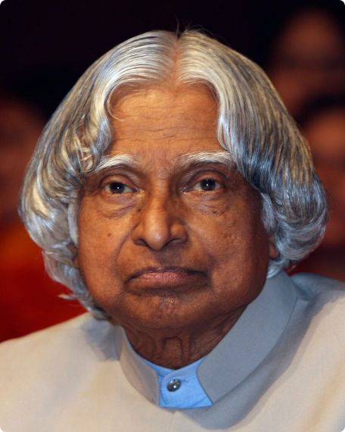
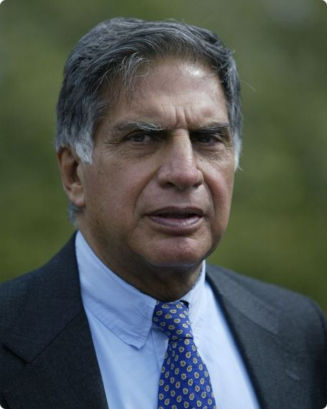
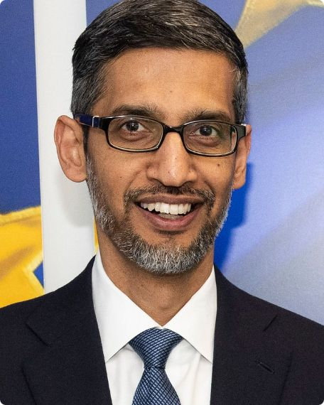
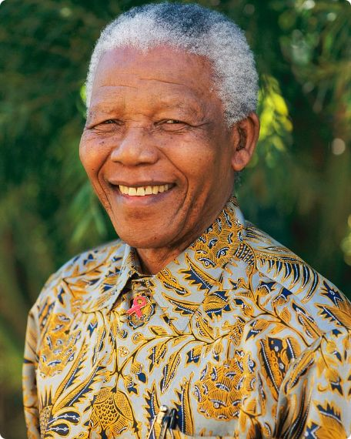
Real-World Leadership Examples
A. P. J. Abdul Kalam
Ratan Tata
Sundar Pichai
Nelson Mandela
Vision and humility
Integrity and empathy
Calm leadership and adaptability
Resilience and courage
Notes:
These aren't biographies — they're leadership lessons. Kalam showed us that vision and humility can coexist. Ratan Tata built an empire on integrity. Pichai leads one of the world's most complex organizations with calm adaptability. And Mandela proved that resilience and courage can change history. Each one demonstrates that leadership takes many forms.

Slide 8
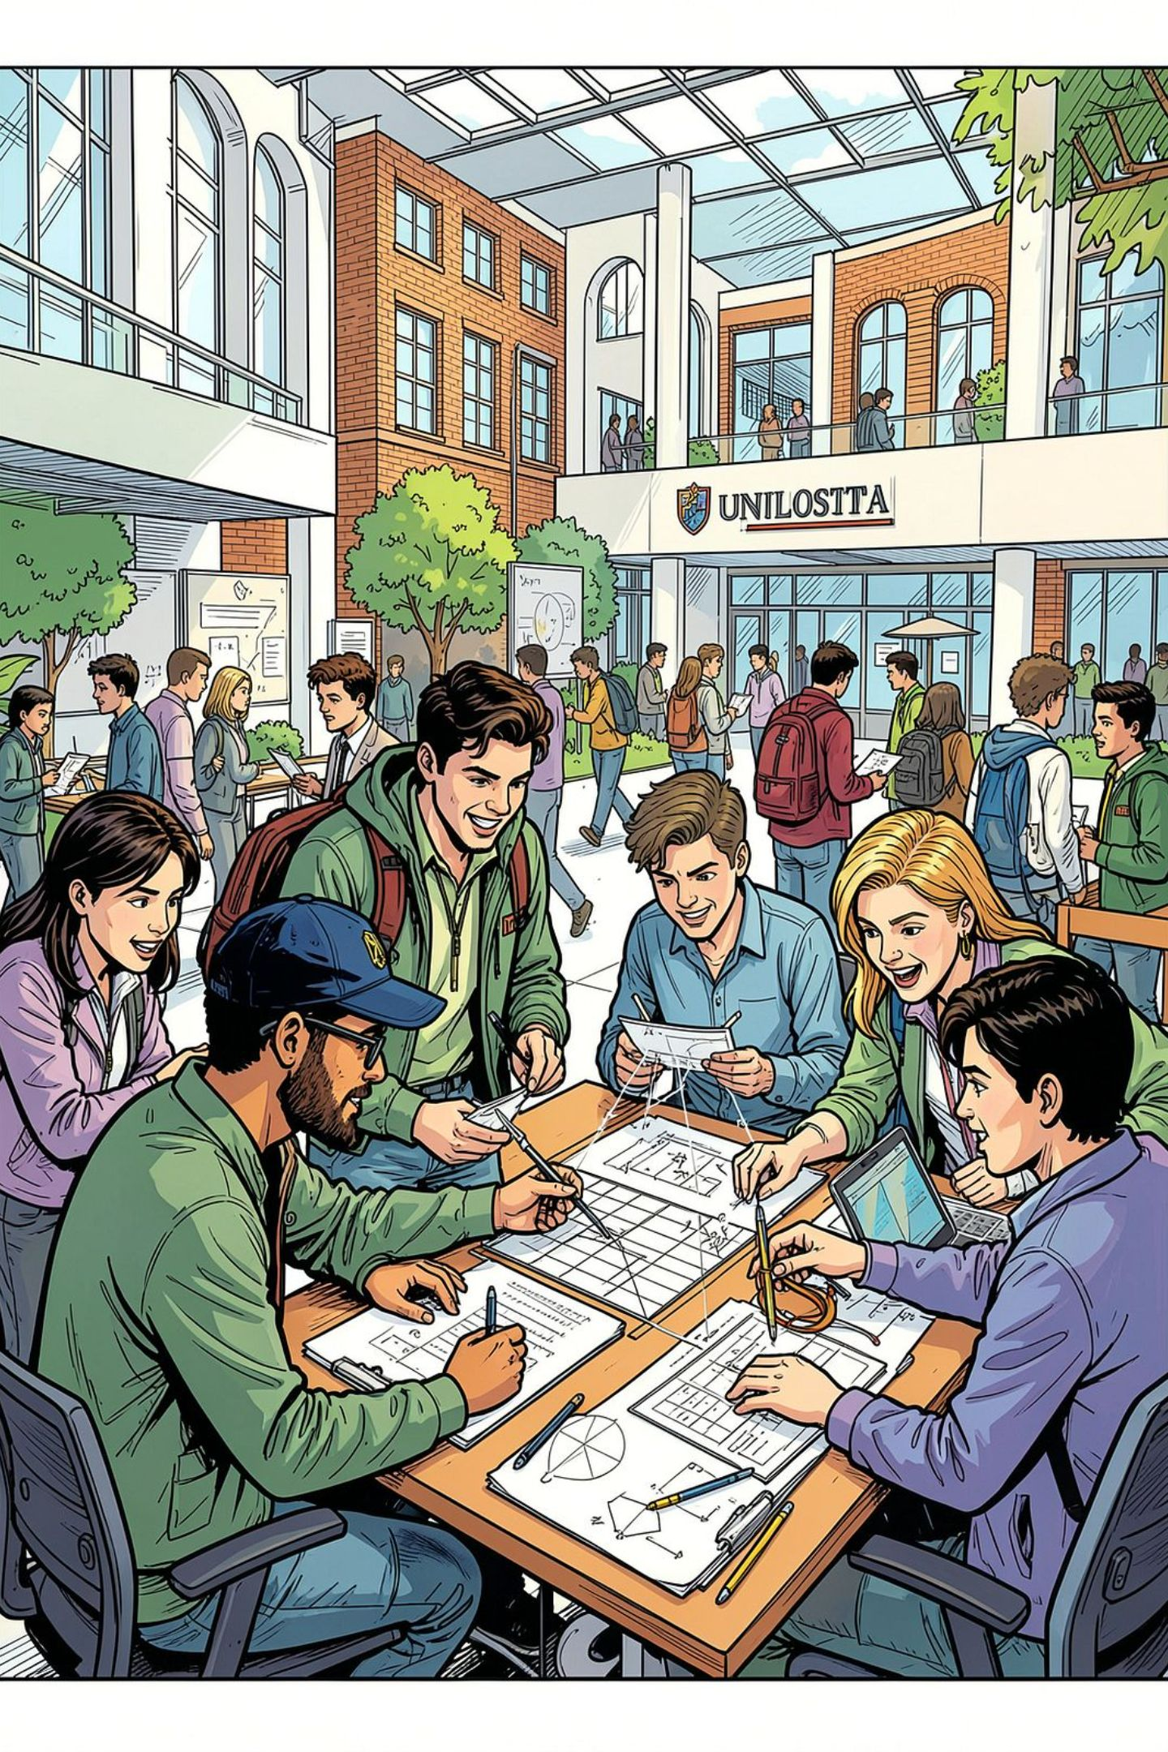
Leadership in Student Life
You don't need a title to lead.
🎯 Lead a Project
📋 Organize Events
🤝 Resolve Conflicts
⚡ Take Initiative
Notes:
Leadership isn't reserved for CEOs. Right now, in college, you have countless opportunities to lead. Lead your mini-project team. Organize a tech fest event. Step in when there's conflict. Join a club and take initiative. Every one of these moments is a chance to practice the qualities we've discussed today.

Slide 9





How to Develop Leadership Skills
Take Initiative
Improve Communication
Learn to Listen
Accept Responsibility
Learn from Failures
Leadership is not a position. It is a skill that can be developed.
Notes:
Here's a practical roadmap. Start small — take initiative on a task no one else wants. Work on how you communicate. Practice listening more than you speak. Own your mistakes instead of deflecting. And when things go wrong — because they will — treat every failure as a lesson. These five steps, practiced consistently, will make you a stronger leader.

Slide 10
Key Takeaways
Inspire, Don't Command
Build on Core Values
Practice Every Day
Leadership is about making others better because of your presence.
Thank You
Any Questions?
Notes:
To wrap up — remember three things. First, great leaders inspire rather than command. Second, leadership is built on communication, integrity, responsibility, and empathy. Third, every single one of you can develop these skills through practice. Start today, start small, and be consistent. Thank you for your attention — I'm happy to take any questions.

