Slide 1
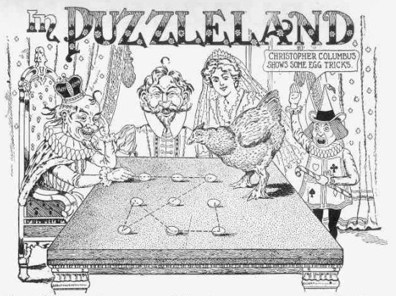
Thinking «out of the box»

Slide 2
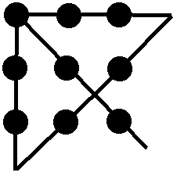
Thinking «out of the box»

Slide 3
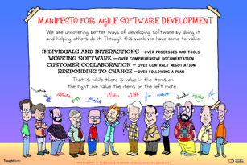
Thinking «out of the box»

Slide 4
Thinking «out of the box»
BOX

Slide 5
Thinking «out of the box»
OUT OF THE BOX
BOX

