Slide 1

Who is the «Architect»?
[...] even by our industry's standards, "architect" and "architecture" are terribly overloaded words.
Martin Fowler
CHIEF Technology Scientist at ThoughtWorks

Slide 2

What is «Architecture»?
The RUP, working off the IEEE definition, defines architecture as “the highest level concept of a system in its environment”.
The architecture of a software system (at a given point in time) is its organization or structure of significant components interacting through interfaces, those components being composed of successively smaller components and interfaces.

Slide 3
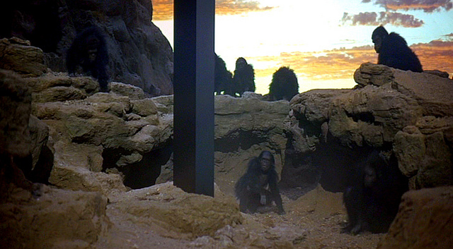
Developers who transcendeds their own nature

Slide 4

Clearly a completely bogus definition...
There is no highest level concept of
a system.
Customers have a different concept
than developers. Customers do not
care at all about the structure of
significant components. So, perhaps an architecture is the highest level concept that developers have of a system in its environment. Let’s forget the developers who just understand their little piece. Architecture is the highest level concept of the expert developers.
What makes a component significant? It is significant because the expert developers say so.

Slide 5
Clearly a completely bogus definition...
There is no highest level concept of
a system.
Customers have a different concept
than developers. Customers do not
care at all about the structure of
significant components. So, perhaps an architecture is the highest level concept that developers have of a system in its environment. Let’s forget the developers who just understand their little piece. Architecture is the highest level concept of the expert developers.
What makes a component significant? It is significant because the expert developers say so.

Slide 6

Architectus «Reloadus»
Is the person who makes all the important decisions.

Slide 7
Architectus «Reloadus»
Is the person who makes all the important decisions.
The architect does this because a single mind is needed to ensure a system’s conceptual integrity, and perhaps because the architect doesn’t think that the team members are sufficiently skilled to make those decisions. Often, such decisions must be made early on so that everyone else has a plan to follow.

Slide 8

Architectus «Oryzus»
This kind of architect must be very aware of what’s going on in the project, looking out for important issues and tackling them before they become a serious problem.

Slide 9
Architectus «Oryzus»
This kind of architect must be very aware of what’s going on in the project, looking out for important issues and tackling them before they become a serious problem.
The most noticeable part of the work is the intense collaboration. In the morning, the architect programs with a developer, trying to harvest some common locking code. In the afternoon, the architect participates in a requirements session, helping explain to the requirements people the technical consequences of some of their ideas in non-technical terms—such as development costs.

Slide 10

Architectus «Oryzus» (Part II)
The most important activity of Architectus Oryzus is to mentor the development team, to raise their level so that they can take on more complex issues.
Improving the development team's ability gives an architect much greater leverage than being the sole decision maker and thus running the risk of being an architectural bottleneck.

Slide 11

Architect's value
This leads to the satisfying rule of thumb that an architect's value is inversely proportional to the number of decisions he or she makes.

Slide 12

«Leading»
Mike Two came up with the best name I’ve heard so far: guide, as in mountaineering.
A guide is a more experienced and skillful team member who teaches other team members to better fend for themselves yet is always there for the really tricky stuff.

Slide 13
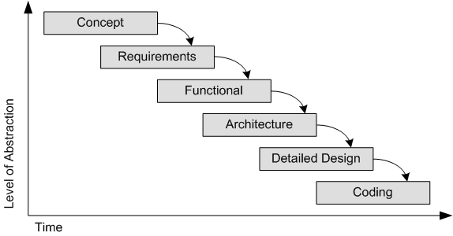
The needs for «early decisions»
There are decisions that you wish you could get right early in a project, so people end up defining architecture as things that people perceive as hard to change.
irreversibility

Slide 14
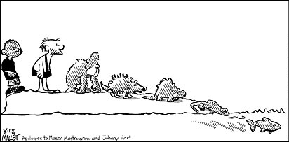
«Irreversibility»
Irreversibility is one of the prime drivers of complexity.
You could see agile methods as a shift that seeks to contain complexity by reducing irreversibility.

Slide 15
Facing irreversibility
Architect «Reloadus»
Documents
Feedbacks
Wrong
choices
Create virtuous cycles, in which positive feedback loops encourage the growth of good activities.
Avoid death spirals, in which positive feedback loops encourage the growth of unproductive or destructive activities.

Slide 16
Facing irreversibility
Architect «Oryzus»
Intense collaboration
Documents
Feedbacks
Wrong
choices
Create virtuous cycles, in which positive feedback loops encourage the growth of good activities.
Avoid death spirals, in which positive feedback loops encourage the growth of unproductive or destructive activities.

Slide 17

Architects Don’t Code
Problem
A large, complicated system needs to be easy and quick to build, debug and maintain.
Real solution
Get architects involved at an implementation level. They don't need to be writing (necessarily) an equal share of production code but they need to get their feet wet from time to time and need to be aware of how changes in their design affect the project.
Resulting context
Implementation lags and fingers are pointed; whoever has the most authority wins, usually the expert. The programmers may need to be replaced if they are deemed not to be "team players" because of arguing with the architect.
Supposed Solution
Some expert, usually an authority, will architect the system on paper. The expert(s) won't be unduly bothered with technical implementation details because their time is valuable. The team will be required to follow the architecture so that the good qualities of the system are assured.

Slide 18

Architects Play Golf
Often architects are difficult to get a hold of during the implementation phase because they no longer feel the need to stick around. Especially around midnight when most of the poor sob developers are still banging away. After all, they've already solved the problem - the rest is just an implementation exercise. My favorite name for this AntiPattern is ArchitectsPlayGolf.

Slide 19

Practices of an Agile Developer
“They typically come in during the beginning of a project, draw all kinds of diagrams, and leave before any serious implementation takes place. There are many "Powerpoint architects" out there, and they aren't effective because of lack of feedback.”

Slide 20


A conflict in team structure
Dedicated software architect
Everybody is software architect
Single point of responsibility for the technical aspects of the software project
Joint responsibility for the technical aspects of the software project

Slide 21
When it comes to dedicated software architect…
Waterfall
Big up front design
and analysis paralysis
UML
Ivory Tower
GolfPlayerArchitect

Slide 22



Architecture as a Service
Software
architecture
document

Slide 23
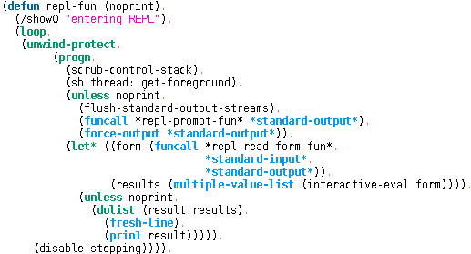
A conflict in process
Software
architecture
document
Big up front design
Requirements capture, analysis
and design complete before
coding starts
Evolutionary architecture
The architecture evolves secondary to the value created by early regular releases of working software

Slide 24

Superarchitect!
(collaborative) code reviews.
knowledge sharing (crunching).
pair programming.
brainstorming.
prototyping.

Slide 25
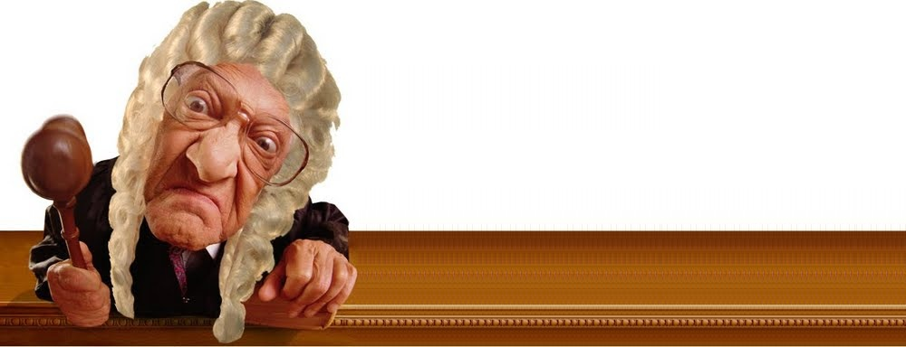
What architecture is not
Governance.
Commitee for validation.
Best practices document provider.

Slide 26
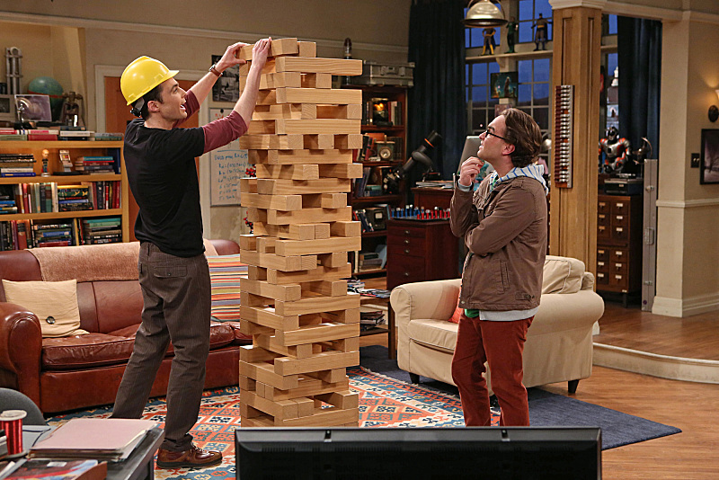
About centralised governance
[...] centralised governance is the tendency to
standardise on single technology platforms.
[...] not every problem is a nail and not every
solution a hammer.
Teams building microservices [...] rather than
use a set of defined standards written down
somewhere on paper they prefer the idea of
producing useful tools that other developers can use to solve similar problems.
Perhaps the apogee of decentralised governance is the build it / run it ethos popularised by Amazon.
Teams are responsible for all aspects of the software they build including operating the software 24/7.
[...] These ideas are about as far away from the traditional centralized governance model as it is possible to be.

