Slide 1
Internet Protocol Suite
and Web Stack
Varsha G. Maragi

Slide 2
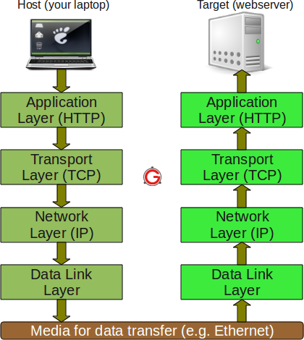
Internet Protocol Suite

Slide 3
Layers in the model
Physical Layer- Physical specifications of the data connection.
Data-Link - Error correction and flow control.
Network Layer- Responsible for addressing.
Transport Layer-reliable/unreliable – also establishes connection
Application Layer-Interacts with the user and gathers the data to be transmitted.

Slide 4
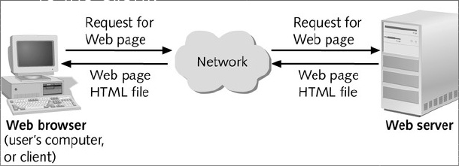
Web Architecture
Client-Server Architecture
Web browser and a Web server

Slide 5
HTTP, HTML and Web Stack
HTTP-Hyper Text Transfer Protocol(The protocol followed by client and server)
HTML-Hyper Text Markup Language(used to write web pages)
A web stack is a collection of software required for web development
LAMP(Linux,Apache,MySQL,PHP) is a web stack

