Slide 1
Demos that Don’t Suck
Making Demos Matter

Slide 2
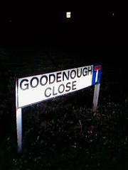
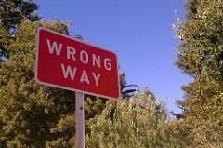
Prepare to learn
Deliver demos that are good enough
Spot Bad Demos

Slide 3
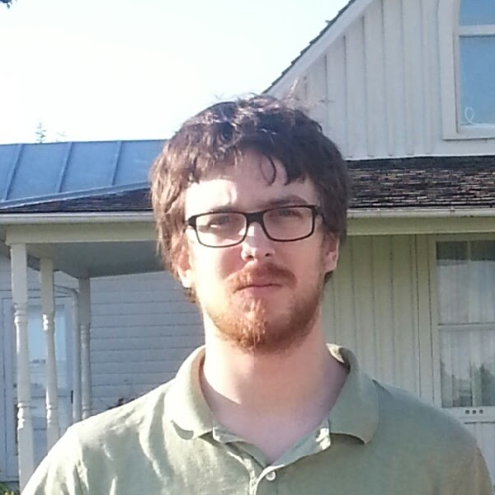
Who is this guy?
Scrum Master, Product Owner, Scrum Lead, Project Manager, QA, QA Lead, SI&T, API Evangelist, Title Collector
Joshua Carson

Slide 4
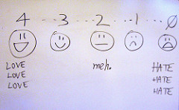
Agenda
Value Of Demos
Demo Preparation
Bad Demos
Good Enough Demos
Great Demos

Slide 5
Value of Demos
More Than Just Ceremony

Slide 6
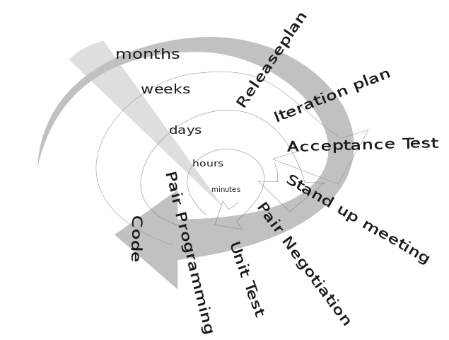
Feedback Loop
Doing Things Right - TDD, ATDD/BDD, Pairing, Continuous Delivery, Continuous Integration
Doing the Right Thing - Demos, Customer Releases, Customer Feedback

Slide 7
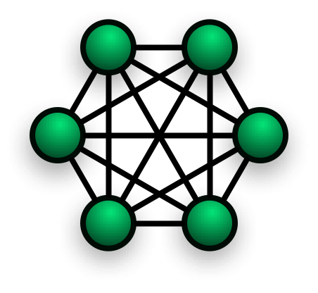
Product Level Setting
What Product Does
What Product Does Not Do
Same Language
Bonding

Slide 8
Demo Preparation
Getting everything lined up

Slide 9

Personas
Customer
Customer’s customer
Sales Team
Support Team
What they want
How they work
How they will work
Persona to persona interactions

Slide 10
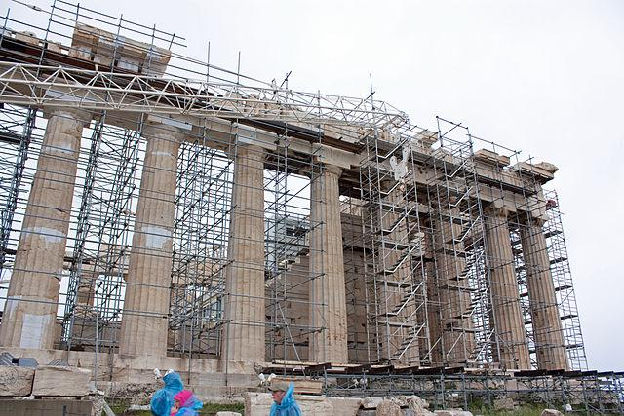
Test Data
Account per persona
Never use word ‘test’
Data in all environments
Data not shared

Slide 11
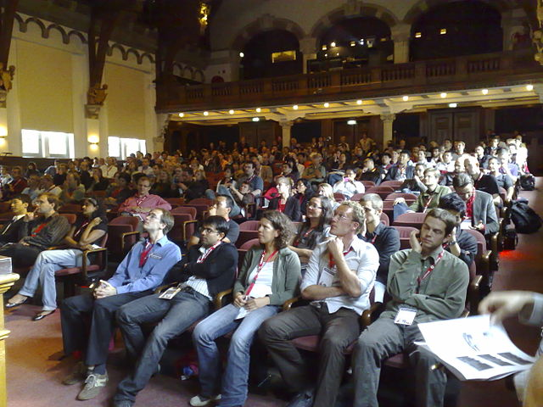
Right Audience
The Money
The Feedback
The Actual Customer
The Team

Slide 12
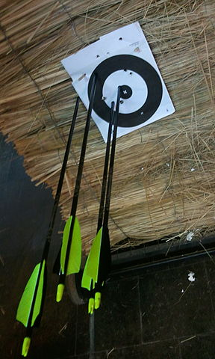
Practice Rounds
Trial Run Day/Night Before - Full flow
Trial Run Five Minutes Before - Sanity Check

Slide 13
Bad Demos
Making Sure You’ll Never Have To Demo Again

Slide 14
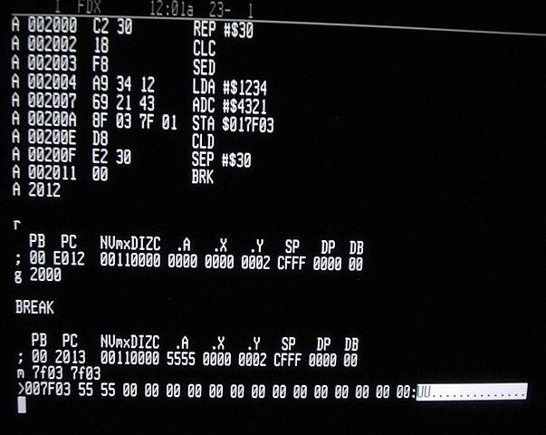
Showing Code
No value shown
Confuses audience
Fun Exercise - www.google.com View Source

Slide 15
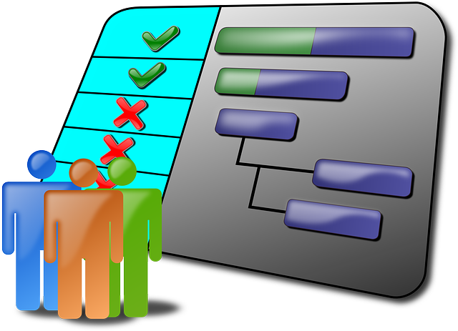
Showing Project Plan
Status, not value
Easily available
Confuses Audience
Feedback not on product

Slide 16
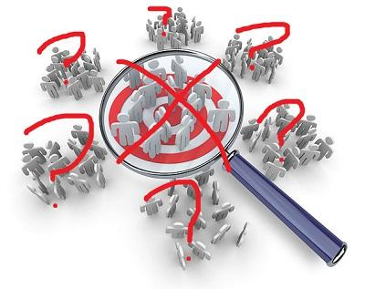
Context - Huh?
No persona
Wrong persona
Missing steps in flow
Missing/Bad setup

Slide 17
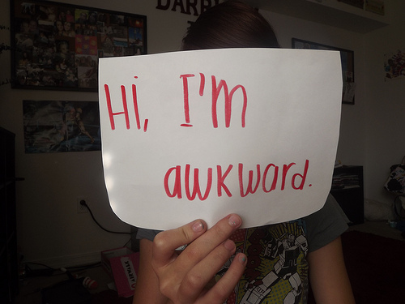
Presenter - Not So Much
Nervous
Jittery
Mumbles
Quiet/Loud
Doesn’t want to
Not feeling well
Poor AV setup

Slide 18
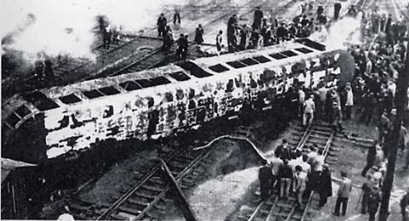
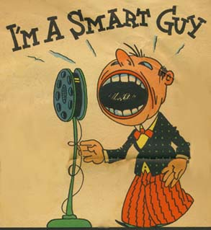
Wrong Crowd
Derailers
Smart Guys
Multitasker

Slide 19
Good Enough Demos
Getting the Point Across

Slide 20

Showing Features
Value deduced
Positive and negative flows
Old way compared to new way

Slide 21
Showing Project Plan
Status avoided
Status minimized otherwise
Planning questions deferred

Slide 22

Context
Persona called out
Flow as persona would
Data looks realistic enough

Slide 23
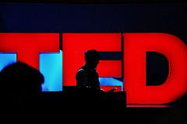
Presenter - Handles It
Calm
Clear
Handles Questions
Approachable

Slide 24

Crowd Management
Questions allowed
Timing monitored
Crowd control

Slide 25
Great Demos
And the Oscar goes to...

Slide 26
Showing Value In Context
Value felt
Personas introduced
Project mentioned briefly
Domain language used

Slide 27
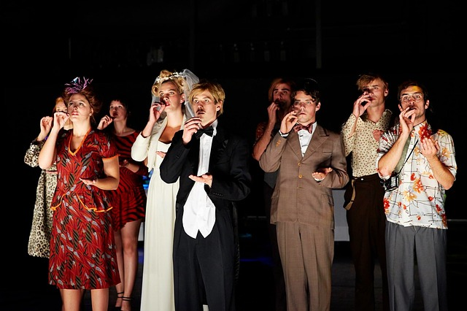
Presenter - Per Persona
No context switch
Speak as persona
Mistakes as persona

Slide 28
Give meaningful context and the customer’s experience while getting audience feedback

Slide 29
Image Credits
Good enough ?!?! by AUSTIN_O at flickr
Wrong Way by Elaine with Grey Cats at flickr
Evaluation scale by billsoPHOTO at flickr
Xp-loop with time frames by Michael Huttermann at Wikimedia Commons
Target-market-in-marketing-plan by Surendar Kumar at Wikimedia Commons, with crossout edits using MSPaint
Parthenon scaffolding 2010 2 by Wknight94 at Wikimedia Commons
MobileHCI 2008 Audience Nhenze at Wikimedia Commons
Archery practice by Leonardob0880 at Wikimedia Commons
W65C816S Machine Code Monitor by BigDumbDinosaur at Wikimedia Commons
Hi, I’m awkward. by Laura Barberis at flickr
Something New Party Logo by James Smith at Wikimedia Commons
Got-an-idea by إبن البيطار at Wikimedia Commons
the spirit of TED by Gisela Giardino at flickr
Who’s Awesome? You’re Awesome! by Kevin Jerrett at flickr

Slide 30
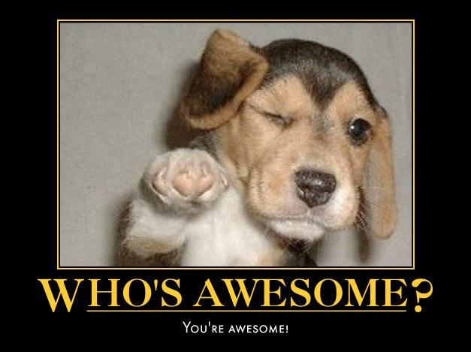
Go Be Awesome
Feedback to:
Email
joshuajcarson@gmail.com
Twitter
@joshuajcarson

