Slide 1
Systems & Techniques
汇报人：师玉龙

Slide 2
Session 7: Systems
IOS: Inter-Operator Scheduler for CNN Acceleration
Value Learning for Throughput Optimization of Deep Learning Workloads
ByzShield: An Efficient and Robust System for Distributed Training
FirePlace: Placing Firecraker Virtual Machines with Hindsight Imitation

Slide 3
Session 10: Techniques
SUOD: Accelerating Large-Scale Unsupervised Heterogeneous Outlier Detection
Lost in Pruning: The Effects of Pruning Neural Networks beyond Test Accuracy
Equality Saturation for Tensor Graph Superoptimization
Doping: A technique for Extreme Compression of LSTM Models using Sparse Structured Additive Matrices

Slide 4
IOS: Inter-Operator Scheduler for CNN Acceleration
accelerate CNN inference
算子并行
算子内并行
a single operator can no longer fully utilize the available parallelism，e.g., Tensorflow (Abadi et al., 2016) and Pytorch (Paszke et al., 2017)
算子间并行
Inter-Operator Scheduler (IOS)

Slide 5
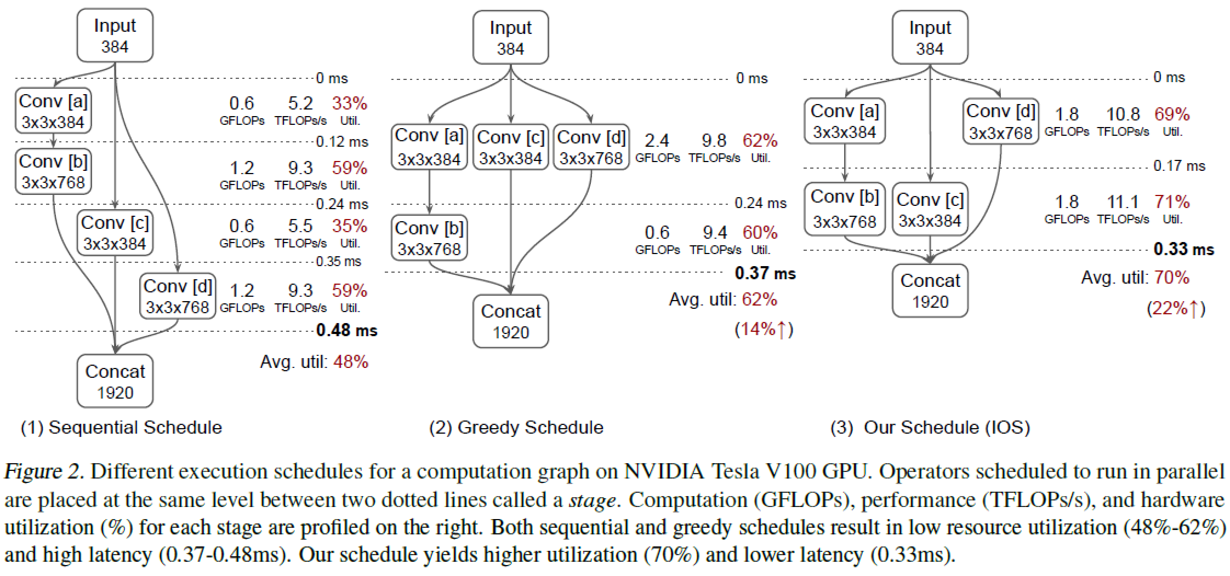
IOS: Inter-Operator Scheduler for CNN Acceleration

Slide 6
IOS: Inter-Operator Scheduler for CNN Acceleration
This greedy schedule is sub-optimal, a challenging task.
算子规模大，难穷举
受限于硬件和推理设置
提出的方案：
We propose IOS, an inter-operator scheduler that accelerates CNN inference by combining intra- and inter-operator parallelism.
优点：
IOS achieves 1:1 to 1:5X inference speedup compared to existing deep learning libraries (e.g., TensorRT).
Furthermore,IOS demonstrates the necessity of customizing the scheduling policy for different hardware and inference configurations. IOS can achieve up to 1:15X inference speedup by customizing the scheduling recipe compared to itself with no customization.

Slide 7
VALUE LEARNING FOR THROUGHPUT OPTIMIZATION OF DEEP NEURAL NETWORKS
neural networks schedule
neural networks frameworks, separate the algorithmic representation of the deep learning model from the schedule.
good schedules:
achieves a similar performance without extensive search, delivering the needed efficiency quickly
Auto-tuning methods, but the search can take hours
深度学习框架的缺点：
it requires the development, optimization, and maintenance of a large library of operators, which necessitates scarce human expertise.
operators can only exchange data through global memory, which is a significant bottleneck.

Slide 8
VALUE LEARNING FOR THROUGHPUT OPTIMIZATION OF DEEP NEURAL NETWORKS
解决方案：
1. projects such as Halide (Ragan-Kelley et al., 2012) and TVM (Chen et al., 2018a) proposed to represent tensor computations, such as the ones underlying deep learning, using a declarative domain specific language based on Einstein’s notation.
2.Various efforts have attempted to tackle the scheduling problem by framing it as a search in the space of valid implementations.
问题本质：组合问题
heuristics 启发式方法：time consuming，suboptimal

Slide 9
VALUE LEARNING FOR THROUGHPUT OPTIMIZATION OF DEEP NEURAL NETWORKS
贡献：
1 A method to derive a set of valid implementation candidates.
2 A performance model capable of predicting the speed of a fully scheduled pipeline almost as accurately as benchmarking on actual hardware while being many times faster. Our cost model is more than one order of magnitude more accurate than the ones proposed by
(Adams et al., 2019) and (Chen et al., 2018b)
3 A technique to iteratively derive from our cost model a value function that forecasts the best performance achievable for a partially scheduled pipeline. We use this value function to greedily navigate the solution
space towards the best candidate two to three orders of magnitude faster than previously published approaches.
4 Combining these techniques, we are able to identify schedules that outperform Halide and TVM by 2:6X and 1:5X respectively.

Slide 10
FirePlace: Placing Firecraker Virtual Machines with Hindsight Imitation (事后诸葛)
研究对象：
We consider the placement of FireCracker VMs (a form of Micro-VMs) lightweight VMs that are typically used for short lived tasks.
目标：
Our objective is to place each VM as it arrives, so that the peak to average （峰均比）ratio of resource usage across PMs （physical machines） is minimized.
挑战：
Placement is challenging as we need to consider resource use in multiple dimensions, such as CPU and memory, and because resource use changes over time.

Slide 11
FirePlace: Placing Firecraker Virtual Machines with Hindsight Imitation (事后诸葛)
我们的方案：
We formulate the problem as a Markov Decision Process (MDP) (Puterman, 1990), where the agent places a Micro-VM at each time step.
We propose FirePlace, a hindsight imitation learning algorithm for Micro-VM placement. We leverage historical data to identify placement decisions that could have been made using hindsight of future Micro-VM compute and memory use, similar to hindsight optimization.
We then cast placement as a supervised learning problem with the hindsight based decision as the label.
实验：
FirePlace improves upon baseline algorithms by 10% when placing 100K Micro-VMs.

Slide 12
PRUNING: THE EFFECTS OF PRUNING NEURAL NETWORKS BEYOND TEST ACCURACY
剪枝的作用：
Neural network pruning is a popular technique used to reduce the inference costs of modern, potentially overparameterized, networks.
过程：
Starting from a pre-trained network, the process is as follows: remove redundant parameters, retrain, and repeat while maintaining the same test accuracy.
结果：
The result is a model that is a fraction of the size of the original with comparable predictive performance (test accuracy).

Slide 13
PRUNING: THE EFFECTS OF PRUNING NEURAL NETWORKS BEYOND TEST ACCURACY
缩减参数的动机：
Deep neural networks tend to contain millions or billions of parameters
Such a reduction in parameter count alleviates the computational burden on training and inference, making it easier to deploy high capacity models to small devices and use them in resource constrained environments.
修剪流水线:
1. Prune weights (“unstructured pruning”) or filters/neurons (“structured pruning”) from the trained network according to some criterion of importance;
2. Retrain the resulting network to regain the full accuracy;
3. Iteratively repeat steps 1 & 2 to further reduce the size.

Slide 14
PRUNING: THE EFFECTS OF PRUNING NEURAL NETWORKS BEYOND TEST ACCURACY
贡献：
1 We propose novel functional distance metrics for classification-based neural networks and investigate the functional similarities between the pruned network and its unpruned counterpart.
2 We propose the notion of prune potential, i.e., the maximal prune ratio (model sparsity) at which the pruned network can achieve commensurate performance, as a quantifiable means to estimate the overparameterization of a network and show that it is significantly lower on challenging inference tasks.
3 We provide a unified framework to establish task specific guidelines that help practitioners assess the effects of pruning during the design and deployment of neural networks in practice.
4 We conduct experiments across multiple data sets, architectures, and pruning methods showing that our observations hold across common pruning benchmarks and real-world scenarios.

Slide 15
EQUALITY SATURATION FOR TENSOR GRAPH SUPEROPTIMIZATION
研究问题：
One of the major optimizations employed in deep learning frameworks is graph rewriting. Production frameworks rely on heuristics to decide if rewrite rules should be applied and in which order.
研究现状：
Prior research has shown that one can discover more optimal tensor computation graphs if we search for better sequence of substitutions instead of relying on heuristics.
缺点：
However, we observe that existing approaches for tensor graph superoptimization both in production and research frameworks apply substitutions in a sequential manner. Such sequential search methods are sensitive to the order in which the substitutions are applied and often only explore a small fragment of the exponential space of equivalent graphs

Slide 16
EQUALITY SATURATION FOR TENSOR GRAPH SUPEROPTIMIZATION
我们的方案：
This paper presents TENSAT, a tensor graph superoptimization framework that employs equality saturation (等式饱和), a recent technique that mitigates the phase-ordering problem by applying all possible rewrites at once.
Equality saturation splits program optimization into two phases: exploration and extraction.
实验效果：
We show that our approach can find optimized graphs with up to 16% speedup over state-of-the-art, while spending on average 48x less time optimizing.

Slide 17
DOPING: A TECHNIQUE FOR EXTREME COMPRESSION OF LSTM MODELS USING SPARSE STRUCTURED ADDITIVE MATRICES
问题提出背景：
Language models (LMs) based on neural networks have been extremely effective in enabling a myriad of natural language processing (NLP) applications in recent years. However, many of these NLP applications are increasingly being deployed on consumer mobile devices and smart home appliances, where the very large memory footprint of large LMs is a severe limitation.
研究趋势：
Therefore, to enable efficient inference on resource constrained devices, there is a sustained need for improved compression techniques that can achieve high compression factors without compromising accuracy.

Slide 18
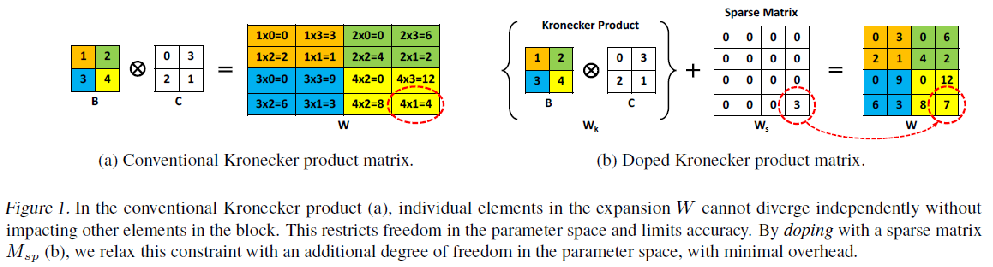
DOPING: A TECHNIQUE FOR EXTREME COMPRESSION OF LSTM MODELS USING SPARSE STRUCTURED ADDITIVE MATRICES
研究现状：
Model compression using structured matrices has been previously demonstrated on various image and audio tasks, such as object detection, human activity recognition (HAR), orthogonal projections and key-word spotting （正交投影与关键词识别）(KWS).
Figure 1a shows that the root issue (perplexity loss) with conventional KP is that during the optimization of the constituent matrices B and C.

Slide 19
DOPING: A TECHNIQUE FOR EXTREME COMPRESSION OF LSTM MODELS USING SPARSE STRUCTURED ADDITIVE MATRICES
我们的方案：
In this paper, we relax this limitation in the parameter space by doping (掺杂) the structured matrix Mk with an extremely sparse additive matrix Ms (Figure 1b). This approach was inspired by robust PCA techniques, and allows an additional degree of freedom to recover accuracy at very low inference-time cost.
实验效果：
Present state-of-the-art results for compressing language models and translation applications using doped KP, which are 1.5 - 2.4X smaller than previous work at comparable accuracy values.

Slide 20
谢谢！

