Slide 1
Optimizing DNN Computation With Relaxed Graph Substitution
The Conference on Systems and Machine Learning (2019, SysML)
姚春荣

Slide 2

Motivation
Methodology
Evaluation
Conclusion

Slide 3
Motivation
Methodology
Evaluation
Conclusion

Slide 4
Motivation
Computation graph (node, edge);
Existing deep learning frameworks optimize the computation graph of a DNN model by performing greedy rule-based graph transformations (i.e., operator fusion);
The current optimizers miss many more complex optimization opportunities;

Slide 5
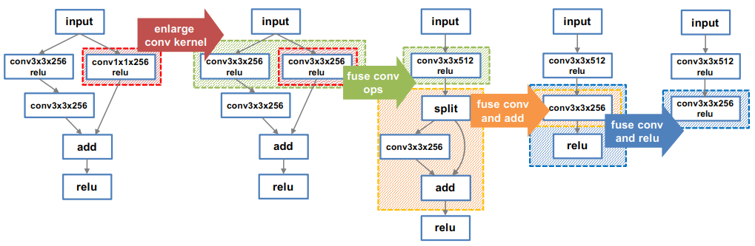
Motivation
Relaxed graph substitutions;

Slide 6
Motivation
Methodology
Evaluation
Conclusion

Slide 7
Methodology
Computation graph
Define
Equivalent
Relaxed graph substitutions
Source graph: it defines the structure of valid subgraphs for a substitution.
Target graph: it describes how to construct a new subgraph to substitute for the mapped subgraph.

Slide 8
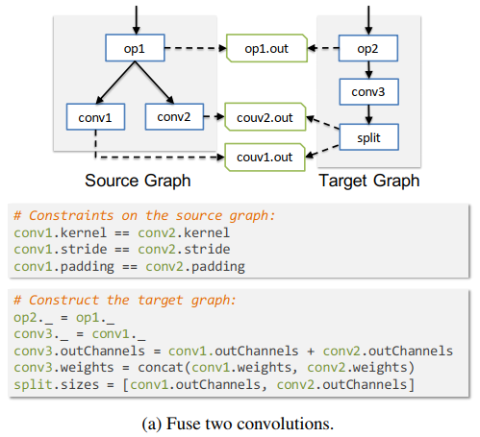
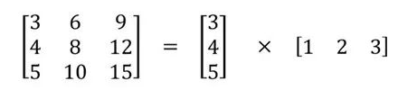
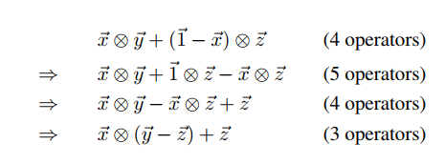
Methodology
CONV3
CONV1
CONV2

Slide 9
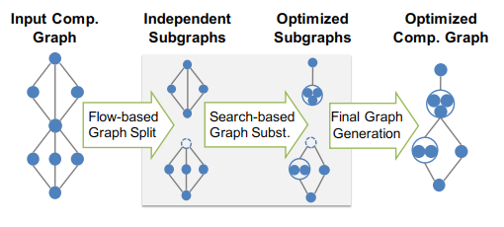
Methodology
MetaFlow (https://github.com/jiazhihao/metaflow_sysml19)
Flow-based graph split algorithm: it divides the input graph into subgraphs that are amenable to direct search;
Backtracking search algorithm: it finds an optimized candidate graph in the search space under the cost model;

Slide 10
Methodology
The MetaFlow search algorithm
Cost Model
Cost dimensions:
FLOPs
Memory usage
The number of kernel launches
Backtracking Search

Slide 11
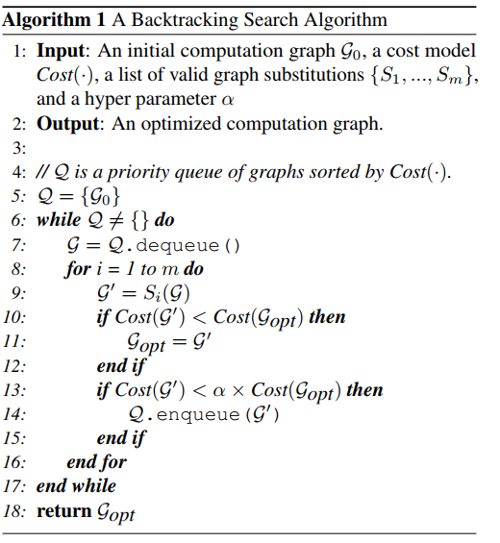
Methodology
Keep current solution
Greedy algorithm
Expand the search space

Slide 12
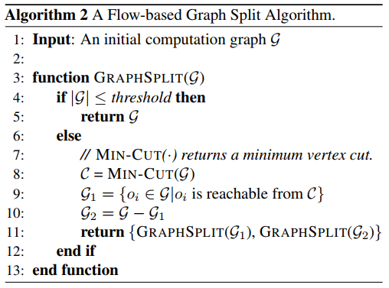
Methodology
Flow-Based Recursive Graph Split

Slide 13
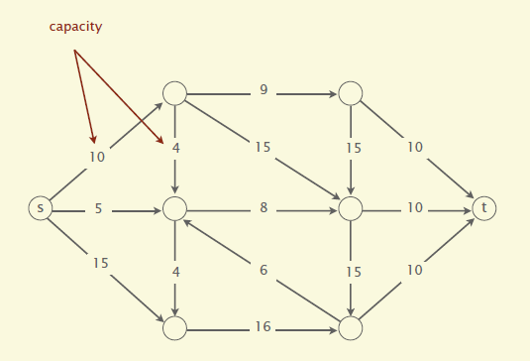
Methodology
Min-cut & Max-flow

Slide 14
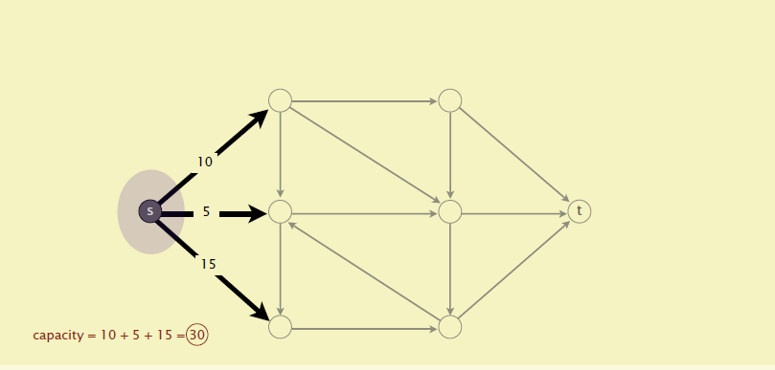
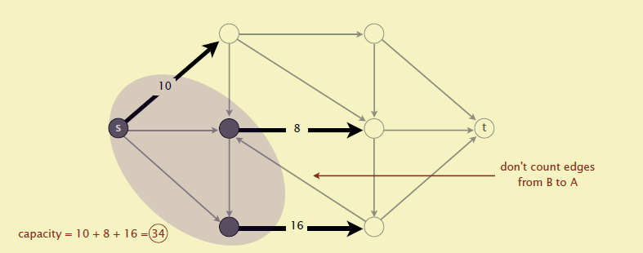
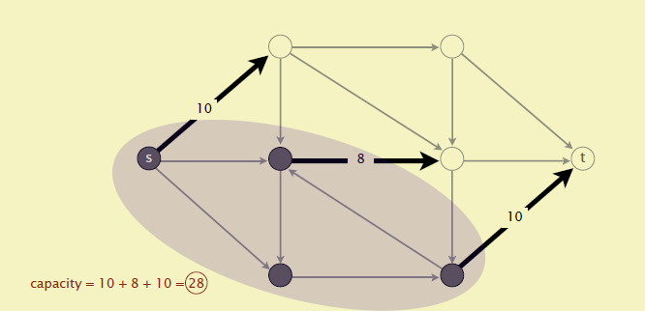
Methodology
Min-cut

Slide 15
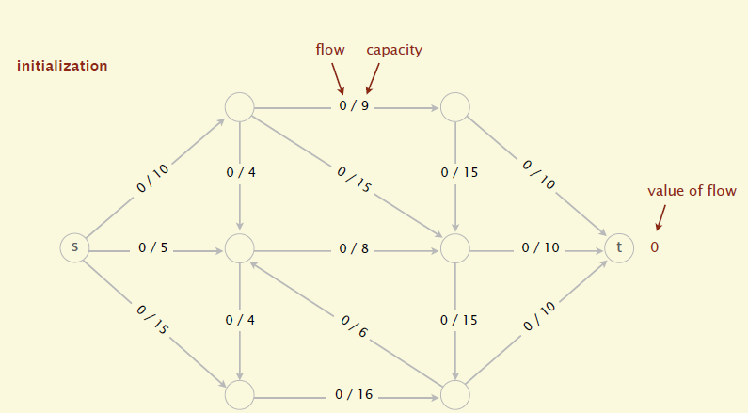
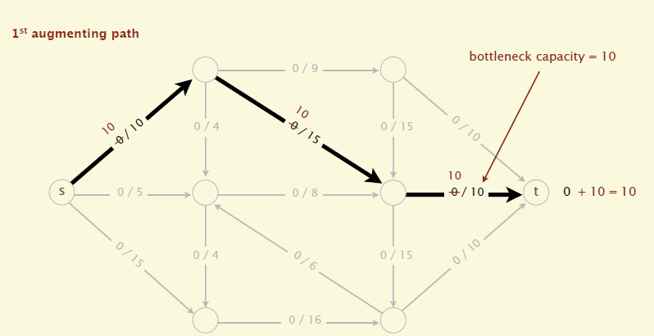
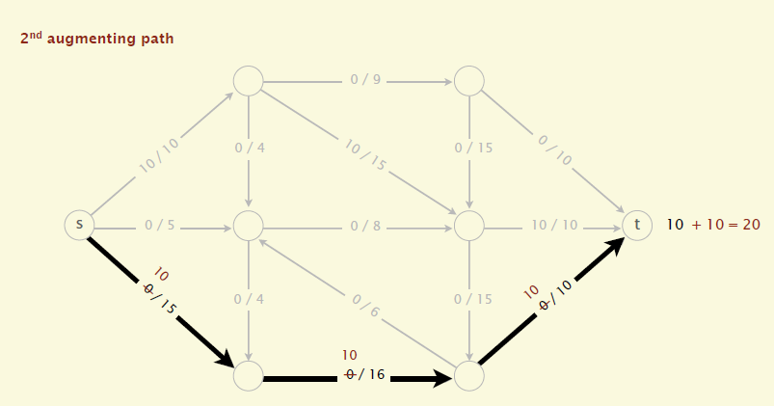
Methodology
Max-flow
Edge: 0≤ flow < capacity;
Node: inflow = outflow (except s, t) ;
value of the flow = t.inflow

Slide 16
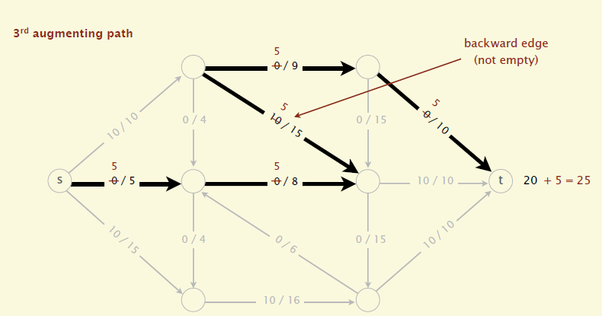
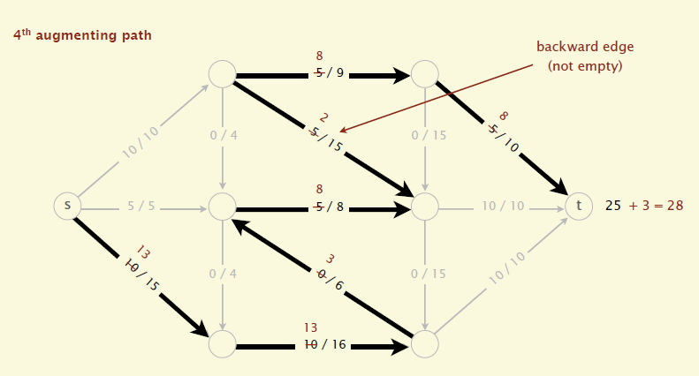
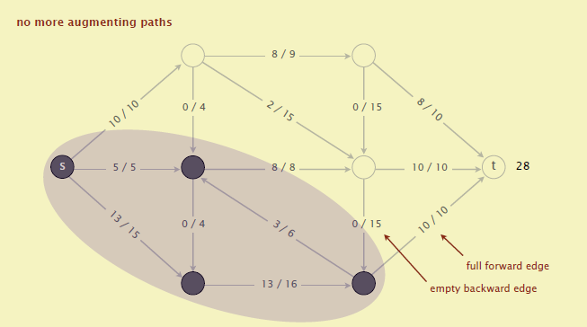
Methodology

Slide 17
Motivation
Methodology
Evaluation
Conclusion

Slide 18
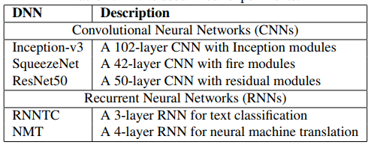
Evaluation
Experimental Setup
DNNs
Deep learning frameworks
TensorFlow
TensorFlow XLA
TensorRT
Cost Model
Minimize execution time
Parameter

Slide 19
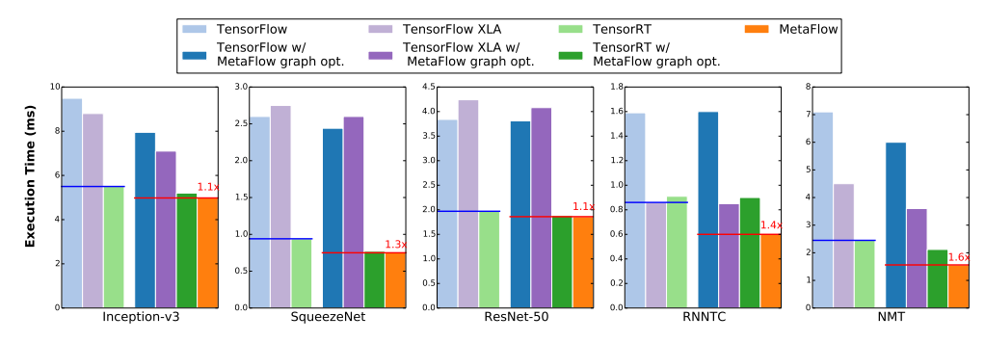
Evaluation
Inference Performance
MetaFlow outperforms existing deep learning inference engines with speedups ranging from 1.1x to 1.6x.

Slide 20
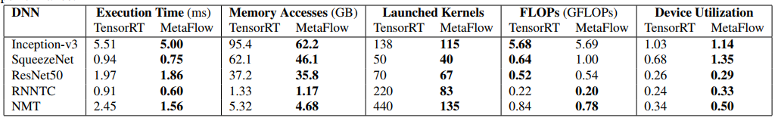
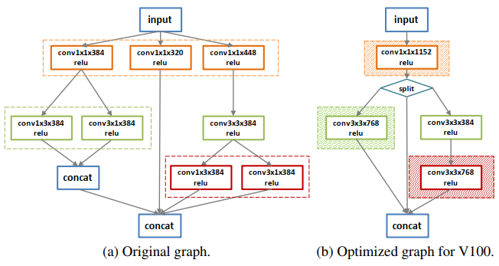
Evaluation
MetaFlow reduces the overall memory accesses by up to 1.6x and the number of kernel launches by up to 3.7x.

Slide 21
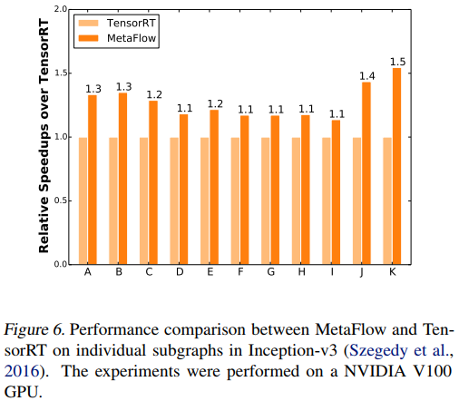
Evaluation
Subgraph performance
MetaFlow can consistently find faster computation graphs than TensorRT, which leads to a performance improvement of 1.25x.

Slide 22
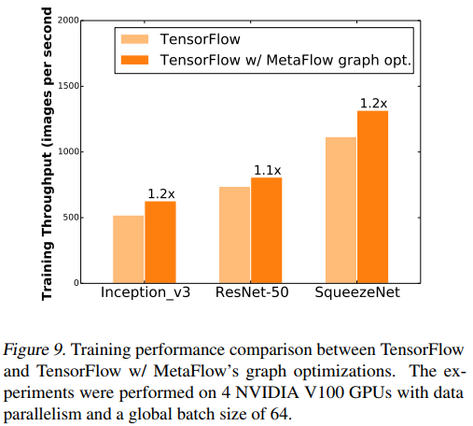
Evaluation
Training Performance
MetaFlow can still discover computation graphs that increase training throughput by up to 1.2x.

Slide 23
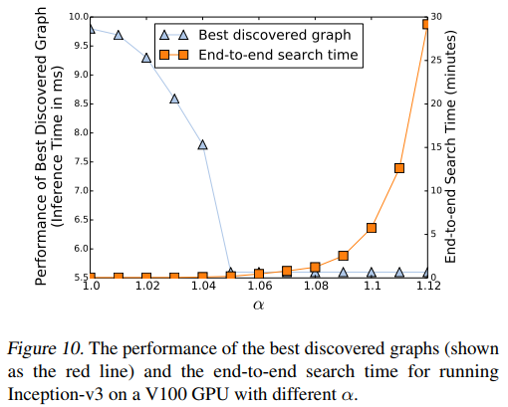
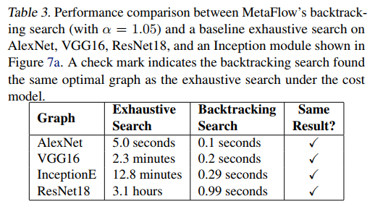
Evaluation
Search Algorithm Performance

Slide 24
Motivation
Methodology
Evaluation
Conclusion

Slide 25
Conclusion
Relaxed graph substitutions;
MetaFlow
Backtracking search;
Flow-based recursive graph split;

Slide 26
Work progress
A layer-level energy optimization framework for CNN inference on GPUs (research idea)
Motivation
CNNs behave optimally only by changing the DVFS configuration for each layer. If we consider CNNs as a blackbox, the lowest energy consumption will not be achieved.
Definition
To minimize energy consumption while meeting latency SLO for CNN inference.

Slide 27
Work progress
Problem
How to model energy and time in layers;
How to find the optimal configuration in whole network;

Slide 28
Work progress
Model
network
layer
kernel
performance counters (PMCs)
Reading/writing data from the global memory
Reading/writing data from the shared memory
Computing

Slide 29
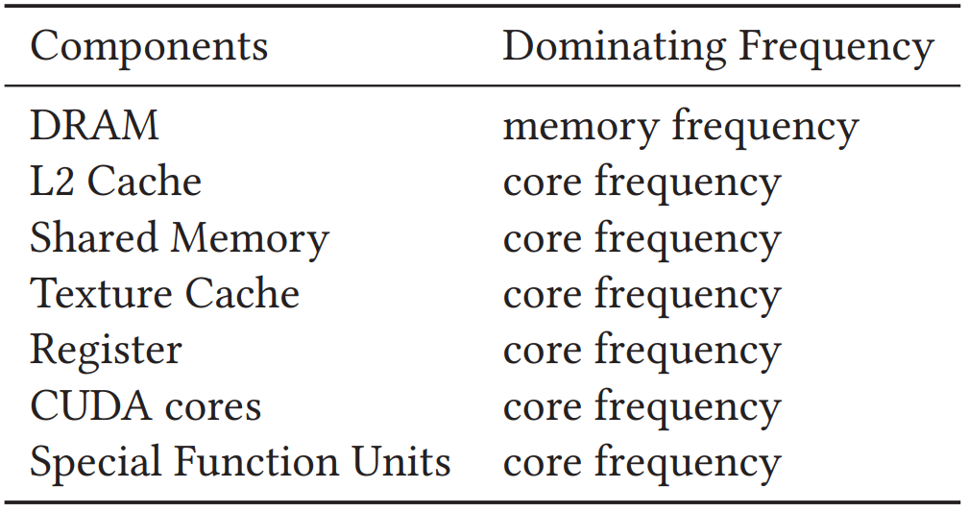
Work progress
DVFS
Multiple Linear Regression (MLR)

Slide 30
Work progress
Trade-off energy and time
PredJoule
Although this method is simple, it cannot find the global optimal solution.
Heuristic algorithm
It can be regarded as the shortest path problem with constraints.
Ant Clony Optimization (ACO)

Slide 31
谢谢！

