Slide 1
KungFu: Making Training in Distributed Machine Learning Adaptive
Zhibing Liu
Dec. 4th, 2020
* The slices are modified from the open presentation Luo Mai made in OSDI 20.
Notes:
kung fu, a library that can make training in distributed machine leraning adaptive
https://www.usenix.org/conference/osdi20/presentation/mai

Slide 2

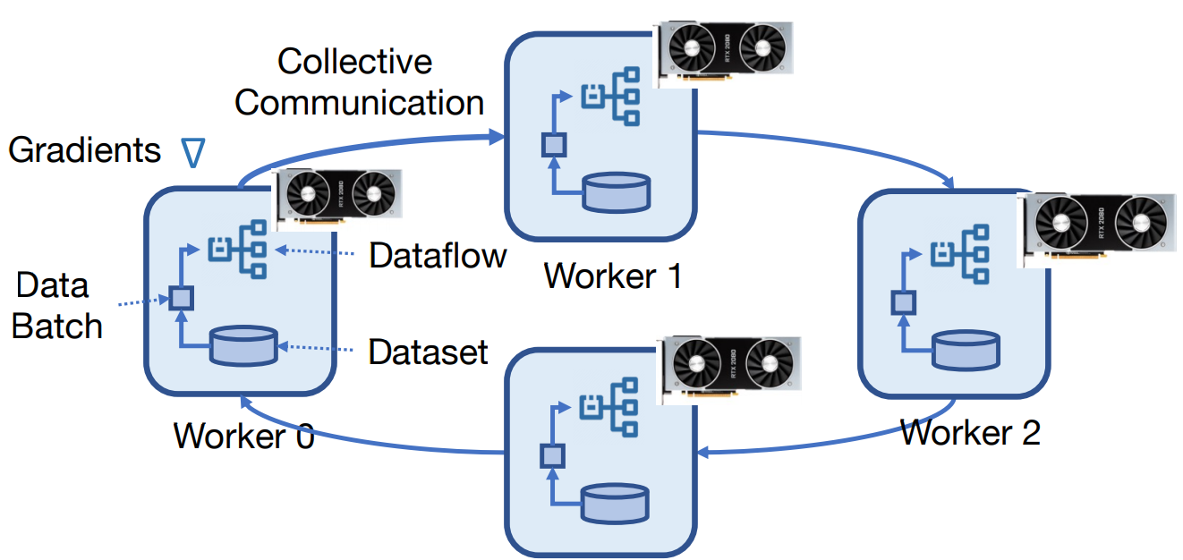
Training in Distributed ML Systems
Distributed training systems are key to combining big data with large models
Notes:
Background: The volume of data is getting bigger, and the model has been increasingly complex, it’s hard to train modern deep learning models on a single machine. We have to go distributed.
Developers use distributed training systems like horovod and tensorflow to scale out the training of their models
Implement data parallel training: partition the dataset, replicate the model to use multiple parallel processors such as GPUs or multiple workers
They compile the models into the dataflow.
In every iteration of training the dataflow will read the data batch and compute the gradients.
The gradients need to be averaged across all the working machines by using allreduce operation provided by collective communication system.
the training lasts for many iterations until the model reach high accuracy.

Slide 3
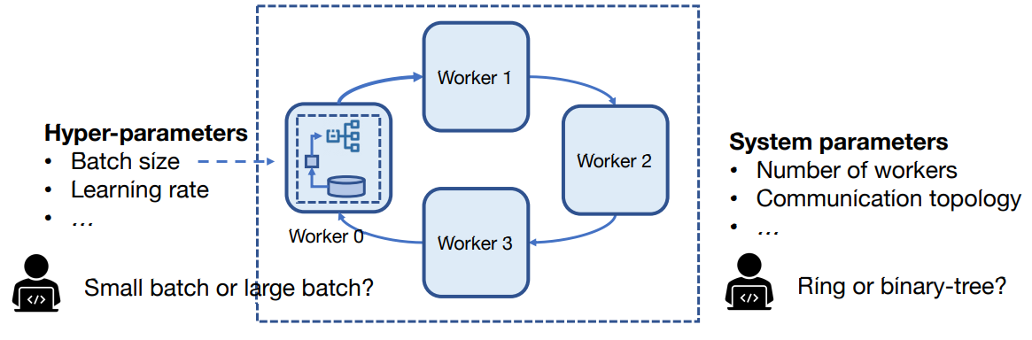
Parameters in Distributed ML Systems
Users must tune parameters to optimize time-to-accuracy
Notes:
Tune hyper-parameters, system parameters.
Hyper-parameters:
1. define how the model is updated
2. decide the model accuracy.
System parameters:
1. decide how the workload is being distributed across the workers
2. affect the training throughput.
Users often rely on their empirical experience to tune these parameters.

Slide 4
Issues with Empirical Parameter Tuning
Dataset-specific
“Change batch size at data epoch 30, 60, and 90 when training with ImageNet.” [1]
Model-specific
“Linearly scale the learning rate with the #workers when training ResNet models.”[2]
Cluster-specific
“Set the topology to a ring by default.”
Time-consuming
[1] Dynamic Mini-batch SGD for Elastic Distributed Training: Learning in the Limbo of Resources, 2020
[2] Accurate, Large Minibatch SGD: Training ImageNet in 1 Hour, 2018
[3] Horovod: fast and easy distributed deep learning in TensorFlow, 2018
Notes:
When using other dataset, need retune.
Barely works on other models
Work well in HPC clusters but might perform poorly in cloud cluster.

Slide 5
Automatic Parameter Adaptation
Example
OpenAI predicts batch size based on Gradient Noise Scale (GNS)
Intuition
GNS measures variation in data batches
Proposal
When GNS is small → keep batch size
When GNS is large → increase batch size
Notes:
Small GNS: the system can’t learn from the many data samples in parallel. More data samples will be redundant.
Large GNS: the system can effectively learn from huge batches of data. Increase batch size can help the system converge faster.

Slide 6
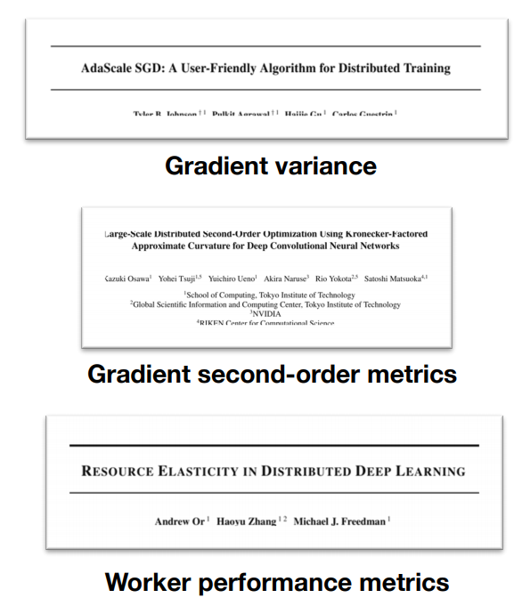
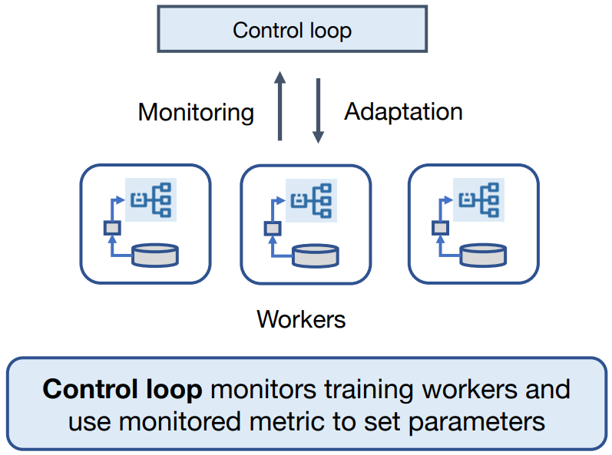
Proposals for Automatic Parameter Adaptation
Notes:
Recent similar proposals
Nvidia and Apple: Gradient variance and gradient second-order metrics → automatically set learning rate
Worker performance metrics → decide the optimal #workers
If we abstract these proposals from their contexts, we can conclude that 2 roles are involved in parameter adaptation, the control loop and workers.
Control loop:
Workers: train models

Slide 7
Open Challenges
Can we design a distributed ML system that supports adaptation?
Design challenges:
How to support different types of adaptation?
How to adapt based on large volume of monitoring data?
How to change parameters of stateful workers?
Notes:
Challenge 2: Because the adaptation often rely on monitoring and analyzing data such as gradients, but gradients can be produced several GB/s by deep learning servers. → It is challenging to analyze them in real time.
Challenge 3: Just the model will be very large. The adaptation should not affect the consistency of the states on distributed nodes.

Slide 8
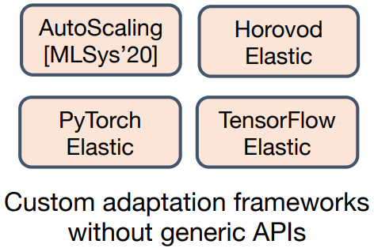
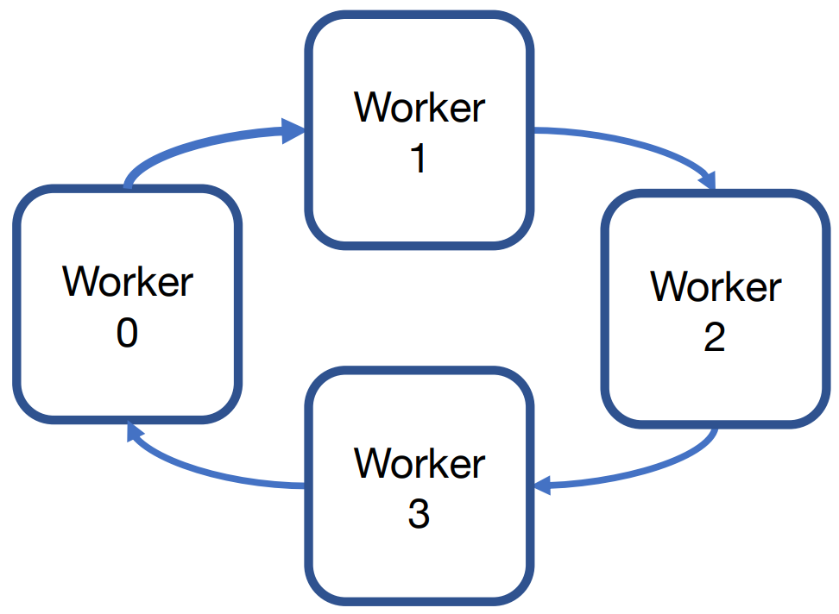
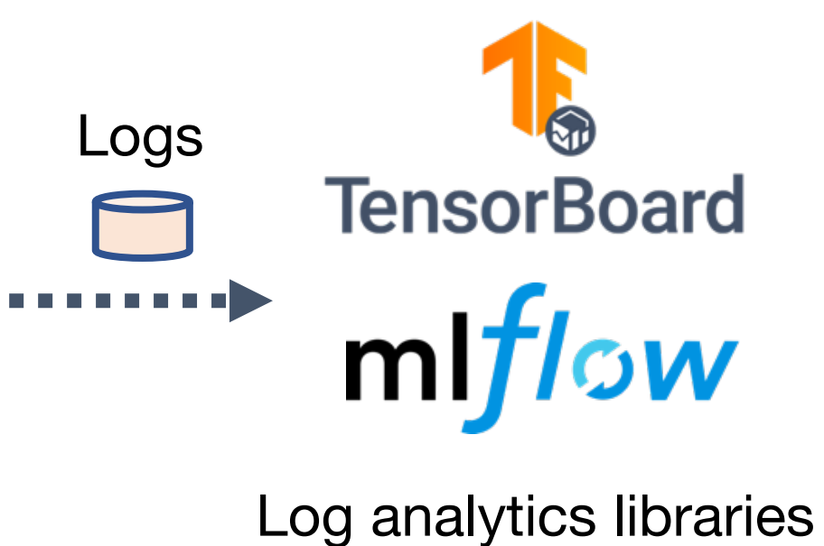
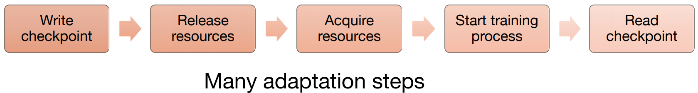
Existing Approaches for Adaptation
1. No unified mechanism for adaptation
2. Processing of monitoring data offline
3. Chectpoint-and-recovery
Notes:
Problems with existing approaches
Users implement custom external framework. No generic APIs to support new adaptation proposals.
Workers dump monitoring data as logs to external log analytics libraries. These libraries are not designed for analyzing tremendous gradients in real time and there is no natural way to send the result back to the training system to guide online adaptation decisions.
To protect the consistency of the state, workers require users to checkpoint their states. These steps build up large adaptation latency.

Slide 9
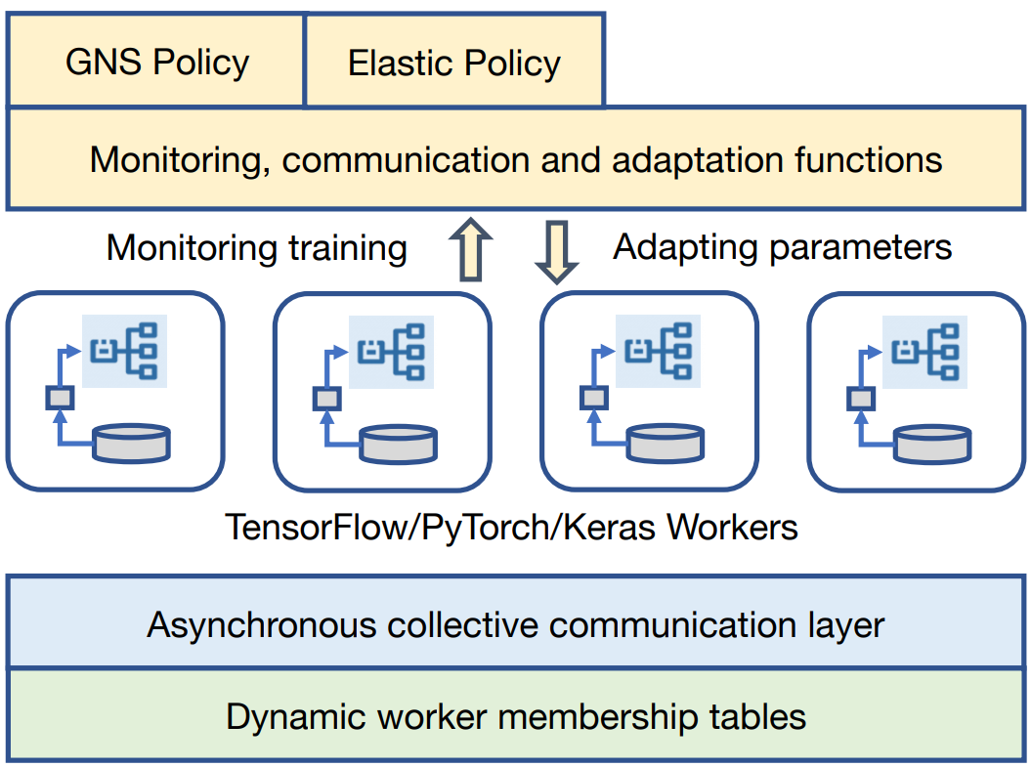
KungFu Overview
Contributions
Adaptation policies
Embedding monitoring operators inside dataflow
Distributed mechanisms for parameter adaptation
Supporting different types of adaptation
Processing large volume of monitoring data
Consistent adaptation for stateful workers
Notes:
KungFu: Make adaptative training easy and efficient
Policies are implemented to be combinations of high level APIs that are intuitive for ML developers. These APIs can be used to monitor and adapt workers running existing ML framework.
[Words on the left, contribution] enable KungFu to be able to [Words on the right, capability].
New distributed mechanisms allows workers to expose low level system parameters in a stateful manner. When parameters change, KungFu can automatically synchronize the updates and make sure the adaptation is consistent.

Slide 10
Contribution 1: Adaptation Policies

Slide 11
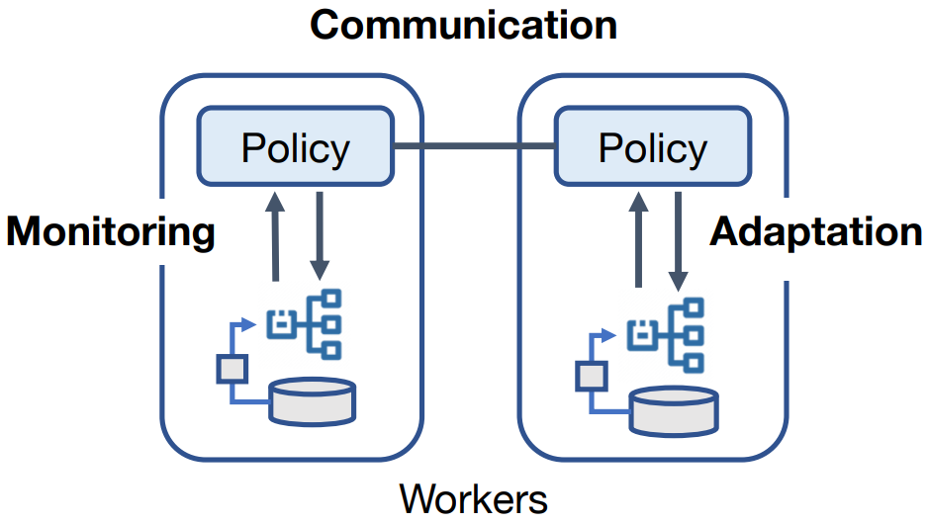
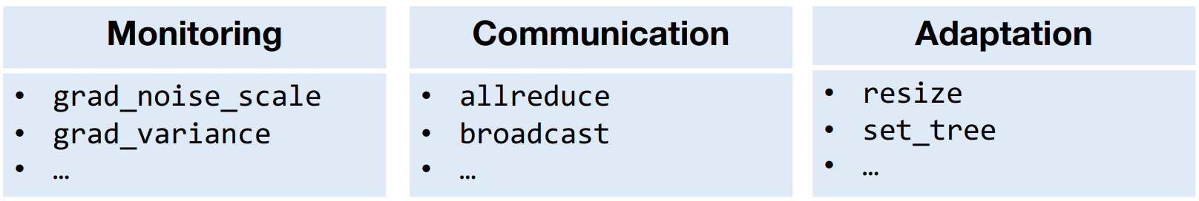
Adaptation Policies
Goal: Express adaptation over control loop for parameters
Idea: Write adaptation policies using expressive API functions:
Notes:
How policies work? As shown in the figure:
1. Replicate the policies on all workers, the policies will monitor data flow in parallel.
2. Use communication functions to aggregate the local monitoring results.
3. When policies agree on one decision, the adaptation will be applied in parallel.

Slide 12
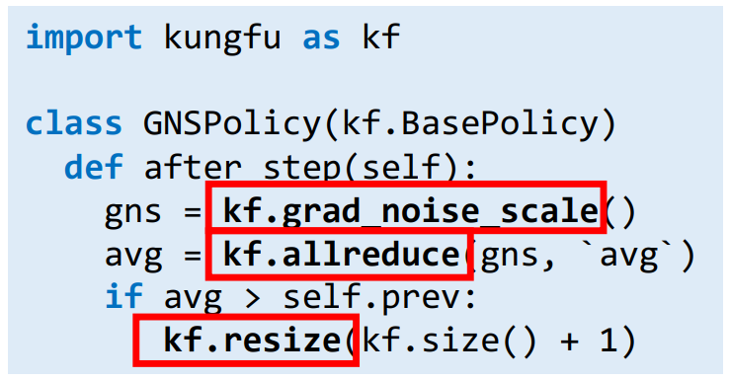
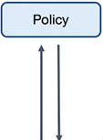
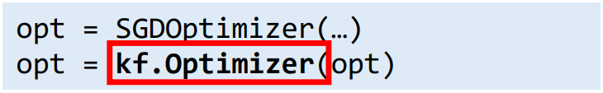
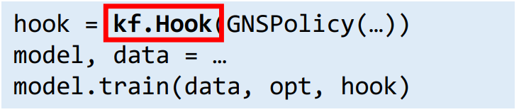
Example: Adaptation Policy for GNS
Adaptation logic in policy functions
KungFu Optimizer enables monitoring
Optimizer
Step N
Step N+1
Hook
KongFu Hook enables the policy
Notes:
Policy: monitor the gradient noise scale to adapt the batch size in between every training step
The user embeds his policy by overwriting the policy function called after step. Note: resize function changes #worker.
The optimizer is a wrapper of local optimizer and can automatically embed monitoring inside each training step.
Hook is a wrapper for policies, and can be passed into a high level model trainer, e.g., tensorflow estimator, as a user-defined callback, so its execution can be scheduled by tensorflow transparently.
As we can see, KungFu policies don’t require too much modification to existing machine learning programs.

Slide 13
Contribution 2: Embedding Monitoring Inside Dataflow

Slide 14
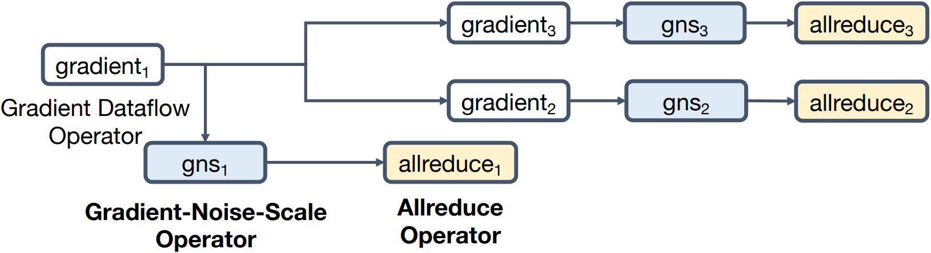
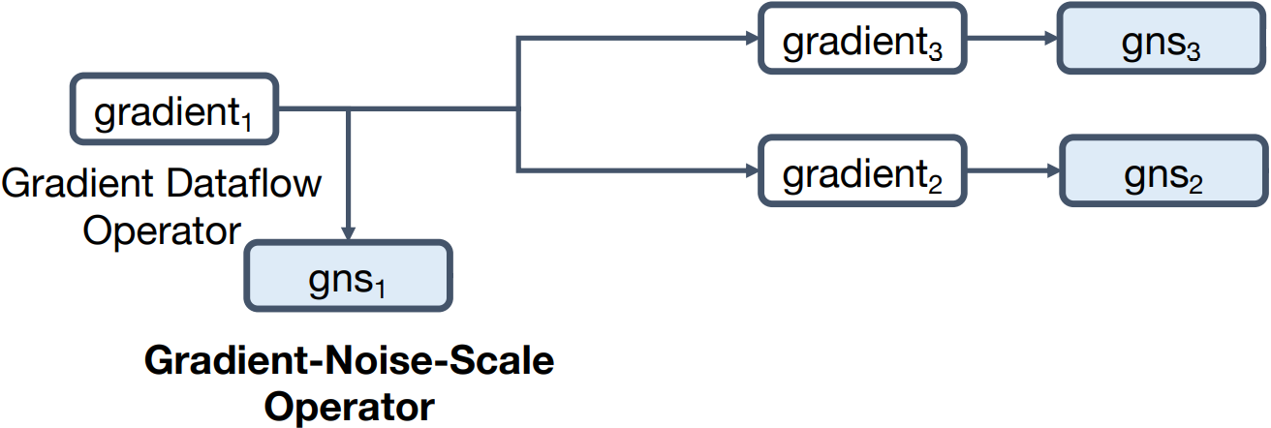
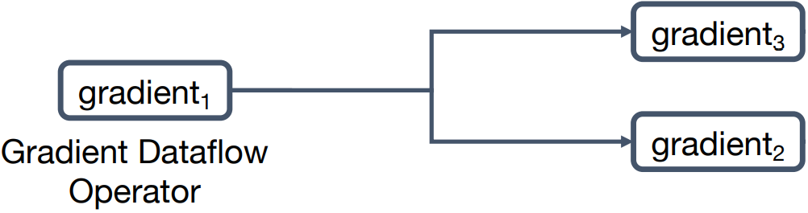
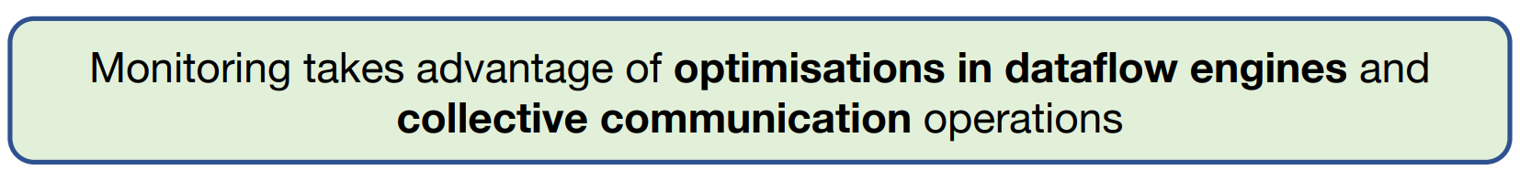
Embedding Monitoring Inside Dataflow
Problem: High monitoring cost reduces adaptation benefit
Idea: Improve efficiency by adding monitoring operators to dataflow graph
Dataflow Graph
Notes:
Example: implement GNS monitoring on this simple dataflow graph
Append a GNS operator to each gradient operator
To combine all the local GNS matrix, append one more allreduce operator.
The dataflow engines are already optimized for using GPUs and parallel execution.
Collective communication operations can scale out the monitoring of gradients in a well-distributed manner.

Slide 15
Challenges of Dataflow Collective Communication
Problem: Collective communication reduces dataflow performance
Worker 0
Worker 1
1. Dataflow engine launches operators asynchonously
Allreduce₁
Allreduce operators
Allreduce₂
Allreduce₂
Allreduce₁
Coordinating synchronous allreduce prevents system from scaling
Allreduce₂
Allreduce₂
Allreduce₁
Allreduce₁
Time
2. Message-Passing-Interface (MPI) requires synchronous execution
Notes:
Dataflow engine has been optimized for out-of-order parallel execution.
Collective communication system require users to call allreduce operations sequentially.
To meet MPI’s requirement, users have to use a central coordinator to coordinate the global execution sequence of allreduce operations.

Slide 16
Making Collective Communication Asynchronous
Idea: Use asynchronous collective communication
Collective Message
Collective State
key | data
key | data | control
Worker 0
2. Maintain allreduce state
Worker 1
CM
Allreduce₁
Allreduce₂
1. Pass message asynchronously
CM
Allreduce₁
3. Pass complete result downstream
Time
No need for coordination in asynchronous collective communication
Notes:
The time an allreduce operation is ready, send it immediately to its downstream worker. The message contains a key and data.
The receiver receives a message and read the key. Then check a state table to see if it has seen the key before. If so, update its control field. If not, create a new table entry. The control filed indicates the progress of the accumulation.
Once the accumulation finishes, the receiver will pass a new message to its downstream worker.
So, no global coordination here in asynchronous collective communication.

Slide 17
Contribution 3: Distributed Mechanisms for Parameter Adaptation

Slide 18
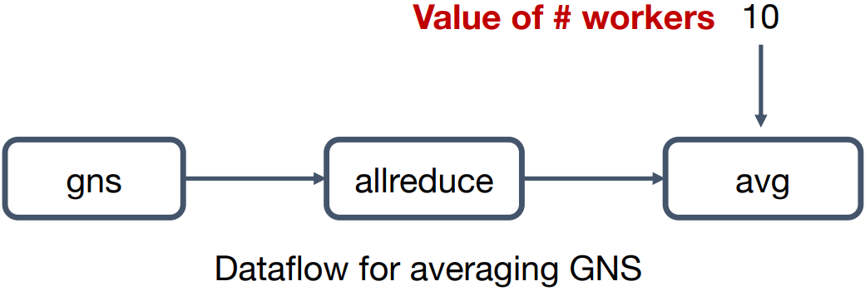
Issues When Adapting System Parameters
Problem: Parameter adaptation affects state consistency
Other system parameters
Worker ranks
Communication topology
…
Notes:
Example:
Normal execution routine needs #worker
After resizing #worker, we need to recompile the dataflow (update #worker in the dataflow)
The reason to the conclusion (words in orange text block): system parameters and dataflow are coupled together.

Slide 19
Distributed Mechanism for Parameter Adaptation
Idea: Decouple system parameters with dataflow state
gns
allreduce
avg
2. Update worker membership using collective communication
1. System parameters as computional operators
size_op
Parameter update
Dynamic worker membership
Membership
Membership
KungFu communication layer
Online parameter adaptation is consistent and fast
Notes:
Represent system parameters as computational operators, value read from “worker membership table”. The table stores on the KungFu communication layer.
Worker membership can be updated in parallel. The consistency is guaranteed by the collective communication operations.
KungFu will enforce a global adaptation barrier before moving into next step.

Slide 20
Experimental Evaluation
Notes:
They evaluated KungFu using test-based experiments and used the GNS policy as an example to compare KungFu with empirical tunning in choosing batch size to show the benefits of enabling adaptation.

Slide 21
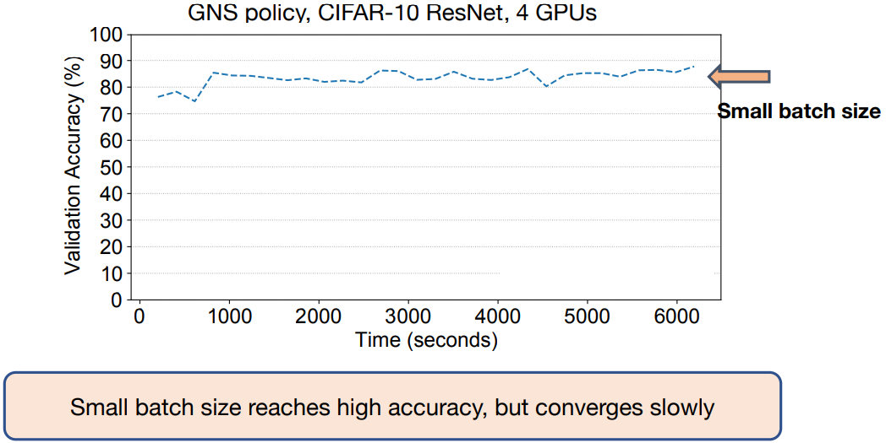
How Effectively Does KungFu Adapt?
Notes:
Some users using small batch size.
Small batch size is good to reach high training accuracy using a limit amount of training data.
But it under utilize the hardware and takes more training steps or time to finish

Slide 22
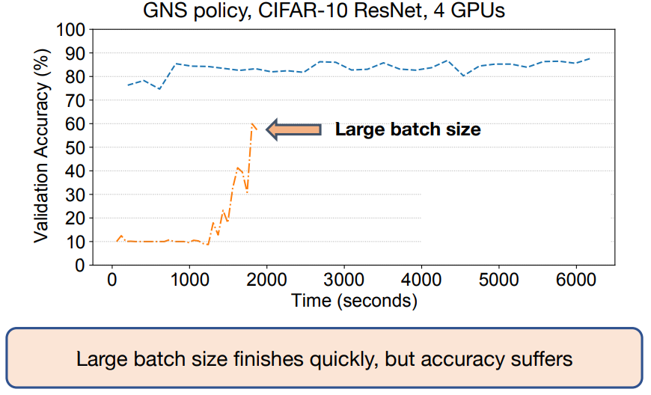
How Effectively Does KungFu Adapt?
Notes:
Some users prefer to use large batch size.
If we use large batch size, we can quickly finish training. but model accuracy might suffer.

Slide 23
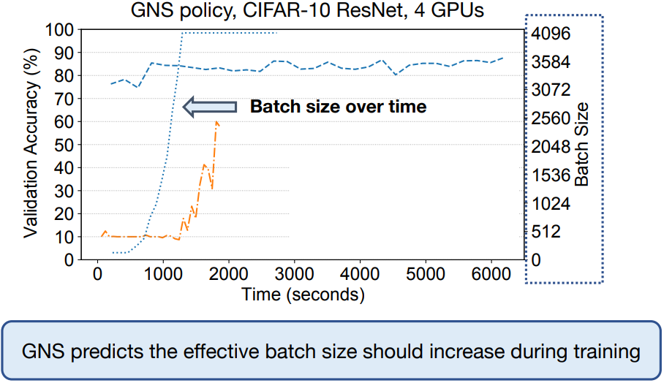
How Effectively Does KungFu Adapt?
Notes:
KongFu uses GNS to guide how we set batch size.
as the figure shows, KongFu use small batch size at the beginning, and increase it later.

Slide 24
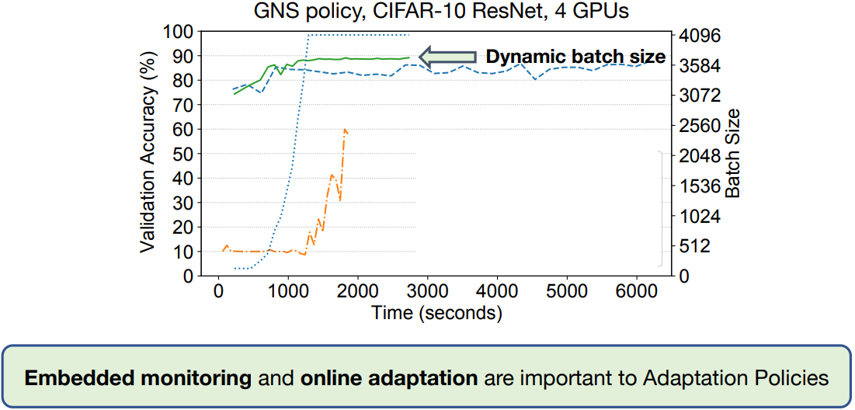
How Effectively Does KungFu Adapt?
Notes:
Looking at the validation accuracy, the policy had pretty good result. And it has the best time-to-accuracy as well.
[Click mouse]

Slide 25
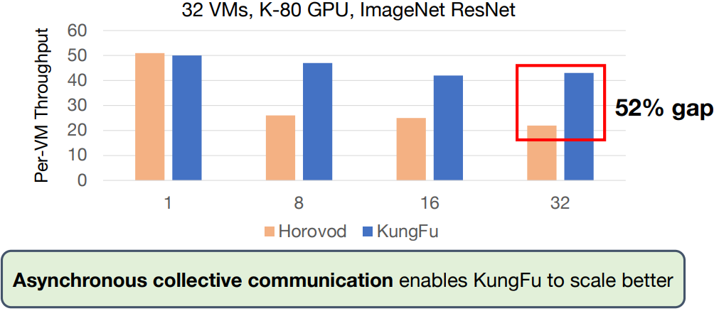
What is KungFu’s Distributed Performance?
Compare KungFu with state-of-the-art library (Horovod)
Notes:
They also compared KungFu’s distributed performance with the state-of-the-art system, horovod.
As we can see from the figure, KungFu out performs horovod when #worker increased.
It even achieved a 52% higher throughput [click] thanks to its asynchronous collective communication mechinism, which avoids global coordination and allows KungFu scales better.

Slide 26
A Quick Summary
What the papers are about
KungFu, a system that makes distributed machine learning adaptive
What problems they solve
Adaptation policies that realise complex adaptation
Embedding monitoring inside dataflow
Distributed mechanisms for consistent adaptation
Why the problem is interesting
The first system that supports automatically tunning both hyper-parameters and system parameters

Slide 27
A Quick Summary
What is really new
Current systems have no unified mechanism for adaptation
Why it's so neat
It is designed from scratch with the goal to support auto-tunning instead of modifying an exist system, which assure its efficiency.

Slide 28
Q&A

Slide 29
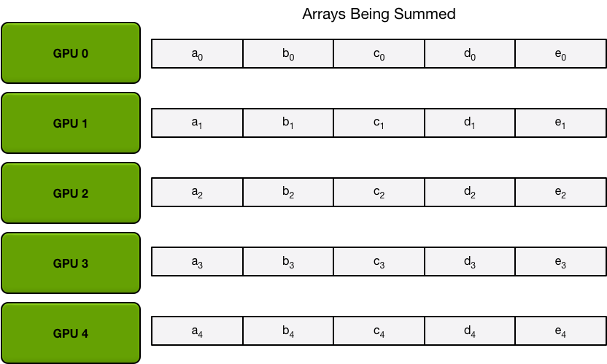
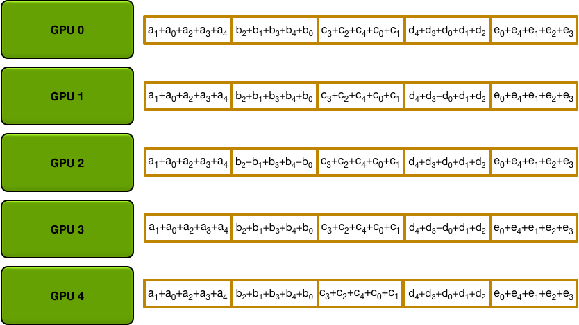
Allreduce Operation
RETURN
Here the “+”(sum operation) can be replaced by other operations, e.g., min/max/and/or
Notes:
Allreduce to sum gradients.

Slide 30
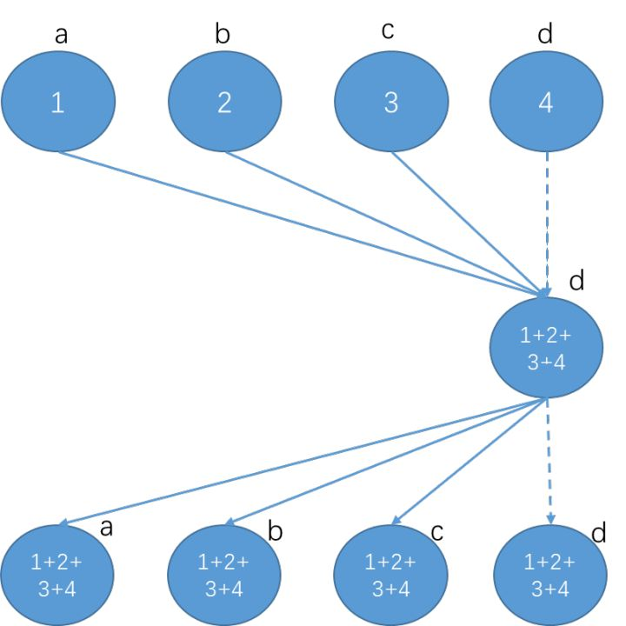
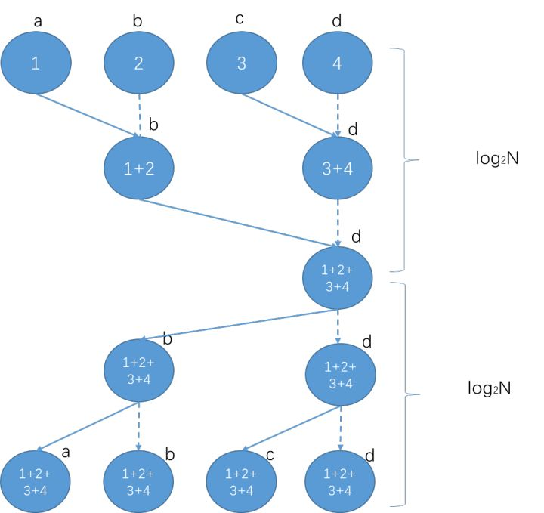
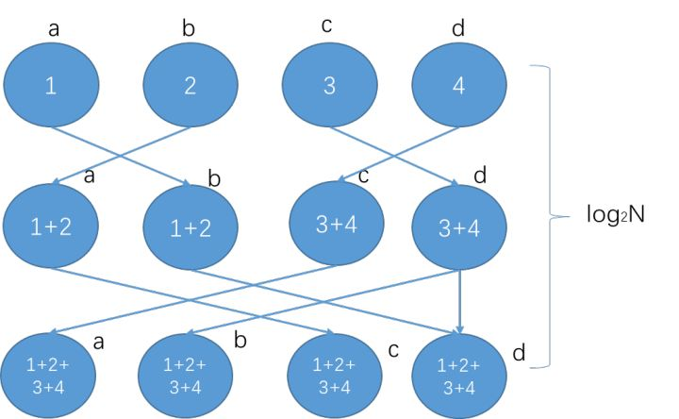
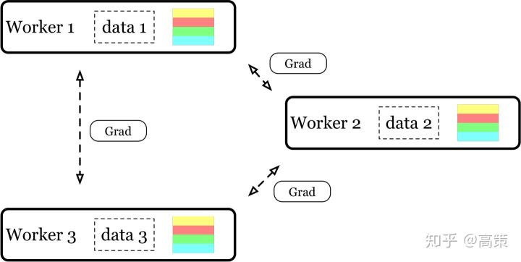
RETURN
Reduce + Broadcast
recursive halving and doubling
Butterfly
ring

Slide 31
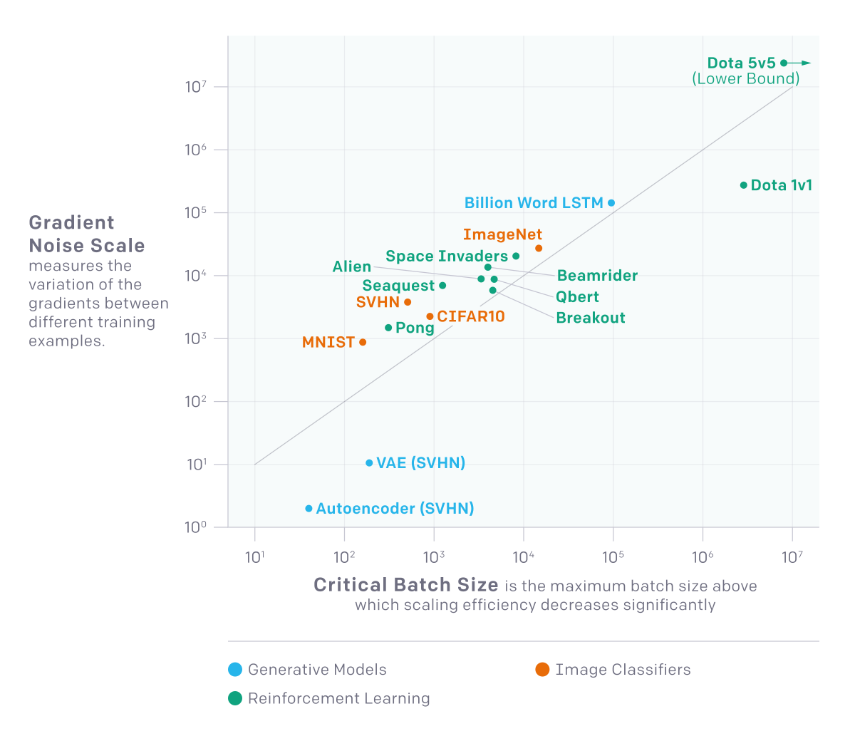
RETURN
Notes:
An instinc of what gradient noise scale means
GNS = B_{noise}=E[|G-G_{true}|²] / |G_{true}|²

Slide 32
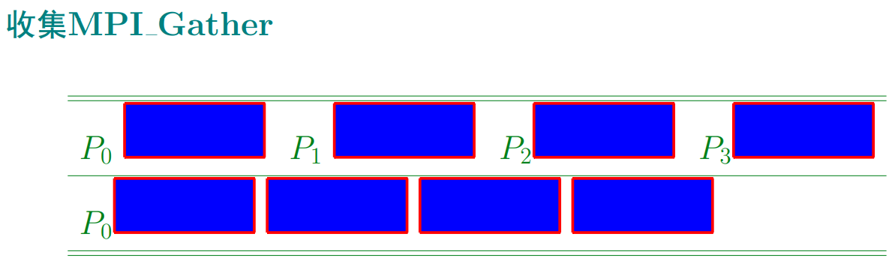
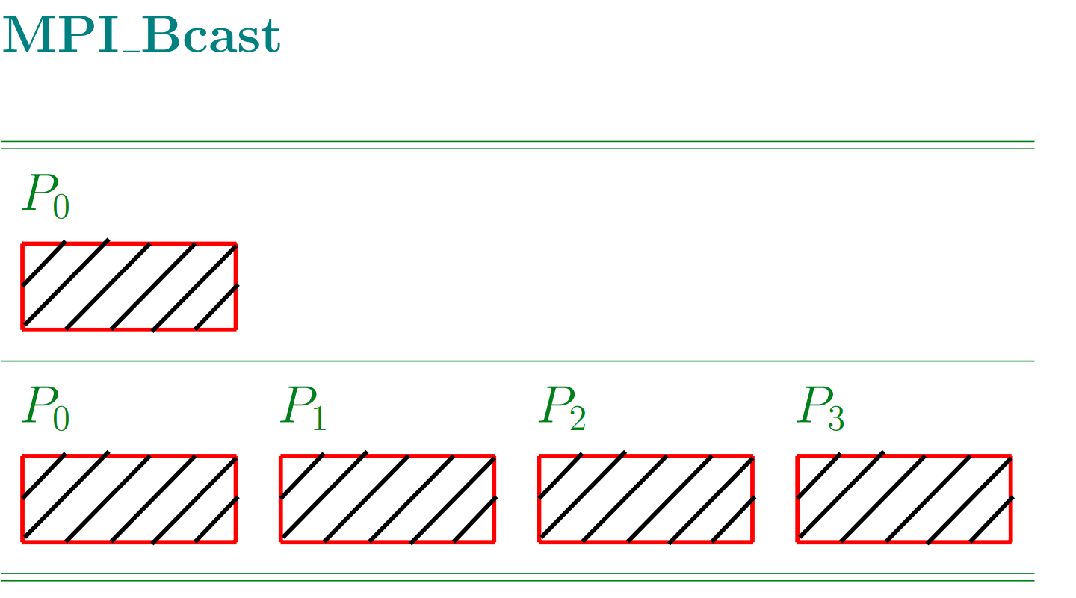
RETURN
Notes:
Gather and broadcast operations are needed to do communication coordination among workers.

