Slide 1
The energy efficiency of CNN inference on GPUs
姚春荣

Slide 2

Background
Estimation of energy
Energy efficiency
Conclusion

Slide 3

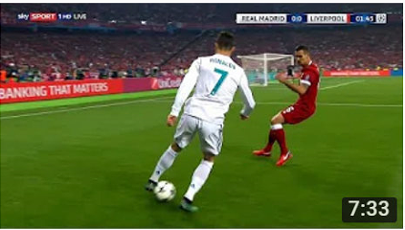
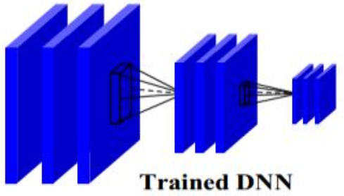


Extensive application of deep learning
Eagle
Football
World Cup
Hello, thank you
Winter Olympics

Slide 4
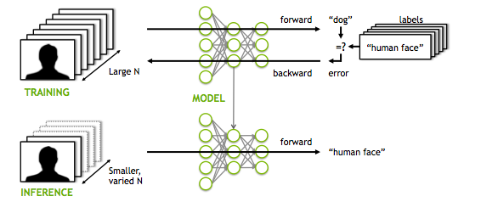
Training & Inference

Slide 5
Inference
Inference requires billions of queries per day and is surpassing training in datacenters (Facebook);
Compared with training, the inference is a larger energy consumer;
80-90% of the cost of neural networks lies in inference processing (NVIDIA);
[Applied machine learning at facebook: A datacenter infrastructure perspective, 2018, HPCA]
[Google Cloud Doubles Down On NVIDIA GPUs For Inference, 2019]

Slide 6
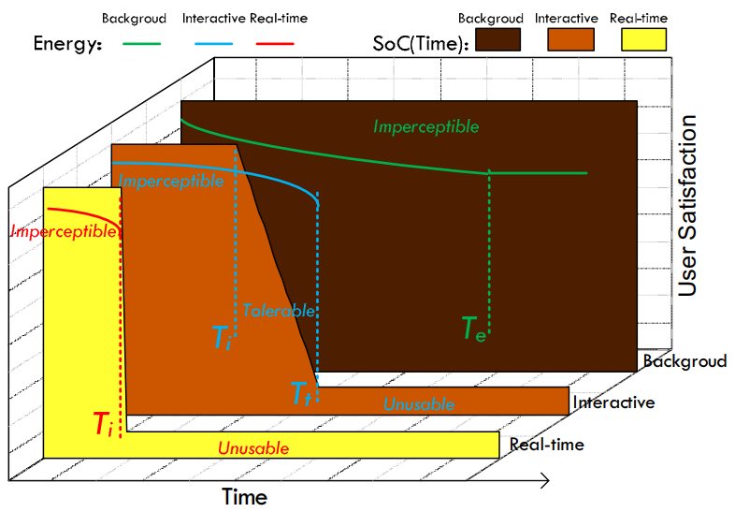
Inference tasks
Real-time tasks (e.g., autonomous driving)
Interactive tasks (e.g., Google translate)
Background tasks
Imperceptible (0, T_{i}]
Imperceptible (0, T_{i}]
Tolerable (T_{i}, T_{t}]
Unusable (T_{t}, + ∞)
Imperceptible (0, T_{e}]
User satisfaction of CNN-based applications
[Towards Pervasive and User Satisfactory CNN across GPU Microarchitectures, 2017, HPCA]

Slide 7
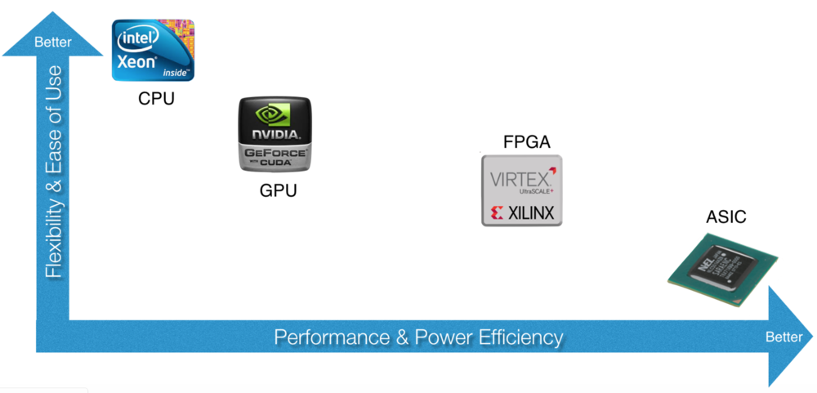
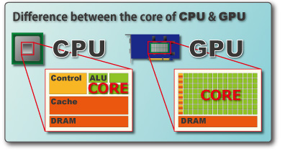
Hardware
Central Processing Unit
Graphic Processing Unit
Field Programmable Gate Array
Application Specific Integrated Circuit
CPU (5% ALU)
GPU (40% ALU)

Slide 8
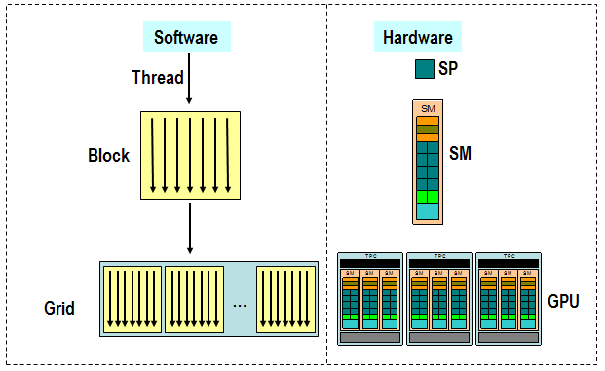
GPU
CUDA (Compute Unified Device Architecture)
Streaming
Pocessor
Streaming Multiprocessor

Slide 9
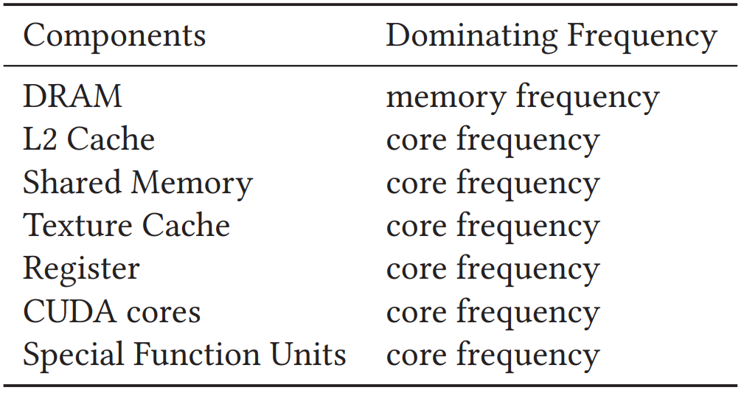
DVFS (Dynamic Voltage and Frequency Scaling)
It is a technology to trade-off performance and power
Two sets of frequencies
NVIDIA provides nvidia-smi and NVIDIA Management Library (NVML) to control these frequencies.
Core frequency
Memory frequency

Slide 10
DVFS (Dynamic Voltage and Frequency Scaling)
Device | Tesla M40 | Tesla P4 | Tesla V100
Architecture | Maxwell | Pascal | Volta
Range of core freq.(MHz) | [532,1114] | [455,1531] | [135,1530]
Core freq. levels | 24 | 86 | 187
Memory freq. (MHz) | 3004 | 3003 | 877
The overhead of DVFS

Slide 11
DVFS (Dynamic Voltage and Frequency Scaling)
Energy-saving
Energy
Time & frequency
Power & frequency
Frequency & Voltage
The relationship between frequency and power (power saving achievable by voltage)
[ Dynamic voltage frequency scaling (DVFS) for microprocessors power and energy reduction, Electrical and Electronics Engineering. Vol. 12. 2005. ]

Slide 12
Background
Estimation of energy
Energy efficiency
Conclusion

Slide 13
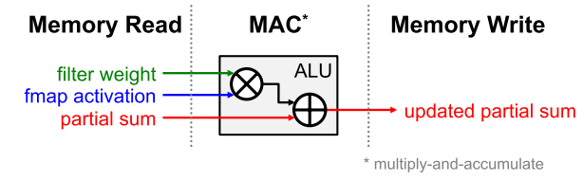
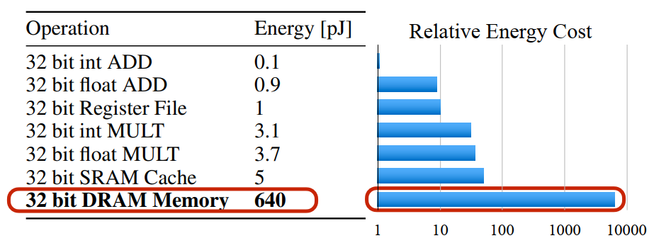
Where is the energy consumed?
[Efficient Processing of Deep Neural Networks: A Tutorial and Survey, Proc. IEEE, 2017]

Slide 14
Taxonomy of power estimation
Direct measurement
Watt-meters
Power sensors
Power estimation models
Application-level
Performance counters (PMCs) using regression
Instruction-level
Running a set of curated micro-benchmarks where each benchmark loops over a target instruction type.
[Estimation of energy consumption in machine learning, JPDC, 2019]

Slide 15
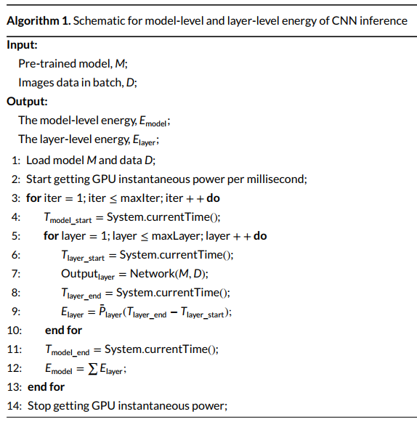
Energy measurement of CNN inference
Model-level energy
Layer-level energy

Slide 16
Background
Estimation of energy
Energy efficiency
Conclusion

Slide 17
Performance & Energy
The energy consumption does not correspond to the performance.
SqueezeNet has 50× fewer weights than AlexNet, it consumes 33% more energy than AlexNet;
DenseNet adopts 1×1 convolution bottleneck architecture for reducing FLOPs, which results in rather increasing the number of layers with smaller operand tensor. GPU-computation becomes inefficiency;
[Designing Energy-Efficient Convolutional Neural Networks using Energy-Aware Pruning, 2017, CVPR]
[An Energy and GPU-Computation Efficient Backbone Network for Real-Time Object Detection, 2019, CVPR]

Slide 18
Energy efficiency
The ratio of computing capacity to power
CNN inference
Model-level
Layer-level

Slide 19
Energy efficiency & Latency
The latency is the best on V100;
The energy efficiency is the best on P4;
We can choose the appropriate GPU according to different inference tasks;
Real-time and interactive tasks have strict runtime requirements. (V100)
Background tasks focus more on energy consumption than latency. (P4)
Device | Tesla M40 | Tesla P4 | Tesl aV100
Max Power (Watts) | 250 | 75 | 300
FP32 (TFLOPs) | 7 | 5.5 | 15.7
Comparison the energy efficiency and latency of CNN inference on different GPUs
4×
2.85×

Slide 20
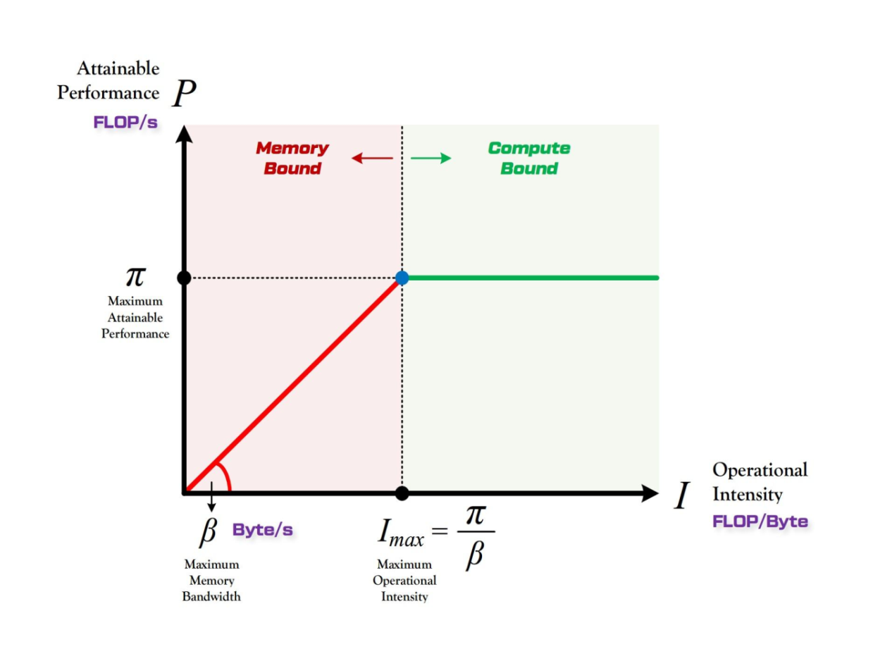
Roofline model
Device | Tesla M40 | Tesla P4 | Tesla V100
FP32 (TFLOPs) | 7 | 5.5 | 15.7
Bandwidth (GB/s) | 288 | 192 | 900

Slide 21
Roofline model
(a) Performance
(b) Power
(c) Energy efficiency
The roofline model of CNN inference on different GPUs (log scale)

Slide 22
Roofline model
Performance
A majority of CNNs are bottlenecked by computing, while VGG-16 is memory bandwidth-bound on P4;
GPUs do not exploit the parallelism from the model depth and small convolution kernels;

Slide 23
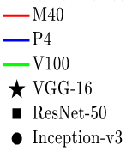
Roofline model
Power
The FLOPs consume more of the power budget than memory access operations on GPUs;
When power becomes a bottleneck, we can increase the operational intensity;

Slide 24
Roofline model
Energy efficiency
There is an intersection point between P4 and V100, which means that the most energy-efficient GPU platform is based on the operational intensity;
V100 is suitable for large models (e.g., VGGNet);
P4 is suitable for small models (e.g., ResNet, Inception, SqueezeNet);

Slide 25
CNN models
Networks | Depth | Model size (MB) | #Params (M) | MACs (GFLOPs)
VGG-16 | 16 | 528 | 138.3 | 15.5
ResNet-50 | 50 | 98 | 25.6 | 4.1
Inception-v3 | 48 | 91 | 27.2 | 5.7
Per-layer energy consumption
Average power

Slide 26
CNN models
Per-layer energy consumption
Convolutional layers are the most energy-consuming layers;

Slide 27
CNN models
Average power
Due to the cache, the power consumption of all layers is relatively balanced;
The convolutional layer has higher data locality;

Slide 28
Background
Estimation of energy
Energy efficiency
Conclusion

Slide 29
Conclusion
DVFS is a technology to trade-off performance and power;
The Roofline model is used to provide performance estimates;
Large model and more memory reference lead to more energy consumption;
The energy consumption does not correspond to the performance;

Slide 30
Thanks for listening!

