Slide 1

Kernal 64 A Commodore 64 Scala emulator
2015
Alessandro Abbruzzetti
abbruzze@gmail.com

Slide 2
What we are not talking about
Scala type system
Scala DSL
Libraries and frameworks
Plug & play components
Category theory
Akka, actors, futures, reactiveness, etc.

Slide 3
What we’re talking about /1
”In computing, an emulator is hardware or software (or both) that enables one computer system (called the host) to behave like another computer system (called the guest). An emulator typically enables the host system to run software or use peripheral devices designed for the guest system. Emulation refers to the ability of a computer program in an electronic device to emulate (imitate) another program or device.”

Slide 4
What we’re talking about /2
An emulator:
needs always the original software of the emulated system (often, obtained with a dumping method)
can be useful to:
combat obsolescence
have better graphics quality than original hardware
allow users to play games for discontinued consoles
add features original hardware didn't have

Slide 5
Why emulate a Commodore 64 ?
Because it is not easy
Because it is funny
Because there is a huge amount of available software for it
Because, still today, there is an active community of developers and internet sites
Because of the demoscene (http://csdb.dk)

Slide 6
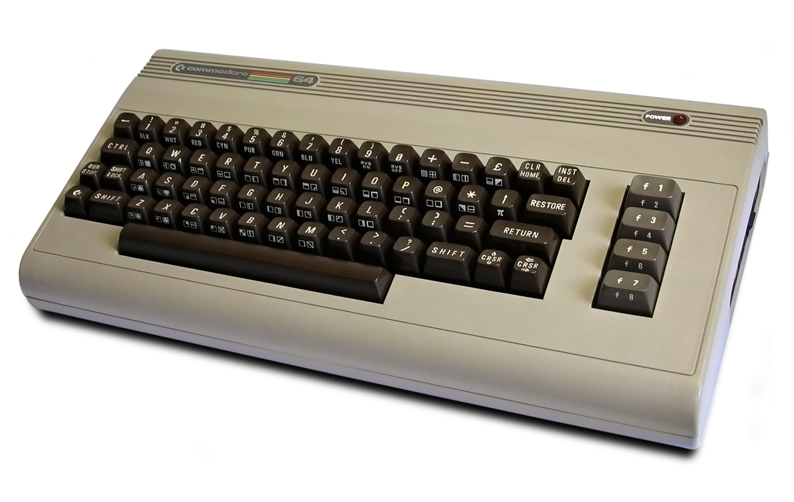
The Commodore 64 !
The "breadbin" model
Do you remember ?

Slide 7
Startup screen. Ready (for what ?)

Slide 8
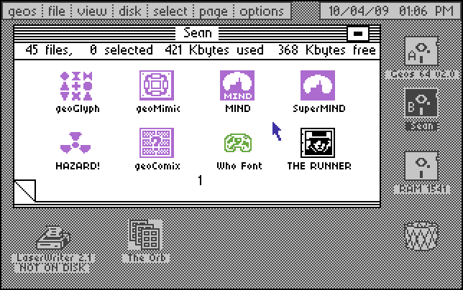
GEOS OS

Slide 9
Commodore 64 History /1
The Commodore 64 is an 8-bit home computer introduced in January 1982 by Commodore International. It is listed in the ”Guinness Book of World Records” as the highest-selling single computer model of all time with independent estimates placing the number sold between 10 and 17 million units. More C64s have been sold than any other single computer system, even to this day.
Approximately 10,000 commercial software titles have been made for the Commodore 64 including development tools, office productivity applications, and games
At its peak, GEOS (Graphic Environment Operating System) was the third most popular microcomputer operating system in the world (trailing only MS-DOS and Mac OS)

Slide 10
Why Scala ?
Because does not exist a C64 emulator written in Scala
Because I love Scala and its ecosystem
Because an emulator written in C/C++ can take advantage of low level operations and ...
Because I was curious about a Scala implementation’s performance

Slide 11
Kernal64 – A Commodore 64 emulator written in the Scala language
It emulates:
all the main hardware chipset and the memory (RAM/ROM)
all the ”internal” I/O devices, like the keyboard, the monitor, the joysticks, the audio device,...
some external I/O device, like the floppy drive, the magnetic tape data storage device, the printer, the cartridges,...

Slide 12
Commodore 64 technical information
Introduced | January 1982
Released | September 1982
End of production | 1993
How many | ~17 million
Price | US $595
CPU | MOS 6510, ~1MHz
Sound | SID 6581, 3 channels of sound/ 9 octaves, 4 waveforms
RAM | 64K
Display | 25 X 40 text 320 X 200, 16 colors max
Ports | TV, Tape interfarce, User port, 2 joysticks, cartridge port serial peripheral port
Peripherals | cassette recorder, printer, modem,external 170K floppy drive
OS | ROM BASIC V2.0 (Microsoft)

Slide 13
Where to start from
Internet is the main source of information
A real machine would be welcome
99% of C64 related information is available, but, that 1% cannot be neglected in order to have a reliable and accurate emulator
Every component is hard to emulate, but the VIC (Video Interface Controller) and the Disk Drive are the hardest ones
The circuit diagram is mandatory

Slide 14
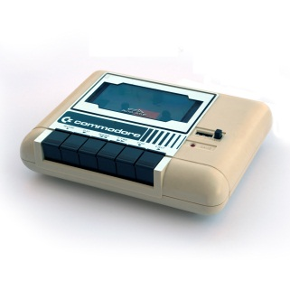
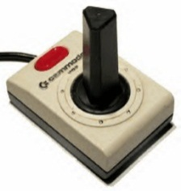
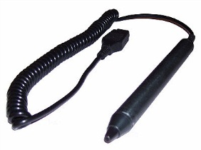
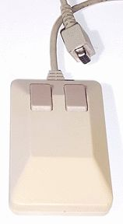
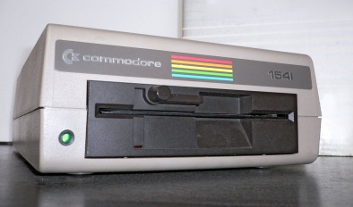

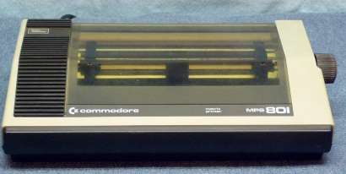
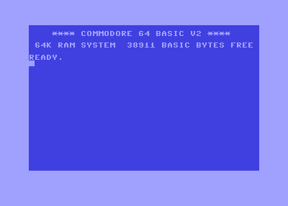
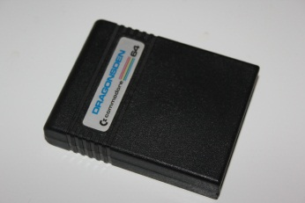
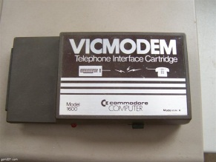
Perhiperals Overview
Cassette Port
Control Port
Serial Bus
Expansion Port
UserPort
PAL/NTSC

Slide 15
Ok, let’s start digging into details...

Slide 16
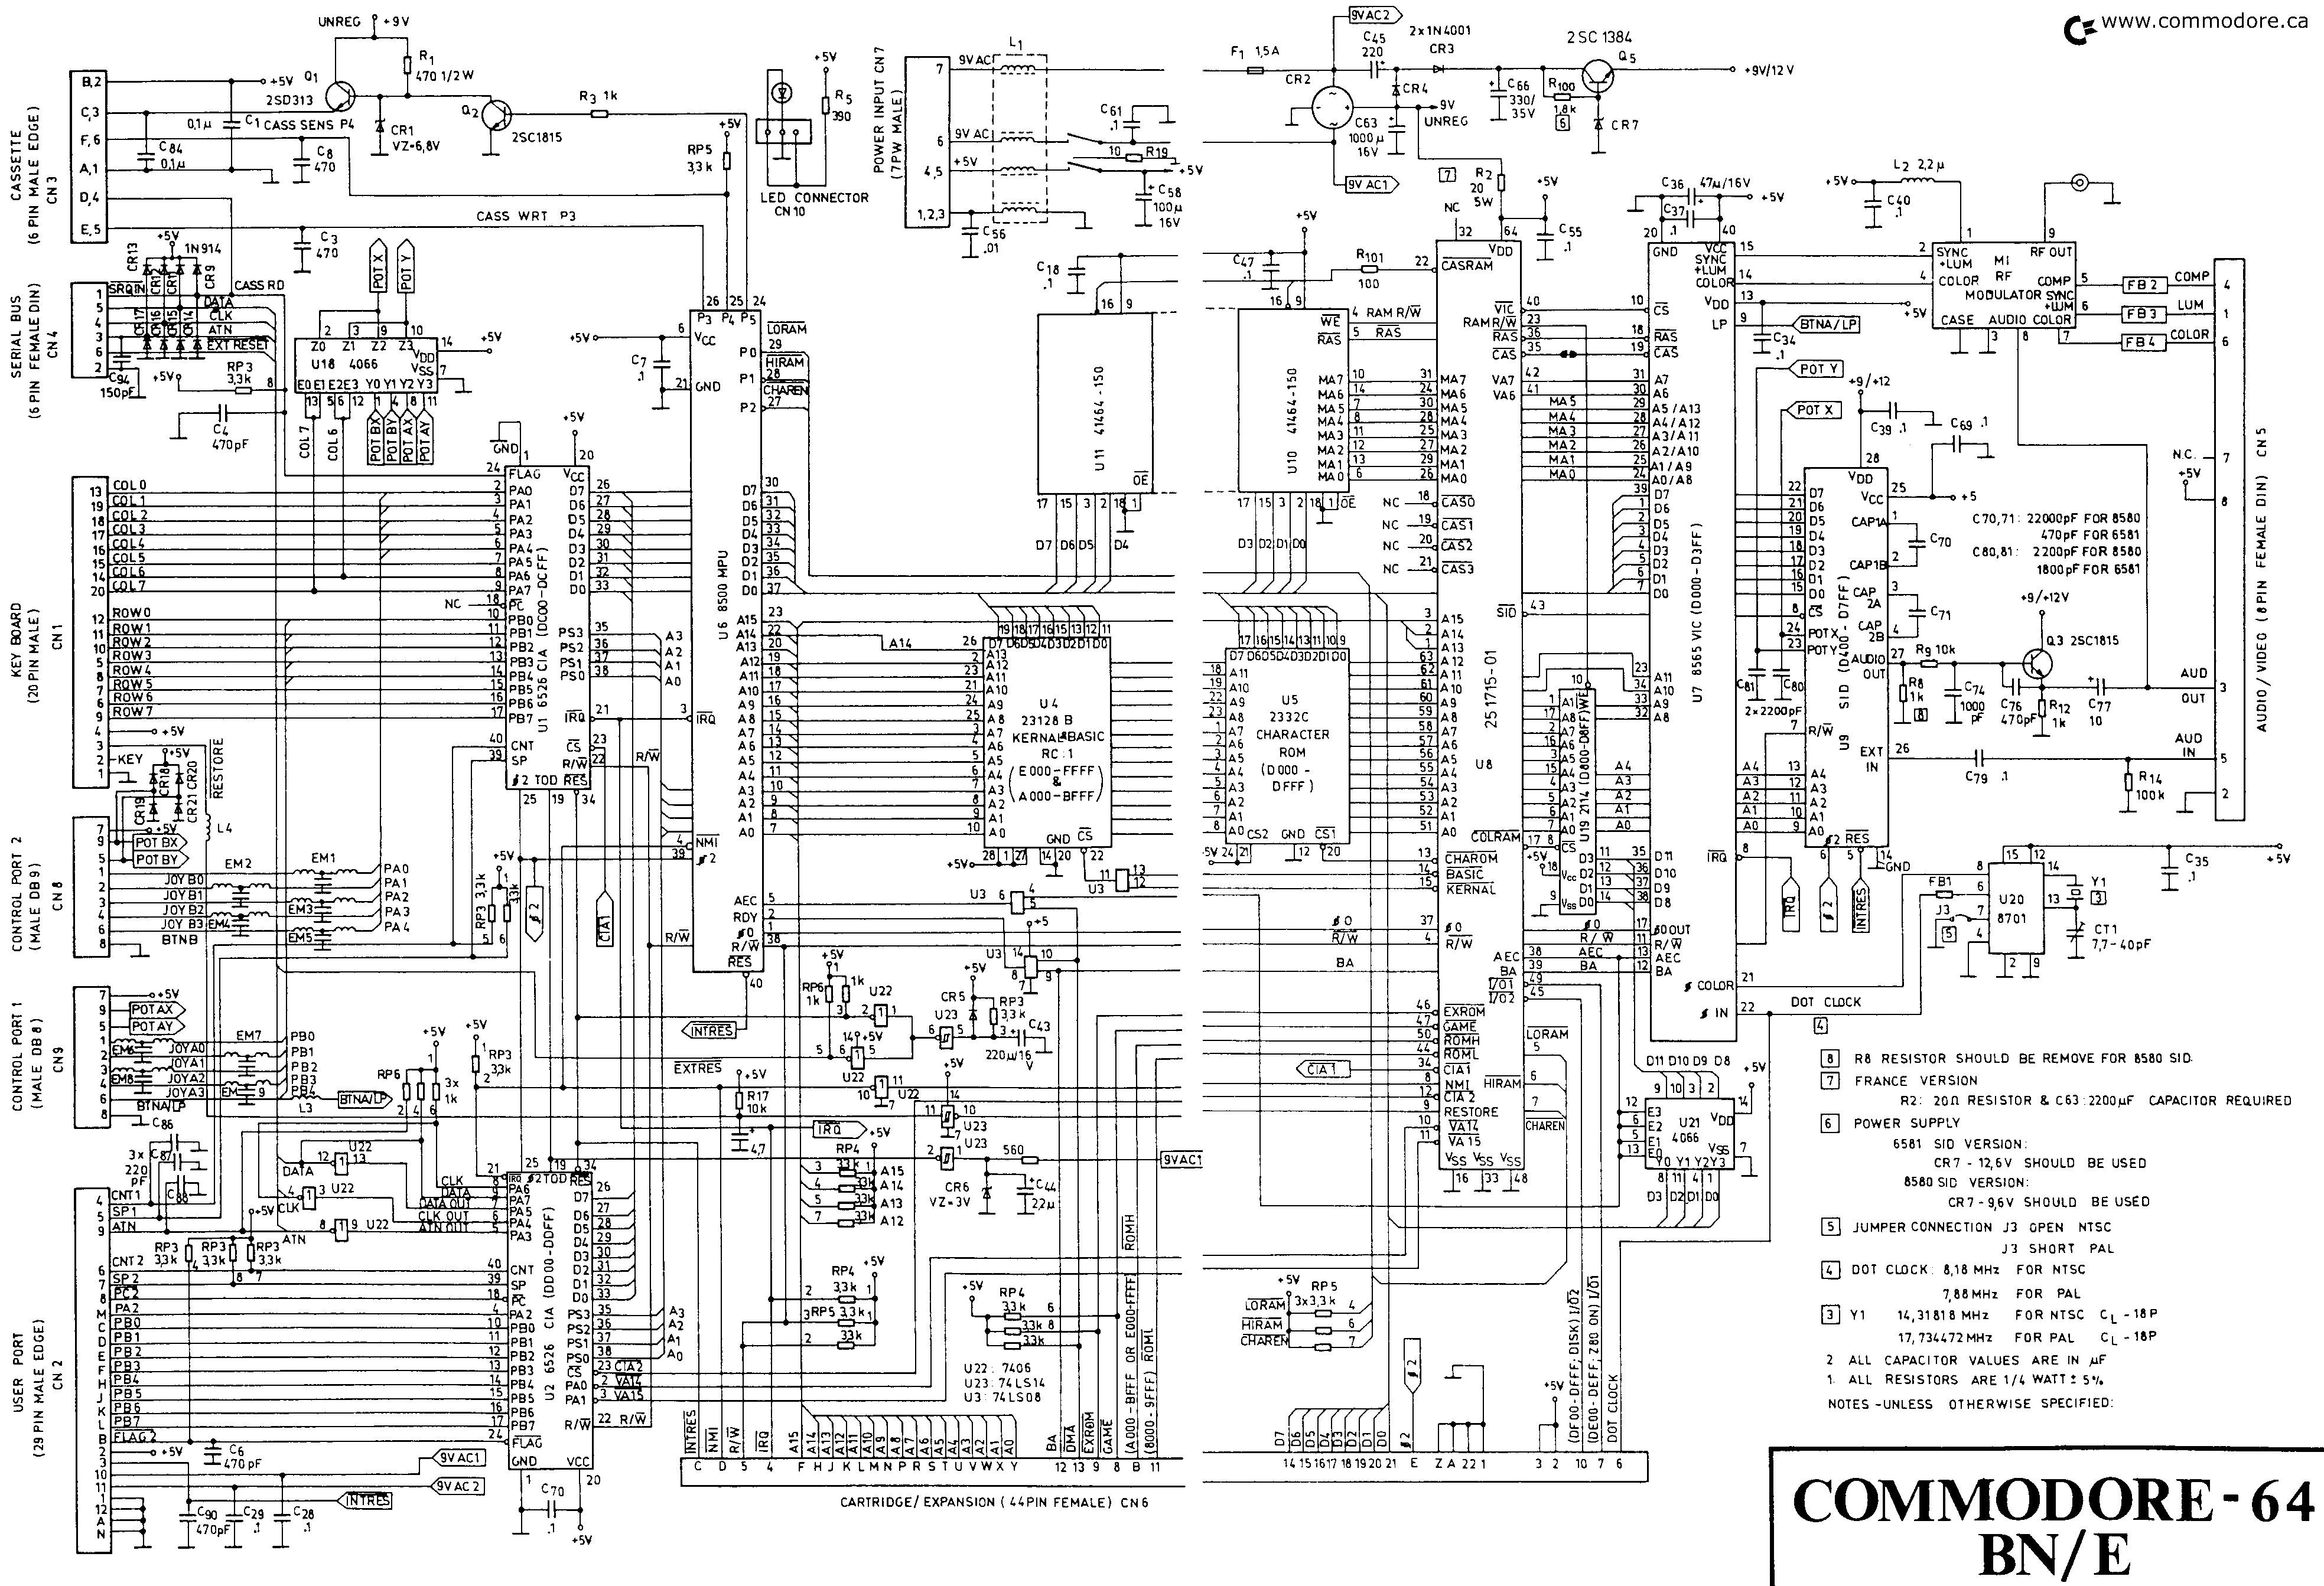
Commodore 64 Circuit Diagram

Slide 17
Commodore 64 Circuit Diagram
C2N
PLA
VIC
Serial
bus
CPU 6510
RAM
Keyboard
CIA1 6526
SID
KERNAL & BASIC ROM
CHAR ROM
Control ports
USER PORT
CIA2 6526
EXPANSION PORT

Slide 18
C64 Emulator Block Diagram
DRAM
CHAR ROM
BASIC ROM
KERNAL ROM
C2N
clk
SID
Serial bus
clk
clk
Audio Contr.
clk
6510
PLA
Key board
CIA #1
rdy
ba
clk
Control Port #1
nmi
irq
ba
VIC II
CRT
clk
Control Port #2
CIA #2
COLOR RAM
User Port
dma
exrom
game
Expansion Port
Clock
clk 985248 Hz

Slide 19
Object Hierarchy
C64Component
C64
Clock
CPU_6510
Expansion Port
IEC
bus
Datassette
CIA
Control Port
MPS 803
VIC
SID
Key
board
C1541
VIA
CIA1
CIA2
RAMs/ROMs
Others
VIA IECbus
VIA
DiskCtr

Slide 20
Memory

Slide 21

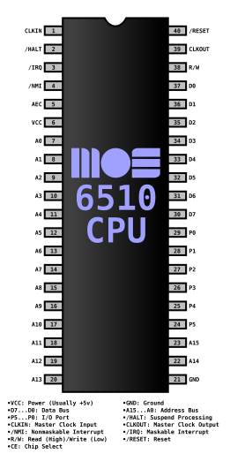
Memory Layout/1
64K RAM
8K BASIC ROM
8K KERNAL ROM
4K CHARACTERS ROM
1000 nibbles COLOR RAM
the operating system
COLOR RAM
I/O
BASIC ROM
CHARROM
KERNAL ROM
RAM
RAM
RAM
RAM
$0000
$A000
$C000
$D000
$E000
$FFFF

Slide 22
Memory Layout/2
Video Controller
Audio Controller
Color RAM
Complex Interface Adapters
I/O Open Address Space
VIC-II
SID
COLOR RAM
CIA1
CIA2
I/O1
I/O2
CHARACTERS ROM
$D000
$D400
$D800
$DC00/ $DD00
$DE00/ $DF00

Slide 23
The Memory trait
trait Memory {
val isRom: Boolean
val length: Int
val startAddress: Int
lazy val endAddress = startAddress + length
val name: String
def init
def isActive: Boolean
def read(address: Int, chipID: ChipID.ID = ChipID.CPU): Int
def write(address: Int, value: Int, chipID: ChipID.ID = ChipID.CPU)
}

Slide 24
The BridgeMemory class
abstract class BridgeMemory extends Memory {
private[this] var bridges : List[(Int,Int,Memory)] = Nil
...
def addBridge(m:Memory) { … }
@inline private def select(address:Int) : Memory = { … }
final def read(address: Int, chipID: ChipID.ID = ChipID.CPU): Int = select(address).read(address,chipID)
final def write(address: Int, value: Int, chipID: ChipID.ID = ChipID.CPU) =
select(address).write(address,value,chipID)
}

Slide 25
Memory implementation /1
Read $A000
Write$D000
Read $DC00
6510 Memory
BASIC ROM
I/O Bridge
Not active
PLA
RAM
VIC
CIA1
CIA2
CHAR ROM
Not active
Composite pattern

Slide 26
Memory implementation /2
Advantages
Modularity
Isolation
Ease of modification
Disadvantages
Performance bottleneck

Slide 27
Clock

Slide 28
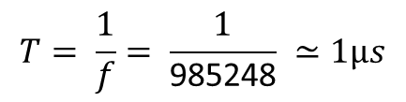
Clock frequency
φ₁
φ₂
$$T= \frac{1}{f}= \frac{1}{\text{985248}} ≃1μs$$
Clock frequency is 985248 Hz
During φ₁ phase the VIC chip accesses the bus
During φ₂ phase the 6510 chip accesses the bus
To emulate the real speed of the C64 the emulator will be able to process about a million cycles per second

Slide 29
Clock – one thread model
The emulator has a single source of synchronization, the clock, like real HW
The clock is managed by one thread
If the thread is preempted by the host cpu, the emulator slows down
Multithread model is very difficult to realize (the C64 6510 cpu running on T1 and the 1541 disk drive 6502 cpu runing on T2)

Slide 30

Emulator main loop /1
Clock’s Thread Loop
delay
cycles/sec
Core sequence
Δ
985248 reference cycles
calibration

Slide 31
Emulator main loop /2
Scheduler
VIC φ₁
Bus devices
Disk drives
Printer
CPU φ₂
A clock cycle is consumed by every component that needs it

Slide 32

Scheduler
It manages a linked list of ordered future events. The time, in the emulator’s world, is discrete and its value is determined by the number of elapsed cycles.
0
x
cycles time
when
what to do
next
Function2[Long] → Unit

Slide 33
Clock ins and outs
class Clock private (errorHandler:Option[(Throwable) =>Unit], name:String = "Clock")(mainLoop: (Long) => Unit) extends Thread(name) with C64Component {
private class ClockEvent (val id : String, val when : Long, val execute: (Long) => Unit)
private class EventList(val e:ClockEvent, var next:EventList = null)
private[this] var events : EventList = null private[this] var cycles = 0L
}

Slide 34
CPU

Slide 35
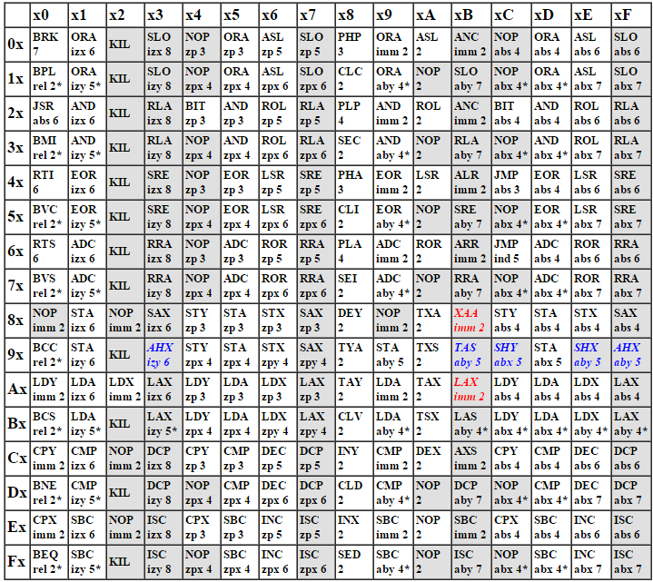
6510 opcodes & cycles

Slide 36
6510 opcode execution flow
Interrupt Handler
INT?
MEMORY
no
RDY?
Fetch
RDY?
no
PC
A
X
Y
SP
FLAGS
Decode
op₁
...
op_{N}
Execute
micro program

Slide 37
Main components

Slide 38

Main component – CPU 6510
MEMORY
Ready signal
Current state
PC
A
X
Y
SP
FLAGS
IRQs
Function1[Unit]
R/W
LDA₁
LDA_{n}
STA₁
STA_{k}
RTS₁
RTS_{m}
...
...
...
...
micro states

Slide 39
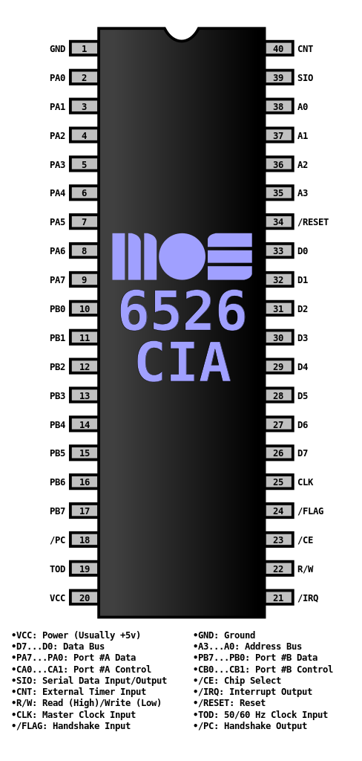
Main component – CIA 6526
Scheduler
MEMORY
events
I/O
mapped
Timer A
TOD
Timer B
State machine - control Logic
Data Port
External devices

Slide 40
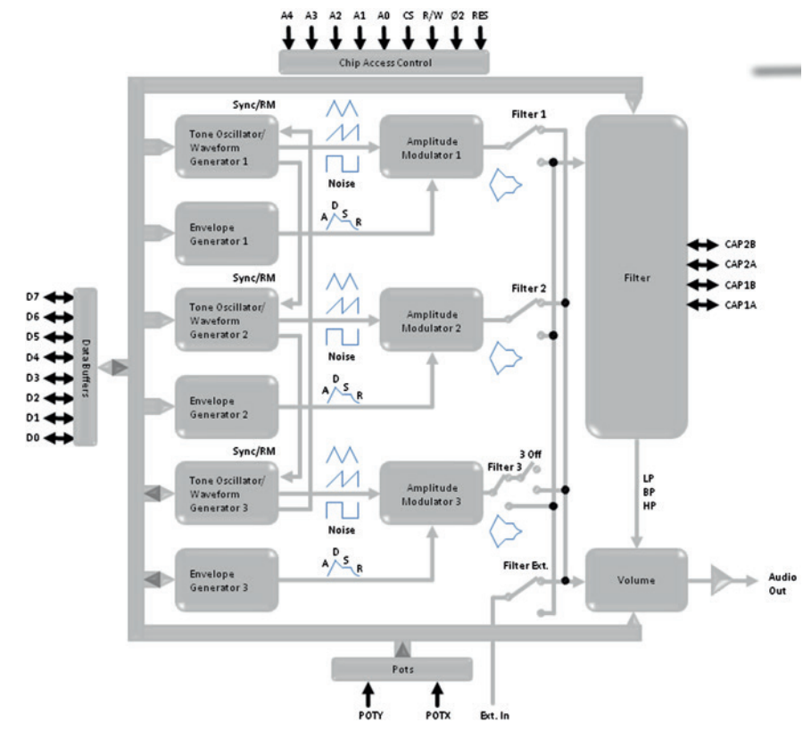

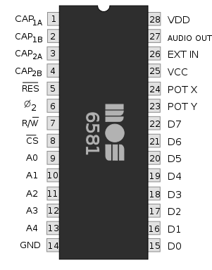
Main component – SID 6581
ReSID library
Scheduler
MEMORY
javax.sound.
sampled.AudioDriver
44kHz sampling,
mono
I/O
mapped

Slide 41
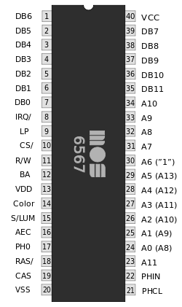
Main component – VIC 6567(9)
16K Bank
RASTER MANAGEMENT PAL = 312 lines
IRQ MANAGEMENT (lightpen,collisions, raster)
JPanel +
java.awt.image. MemoryImageSource
I/O
mapped
Video Matrix Management
Sprites Management
Graphics Data Sequencer
Sprites Data Sequencer
MUX Sprite priorities and collision detection
Border Unit
COLOR RAM

Slide 42
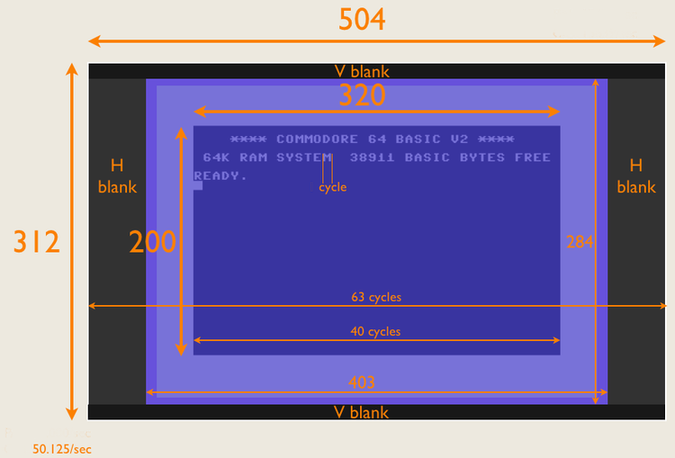
Display

Slide 43
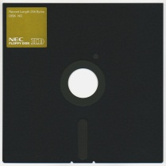
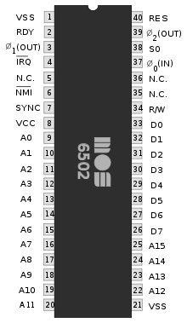
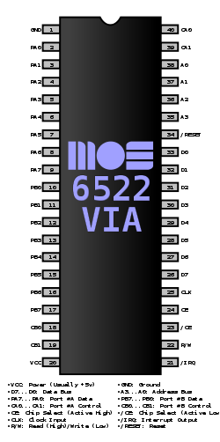
1541 Block Diagram
dump
D64
SO
Motor & R/W logic
PLA
300 RPM
IRQ
GCR (Group code recording)
2K RAM
DOS ROM
IEC BUS
ATN
CLK
DAT

Slide 44
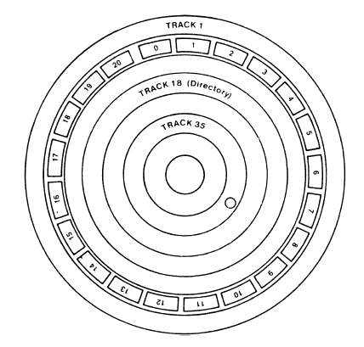
1541 – floppy disk layout
300 RPM

Slide 45
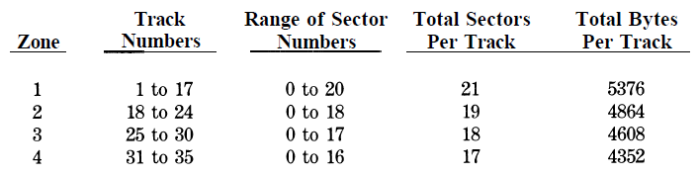
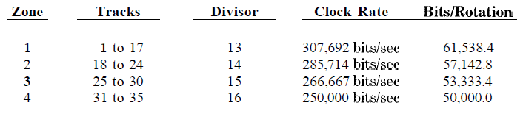
1541 – disk zones

Slide 46
Exchanging data with drive C1541
C64
CPU
6510
C1541
Drive
0 0 1 0
CPU
6502
clock
VIA IEC Bus
data
CIA2
Port A
IEC Bus
Port B
User Port

Slide 47
CIA2 data port A spec.
Address range: $DD00-$DDFF, 56576-56831 Tasks: Serial bus, RS-232, VIC memory, NMI control
Address Hex | Address Dec | Register | Function | Remark
$DD00 | 56576 | 0 PRA | Data Port A | Bit 0..1: Select the position of the VIC-memory %00, 0: Bank 3: $C000-$FFFF, 49152-65535 %01, 1: Bank 2: $8000-$BFFF, 32768-49151 %10, 2: Bank 1: $4000-$7FFF, 16384-32767 %11, 3: Bank 0: $0000-$3FFF, 0-16383 (standard) Bit 2: RS-232: TXD Output, userport: Data PA 2 (pin M) Bit 3..5: serial bus Output (0=High/Inactive, 1=Low/Active) Bit 3: ATN OUT Bit 4: CLOCK OUT Bit 5: DATA OUT Bit 6..7: serial bus Input (0=Low/Active, 1=High/Inactive) Bit 6: CLOCK IN Bit 7: DATA IN
... | ... | ... | ... | …

Slide 48
CIA2 port A implementation
class PortAConnector(mem:BankedMemory,bus:IECBus,rs232:RS232) extends Connector with IECBusListener {
…
val busid = "CIA2_PortA"
import IECBus.bus._
final def read : Int =
(~((clk << 6) | (data << 7)) & 0xC0) | (latch & 0x3C) | bank | rs232.getTXD << 2
final protected def performWrite(data:Int) = {
val value = data | ~ddr
bank = value & 3
mem.setBank(bank)
bus.setLine(busid,if ((value & 8) > 0) GROUND else VOLTAGE, // ATN
if ((value & 32) > 0) GROUND else VOLTAGE, // DATA
if ((value & 16) > 0) GROUND else VOLTAGE) // CLOCK
if ((ddr & 4) > 0) rs232.setTXD((data >> 2) & 1)
}
}
$FFFF
RAM
$DD00
$0000

Slide 49
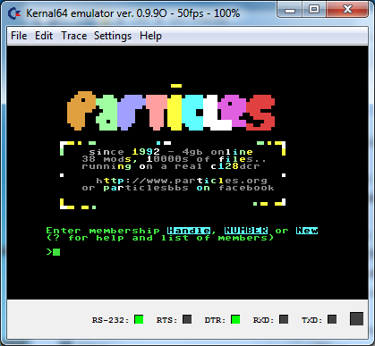
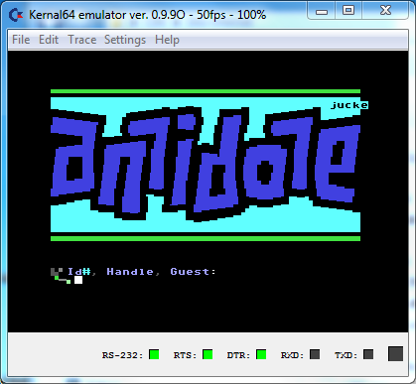
Let’s connect to BBS via Internet! http://cbbsoutpost.servebbs.com/
Bulletin Board System are still alive.
BBS now use the telnet protocol instead of modems
SwiftLink cartridge implementation

Slide 50
Scala performance notes
Avoid private val/var x when possible, use private[this] val/var x instead
Use @inline annotation
Avoid for loops. Use while loops instead
Avoid by name parameters

Slide 51
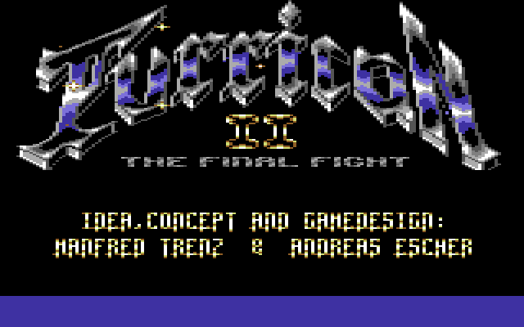

DEMO
Turrican II (1991 by Rainbow Arts)
Comaland (Censor Design, Oxyron), a demo from X’2014 Demo Competition (it won the compo!)

Slide 52
def Q&A(q:Query) : Option[Answer]

Slide 53
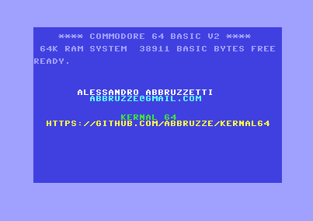
THANK YOU!
2015

