Slide 1



Meril Sinus Relief
MESIRE
TM
BalloonSinusDilation System

Slide 2
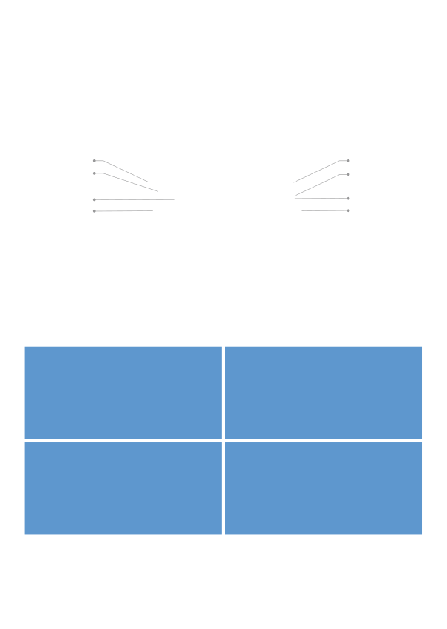
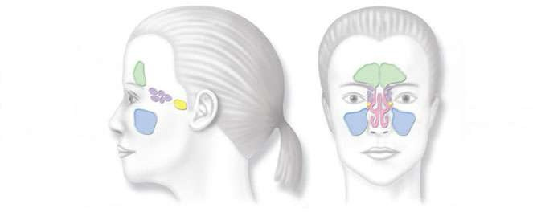
MESIRE
TM
Balloon Sinus Dilation System
Sinusitis Overview
Sinusitis is defined as an inflammation of the sinus lining, and is commonly caused by structural issues such as ostial blockage, bacterial infections, viral infections or a combination of these. For many patients, symptoms vary and may include nasal congestion, facial discomfort, nasal discharge, headache and fatigue. Sinusitis is considered acute when symptoms last
4 weeks or less and chronic when it lasts 12 weeks or longer.
Frontal sinus Ethmoid sinus
Frontal sinus Ethmoid sinus
Sphenoid sinus
Sphenoid sinus
Maxillary sinus
Maxillary sinus
Balloon Sinus Dilation is safe and effective procedure for chronic sinusitis patients who are not responding well to medications
and seeking relief from uncomfortable and painful sinusitis symptoms.
In Balloon Sinus Dilation ENT surgeons open inflamed sinuses in the same way that heart surgeons open up blocked arteries
during balloon angioplasty.
Balloon Sinus Dilation is less invasive than traditional sinus surgery and effective at relieving symptoms of chronic sinusitis. Meril Balloon Sinus Dilation allows patients to return to normal activities quickly unlike conventional sinus surgery. Meril sinus
surgery does not include removal of bones or tissue from the nose.
Safe:
Effective:
- Safe design (eg. atraumatic tip) - Zero adverse events - Less general anesthesia time and necessity
- Patency: Extremely low patency & revision rates - CT Scan: Consistent improvement in Lund-MacKay CT scores - Symptoms: Significantly improved SNOT-20 score Symptoms/QOL scores
Patient Friendly:
Enabling:
- Less invasive - Less trauma - Less pain - Less recovery time - Less scaring - Less follow-up procedures
- Find and treat the frontal sinus/recess - Help special case patients (eg. bleeders, ICU) - May enable paradigm shift to local anaesthesia
In Balloon Sinus Dilation, inflamed sinuses are opened. After Balloon Sinus Dilation the sinuses remain open, allowing the
return of normal sinus drainage and relief of sinus pressure.
Safe & Effective
Minimally invasive–
relieves pain and pressure of chronic sinusitis without cutting or removal of natural structures in the nose.
Fast recovery–
many people return to normal activities within 24 hours.

Slide 3

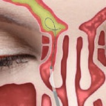
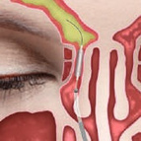
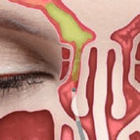
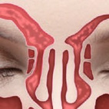
Proven
Reliable –
350,000+ have benefited from Balloon Sinus Dilation
Mandated –
procedure approved by India DGHS & Europian CE work.
INDICATIONS:
Balloon Sinus Dilation System
1. Chronic Rhinosinusits (CRS)
Patients with history of persistent rhinosinusitis (all sinuses) lasting greater than 12 weeks, despite medical management of antibiotics, topical steroids and allergic management or patients with persistently abnormal CT after at least 4 weeks of continuous antibiotic treatment.
2. Recurrent Acute Rhinosinusitis
An abnormal CT during treatment with post-treatment normalization with 3 or more recurrences per year with each episode lasting less than 2 weeks.
3. Revision Surgery
Patients who have undergone ESS (once before or multiple times) with persistent symptoms and opacification on CT scan with a narrow Ostia. Balloon Sinus Dilation is a safe and effective tool in difficult revision surgeries with distorted post-operative anatomy.
Why Balloon Sinus Dilation?
The Balloon Sinus Dilation is an advanced surgical procedure approved in India by Indian DCGI and Europian CE mark approved product. Balloon sinus dilation uses a precise single use flexible balloon catheter to open inflamed sinuses. The balloon catheter is placed into the sinus to reach the inflamed sinuses and gently inflated to restructure the previously blocked nasal passage.
The Balloon Sinus Dilation preserves the normal anatomy of the sinuses and mucosal tissue, and does not require the
removal of bone and tissue – this approach helps restore normal sinus functioning. FESS involves removal of bone and tissue
and the recurrence rates are high.
Since the disease state is minimal, it’s not required to perform extensive procedure as no major abnormalities are associated with the disease. The patient has understood the pros and cons of both the procedure and has opted for sinuplasty which has been the standard of care in many countries today.
Benefits of Balloon Sinus Dilation Procedure:
- Minimal invasive procedure - Lesser blood loss - Associated with fewer recurrences - Post operative recovery is faster and patient can resume work quickly - Safe and effective minimally invasive procedure for the treatment of chronic sinusitis
Balloon Sinus Dilation Procedure:
1. A balloon catheter is
2. The balloon is
3. Saline is used to wash
4. The system is
inserted into the inflamed sinus.
inflated to expand the sinus opening.
the infected sinus.
removed leaving the sinuses open.

Slide 4

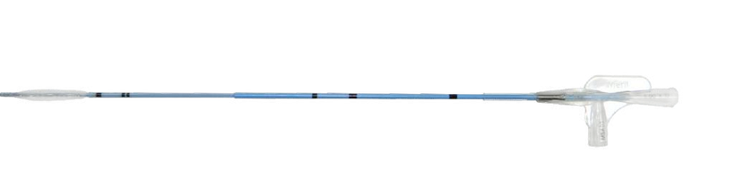

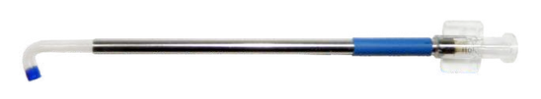
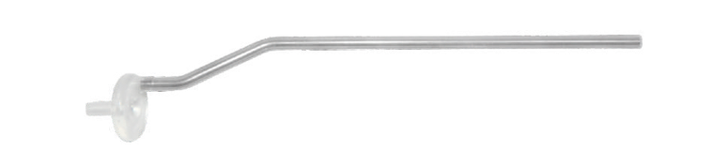
Product Overview:
TM
MESIRE Sinus Balloon Catheter:
MESIRETM Balloon catheter is non-compliant balloon catheters designed for precise control on diameter of balloon expansion. It enables accurate placement of balloon in the sinus ostia through visual indicators.
Non-Compliant Balloon Distal Endoscopic Marker
Rigid Shaft
Flexible Shaft
Proximal Shaft Marker
Lightwire port
Inflation port
Precise balloon placement
– Endoscopic markers provide information on balloon location under direct visualization – Enhanced shaft coloring and markers provide improved visibility under low light
Enhanced tracking and retraction
– Optimized balloon tapers – Six-fold balloon design – New balloon insertion stylet enabling smooth balloon insertion into the sinus guide catheter
Increased procedural efficiency
– Precise re-wrapping of balloon – Less balloon deflation time*
MESIRE Guide Sinus Guide Catheter:
TM
MesireTM guide catheter with a distal angle of 0, 30, 70, 90o, 110° are designed for targeted navigation of the MesireTM
o
o
o
balloon catheter into respective ostium. MesireTM guide is having soft atraumatic tip which prevents the tissue trauma during the insertion.
Transparent Curved Tip
Indicative Band
Stainless Steel
MSG110
Atrumatic Tip
Insertion Port
TM
MESIRE Latch:
Latch is a handle device which help you to assemble all the components of the Balloon Sinus device in one . Also help you to hold entire Balloon device in single hand with other hand endoscope. Flange enables one-handed advancement of the Sinus Balloon Catheter.
Silicon Outer Layer
Connector

Slide 5

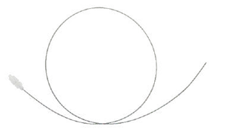
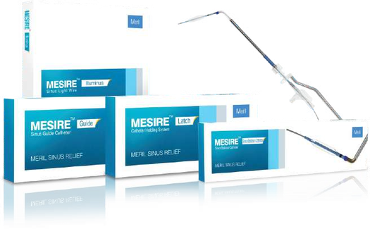



TM
Illuminus Sinus Light Wire:
MESIRE
Light compatible light wire provides sinus cavity navigation and as an insertion aid for the balloon catheter. Illumination of the light wire allows precise placement.
– Enables transcutaneous localization of device tip for confident confirmation of
sinus access
– Distal-tip design enables responsive transmission of fine adjustment to seek
visualized targets
– Compatible with light guide cable, connecting to a standard light source
Ordering Information:
MesireTM Sinus Balloon Catheter
Sr. No.
Product Code
MSB50017 MSB60017 MSB70017
Balloon Diameter
5 mm 6 mm 7 mm
Balloon Length
17 mm 17 mm 17 mm
1
2 3
MesireTM Guide Sinus Guide Catheter
Sr. No.
Product Code
MSG000 MSG030 MSG070 MSG090 MSG110
Angle of Guide Catheter
1
0
O
2 3 4
30O 70O 90O 110O
5
Mesire
TM
Illuminus Sinus light Wire
Sr. No.
Product Code
MSI083
Diameter of Light Wire
0.83 mm
Lenght of Light Wire
1
100 cm

Slide 6



Manufacturer: Meril Life Sciences Pvt. Ltd. Survey No. 135/139, Bilakhia House, Muktanand Marg, Chala, Vapi - 396 191. Gujarat. India. T +91 260 240 8000
Subsidiary companies: Meril Life Sciences India Pvt. Ltd. 512/513, Midas Tower, Sahar Plaza, Andheri (E), Mumbai - 400 059, Maharashtra, India T +91 22 4047 9797 F +91 22 4047 9717
Meril, Inc. 2436 Emrick Boulevard, Bethlehem, PA 18020 T +610 500 2080 F +610 317 1672 Meril South America Doc Med LTDA Al. dos Tupiniquins, 1079 - Cep: 04077-003 - Moema. Sao Paulo. Brazil. T +55 11 3624 5935 F +55 11 3624 5936 Meril GmbH. Bornheimer Strasse 135-137, D-53119 Bonn. Germany. T +49 228 7100 4000 F +49 228 7100 4001 Meril Tibbi Cihazlar Meril Tıbbi Cihazlar İmalat ve Ticaret A.Ş. İçerenköy Mah. Çetinkaya Sok. Prestij Plaza No:28 Kat:4 Ataşehir, 34752 İstanbul / Turkey T +90 216 641 44 24 F +90 216 641 44 25 Meril China Co. Ltd. 2301b,23f, Lixin Plaza, no 90,South Hubin Road, Xiamen, China T 0086-592-5368505 F 0086-592-5368519 Meril SA Pty. Ltd. 102, 104, S101 and S102, Boulevard West Ofce Park, 142 Western Service Road, Erf 813 Woodmead Extension 17 Sandton, Johannesburg – 2191 South Africa T +27 11 465-2049 F +27 86 471 7941 Meril Medical LLC. Nauchnyi Proezd 19, Moscow , Russia – 117 246. Ofce - +7 495 772 7643 EU representative. Obelis S.A. Bd, General Wahis 53, 1030, Brussels, Belgium. T +32 2 732 5954 F +32 2 732 6003 E mail@obelis.net
Meril ENT
E askinfo@merillife.com W www.merillife.com

